Slide 1






Competitive
christmas
Trivia Night Challenge

Slide 2

instructions
1. Compete by correctly answering each trivia question shown on the screen.
2. Teams have one minute to submit an answer.
3. Contestants are not allowed to use any mobile device during the game.
4. The team with the fewest points at the end of each round will be eliminated.
5. The last team standing will be crowned our trivia night champion.

Slide 3


ROUND 1
Get to know Santa Claus

Slide 4
Question #1
Which of the following is not a name Santa Claus goes by?
A. Saint Nicholas
B. Kris Kringle
C. Father Christmas
D. Chimney King

Slide 5


answer
chimney king

Slide 6

ROUND 2
Add topic here

Slide 7

Question #1
ADD YOUR WHOLE QUESTION HERE
A. Open A
B. Open B
C. Open C
D. Open D

Slide 8


answer
Correct answer

Slide 9
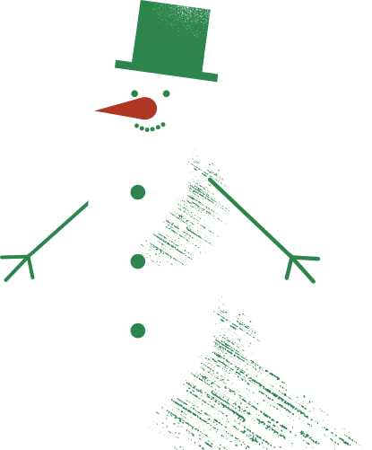
SUMMARY
ROUND 1
ROUND 2
1) Which of the following is not a name Santa Claus goes by?
Answer: D. The Chimney King
1) Question #1 goes here
Answer: Correct answer goes here
2) Question #2 goes here
Answer: Correct answer goes here
2) Question #2 goes here
Answer: Correct answer goes here

Slide 10


thank you for
playing!
We ho-ho-hope you had fun!

Slide 11
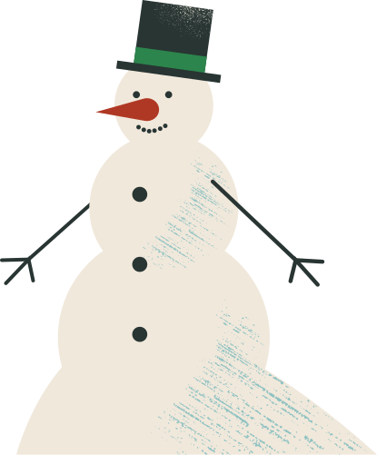
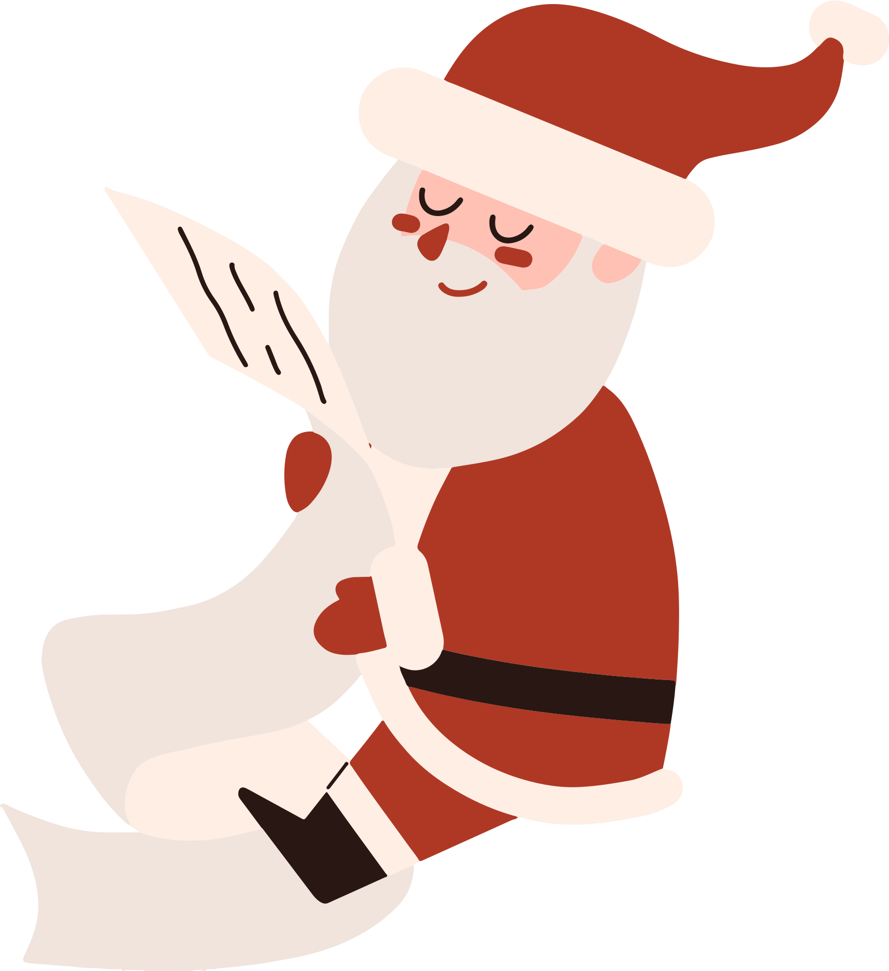
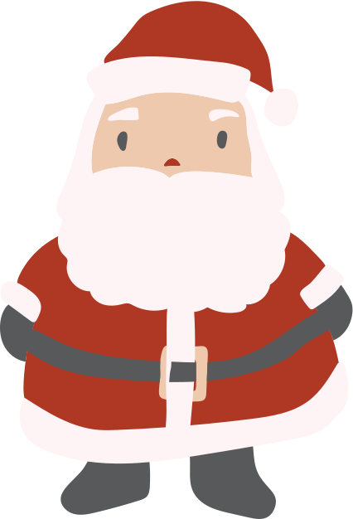

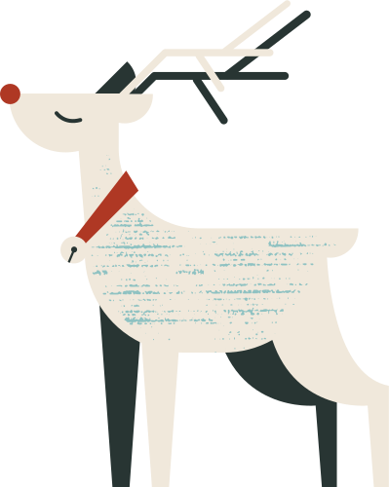
Resource Page
Use these in your presentation. Delete or hide this page before presenting.
Fonts
Design Elements / Icons
This presentation template
uses the following free fonts:
TITLES:
unica one
BODY TEXT:
DM Sans
You can find these fonts online too.
Colors
#1C3726
#2E844C
#AF3824
#D677C3
#FFC409

Slide 12

Credits
This presentation template is free for everyone to use, thanks to the following:
Pexels, Pixabay, & Sketchify
for this presentation template
for the photos, graphics, and elements
Happy designing!

