Slide 1


Hinduism & Buddhism
Exploring Two Ancient Religions

Slide 2

Introduction
Hinduism and Buddhism are deeply rooted in ancient traditions. While they share historical origins, their philosophies and practices differ. This presentation will explore the core tenets of both, offering a comparative understanding.

Slide 3
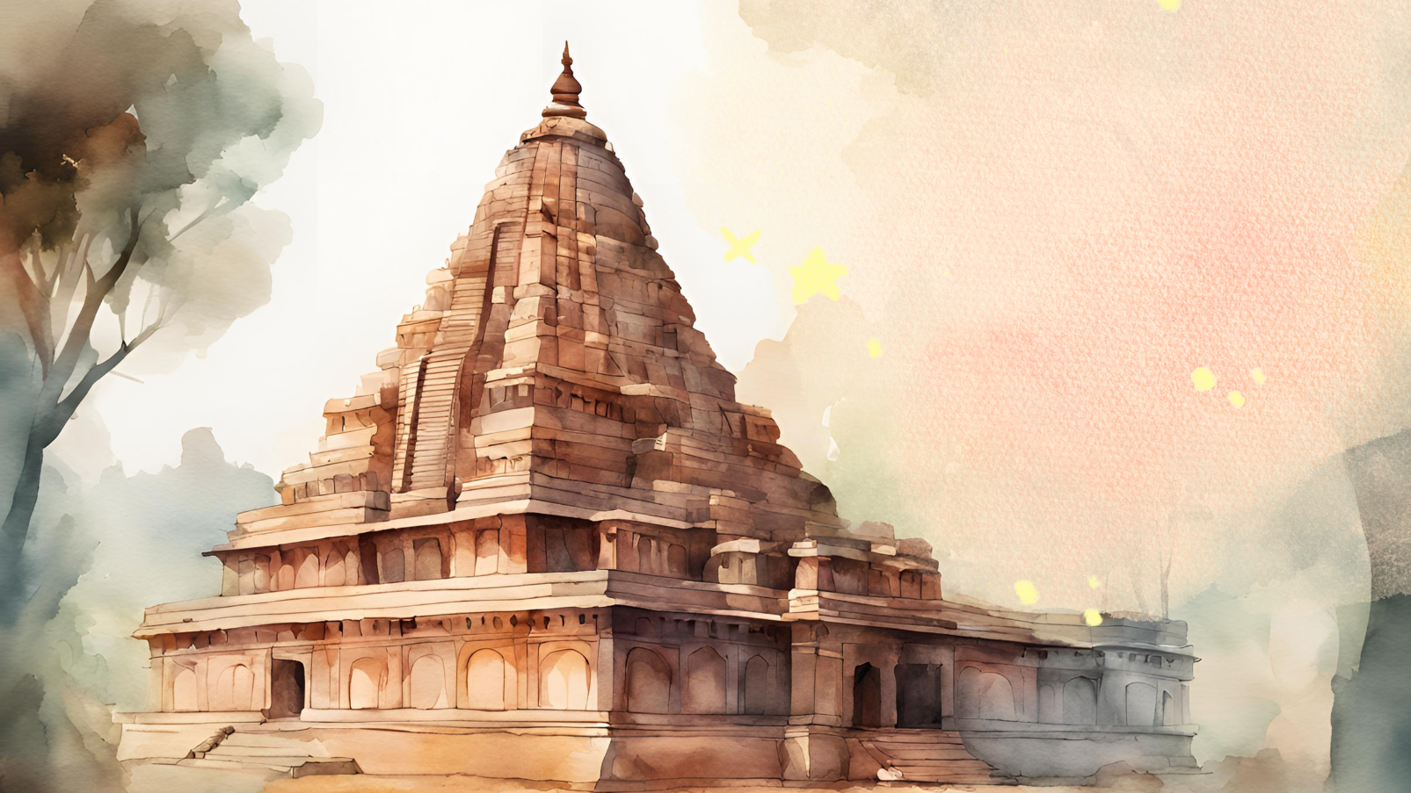
ORIGINS OF
Hinduism
Hinduism is one of the oldest known religions, emerging around 1500 BCE in the Indian subcontinent. It has no single founder and is a rich tapestry of philosophies, rituals, and beliefs.

Slide 4

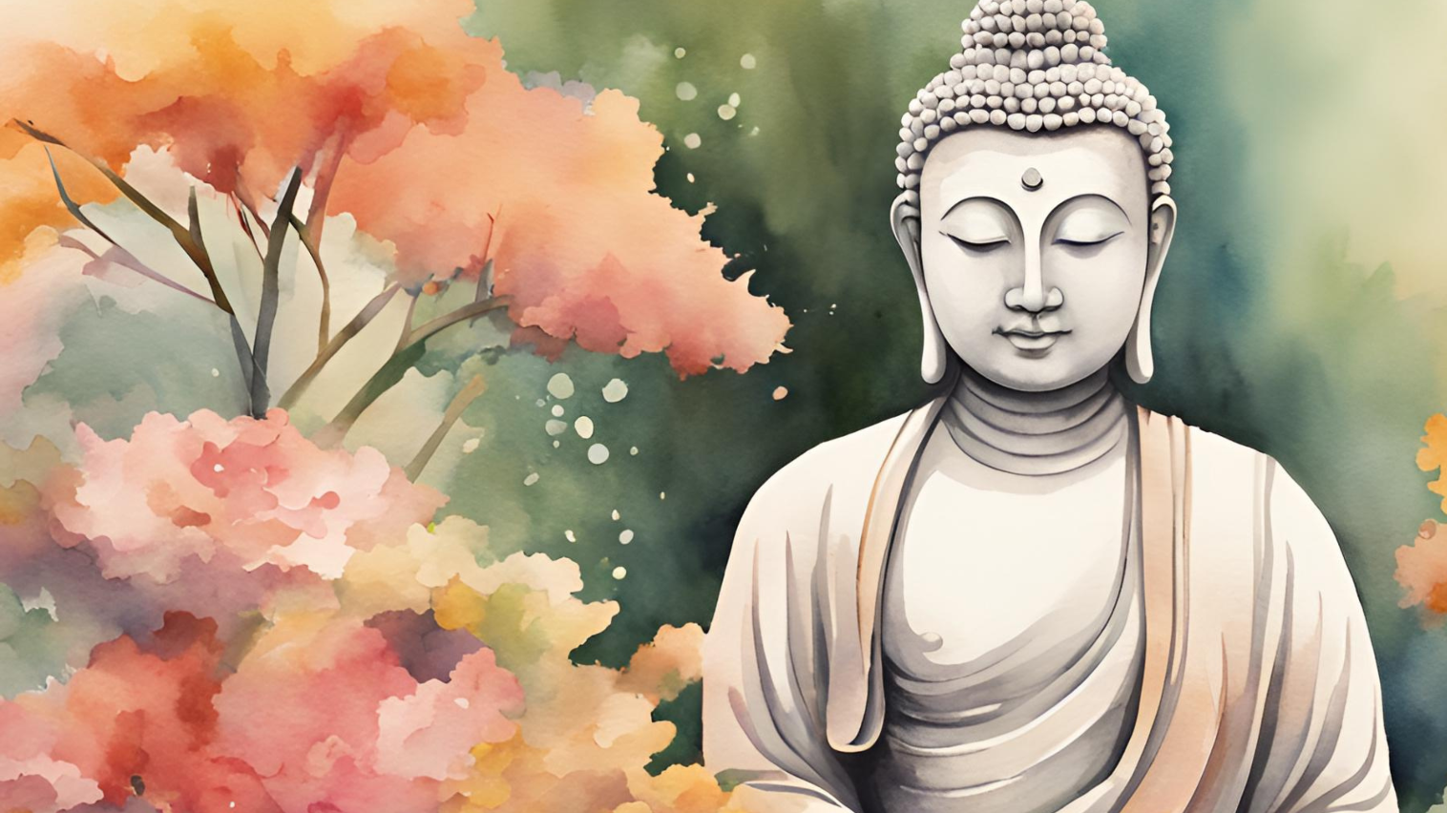
ORIGINS OF
Buddhism
Hinduism is one of the oldest known religions, emerging around 1500 BCE in the Indian subcontinent. It has no single founder and is a rich tapestry of philosophies, rituals, and beliefs.

Slide 5


Key Beliefs of Hinduism
The cycle of birth, death, and rebirth (Samsara)
Karma (the law of cause and effect)
Dharma (ethical duties)
Moksha (liberation from the cycle of rebirth).

Slide 6
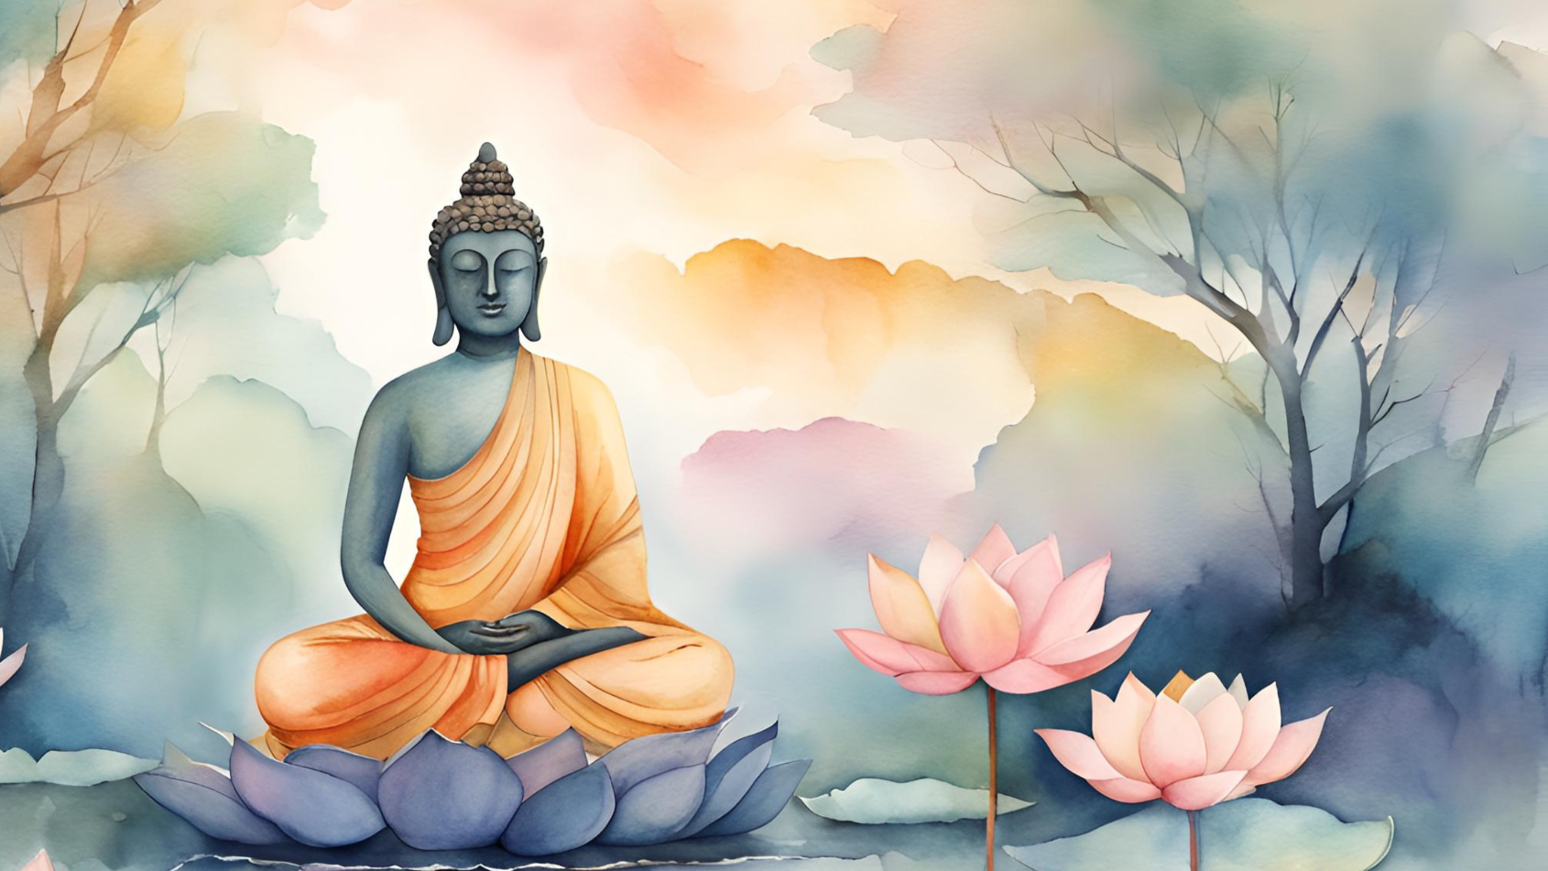
Key Beliefs of Buddhism
Buddhism revolves around
the Four Noble Truths and the Eightfold Path.
It emphasizes the cessation of suffering (Dukkha) and attaining enlightenment (Nirvana).

Slide 7

THE CONCEPT OF
Karma in Hinduism
Karma is the belief that every action has a consequence. Good actions lead to positive outcomes, while negative actions lead to suffering, affecting future lives.

Slide 8
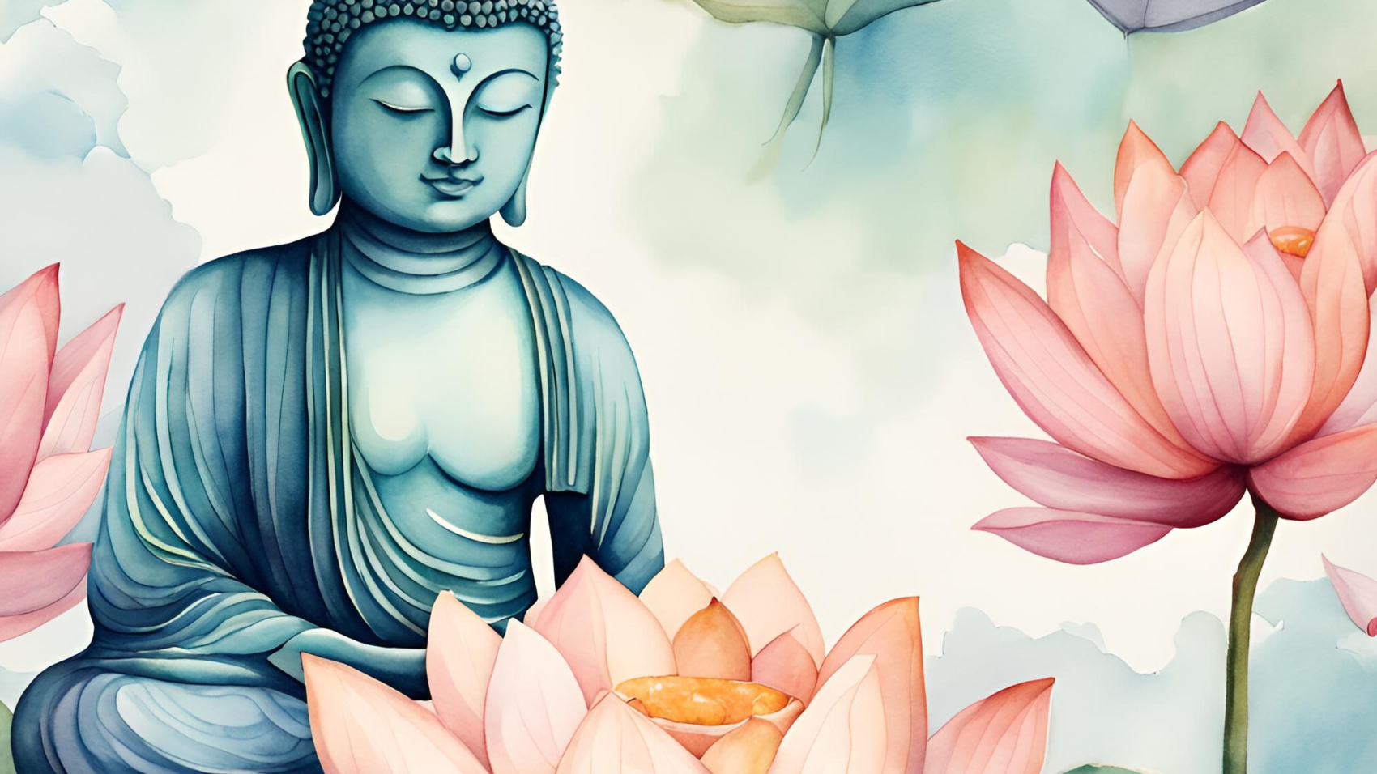
THE CONCEPT OF
Karma in Buddhism
In Buddhism, Karma refers to intentional actions that shape future experiences. Unlike in Hinduism, it doesn't focus on divine reward or punishment but rather on cause and effect.

Slide 9

Gods in Buddhism
Buddhism does not emphasize gods or deities. Instead, it focuses on the individual's path to enlightenment, though some sects venerate the Buddha or bodhisattvas.

Slide 10

Sacred Texts in Hinduism
The primary texts in Hinduism are the Vedas and Upanishads. Other important texts include the Bhagavad Gita and the Ramayana, which offer moral lessons and guidance.

Slide 11

Sacred Texts in Buddhism
Buddhist scriptures include the Tripitaka (Pali Canon) and Mahayana Sutras. These texts outline the Buddha's teachings and guide followers on the path to enlightenment.

Slide 12

The Path to Liberation in Hinduism
Moksha is the ultimate goal in Hinduism, where the soul is freed from the cycle of reincarnation and reunites with Brahman, the universal soul.

Slide 13

The Path to Enlightenment
in Buddhism
In Buddhism, the goal is to achieve Nirvana, the cessation of suffering. This is done by following the Eightfold Path, which includes right view, right intention, and right mindfulness.

Slide 14

Thank you!
Thank you for exploring the spiritual journey of Hinduism and Buddhism. May the wisdom and teachings guide you toward peace, understanding, and inner growth. Continue your journey with an open heart and mind.

Slide 15








































Resource Page
Use these design resources in your Canva Presentation.
Fonts
Design Elements
This presentation template
uses the following free fonts:
TITLES:
CORMORANT GARAMONT ITALIC
HEADERS:
VOLLKORN
BODY COPY:
VOLLKORN
You can find these fonts online too.
Colors
#4E220B
#EFD6BC
  DON'T FORGET TO DELETE THIS PAGE BEFORE PRESENTING.

Slide 16

Credits
This presentation template is free for everyone to use thanks to the following:
  for the presentation template
Pexels, Pixabay
  for the photos
Happy designing!

