Slide 1








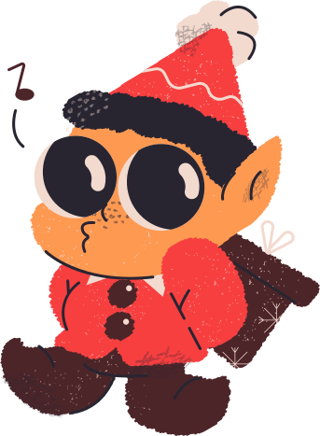

FLOWER CROWN EVENTS SPACE
You’re invited to our
Christmas Trivia Showdown
We ho-ho-hope you can make it!
December 20, 2030 - 8PM
The Grill House
Visit www.reallygreatsite.com to RSVP

Slide 2
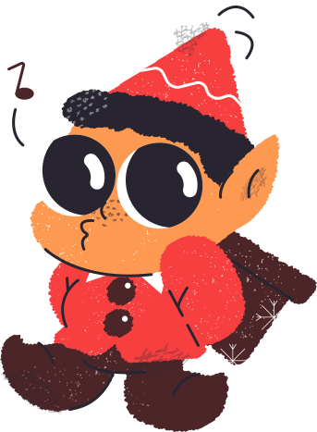







Resource Page
Use these in your template, then delete or hide this page afterward.
Fonts
Colors
This presentation template
uses the following free fonts:
TITLES:
Satisfy
#F3DACF
#F73F40
#F6B051
BODY TEXT:
DM Sans Regular
You can find these fonts online too.
#4C2529
#23713D
#282531
Design Elements / Icons

Slide 3

Credits
This template is free for everyone to use,
thanks to the following:
for this template
Pexels, Pixabay, Sketchify
for the photos, graphics, and elements
Happy designing!

