Slide 1





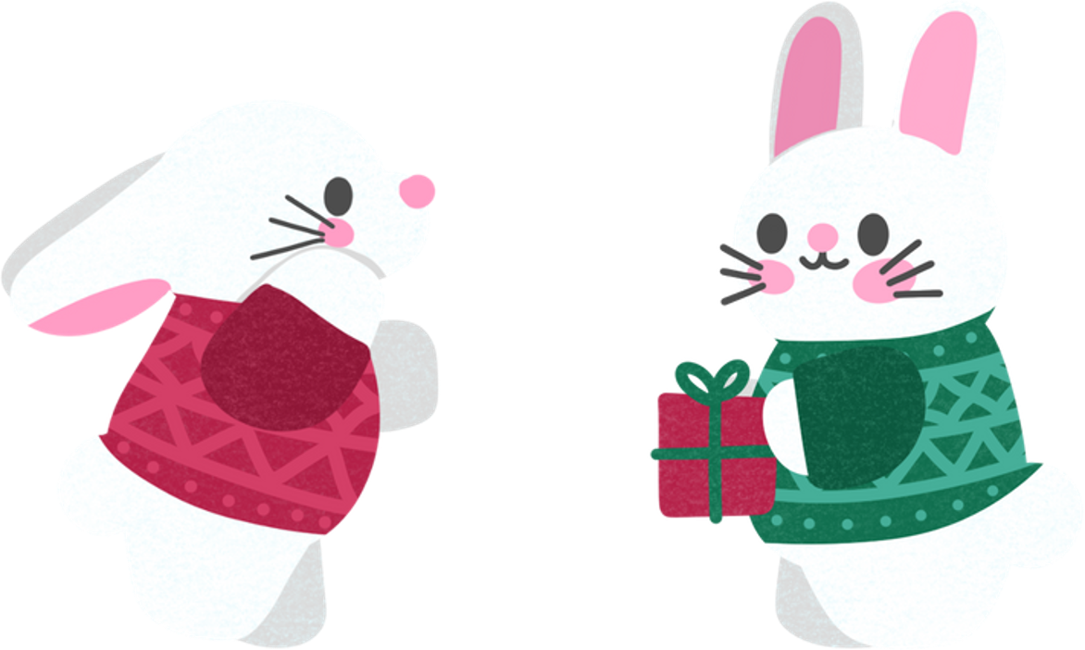

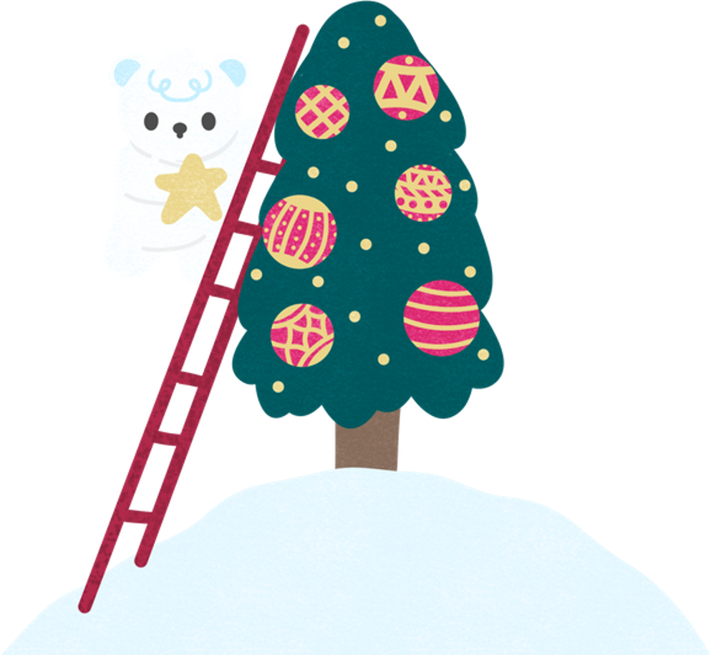






Secret Santa
Gift Exchange
Join us for a festive celebration of generosity and fun, as we spread holiday cheer through thoughtful gifts and delightful surprises.
Gift Limit
$30
Dec 26
6:00 PM
Sylvanian Dining Hall
At 123 anywhere st., any city, st 12345
RSVP to 123-456-7890

Slide 2




Come and celebrate the spirit of generosity and joy with us at our gift exchange gathering!
Secret Santa
Gift Limit
$30
Dec 26
6:00 PM
Sylvanian Dining Hall
At 123 anywhere st., any city, st 12345
RSVP to 123-456-7890

Slide 3



Resource Page
  Use these design resources in your Canva template.
Fonts
Colors
This presentation template
uses the following free fonts:
TITLES AND HEADER:
#E7F9FD
Sue Ellen Francisco
#0064CC
#EFD1FF
BODY COPY:
  Neuton
  You can find these fonts online too.
#D33F67
##C4C482
#01443C
  Design Elements

Slide 4

Credits
  This design template is free for
  everyone to use thanks to the following:
  for the presentation template
Pexels, Pixabay
  for the photos
Happy designing!

