Slide 1




SEO
Competitor Analysis

Slide 2

Table Of Contents
01
02
03
Introduction
Our Projects
About Us
Elaborate on what you want to discuss.
Elaborate on what you want to discuss.
Elaborate on what you want to discuss.

Slide 3

01
Introduction
In a world where the mundane meets the magical, there exists a realm untouched by time and technology—a place known only to a fortunate few. This is the Enchanted Forest, a sanctuary of ancient trees, mythical creatures, and secrets whispered by the wind.
The forest beckons to those with a curious heart and a daring spirit, inviting them to leave behind the ordinary and step into the extraordinary.

Slide 4


Welcome To Presentation
I'm Rain, and I'll be sharing with you my beautiful ideas. Follow me at @reallygreatsite to learn more.

Slide 5



Our Company
Who we are?
Briefly elaborate on what you want to discuss.
What we do?
Briefly elaborate on what you want to discuss.

Slide 6


Mission
Vision
Сontrol was abuzz with activity, each team member immersed in their respective tasks. The hum of computers and the occasional beep from monitoring systems filled the air. A large screen displayed the spacecraft's trajectory, while smaller monitors provided real-time data on its status. Engineers, scientists, and flight directors communicated seamlessly, their focus unwavering. The atmosphere was
Сontrol was abuzz with activity, each team member immersed in their respective tasks. The hum of computers and the occasional beep from monitoring systems filled the air. A large screen displayed the spacecraft's trajectory, while smaller monitors provided real-time data on its status. Engineers, scientists, and flight directors communicated seamlessly, their focus unwavering. The atmosphere was

Slide 7

Our Projects
reflect our commitment to innovation and community impact. Each initiative is designed with the goal of fostering positive change and sustainable growth. From renewable energy solutions to educational programs, we strive to address pressing global challenges while empowering individuals and communities.
Our dedicated teams collaborate with local and international partners to ensure that our projects are not only effective but also inclusive and accessible to all. By prioritizing ethical practices and forward-thinking strategies, we hope to create a brighter, more equitable future for generations to come.

Slide 8




What We Offer
Service One
Service Two
Elaborate on what you want to discuss.
Elaborate on what you want to discuss.
Service Three
Service Four
Elaborate on what you want to discuss.
Elaborate on what you want to discuss.

Slide 9



Gallery Image
What can you say about your projects? Share it here!

Slide 10



Market Research
Elaborate on the featured statistic.
Elaborate on the featured statistic.
Elaborate on the featured statistic.
Elaborate on the featured statistic.

Slide 11
S
W
O
T
STRENGTHS
WEAKNESSES
OPPORTUNITIES
THREATS
What are you doing well?
What sets
you apart?
What are your good qualities?
What are you doing well?
What sets
you apart?
What are your good qualities?
What are you doing well?
What sets
you apart?
What are your good qualities?
What are you doing well?
What sets
you apart?
What are your good qualities?

Slide 12
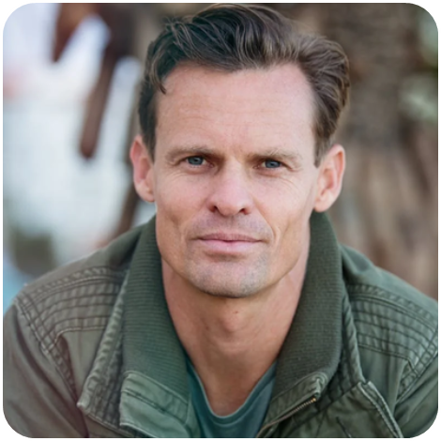


Testimonials
Client name
Client name
Client name
Elaborate on what you want to discuss.
Elaborate on what you want to discuss.
Elaborate on what you want to discuss.

Slide 13

About Us
03
At our core, we are a team of passionate individuals dedicated to making a positive impact in the world. Our journey began with a simple idea: to create meaningful connections and foster a community where everyone feels valued and inspired.
Our mission is to deliver exceptional products and services that not only meet but exceed our customers' expectations. We believe in innovation, integrity, and inclusivity, and these values drive everything we do. From our commitment to sustainability to our efforts in supporting local communities, we strive to make a difference every day.

Slide 14

Our History
Is a rich tapestry woven from countless stories, triumphs, and trials. It is marked by the bravery of those who stood up for justice, the creativity of minds that dared to dream, and the resilience of spirits that refused to give up. Every era has left its imprint, from the ancient civilizations that built monumental wonders to the modern pioneers pushing the boundaries of technology and human potential.
In the ancient past, we see the rise of great empires, their legacies etched in stone and myth. The pyramids of Egypt, the philosophical schools of Greece, the vast expanse of the Roman Empire—each contributed to the foundation of our shared heritage.

Slide 15




Add a main point
Elaborate on what you want to discuss.
Add a main point
Elaborate on what you want to discuss.
Add a main point
Elaborate on what you want to discuss.

Slide 16

A picture is worth a thousand words

Slide 17
Write an original statement or inspiring quote
— Include a credit, citation, or supporting message

Slide 18


Contact Us
123 Anywhere St., Any City,ST 12345
123-456-7890
hello@reallygreatsite.com
@reallygreatsite
reallygreatsite.com

Slide 19

Resource Page
Use these design resources in your Canva Presentation.
You can find these fonts online too. Happy designing!
Don't forget to delete this page before presenting.
This presentation template uses the following free fonts:
  Titles: Anton
  Headers: Anton
  Body Copy: Montserrat

Slide 20

Credits
This presentation template is free for everyone to use thanks to the following:
SlidesCarnival for the presentation template
Pexels for the photos
Happy designing!

