Slide 1
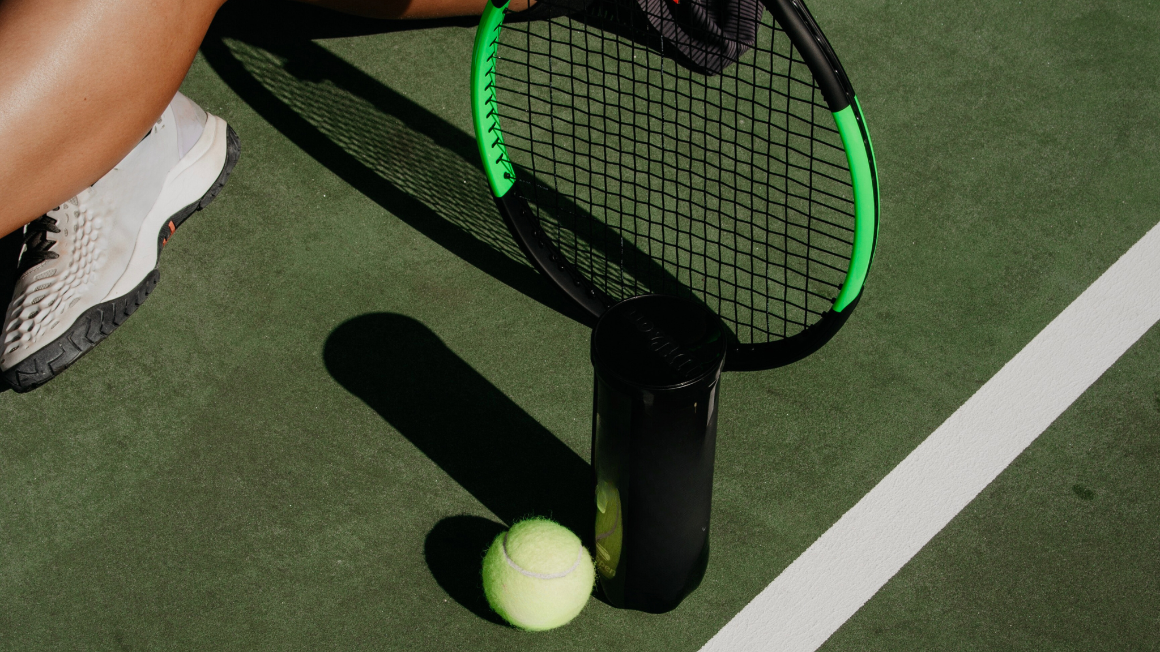
A Presentation
SlidesCarnival
2024
SUCCESS STORY

Slide 2
A Presentation
SlidesCarnival
2024
About the Company
COMPANY NAME is a dynamic marketing agency dedicated to helping businesses build impactful brands, reach target audiences, and drive measurable growth. With expertise in digital marketing, content creation, social media strategy, and data-driven analytics, COMPANY NAME crafts tailored solutions that align with each client’s unique goals. Our team combines creativity with strategic insights to create campaigns that resonate, engage, and deliver lasting results.

Slide 3
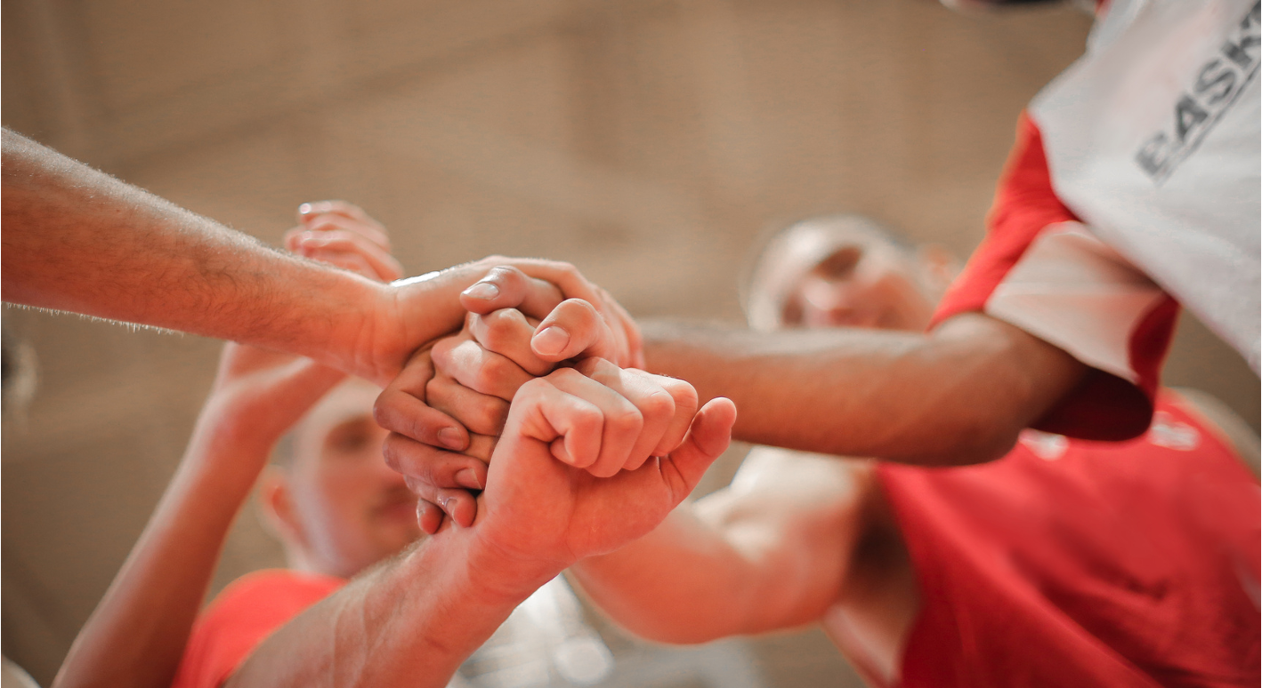
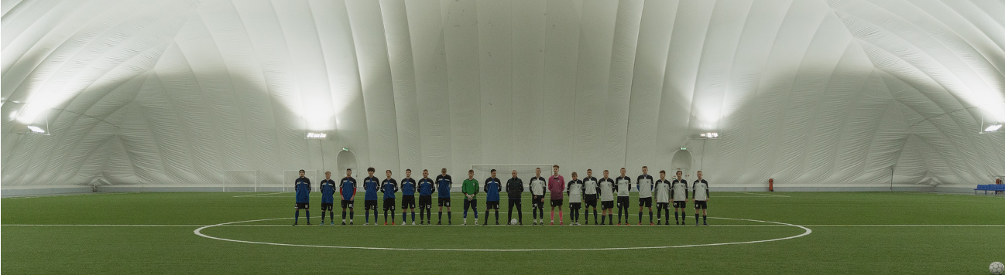

A Presentation
SlidesCarnival
2024
Our History
Founded in the early 2000s, the Stellar Sports Team began as a small group of dedicated athletes passionate about competition. Initially focused on local leagues, they quickly gained a reputation for skillful play and teamwork by combining traditional training with modern sports analytics. As their talent grew, they attracted attention from larger competitions while maintaining a strong sense of community and sportsmanship.

Slide 4
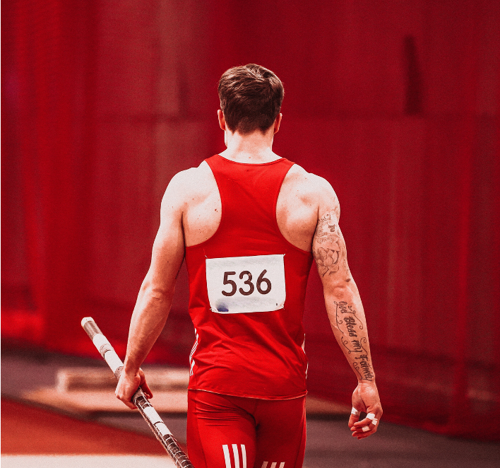
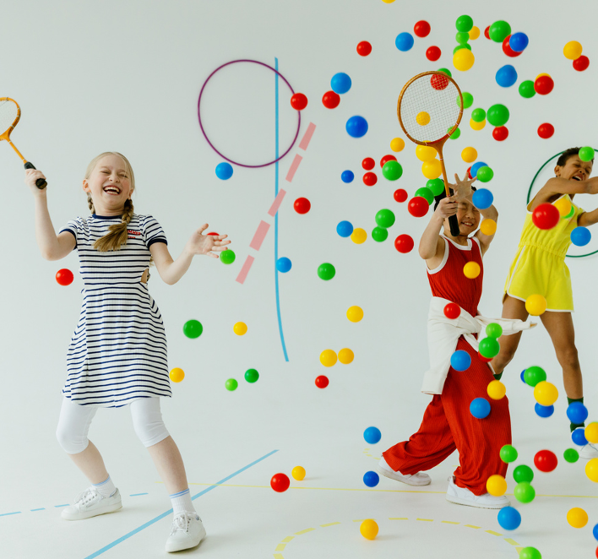
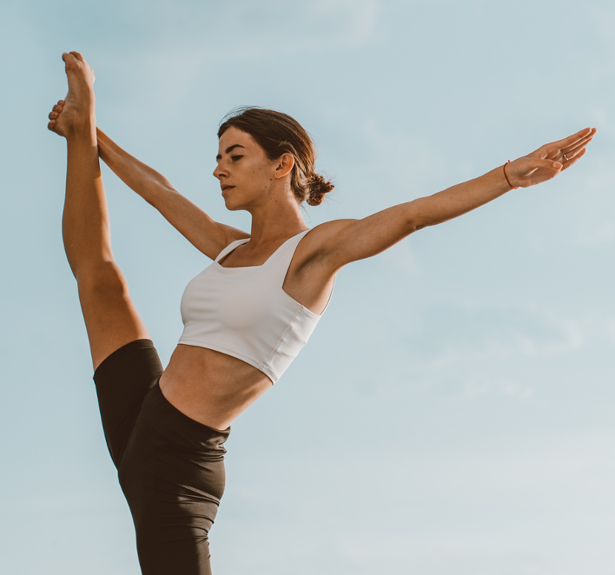
A Presentation
SlidesCarnival
2024
Our Strategies
This style focuses on evoking emotions to connect with the audience.
Humorous ads aim to entertain the audience while promoting a product or service.
This style features satisfied customers or celebrities endorsing a product or service.
EMOTIONAL
APPEAL
HUMOR
TESTIMONY

Slide 5
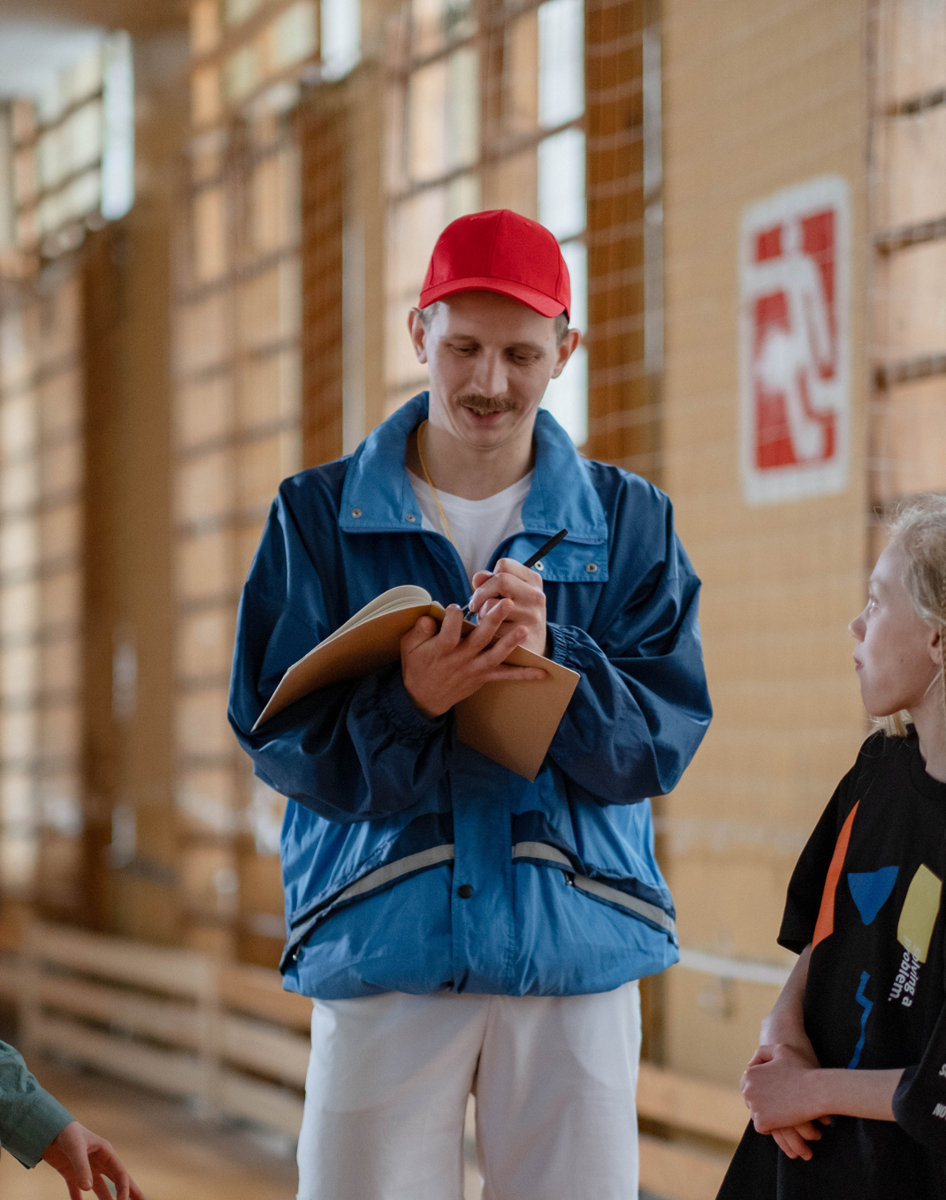
A Presentation
SlidesCarnival
2024
Our Founder
JANE DOE
Jane Doe is the visionary founder of a successful sports agency that specializes in representing athletes and sports professionals. With a background in sports management and a passion for the industry, she has transformed her agency into a premier destination for innovative representation strategies. Under her leadership, the agency has built a reputation for delivering measurable results, negotiating lucrative contracts, and fostering strong relationships between athletes and teams. Jane's commitment to her clients extends beyond contracts; she focuses on personal branding, career development, and life after sports, ensuring that the athletes she represents are equipped for success both on and off the field. Her agency is known for its holistic approach, emphasizing the importance of community engagement and athlete advocacy, making it a trusted partner in the competitive world of sports.

Slide 6
A Presentation
SlidesCarnival
2024
Our Process
PREPARATION
Elaborate on your process step here.
STRATEGIZING
Elaborate on your process step here.
TRAINING
Elaborate on your process step here.
WINNING
Elaborate on your process step here.

Slide 7
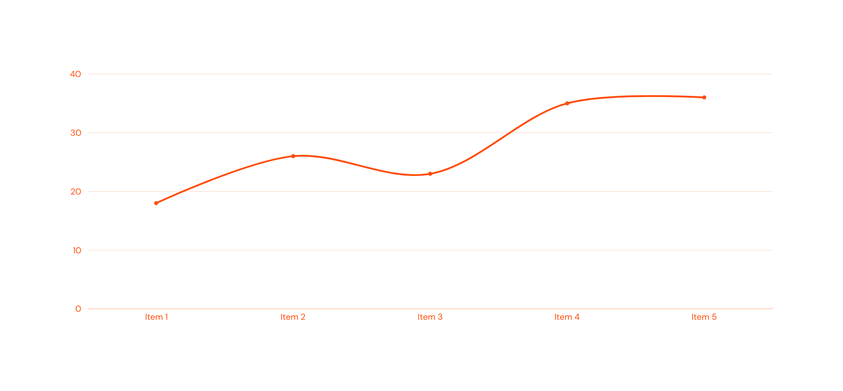
A Presentation
SlidesCarnival
2024
Analytics
Elaborate on the given statistics here. Highlight their quirks and importance when it comes to your advertising and marketing goals.

Slide 8
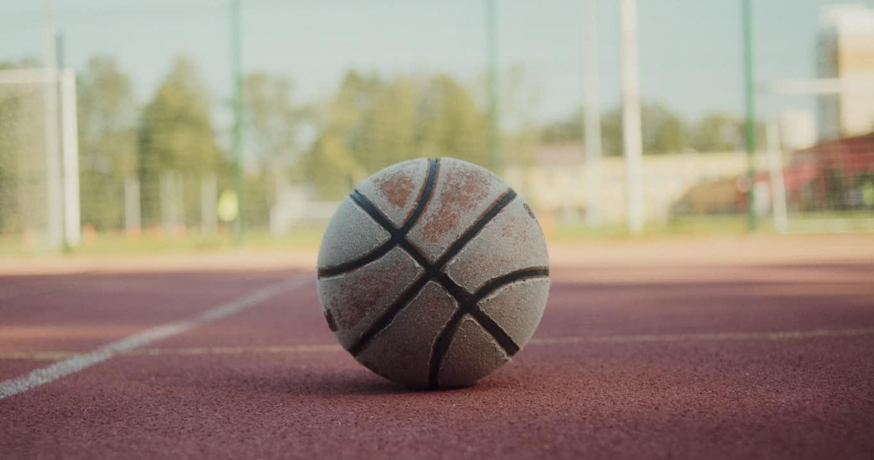
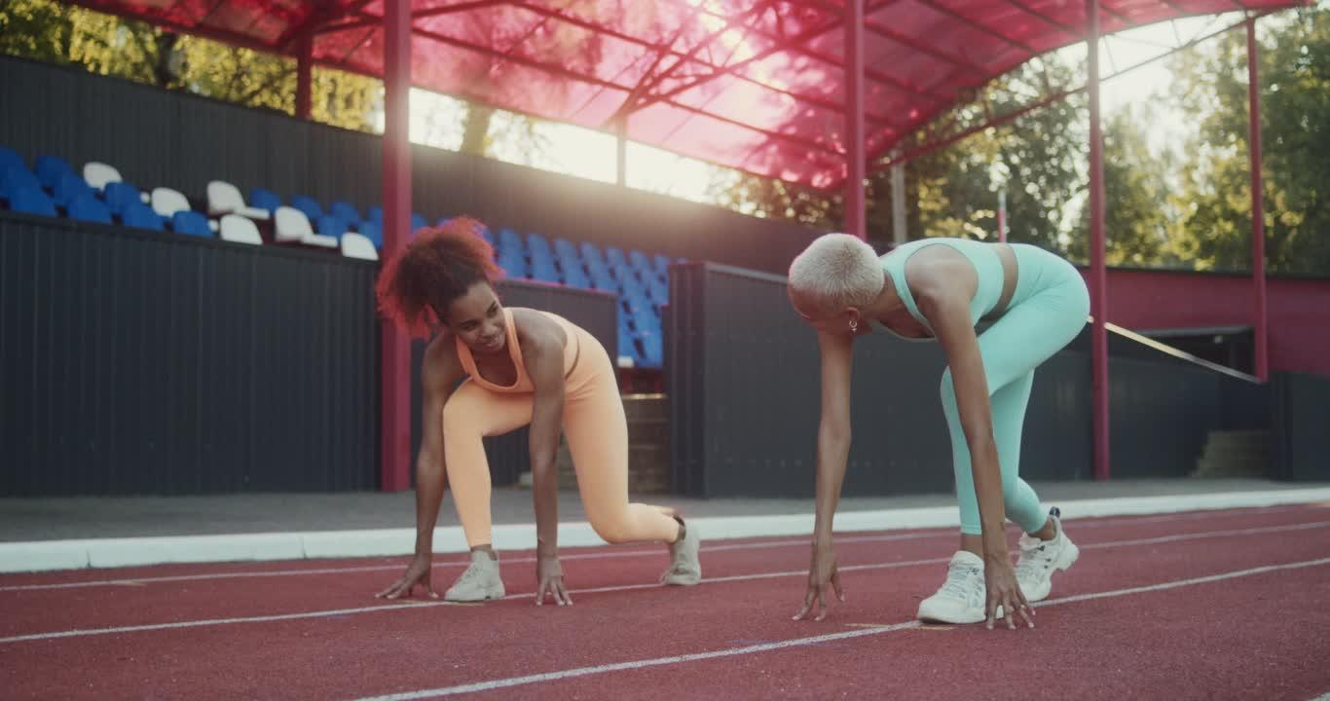
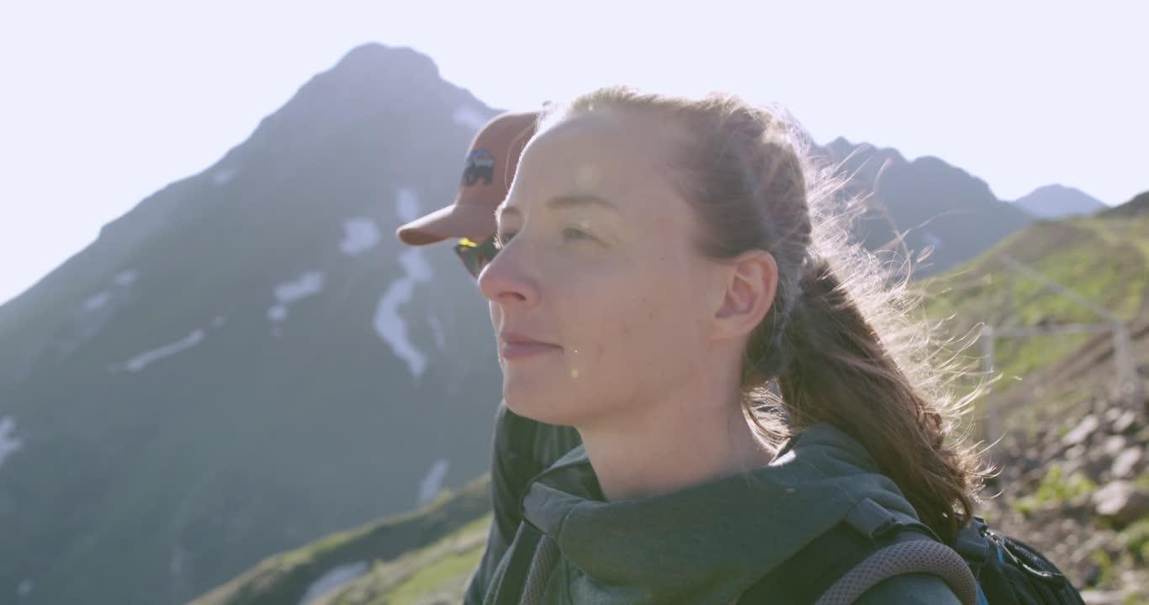
A Presentation
SlidesCarnival
2024
Our Projects
"OWN THE COURT"
"RUN WILD"
"UP THE SUMMIT"

Slide 9
A Presentation
SlidesCarnival
2024
"OWN THE COURT"
"Own the Court" was a resounding success, attracting basketball enthusiasts, industry leaders, and brands eager to showcase their passion for the game. The event featured engaging competitions, interactive experiences, and insightful panels, fostering meaningful connections among participants and providing brands with invaluable exposure. Attendees left inspired and energized, eager to implement innovative strategies and collaborations that emerged from the event. The feedback was overwhelmingly positive, with many praising the seamless organization and the vibrant atmosphere that celebrated both the sport and the spirit of community. Overall, "Own the Court" not only elevated brand visibility but also reinforced the strong bond between basketball and marketing, setting the stage for future collaborations and events.

Slide 10
A Presentation
SlidesCarnival
2024
"Run Wild" was a highly successful marketing event that celebrated outdoor running and fitness, attracting a diverse group of participants.
"RUN WILD"
The event featured various races, interactive workshops, and vendor booths showcasing the latest running gear and nutrition products, fostering a vibrant community atmosphere. Attendees praised the event for its engaging activities and stunning natural backdrop.

Slide 11
A Presentation
SlidesCarnival
2024
"UP THE SUMMIT"
"Up the Summit" was an exhilarating hiking event that brought together outdoor enthusiasts for a challenging yet rewarding adventure. Participants tackled a scenic trail leading to a breathtaking summit, with guided workshops on hiking safety and gear usage along the way. The event fostered a strong sense of community and appreciation for nature, resulting in overwhelmingly positive feedback and increased brand engagement for sponsors.

Slide 12
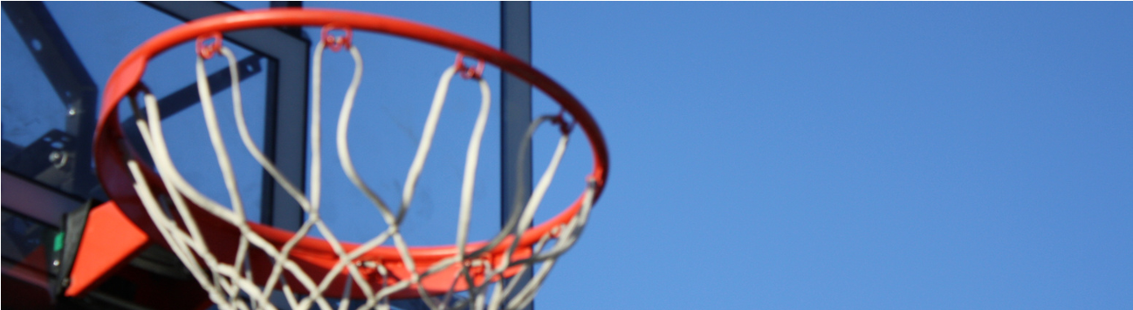
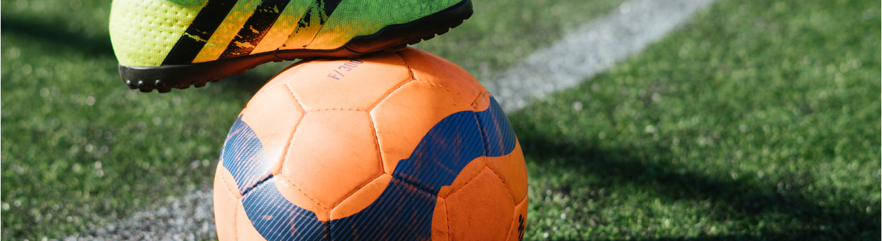
A Presentation
SlidesCarnival
2024
WRITE AN ORIGINAL STATEMENT OR INSPIRING QUOTE.
— Include a credit, citation, or supporting message

Slide 13
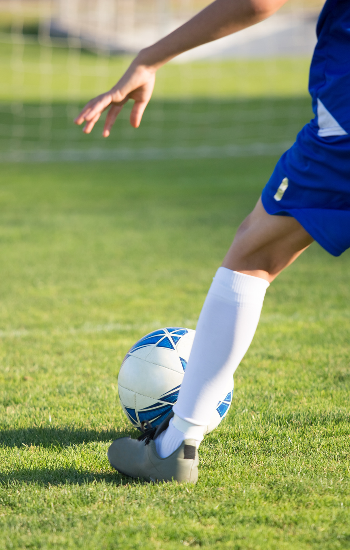
A Presentation
SlidesCarnival
2024
Contact Us
123 Anywhere St., Any City,ST 12345
123-456-7890
hello@reallygreatsite.com
@reallygreatsite
reallygreatsite.com

Slide 14







































Resource Page
  Use these design resources in your Canva Presentation.
FONTS
DESIGN ELEMENTS
This presentation template
uses the following free fonts:
ORANIENBAUM
DM SANS
You can find these fonts online too.
COLORS
#FF4D0A
#FFFFFF
  DON'T FORGET TO DELETE THIS PAGE BEFORE PRESENTING.

Slide 15

Credits
  This presentation template is free for everyone to use thanks to the following:
  for the presentation template
Pexels, Pixabay
  for the photos
  Happy designing!

