Slide 1



KIDS ROOM DECORATION
Project Proposal

Slide 2

How to Use This Presentation
GOOGLE SLIDES
POWERPOINT
CANVA
Click on the "Google Slides" button below this presentation preview.
Click on "Make a copy."
Start editing your presentation.
You need to sign in to your Google account.
Click on the "PowerPoint" button below this presentation preview.
Start editing your presentation.
Download and install the fonts used in this presentation as listed on the next page.
Click on the "Canva" button under this presentation preview.
Start editing your presentation.
You need to sign in to your Canva account.

Slide 3



Table Of Contents
01
02
03
Introduction
Our Process
About Us
  Elaborate on what
  you want to discuss.
  Elaborate on what
  you want to discuss.
  Elaborate on what
  you want to discuss.

Slide 4


01
Introduction
  Elaborate on what you want to discuss.

Slide 5


Welcome To
Presentation
I'm Rain, and I'll be sharing with you my beautiful ideas.
  Follow me at @reallygreatsite to learn more.

Slide 6


Our Company
Who we are?
Briefly elaborate on
  what you want to discuss.
What we do?
Briefly elaborate on
  what you want to discuss.

Slide 7


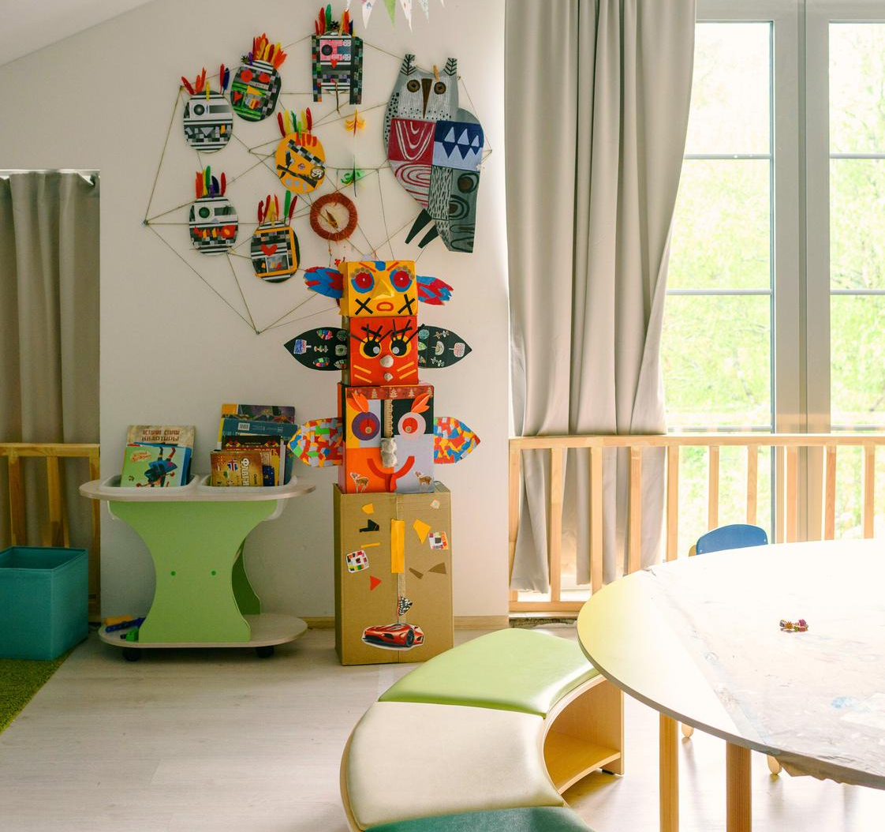
Mission
Vision
Enter your grand
  vision statement!
Enter your grand
  vision statement!

Slide 8




Add a Timeline Page
Add a main point
Add a main point
2017
Elaborate on what
  you want to discuss.
2021
Elaborate on what
  you want to discuss.
Add a main point
Add a main point
2019
2023
Elaborate on what
  you want to discuss.
Elaborate on what
  you want to discuss.

Slide 9



02
Our Process
  Elaborate on what you want to discuss.

Slide 10



Our Services
Service One
Service Two
Elaborate on what
  you want to discuss.
  Elaborate on what
  you want to discuss.
Service Three
Service Four
  Elaborate on what
  you want to discuss.
  Elaborate on what
  you want to discuss.

Slide 11



Your Project
  Presentations are communication tools that can be used as demonstrations, lectures, speeches, reports, and more. It is mostly presented before an audience. It serves a variety of purposes, making presentations powerful tools for convincing and teaching.
  YEAR: 2022
  ROLE: WRITE YOUR ROLE

Slide 12




  What can you say about your projects? Share it here!
Gallery Image

Slide 13

Market Research
  Elaborate on the featured statistic
43%
60%
35%
  Elaborate on the
  featured statistic.
  Elaborate on the
  featured statistic.
  Elaborate on the
  featured statistic.

Slide 14

  50
Analysis
  Elaborate on the featured statistic.
  40
  30
  20
  10
  0
  Item 1
  Item 2
  Item 3
  Item 4
  Item 5

Slide 15







Target
Step 1
Step 2
Step 3
Step 4
Step 5
  Elaborate on
  the step here
  Elaborate on
  the step here
  Elaborate on
  the step here
  Elaborate on
  the step here
  Elaborate on
  the step here

Slide 16


Market Research
  Elaborate on what you want to discuss.
Example
Example
  Presentations are
  communication tools
  Presentations are
  communication tools
Example
Example
  Presentations are
  communication tools
  Presentations are
  communication tools

Slide 17



123,456,789
  Elaborate on the featured statistic.

Slide 18

Strengths
Weaknesses
S
W
  What are you doing well?
  What sets you apart?
  What are your good qualities?
  Where do you need to improve?
  Are resources adequate?
  What do others do
  better than you?
Opportunities
Threats
O
T
  What are your goals?
  Are demands shifting?
  How can it be improved?
  What are the blockers
  you're facing?
  What are factors outside
  of your control?

Slide 19



2 out of 5
95%
12 million
  Elaborate on the featured statistic.
  Elaborate on the featured statistic.
  Elaborate on the featured statistic.

Slide 20


Add a Pricing Page
Monthly
Monthly
Yearly
20$
30$
300$
Add a feature
Add a feature
Add a feature
Add a feature
Add a feature
Add a feature
Add a feature
Add a feature
Add a feature
Add a feature
Add a feature
Add a feature

Slide 21


A picture is worth a thousand words

Slide 22



03
About Us
  Elaborate on what you want to discuss.

Slide 23


Our History
  Presentations are communication tools that can be used as demonstrations, lectures, speeches, reports, and more. It is mostly presented before an audience.

Slide 24



Add a Team Members Page
  Elaborate on what you want to discuss.
  Name
  Name
  Name
  Name
  Title or Position
  Title or Position
  Title or Position
  Title or Position

Slide 25




Our Founder
Name Surname
  Presentations are communication tools that can be used as demonstrations, lectures, speeches, reports, and more. It is mostly presented before an audience.

Slide 26






Write an original statement
or inspiring quote
  — Include a credit, citation, or supporting message

Slide 27


Contact Us
reallygreatsite.com
123-456-7890
@reallygreatsite
  hello@reallygreatsite.com

Slide 28


Credits
This presentation template
is free for everyone to
use thanks to the following:
Slides Carnival
  for the presentation template
Pexels
  for the photos

Slide 29


Fonts In this Presentation
This presentation template uses the following free fonts:
  Titles: Pangolin
  Headers: Pangolin
  Body Copy: Ubuntu
  You can find these fonts online too. Happy designing!

Slide 30



Free templates for all your presentation needs
  For PowerPoint, Google Slides, and Canva
  100% free for personal
  or commercial use
  Ready to use, professional,
  and customizable
  Blow your audience away
  with attractive visuals

Slide 31










































Resource
Page
Use these design resources
  in your Canva Presentation.
  Happy designing!
  Don't forget to delete this
  page before presenting.

Slide 32







































Resource
Page
Use these design resources
  in your Canva Presentation.
  Happy designing!
  Don't forget to delete this
  page before presenting.

