Slide 1

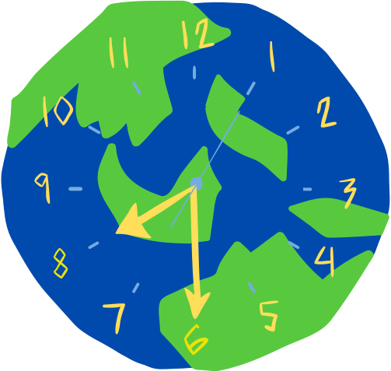
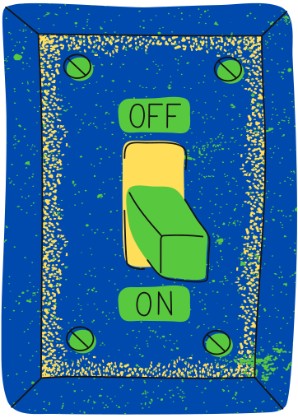

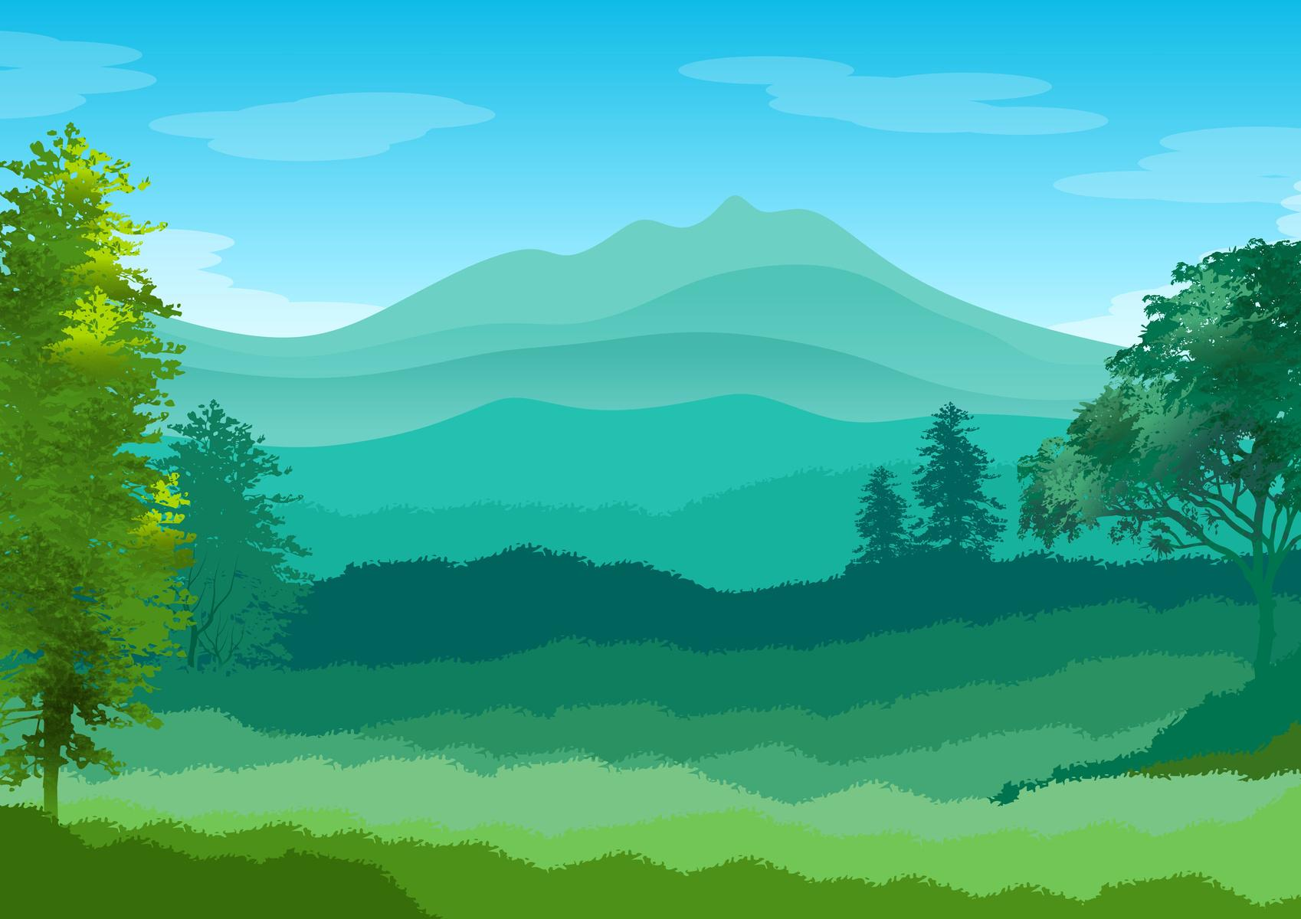




EARTH HOUR
Join the Biggest Hour for Earth
WHEN IS EARTH HOUR?
PREPARE BY TURNING OFF
JUST ENJOY YOUR TIME
It takes place on the last Saturday of March at 8:30 PM local time.
Turn off all non-essential lights and electronics for one hour.
Try non-electric activities such as chatting with loved ones, reading, or playing games.
SHARE YOUR EARTH HOUR EXPERIENCE
KEEP THE POST-EARTH HOUR GOING!
Show and spread awareness on social media.
Remember to take small steps like turning off lights and reducing single-use plastic.
Following these steps can help promote sustainability awareness and
accelerate the movement to reduce carbon emissions worldwide.

Slide 2
EARTH HOUR
Join the Biggest Hour for Earth
WHEN IS EARTH HOUR?
It takes place on the last Saturday of March at 8:30 PM local time.
PREPARE BY TURNING OFF
Turn off all non-essential lights and electronics for one hour.
JUST ENJOY YOUR TIME
Engage in non-electric activities like chatting with loved ones, reading, or playing games.
SHARE YOUR EXPERIENCE
Display and raise awareness about your Earth Hour experience on social media.
KEEP THE POST-EARTH HOUR GOING!
Remember to take small steps like turning off lights and reducing single-use plastic.

Slide 3
RESOURCE PAGE
  Use these design resources in your Canva Presentation.
Fonts
Colors
This presentation template
uses the following free fonts:
TITLES:
LUCKIEST GUY
BODY COPY:
POPPINS
#004AAD
#41B93C
#FFDE59
#EFF4BF
You can find these fonts online too.
Design Elements

Slide 4

CREDITS
This presentation template is free for everyone to use
  thanks to the following:
  for the presentation template
Pexels, Pixabay
  for the photos
  HAPPY DESIGNING!

