Slide 1
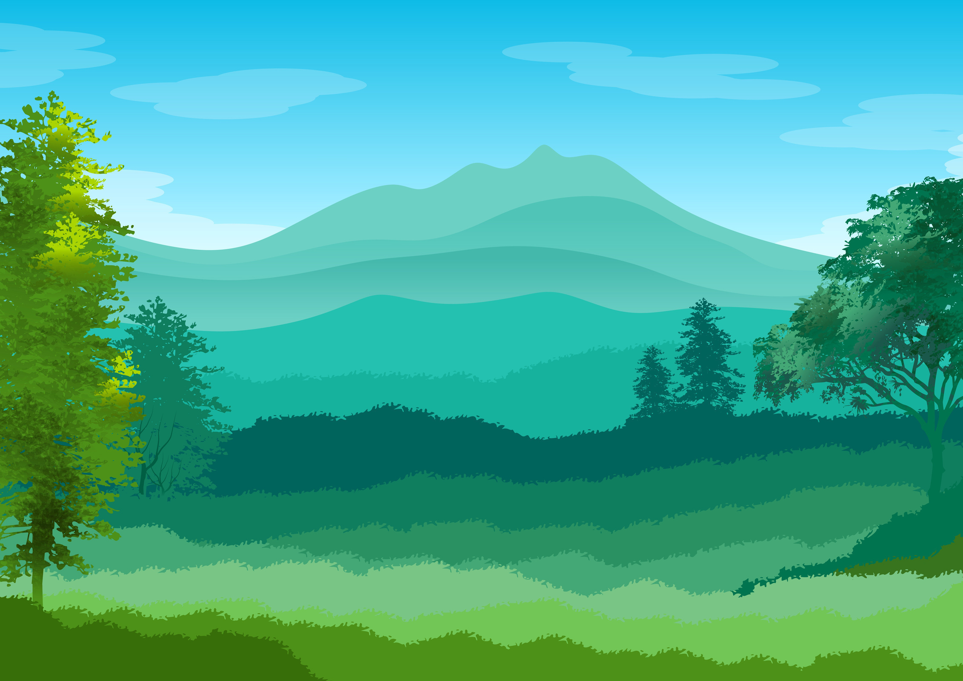

Name:
I CAN HELP THE EARTH!
Recycling, reusing, and reducing waste are important to help keep our planet clean and healthy. What are some ways that you can help?
I can help the earth by recycling
I can help the earth by reusing
I can help the earth by reducing

Slide 2
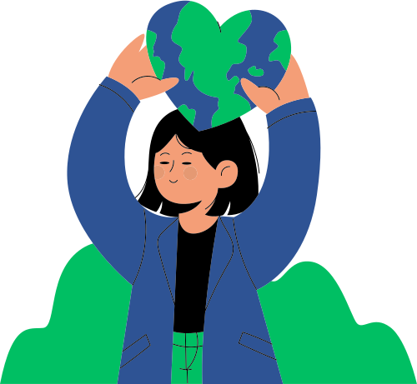





Name:
Class:
Date:
I CAN HELP THE
EARTH!
I can help the earth by recycling
I can help the earth by reusing
I can help the earth by reducing

Slide 3







I CAN HELP THE EARTH!
I can help the earth by recycling
I can help the earth by reusing
I can help the earth by reducing

Slide 4
RESOURCE PAGE
  Use these design resources in your Canva Presentation.
Fonts
Colors
This presentation template
uses the following free fonts:
TITLES:
LUCKIEST GUY
BODY COPY:
JUA
#228C59
#2E5394
#EE5600
#00B8F1
You can find these fonts online too.
Design Elements

Slide 5

CREDITS
This presentation template is free for everyone to use
  thanks to the following:
  for the presentation template
Pexels, Pixabay
  for the photos
  HAPPY DESIGNING!

