Slide 1

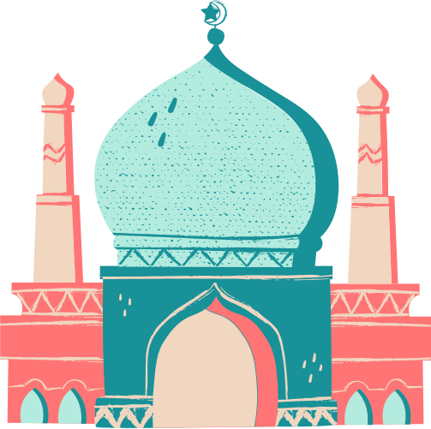


Ramadan
In Egypt
Presentation Slides

Slide 2


Explore the cultural, spiritual, and festive significance of Ramadan in the heart of Egypt.

Slide 3



Introduction
What Makes Ramadan Unique in Egypt?
Ramadan in Egypt is more than a holy month—it's a celebration of community, heritage, and devotion. Streets come alive with lanterns, mosques resonate with prayers, and families gather for feasts that honor centuries-old traditions.

Slide 4


The Spirit of Ramadan
During Ramadan, Egyptians embrace fasting from dawn to dusk, accompanied by prayer and introspection. It's a time to strengthen spiritual connections and practice compassion.
During Ramadan, Egyptians embrace fasting from dawn to dusk, accompanied by prayer and introspection. It's a time to strengthen spiritual connections and practice compassion.
During Ramadan, Egyptians embrace fasting from dawn to dusk, accompanied by prayer and introspection. It's a time to strengthen spiritual connections and practice compassion.
During Ramadan, Egyptians embrace fasting from dawn to dusk, accompanied by prayer and introspection. It's a time to strengthen spiritual connections and practice compassion.

Slide 5

Suhoor
The Pre-Dawn Meal
Suhoor, the pre-dawn meal, is a vital part of Ramadan. Egyptians savor dishes like ful medames (fava beans) and bread, sharing moments of unity before the day’s fast begins.

Slide 6

The Art of Fanoos Lanterns
The fanoos lantern, a vibrant symbol of Ramadan, brightens Egyptian streets and homes. Rooted in history, these lanterns represent hope, light, and joy.

Slide 7

The Call to Prayer
Marking the End of the Fast
The Maghrib call to prayer signals the end of fasting each evening. Families gather to break their fast with dates and water, a tradition reflecting the Prophet Muhammad’s example.

Slide 8

Taraweeh Prayers
Special evening prayers, known as Taraweeh, fill mosques across Egypt. These prayers bring communities together in shared faith and spiritual rejuvenation.

Slide 9
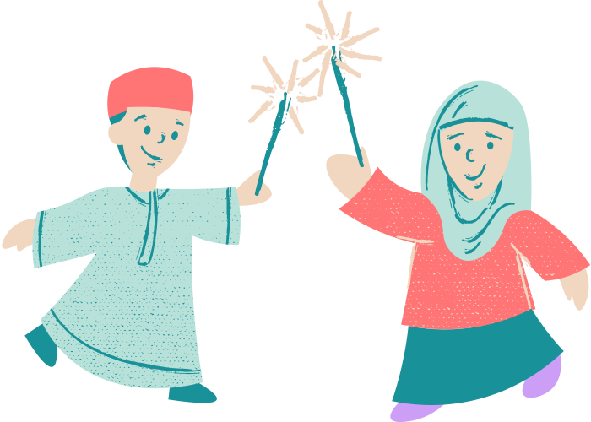

After breaking their fast, Egyptians gather in bustling markets and cafés, enjoying music, sweets, and lively conversations that continue late into the night.
Ramadan Nights in Egypt
gyptian streets transform during Ramadan, adorned with colorful banners, lights, and textiles. The vibrant decor captures the joyous spirit of the holy month.

Slide 10

Charity and Giving Back
Embodying Compassion
Acts of charity, or zakat, are central to Ramadan. Egyptians organize food drives and donate to those in need, embodying the month’s spirit of generosity.

Slide 11
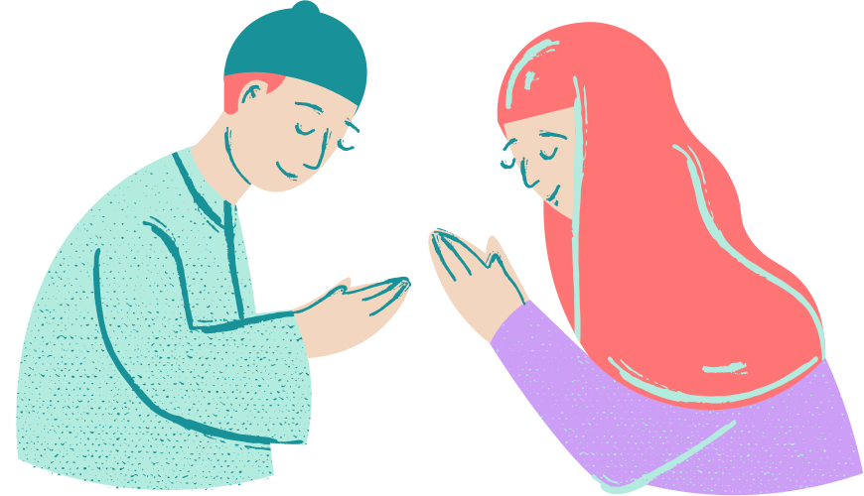
A Month of Togetherness
Ramadan strengthens bonds—between families, neighbors, and strangers. The shared experience of fasting and celebration unites Egyptians across generations.
Ramadan strengthens bonds—between families, neighbors, and strangers. The shared experience of fasting and celebration unites Egyptians across generations.

Slide 12

Ramadan Through the Ages
Tradition Meets Modernity
While rooted in faith, Ramadan in Egypt evolves with time. Today, traditions blend seamlessly with modern life, keeping its spirit alive and thriving.

Slide 13


Key Takeaways
Deep spiritual significance
Rich cultural traditions
Vibrant community celebrations
Unwavering spirit of giving
What Makes Ramadan in Egypt Special?

Slide 14

Ramadan
Kareem!
Thank you for exploring Ramadan in Egypt with us. May this month bring light, love, and peace to all.

Slide 15

Resource Page
Use these design resources in your Canva Presentation.
Fonts
Design Elements
This presentation template
uses the following free fonts:
TITLES:
FINDEL
HEADERS:
BUFFALO
BODY COPY:
BUFFALO
You can find these fonts online too.
Colors
#FDE9D8
#FA8888
#B3EBDF
#032D30
  DON'T FORGET TO DELETE THIS PAGE BEFORE PRESENTING.

Slide 16

Credits
This presentation template is free for everyone to use thanks to the following:
  for the presentation template
Pexels, Pixabay
  for the photos
Happy designing!

