Slide 1



ELECTION DAY COUNTDOWN
1
8
2
2
3
0
DAYS
HOURS
MINUTES
#PresidentialElections2024
REGISTER NOW

Slide 2



14 DAYS
UNTIL ELECTION DAY
VOTING IS NOT ONLY OUR RIGHT—IT IS OUR POWER.
WWW.VOTENOW.GOV

Slide 3





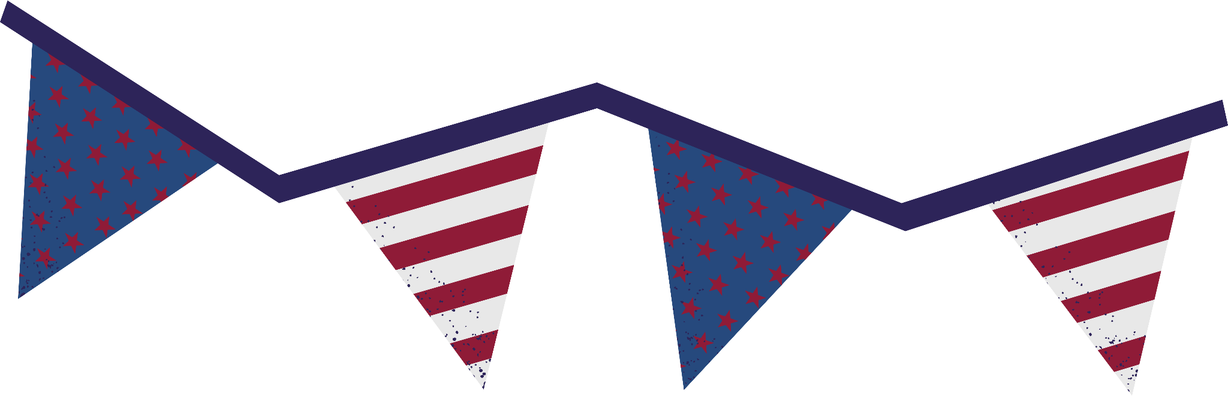


Resource Page
  Use these design resources in your Canva Presentation.
Fonts
  Design Elements
  This presentation template
  uses the following free fonts:
  Titles and Body:
MULI
PLAYFAIR DISPLAY
CABIN
ANTON
  You can find these fonts online too.
Colors
  Don't forget to delete this page before presenting.

Slide 4

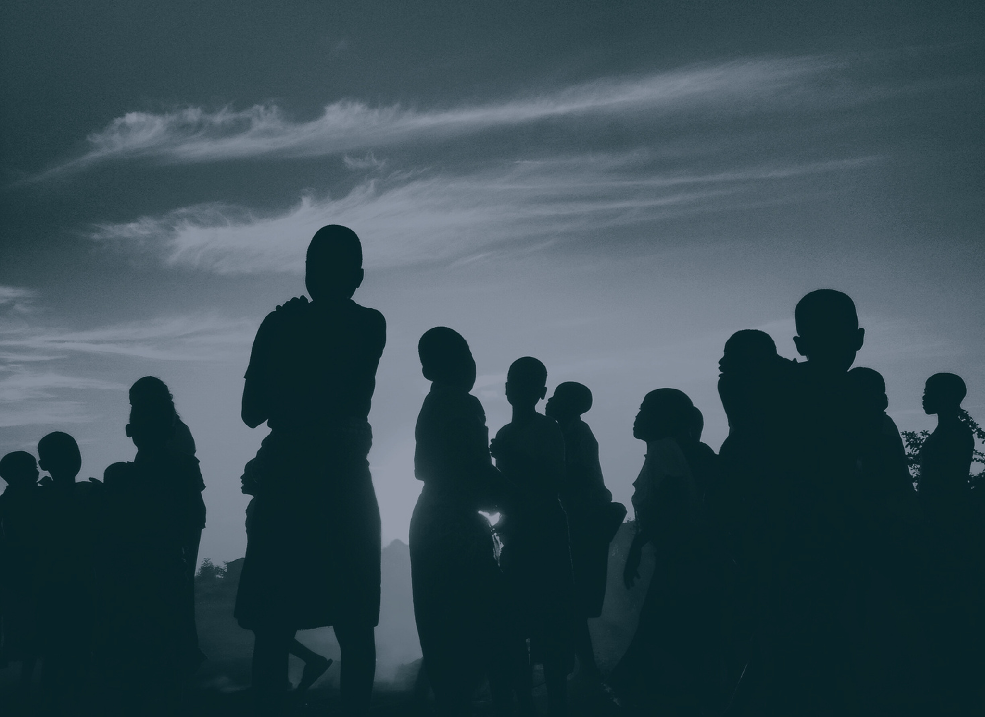

Credits
  This design template is free for everyone to use thanks to the following:
  for the presentation template
  PEXELS, PIXABAY
  for the photos
  HAPPY DESIGNING!

