Slide 1


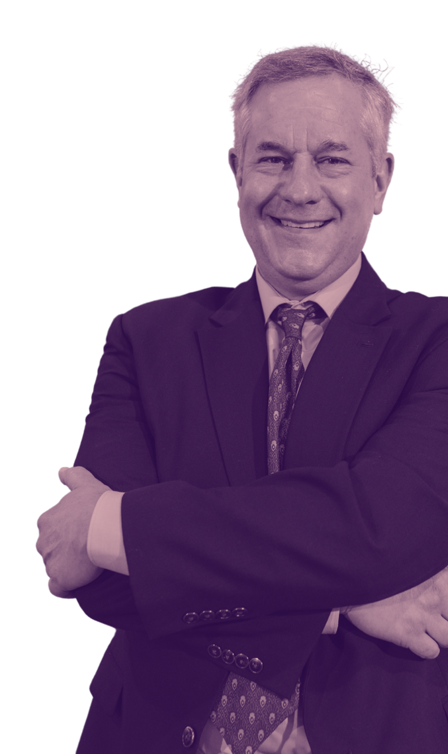


ELECTION 2024
VOTE
MARK DARCY
FOR SENATOR
Building a Better Community Together!
LEARN MORE:
elections2024.com
#elections2024

Slide 2


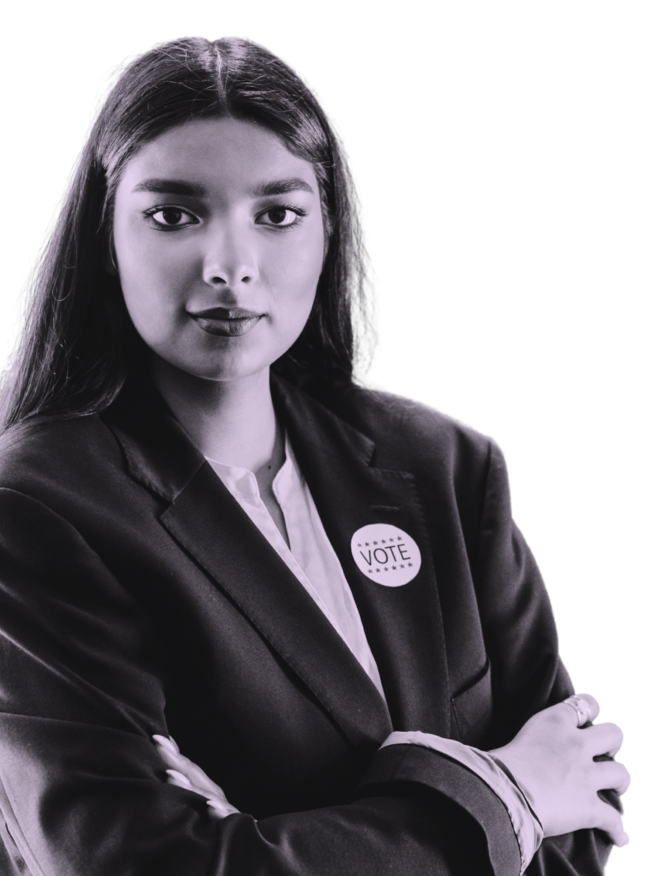

#
InspireChange
ELECTION 2024
“
For the youth, by the youth.
“
EMMA
NEUMAN
FOR CITY MAYOR
LEARN MORE:
elections2024.com

Slide 3


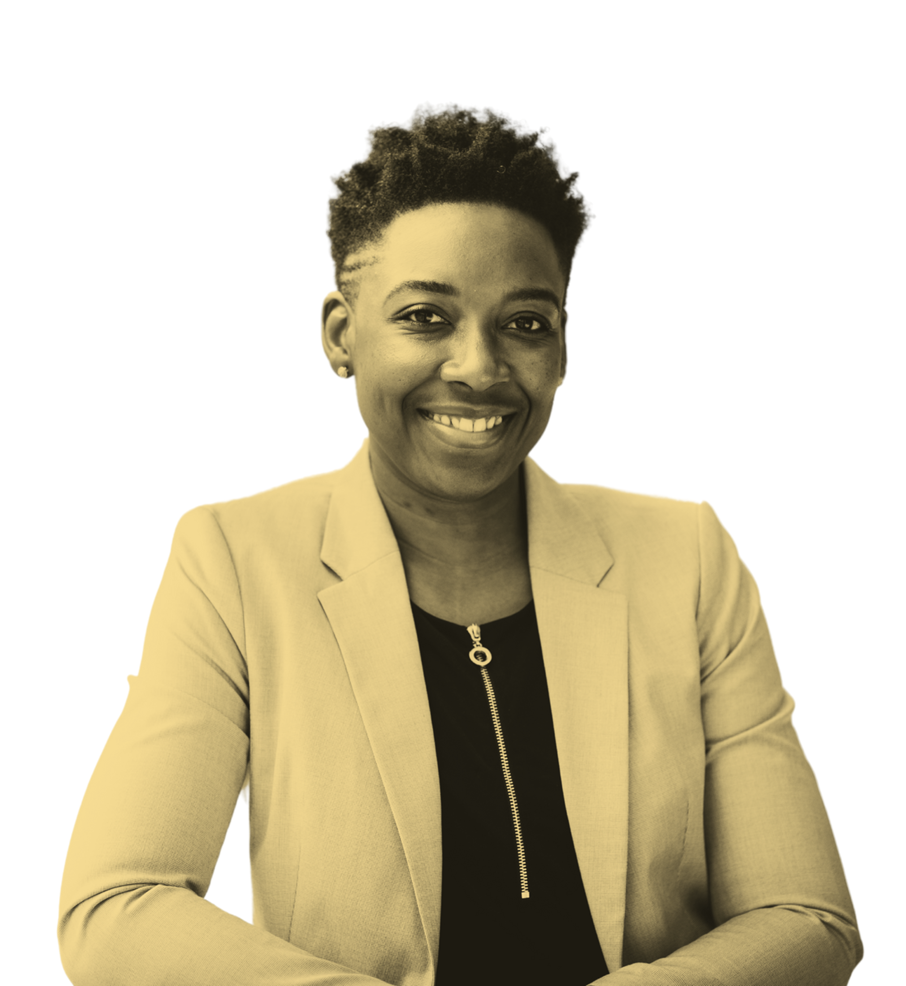




SOPHIA
TURNER
FOR CITY COUNCIL MEMBER
VOTE FOR CHANGE
VOTE FOR HOPE
ELECTION
2024

Slide 4






RESOURCE PAGE
  Use these design resources in your Canva Presentation.
FONTS
COLORS
This presentation template
uses the following free fonts:
TITLES AND BODY COPY:
#280742
#2C2A5D
#D7D7F1
STAATLICHES
OSWALD
MONTSERRAT
BD0864
#602058
#6767B4
Tangerine
ALEO
You can find these fonts online too.
#FF3156
#ED7843
#EFCC61
  Design Elements

Slide 5


CREDITS
This design template is free for
  everyone to use thanks to the following:
  for the presentation template
Pexels, Pixabay
  for the photos
  Happy Designing!

