Slide 1





ELECTRICAL
HAZARDS
Comprehensive analysis and mitigation strategies for electrical hazards in Industrial and residential settings: Ensuring safety through prevention and preparedness.
SLIDES

Slide 2


TABLE OF CONTENTS
01.
02.
03.
Introduction
OUR PROJECTS
ABOUT US
Elaborate on what you want to discuss.
Elaborate on what you want to discuss.
Elaborate on what you want to discuss.

Slide 3



INTRODUCTION
To the world of literature, where words come alive and stories unfold in the most enchanting ways. Here, imagination knows no bounds, and every page turned is a gateway to new experiences, emotions, and perspectives.
Whether you are a seasoned reader or just beginning your literary journey, the magic of books awaits you, ready to transport you to distant lands, introduce you to unforgettable characters, and ignite your passion for the written word. Dive in, and let the adventure begin!From the dusty shelves of ancient libraries to the sleek screens of modern e-readers, literature has the power to connect us across time and space.

Slide 4

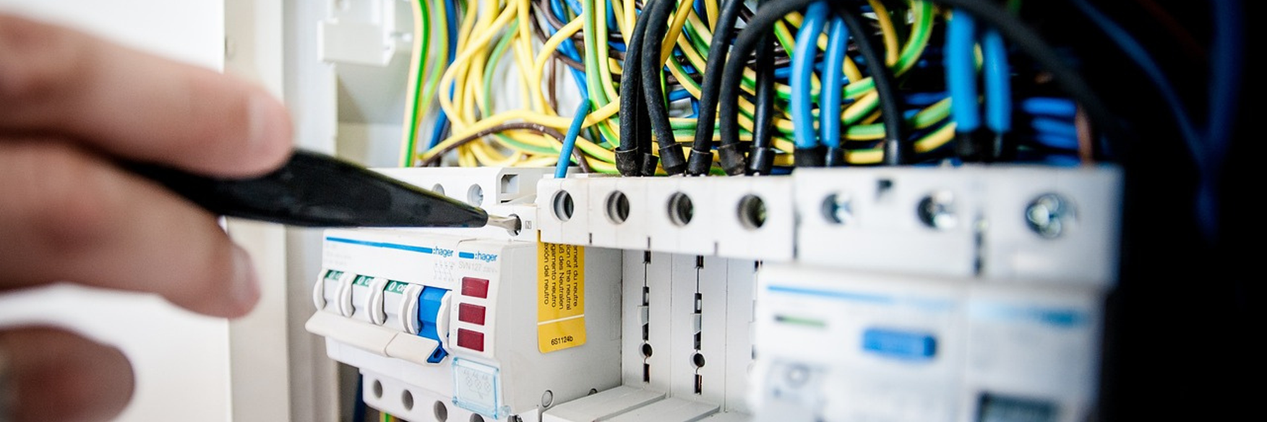

WELCOME TO PRESENTATION
I'm Rain, and I'll be sharing with you my beautiful ideas. Follow me at @reallygreatsite to learn more.

Slide 5




OUR COMPANY
WHO WE ARE?
WHAT WE DO?
Briefly elaborate on what you want to discuss.
Briefly elaborate on what you want to discuss.

Slide 6




MISSION
VISION
In pursuit of our mission, we strive to inspire and empower individuals to reach their full potential. We believe in fostering a community where diversity is celebrated, and inclusivity is the cornerstone efforts.
Vision is like a guiding light that illuminates our path towards our dreams and aspirations. It is the powerful force that propels us forward, inspiring us to reach for the stars and achieve our full potential.

Slide 7


OUR PROJECTS
At our core, we are driven by a passion for innovation and a commitment to excellence in all that we do. Our projects embody our dedication to creating impactful solutions that make a difference in the world. From groundbreaking technological advancements to community-driven initiatives, each project we undertake is a testament to our belief in the power of creativity and collaboration.
We strive to push the boundaries of what is possible, constantly seeking new ways to address challenges and improve lives. Our diverse portfolio reflects our unwavering determination to tackle complex problems with fresh perspectives and unwavering dedication. With each new project, we embrace the opportunity to learn, grow, and make a positive impact on the world around us.

Slide 8





WHAT WE OFFER
SERVICE ONE
SERVICE TWO
Elaborate on what you want to discuss.
Elaborate on what you want to discuss.
SERVICE THREE
SERVICE FOUR
Elaborate on what you want to discuss.
Elaborate on what you want to discuss.

Slide 9

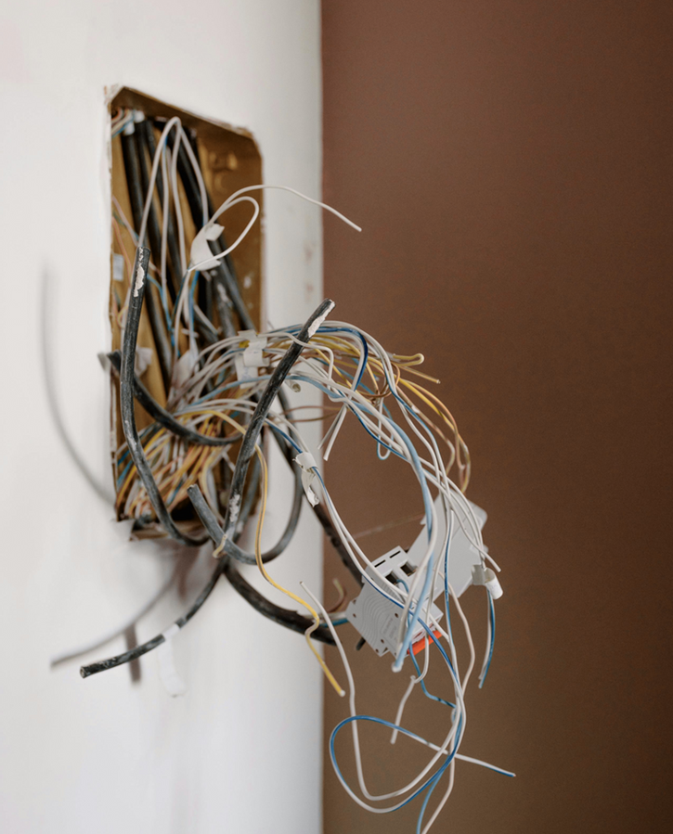


GALLERY IMAGE
What can you say about your projects? Share it here!

Slide 10



MARKET RESEARCH
Elaborate on the featured statistic.
Elaborate on the featured statistic.
Elaborate on the featured statistic.
Elaborate on the featured statistic.

Slide 11

S
O
W
T
STRENGTHS
OPPORTUNITIES
  What are you doing well?
  What sets you apart? What are your good qualities?
  What are your goals?
  Are demands shifting? How can it be improved?
WEAKNESSES
THREATS
  Where do you need to improve?
  Are resources adequate? What do others do better than you?
  What are the blockers you're facing?
  What are factors outside of your control?

Slide 12




TESTIMONIALS
CLIENT NAME
CLIENT NAME
CLIENT NAME
Elaborate on what you want to discuss.
Elaborate on what you want to discuss.
Elaborate on what you want to discuss.

Slide 13


ABOUT US
We are a team of passionate individuals dedicated to providing exceptional service and creating memorable experiences for our clients. With a commitment to excellence and a focus on innovation, we strive to exceed expectations and deliver top-notch results. Our goal is to build lasting relationships with our clients and make a positive impact in everything we do. Thank you for choosing us to be a part of your journey.

Slide 14

OUR History
Is a rich tapestry woven with the threads of countless stories, triumphs, and challenges. From ancient civilizations that built wonders like the pyramids and the Great Wall, to the Renaissance that sparked a new era of art and science, every chapter has contributed to the world we know today.
Our history is also marked by the resilience and ingenuity of people who have overcome adversity to make significant strides in human rights, technology, and culture. It’s a chronicle of explorers who ventured into the unknown, thinkers who revolutionized our.

Slide 15



OUR History
ADD A MAIN POINT
ADD A MAIN POINT
ADD A MAIN POINT
Elaborate on what you want to discuss.
Elaborate on what you want to discuss.
Elaborate on what you want to discuss.

Slide 16


A PICTURE IS WORTH A THOUSAND WORDS

Slide 17

WRITE AN ORIGINAL STATEMENT OR INSPIRING QUOTE
— Include a credit, citation, or supporting message

Slide 18

CONTACT US
123 Anywhere St., Any City,ST 12345
123-456-7890
hello@reallygreatsite.com
@reallygreatsite
reallygreatsite.com

Slide 19

RESOURCE
PAGE
Use these design resources in your Canva Presentation.
You can find these fonts online too. Happy designing!
Don't forget to delete this page before presenting.
This presentation template uses the following free fonts:
  Titles: Archivo Black
  Headers: Archivo Black
  Body Copy: Open Sans

Slide 20



CREDITS
This presentation template is free for everyone to use thanks to the following:
SlidesCarnival for the presentation template
Pexels for the photos
Happy designing!

