Slide 1

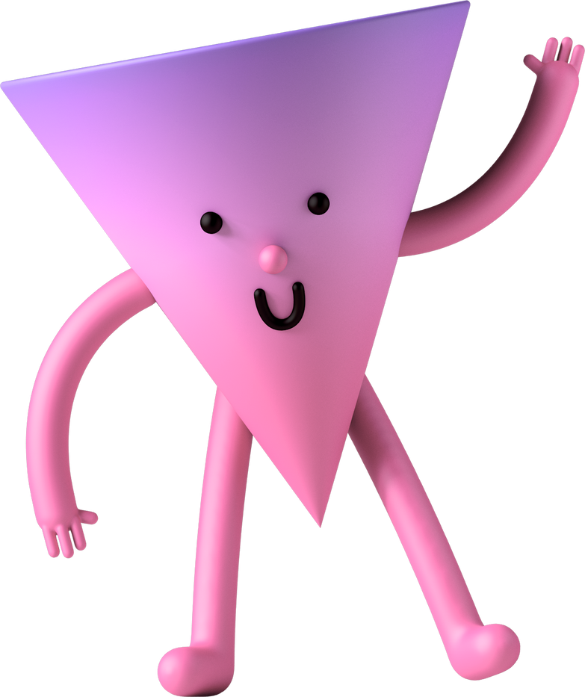
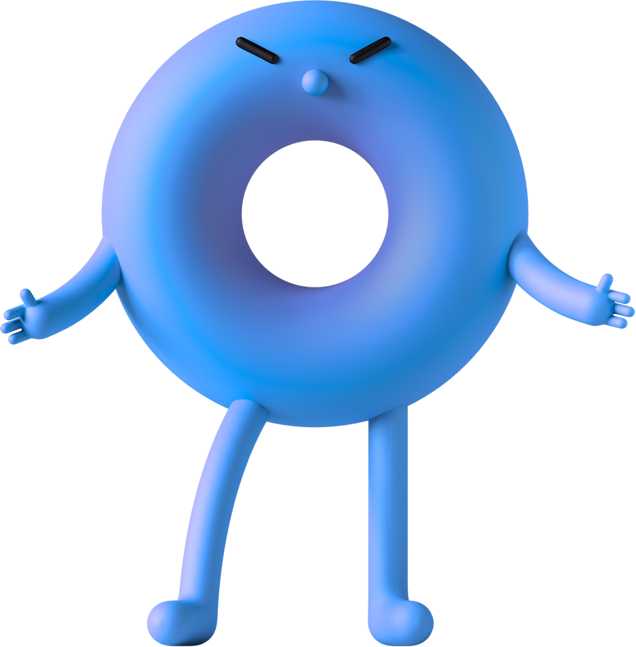

GRADE 1
What are nouns?
Spotting common naming words

Slide 2

Today, you’ll...
Learn what a noun is
Name some examples of nouns
Find nouns in sentences

Slide 3
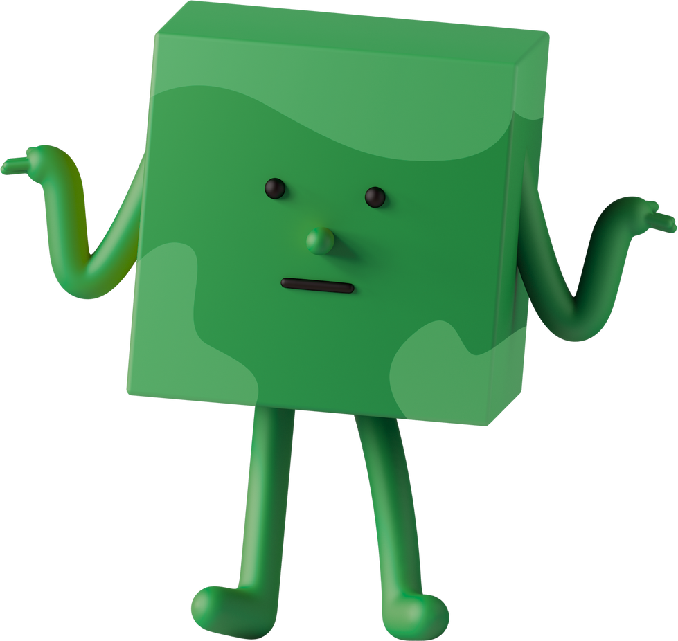
What is a ?
noun
A noun names a person, animal, place, or thing

Slide 4
Let’s explore
nouns

Slide 5

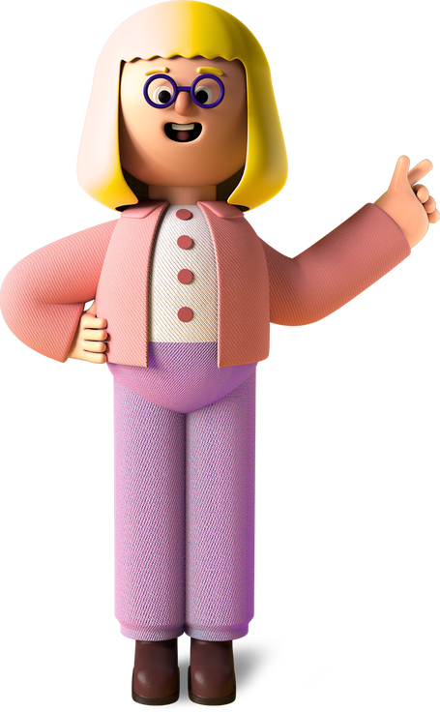
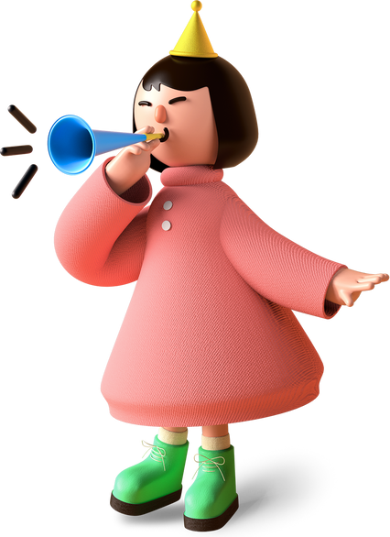
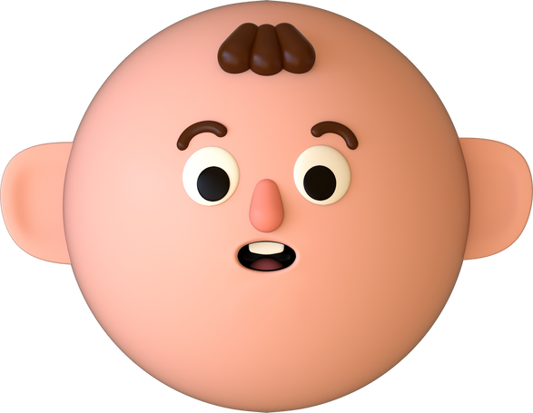

Person
teacher
sister
baby

Slide 6

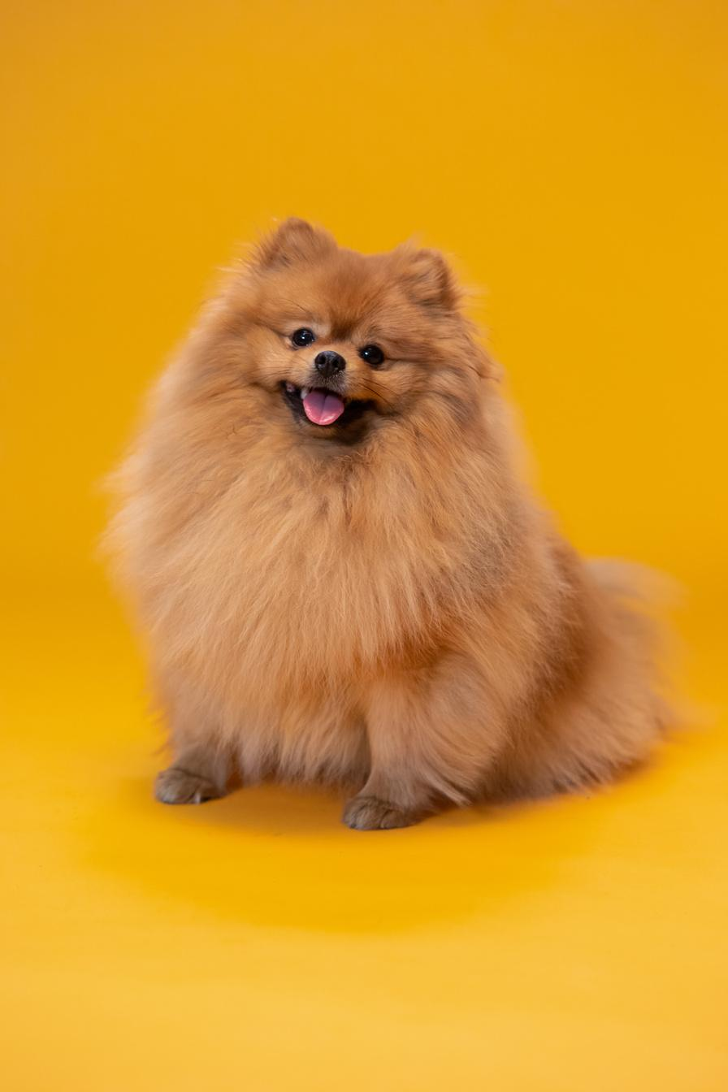
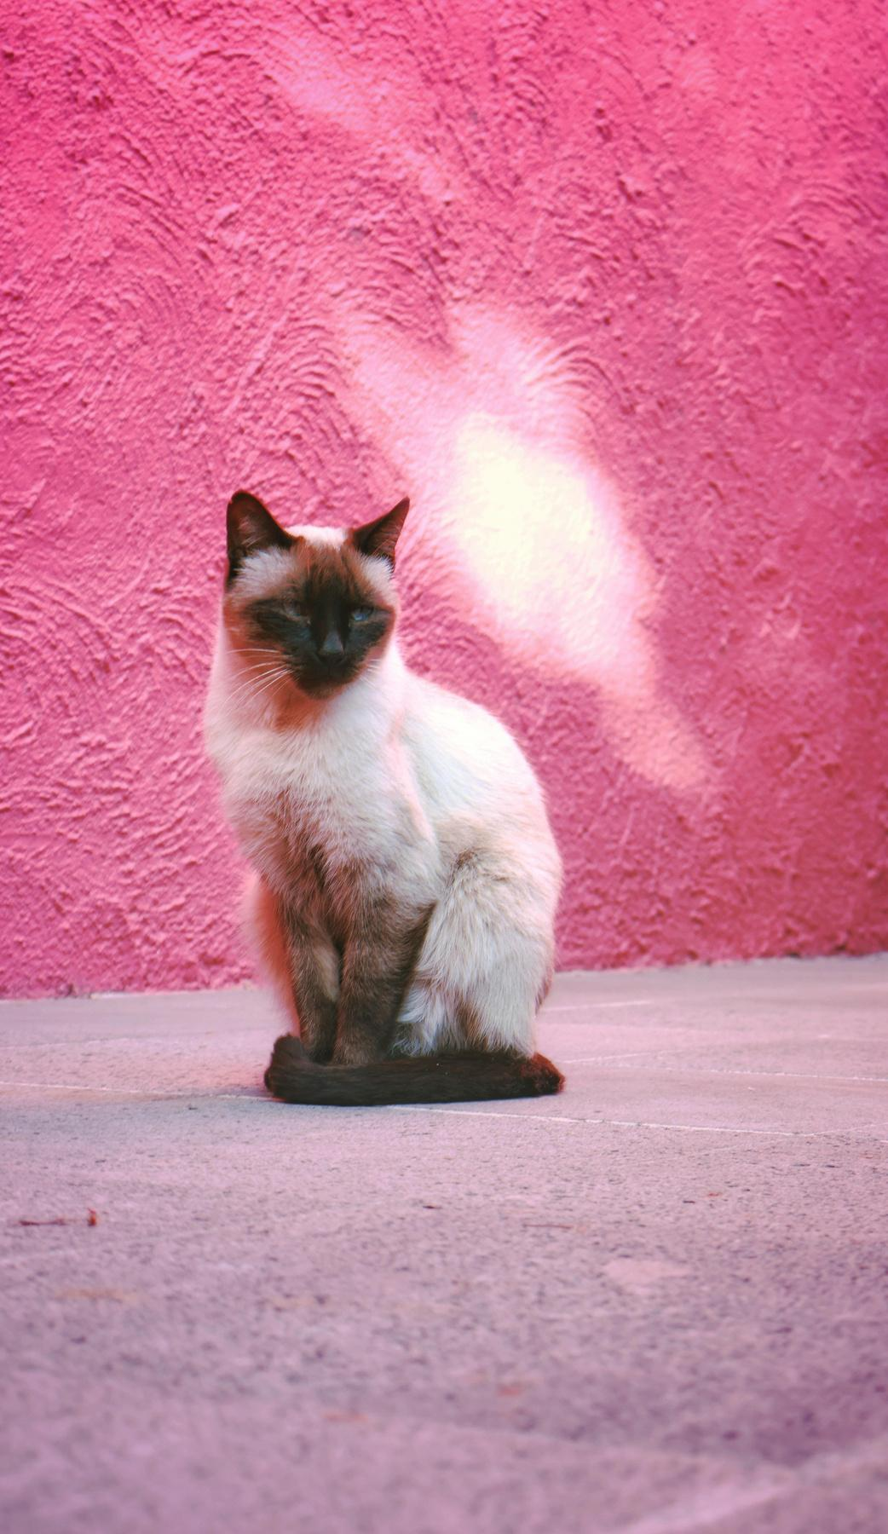
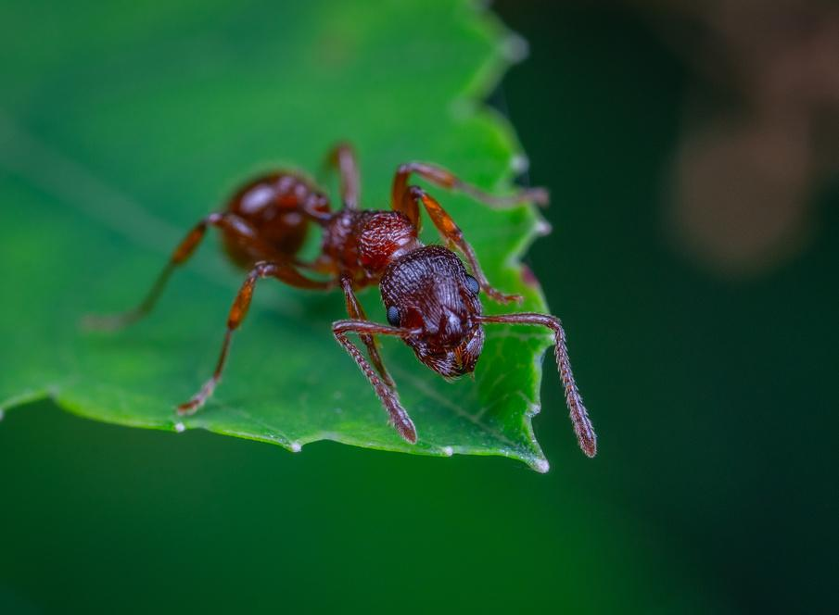

Animals
dog
ant
cat

Slide 7


Find the noun
the
sometimes
coin
Is the noun a person, animal, place, or thing?

Slide 8

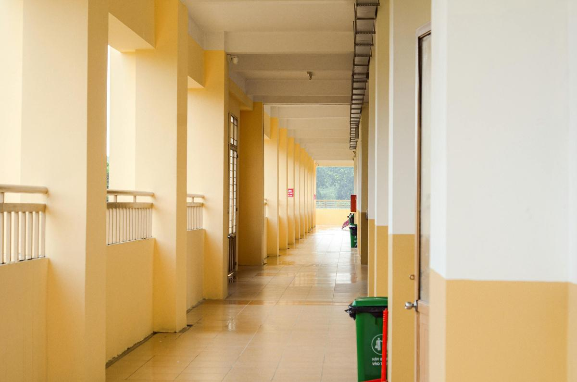
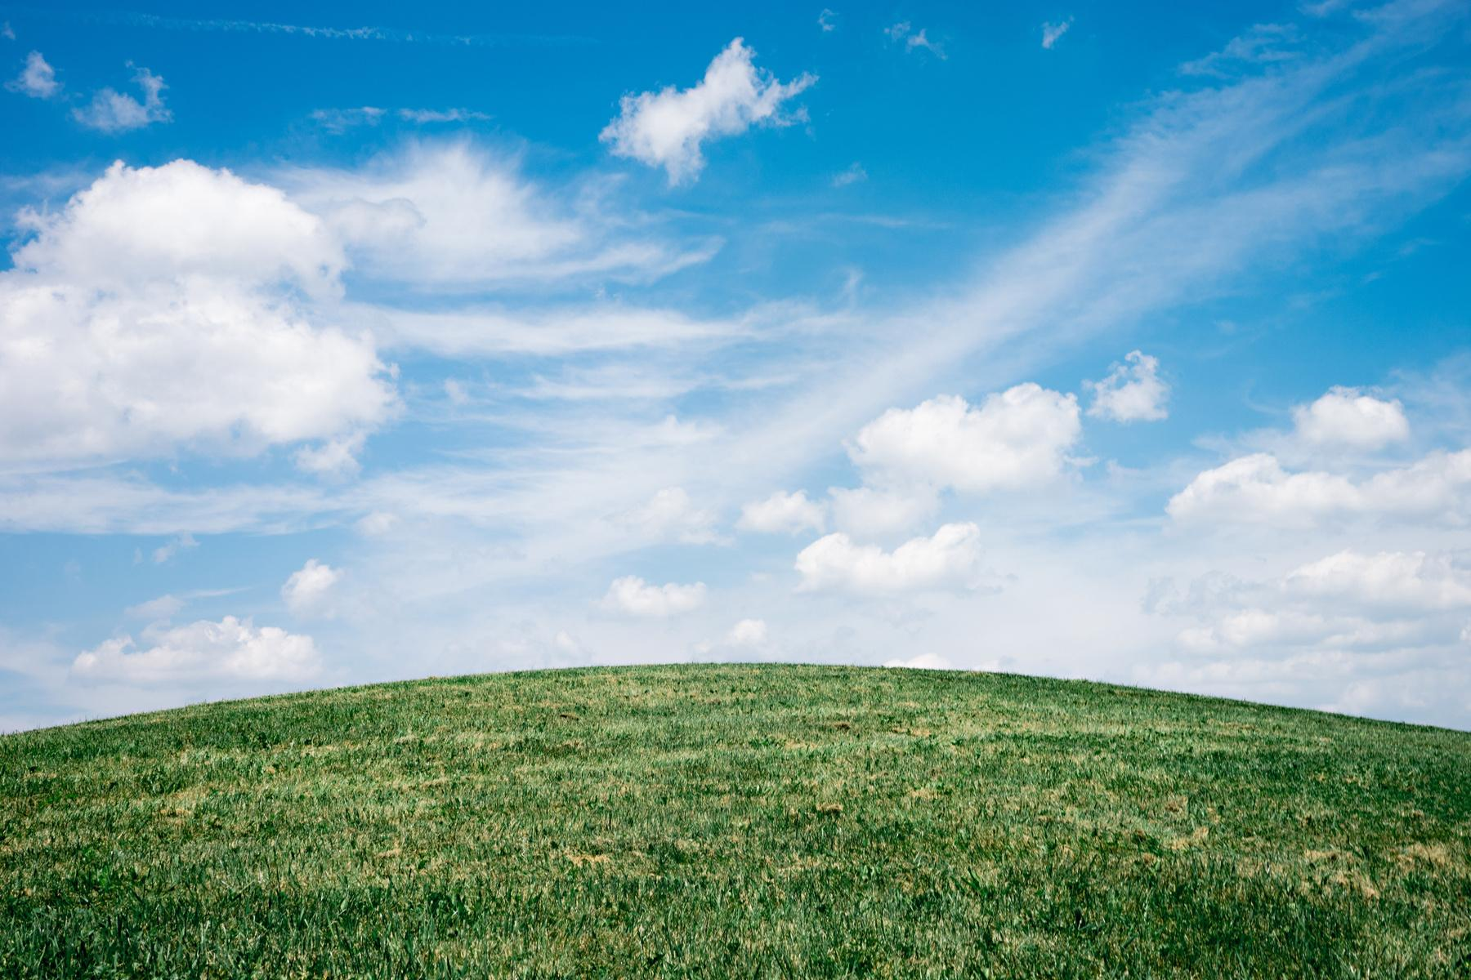
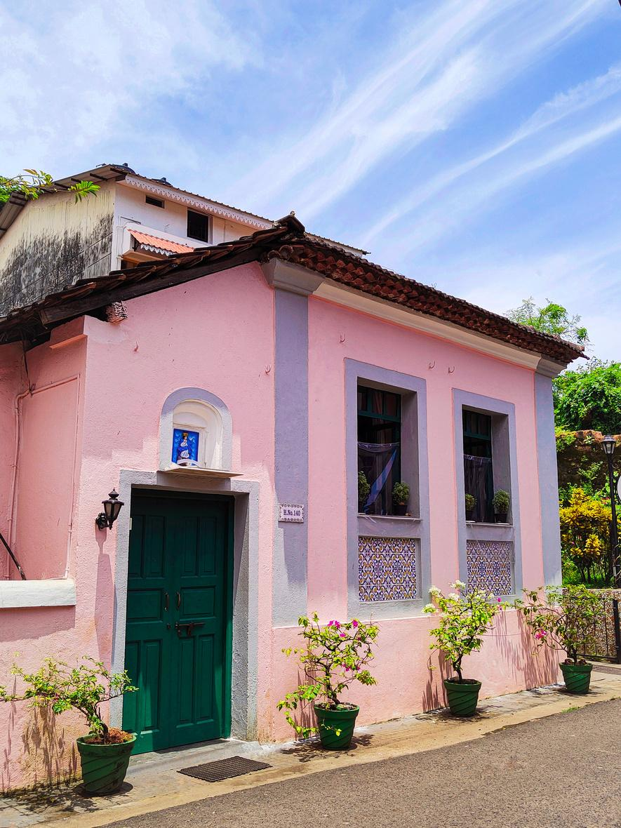

Places
school
house
field

Slide 9

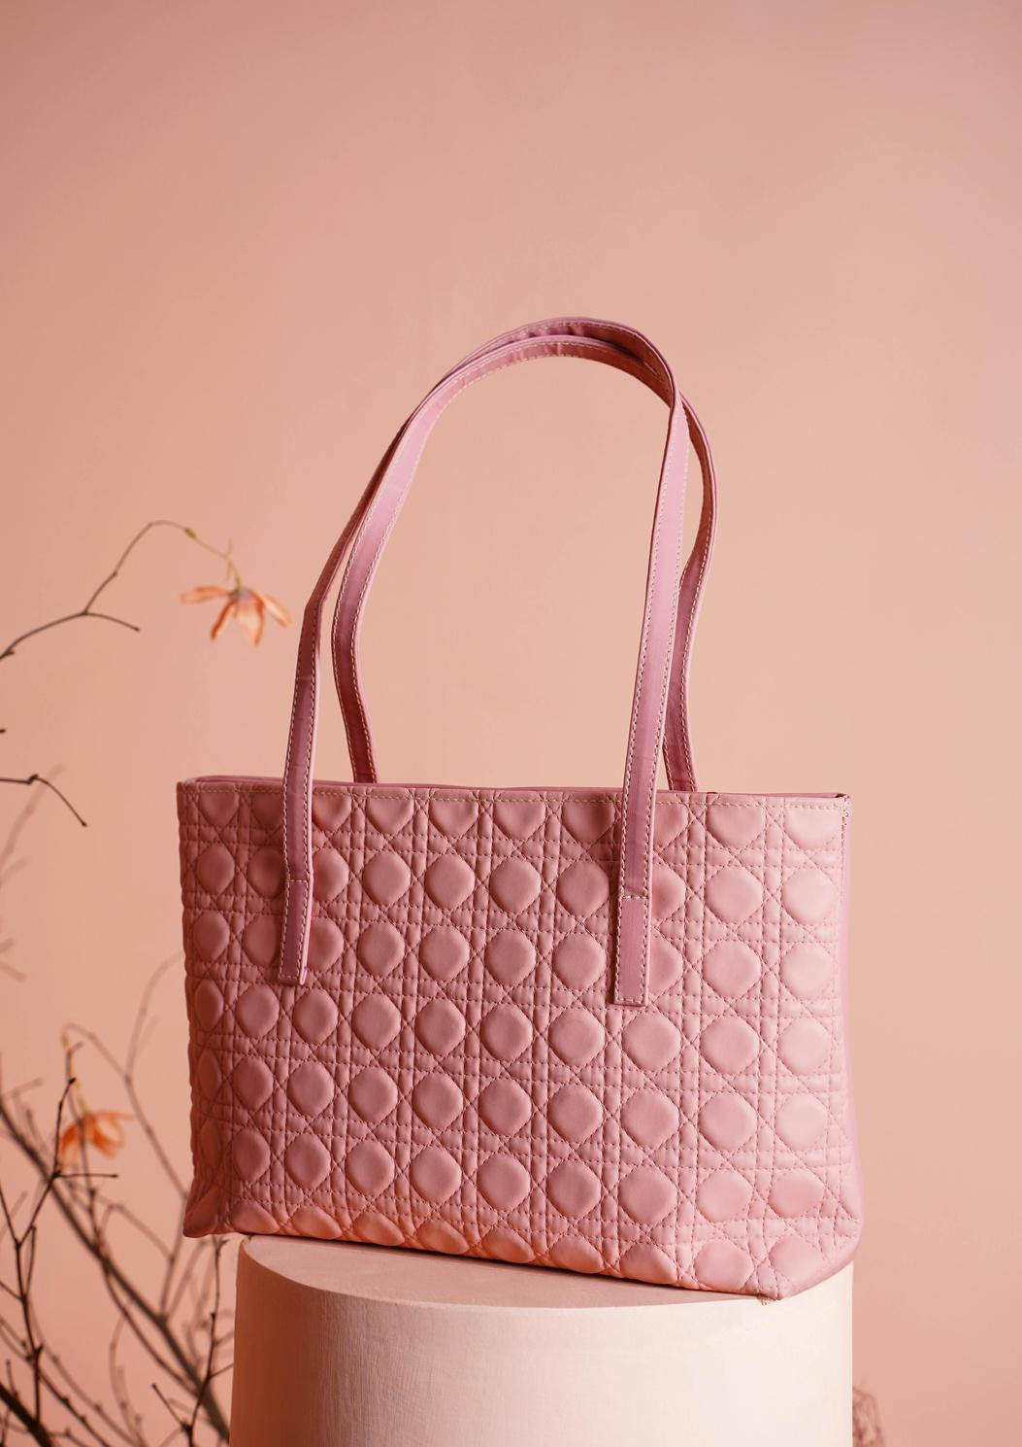
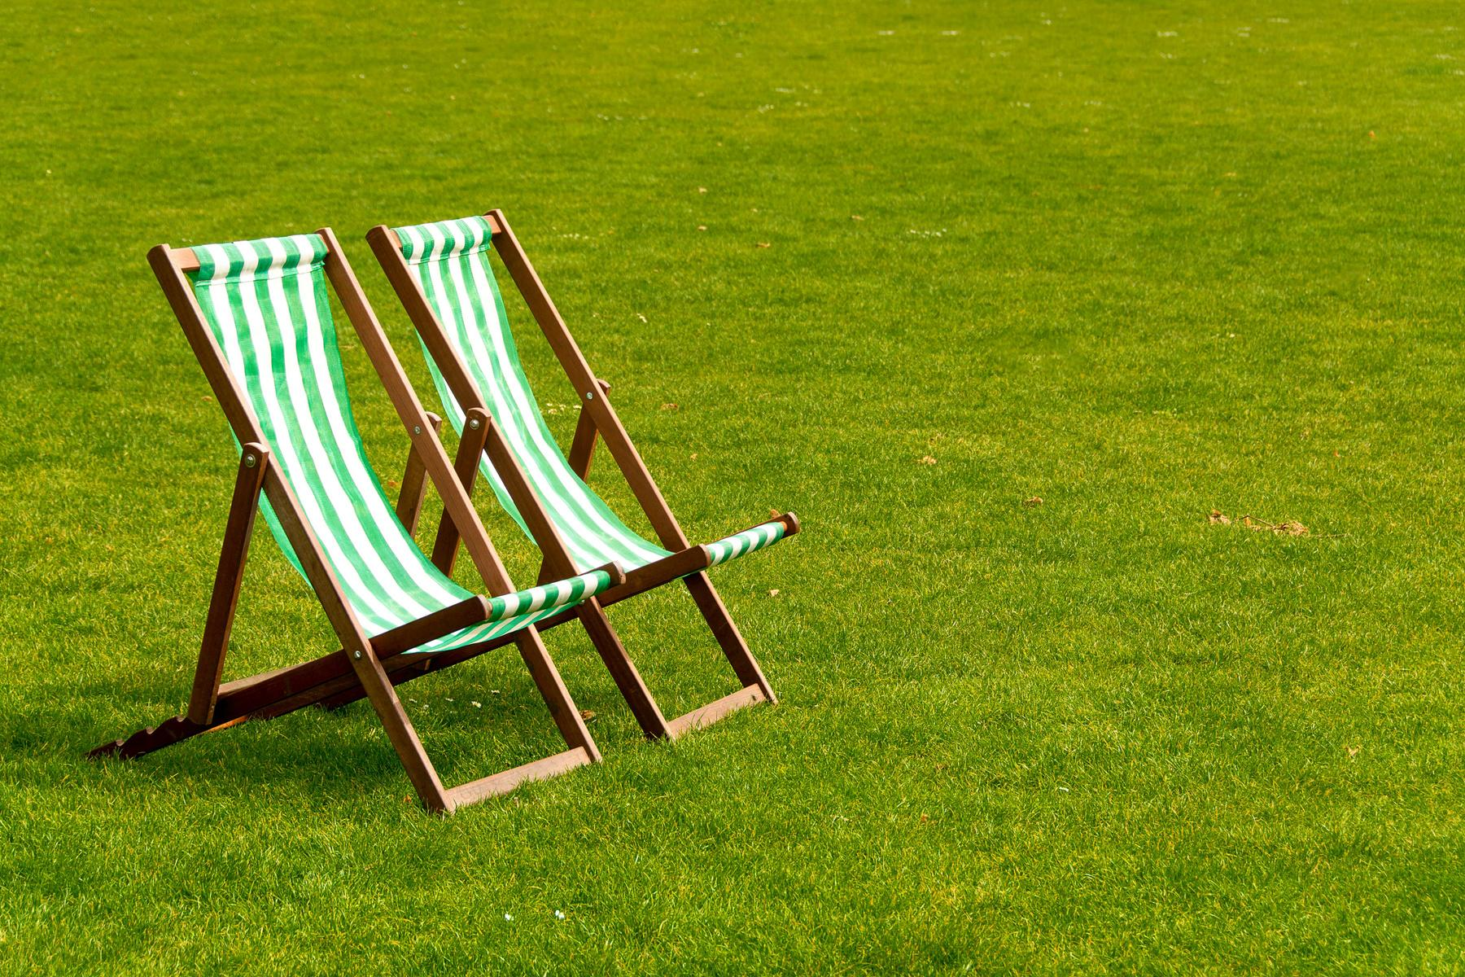
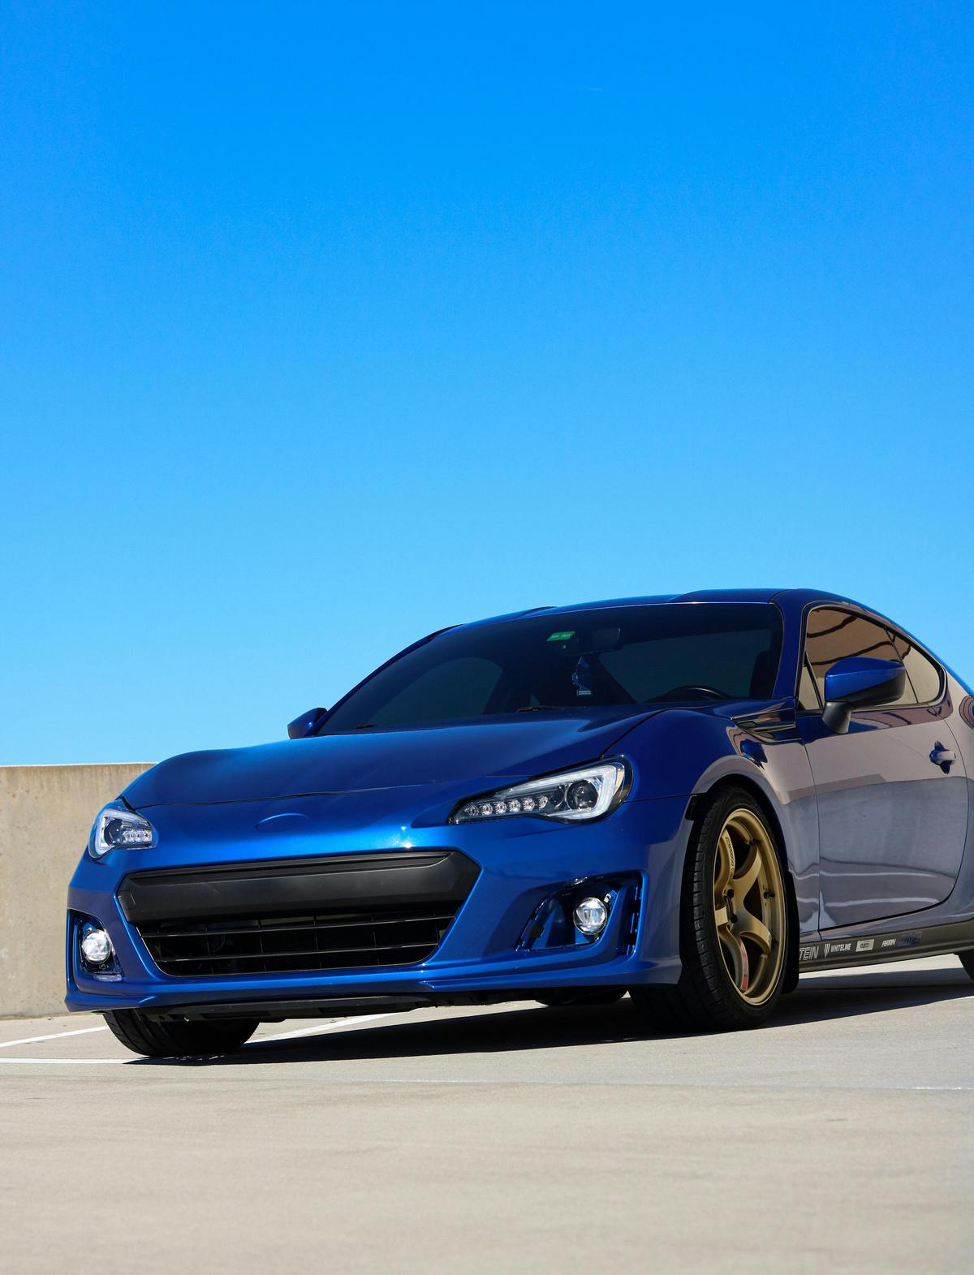

Things
bag
car
chair

Slide 10

Are you
ready to spot
those ?
nouns

Slide 11

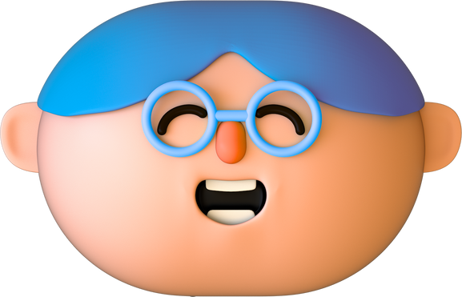

Find the noun
boy
up
how
Is the noun a person, animal, place, or thing?

Slide 12

Find the noun in the sentence
The sun shines in the sky.
Is the noun a person, animal, place, or thing?

Slide 13

Find the noun in the sentence
I opened the gift.
Is the noun a person, animal, place, or thing?

Slide 14

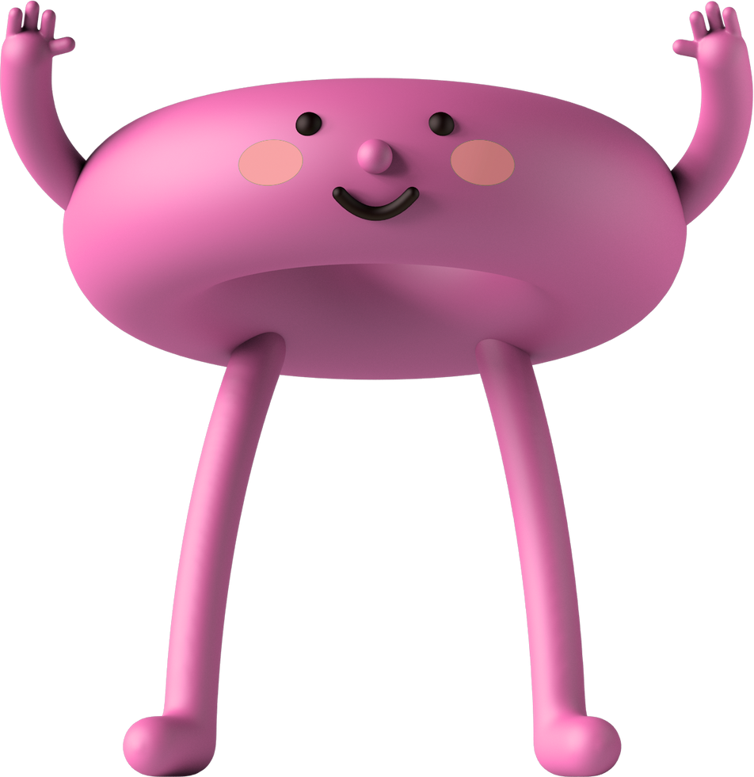
You did it!
You’re officially a
noun expert

Slide 15
Resource Page
Use these in your presentation. Delete or hide this page before presenting.
Fonts
Design Elements / Icons
This presentation template
uses the following free fonts:
TITLES:
Cabin SemiBold
BODY TEXT:
Cabin Regular
You can find these fonts online too.
Colors
#0586E5
#09AB47
#F8BC02
#FE8BC2
#0F1A38

Slide 16



Credits
  This presentation template is free for everyone to use, thanks to the following:
Pexels, Pixabay, Sketchify
  for this presentation template
  for the photos, graphics, and elements

