Slide 1






MODAL VERBS & ADJECTIVE ORDER
express meanings with can, may, and must

Slide 2

HOW TO USE THIS PRESENTATION
GoogleSlides
PowerPoint
Canva
Click on the "Google Slides" button below this presentation preview. Make sure to sign in to your Google account. Click on "Make a copy." Start editing your presentation.
Alternative: Click on the "Share" button on the top right corner in Canva and click on "More" at the bottom of the menu. Enter "Google Drive" in the search bar and click on the GDrive icon to add this design as a Google slide in your GDrive.
Click on the "PowerPoint" button below this presentation preview. Start editing your presentation.
Alternative: From Canva template file, Click on the "Share" button on the top right corner in Canva and click on "More" at the bottom of the menu. Enter "PowerPoint" in the search bar and click on the PowerPoint icon to download.
Click on the "Canva" button under this presentation preview. Start editing your presentation. You need to sign in to your Canva account.

Slide 3

What are modals?
LESSON OUTLINE
Modal: Can
Modal: May
Modal: Must
Let’s practice using modals

Slide 4



GUESS THE OCCUPATION!
  You must take care of students.
  You mustn’t be late for class.
  You may read and write a lot.
  You can treat injuries.
  You may work in the morning or at night.
  You must take care of the patients.

Slide 5



GUESS THE OCCUPATION!
  You must take care of students.
  You mustn’t be late for class.
  You may read and write a lot.
  You can treat injuries.
  You may work in the morning or at night.
  You must take care of the patients.

Slide 6




Can you describe other occupations
using the following prompts?
You must ...
You can ...
You may ...

Slide 7


MODALS
The words "can," must," and "may" are common auxiliary verbs
used to express a speaker's attitudes and opinions that include:
permission
possibility or impossibility
necessity or lack of
ability or inability
desire
obligation or lack of
Auxiliary verbs are also called helping verbs.
They are always paired with another verb.

Slide 8



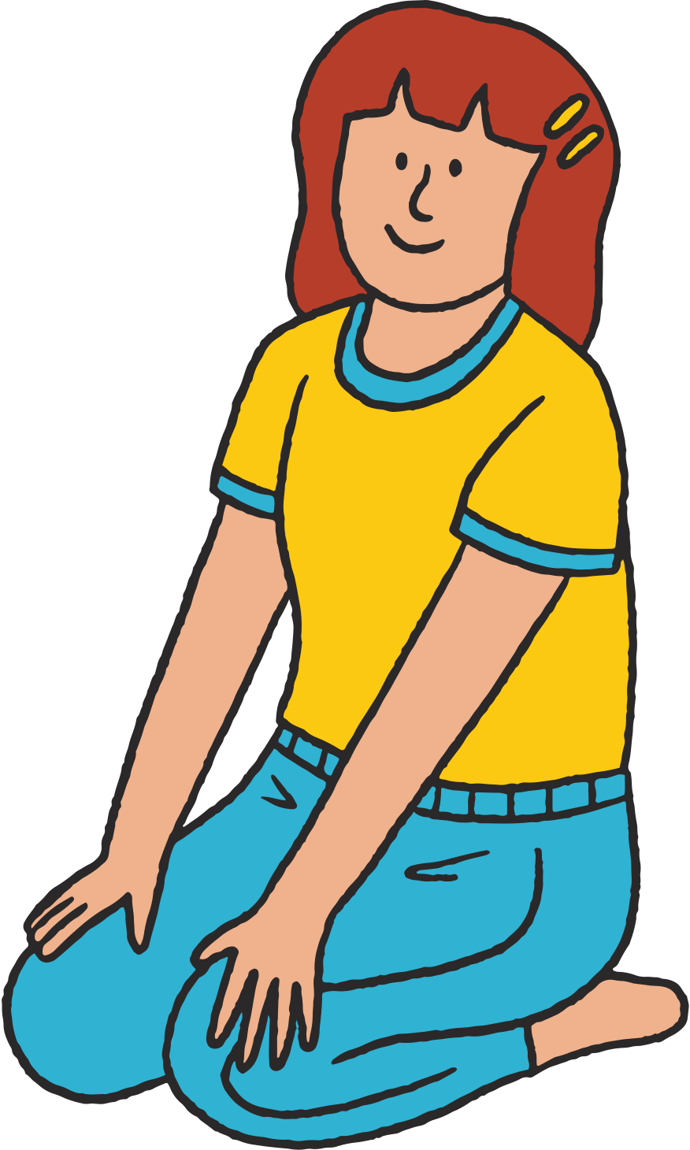

What do all modal verbs have in common?

Slide 9


1
What do all modal verbs have in common?
Modal verbs don’t add -s for the third-person singular, so the form is always the same.
She can swim.

Slide 10


2
What do all modal verbs have in common?
The question form is created by
inverting the subject and the verb.
Can you dive?

Slide 11



3
What do all modal verbs have in common?
We make the negative form
by adding “not.”
They must not swim at the lake.

Slide 12

4
What do all modal verbs have in common?
They are followed by a verb without “not.”
They must bring their own tent at the camping site.

Slide 13




CAN
Ability/Inability
Permission
Possibility
I can speak
different languages.
Can I borrow
a dictionary?
Anyone can
become multilingual.

Slide 14




MAY
Possibility
Permission
Possibility
She may be at home.
May I take a break?
May I have some coffee?

Slide 15




MUST
Obligation
Possibility
Prohibition
You must get the driver's license before I buy you a car.
They must be at home; their car is parked at the garage.
You mu﻿st not drive fast.

Slide 16


TYPES OF MODALS
Ability
Possibility
Request
I can pay you next week.
Could you pass me the salt?
She can't be his daughter.
My wallet is gone! Someone must have stolen it.
Permission
Obligation
Can I sit down?
I may see you tomorrow.
You must see a doctor.
May I go after dinner?

Slide 17





EXERCISE

Slide 18
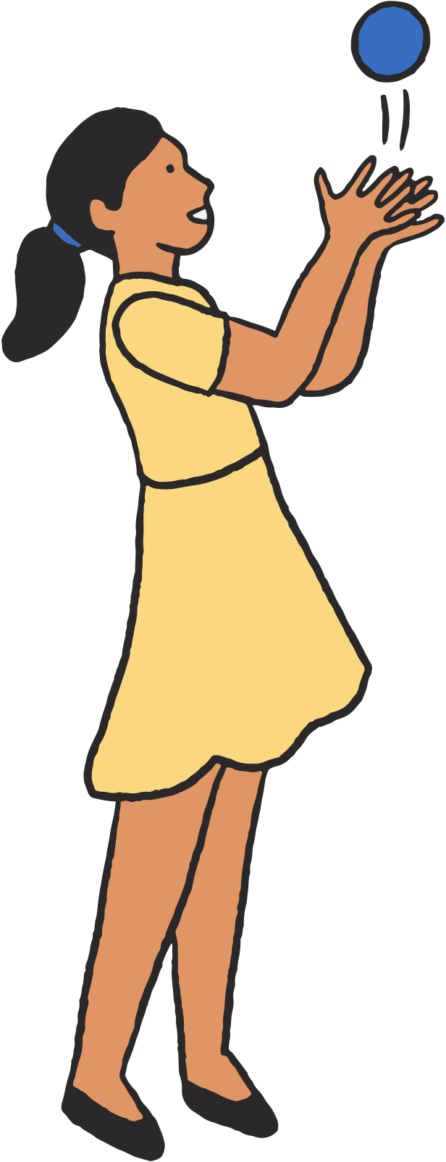

LET'S PRACTICE
Identify the modal used in each sentence and its corresponding function.
Ability
Permission
Possibility
Request
Obligation
Alden can't play the piano today.
He must be sick.
You must take your medicine.
Can I watch tv to relax?
Could you buy me some milk at the store?

Slide 19

LET'S PRACTICE
Identify the modal used in each sentence and its corresponding function.
Ability
Permission
Possibility
Request
Obligation
  Alden can't play the piano today.
  He must be sick.
  You must take your medicine.
  Can I watch tv to relax?
  Could you buy me some milk at the store?
Ability
Possibility
Obligation
Permission
Request

Slide 20
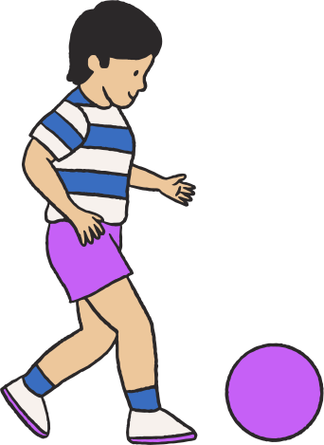

LET'S TRY THIS
Switch the modals between the following sentences. How will the meaning change?
The device not be used underwater.
must
Hugo's cat be hiding under the bed.
may
She cook flavorful meals.
can

Slide 21


LET'S TRY THIS
Switch the modals between the following sentences. How will the meaning change?
The device not be used underwater.
must
This reminder sounds less strict than when "must" was used.
Hugo's cat be hiding under the bed.
may
It seems more certain that the cat is under the bed.
She cook flavorful meals.
can
Good cooking becomes a requirement for the person.

Slide 22



SUMMARY
as helping verbs, modals do not take the -s form and are always paired with the base form of the main verb
modals express different meanings such as: ability, possibility, permission, and obligation
common examples of modals are: must,
can, may

Slide 23







SIGNS & SYMBOLS
Look around and take pictures of the signs you see in school, at
home, or in your neighborhood. Describe those signs using modals.
(For example, "You can't enter here.")

Slide 24





THANK YOU!
  Write a closing statement or call-to-action here.

Slide 25









Resource
Page
Use these design resources
in your Canva Presentation.
This presentation template
uses the following free fonts:
Titles: Dosis
Headers: Dosis
Body Copy: Dosis
You can find these fonts
online too. Happy designing!
Don't forget to delete this
page before presenting.

Slide 26










Slide 27



CREDITS
This presentation template is free
for everyone to use thanks to the following:
SlidesCarnival for the presentation template
Canva Creative Studio for the lesson plan
Pexels for the photos
HAPPY DESIGNING!

