Slide 1


SYNONYMS,
ANTONYMS
Understanding Word Relationships
ANALOGIES

Slide 2

HOW TO USE THIS PRESENTATION
GoogleSlides
PowerPoint
Canva
Click on the "Google Slides" button below this presentation preview. Make sure to sign in to your Google account. Click on "Make a copy." Start editing your presentation.
Alternative: Click on the "Share" button on the top right corner in Canva and click on "More" at the bottom of the menu. Enter "Google Drive" in the search bar and click on the GDrive icon to add this design as a Google slide in your GDrive.
Click on the "PowerPoint" button below this presentation preview. Start editing your presentation.
Alternative: From Canva template file, Click on the "Share" button on the top right corner in Canva and click on "More" at the bottom of the menu. Enter "PowerPoint" in the search bar and click on the PowerPoint icon to download.
Click on the "Canva" button under this presentation preview. Start editing your presentation. You need to sign in to your Canva account.

Slide 3

Food Web and Words
Word Relationships: Synonym, Antonym, & Analogy
Food Web and Words
Group Activity
LESSON OUTLINE
Analogy Word Match
Summary

Slide 4
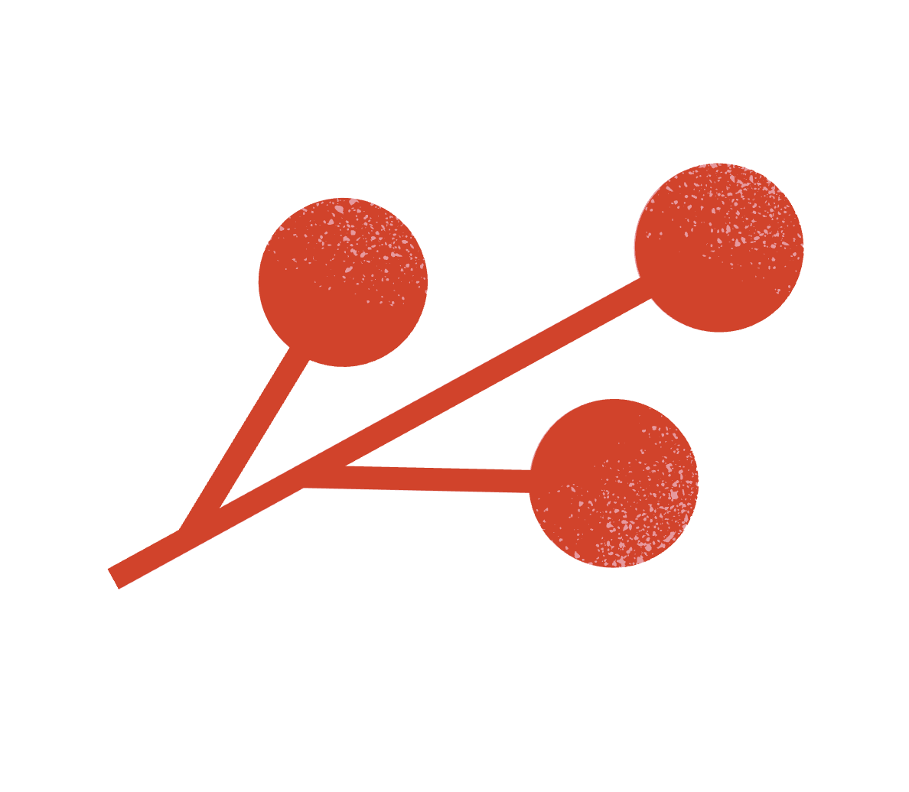

TODAY YOU WILL BE LEARNING:
How to use the relationship between particular words, such as synonyms and antonyms or analogies, to better understand each of the words.
LEARNING OUTCOMES

Slide 5


WORD RELATIONSHIPS
SYNONYM
It is a word having the same or nearly the same meaning as another word.
For example: happy, joyful, and elated are all synonyms

Slide 6


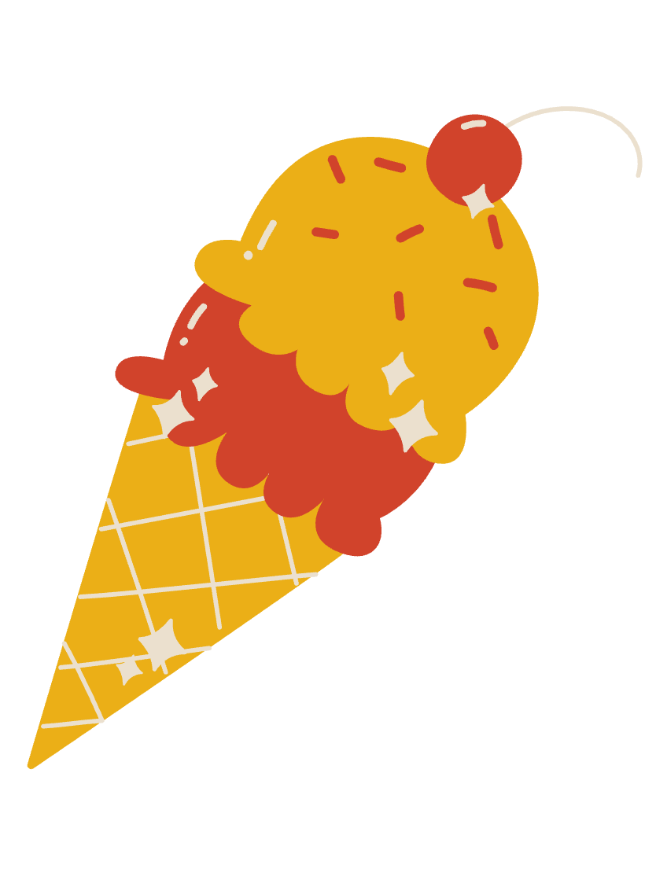
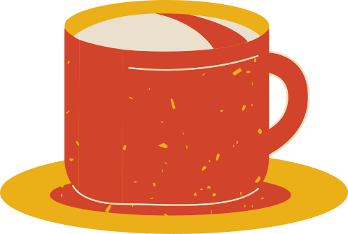
WORD RELATIONSHIPS
ANTONYM
They are two words
with opposite meanings.
For example: cold and hot are antonyms

Slide 7


WORD RELATIONSHIPS
ANALOGY
a similarity between like features of two things, on which a comparison may be based.
For example: both heart and water pump help move liquids, so they can be paired in an analogy

Slide 8
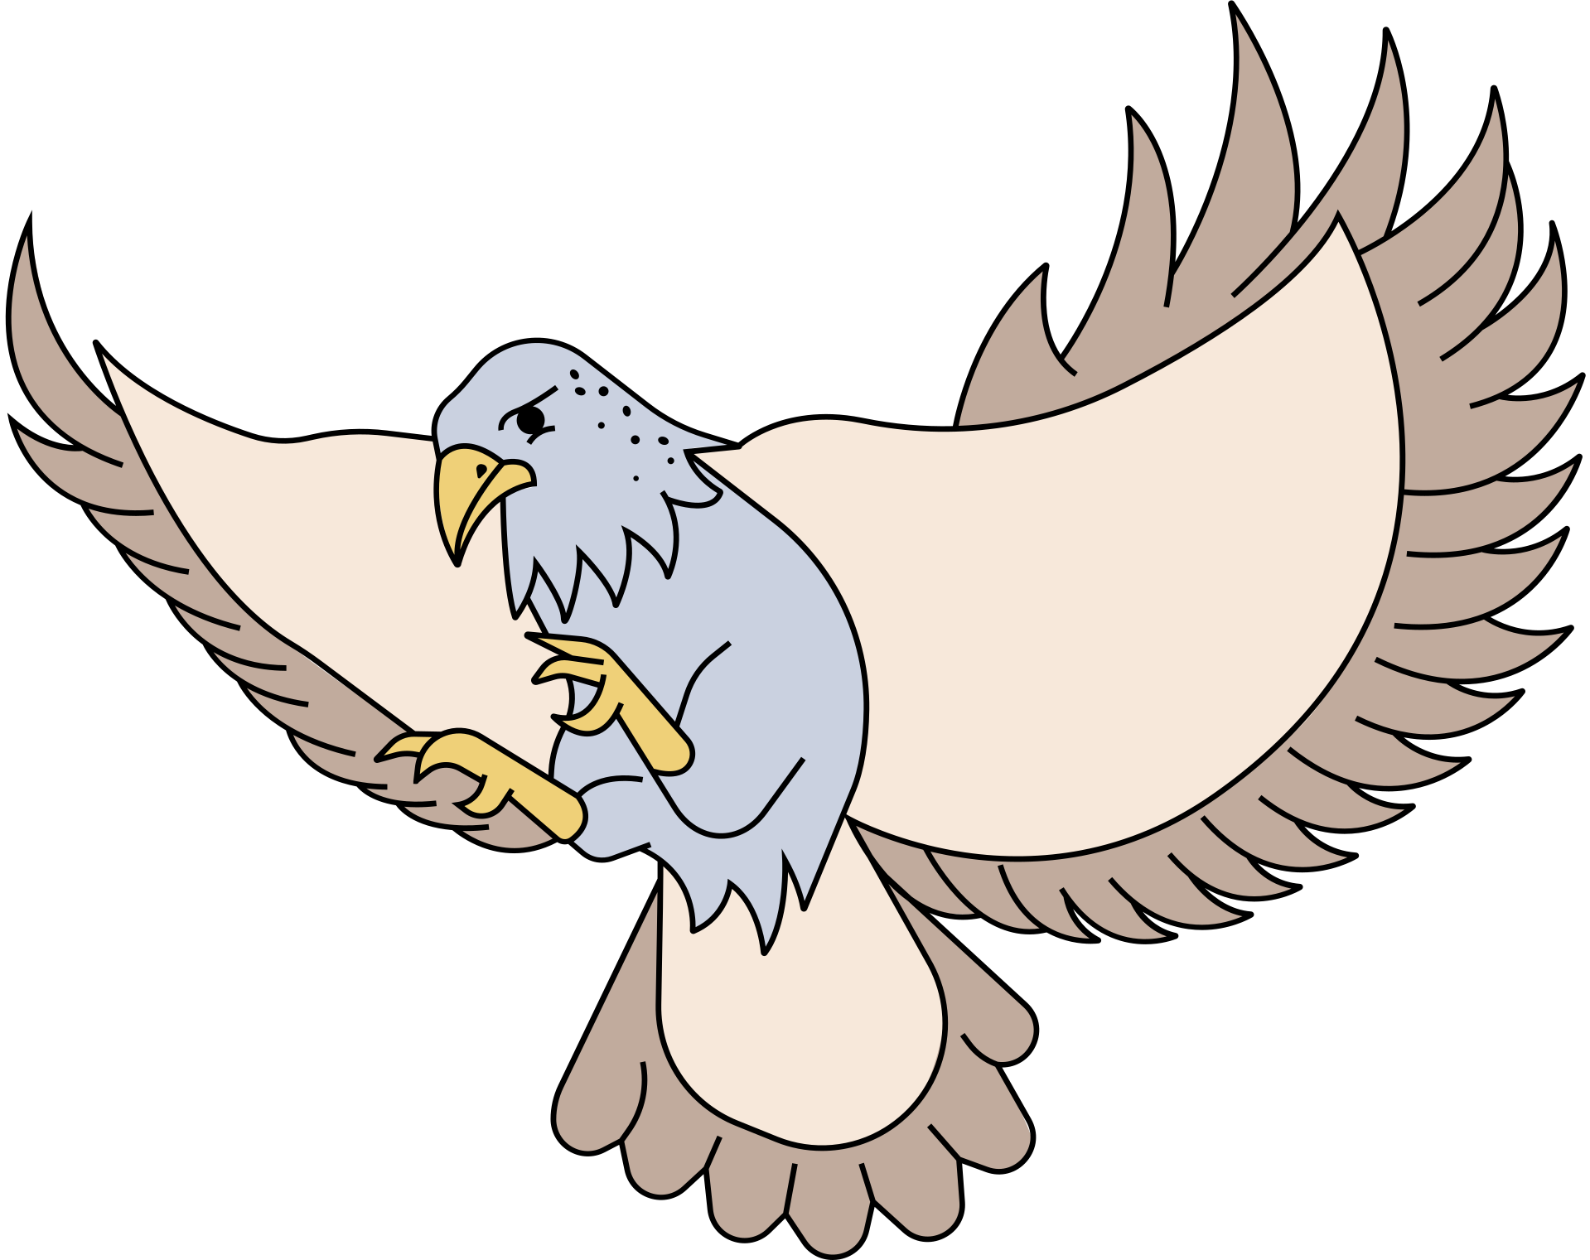

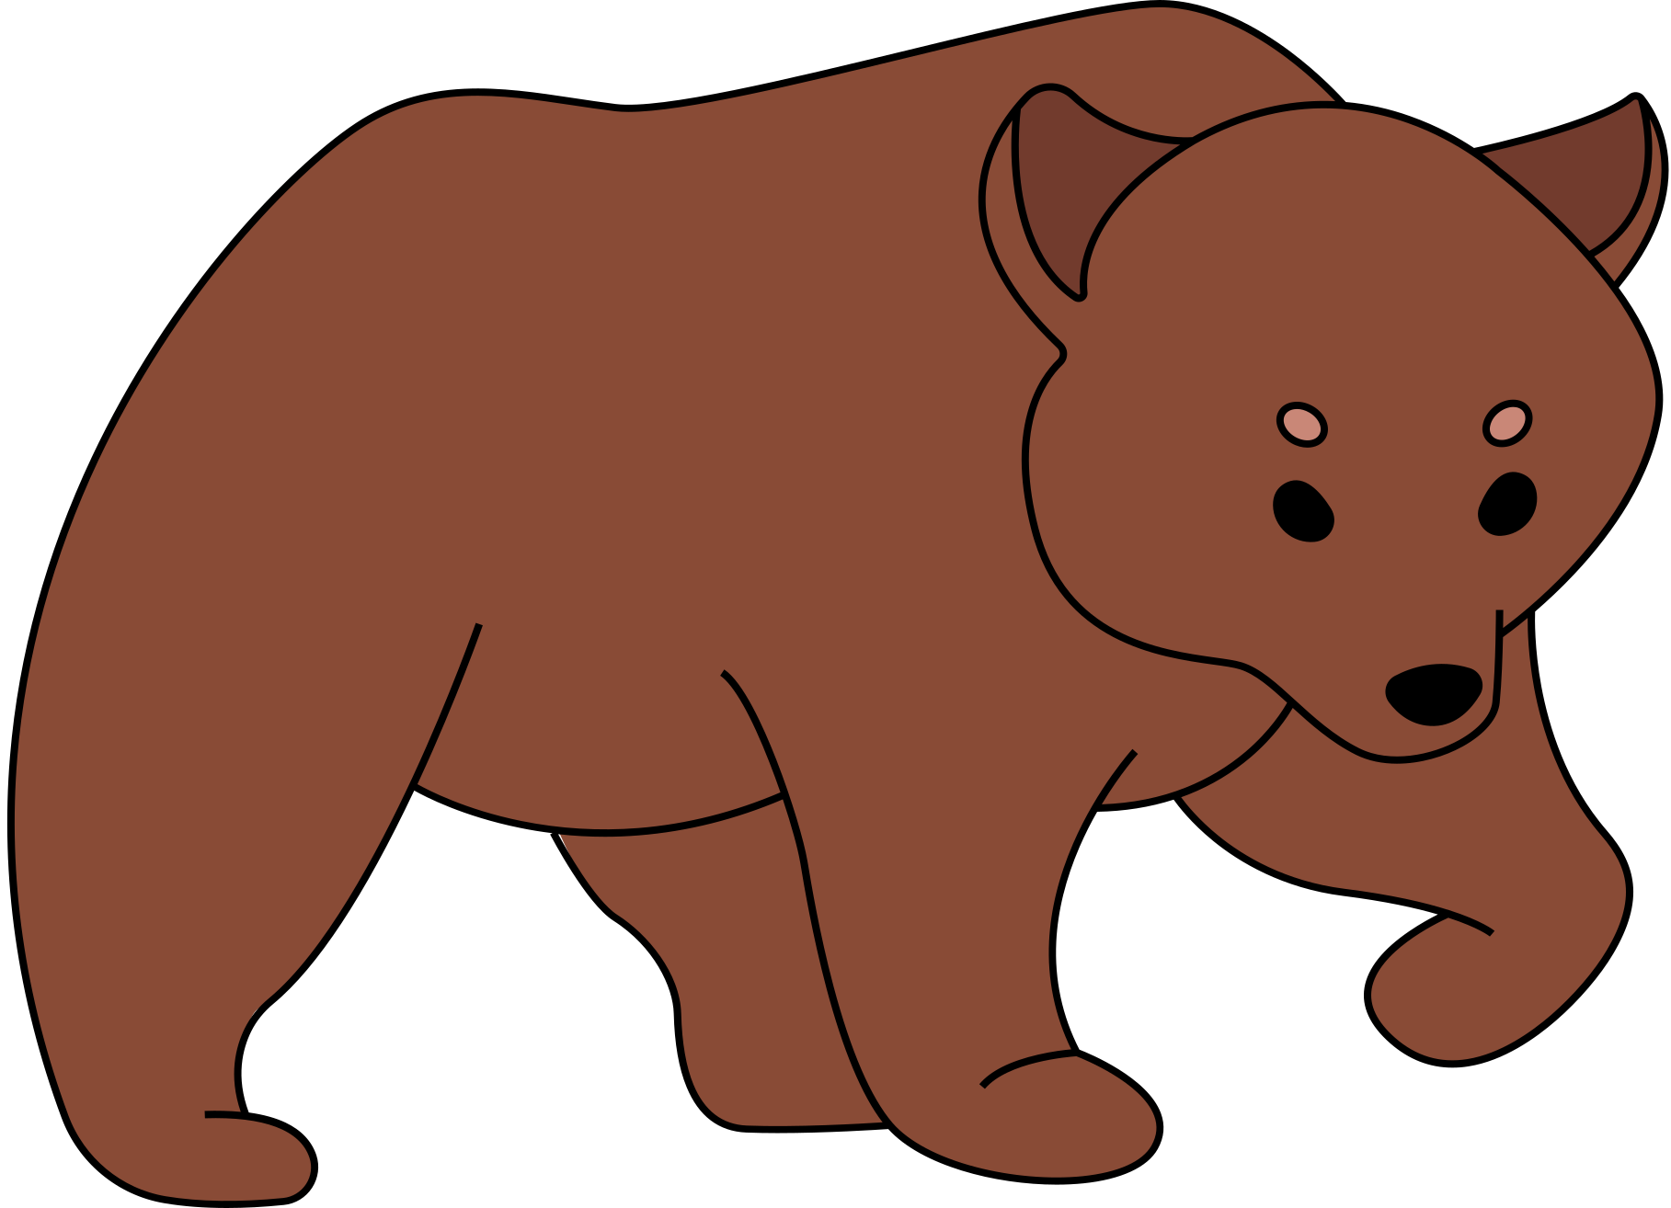
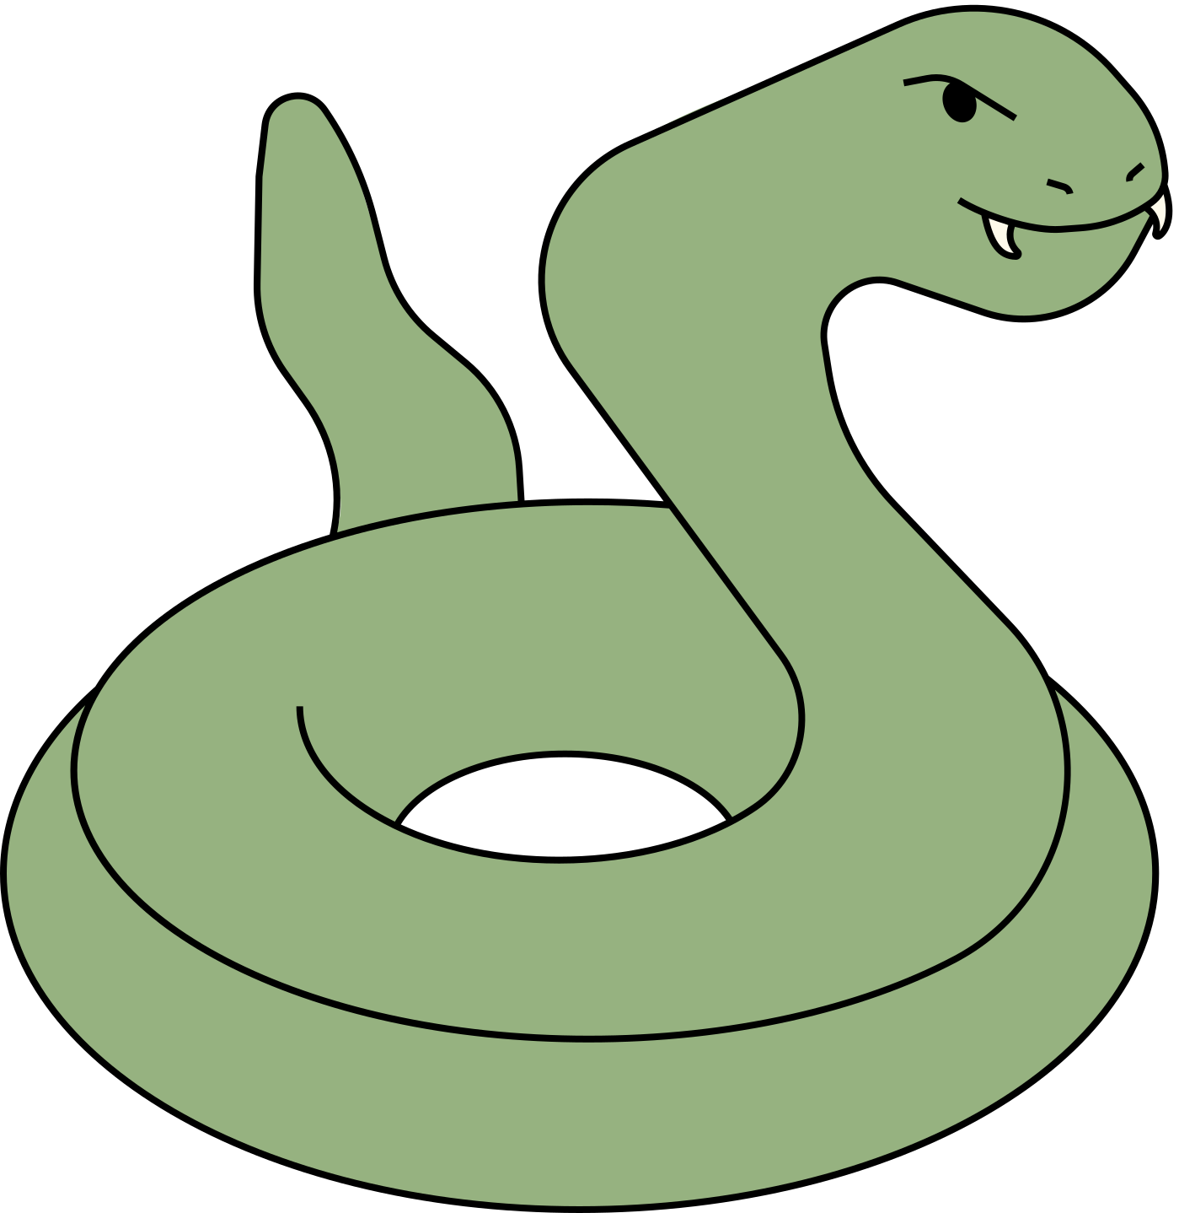
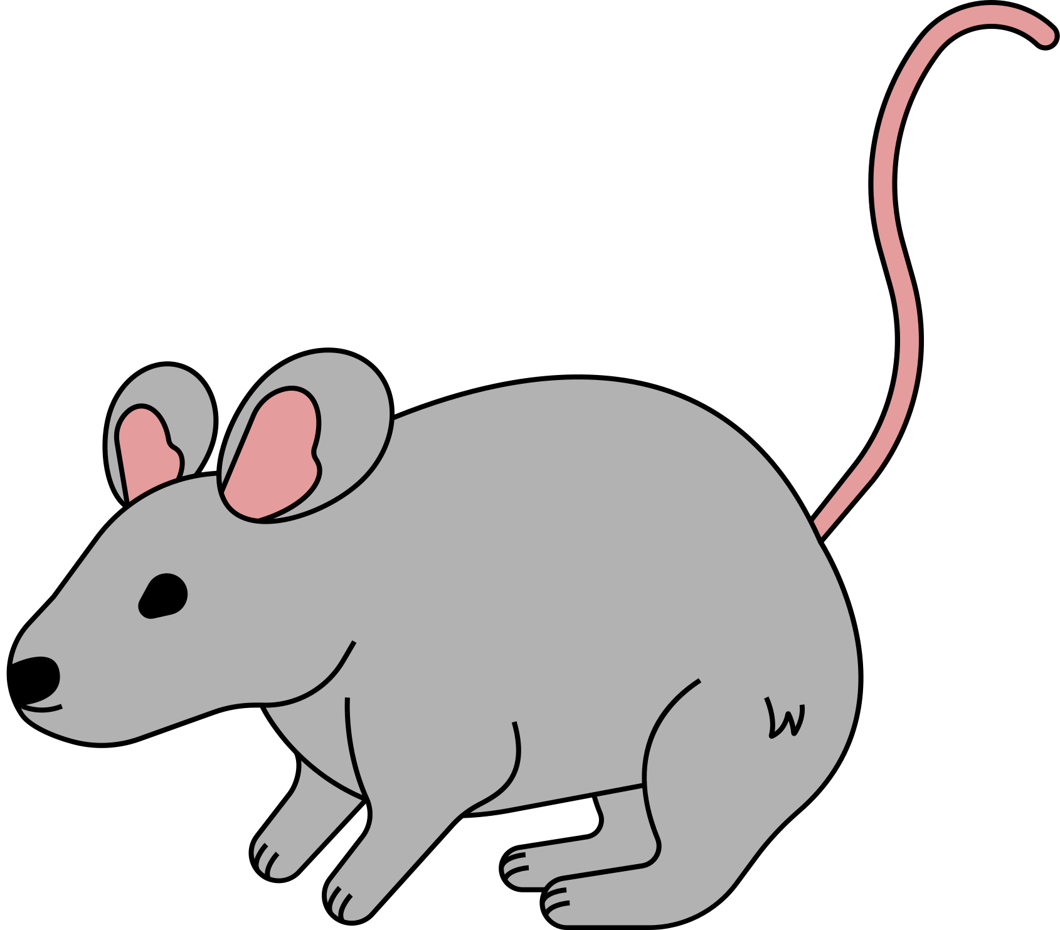
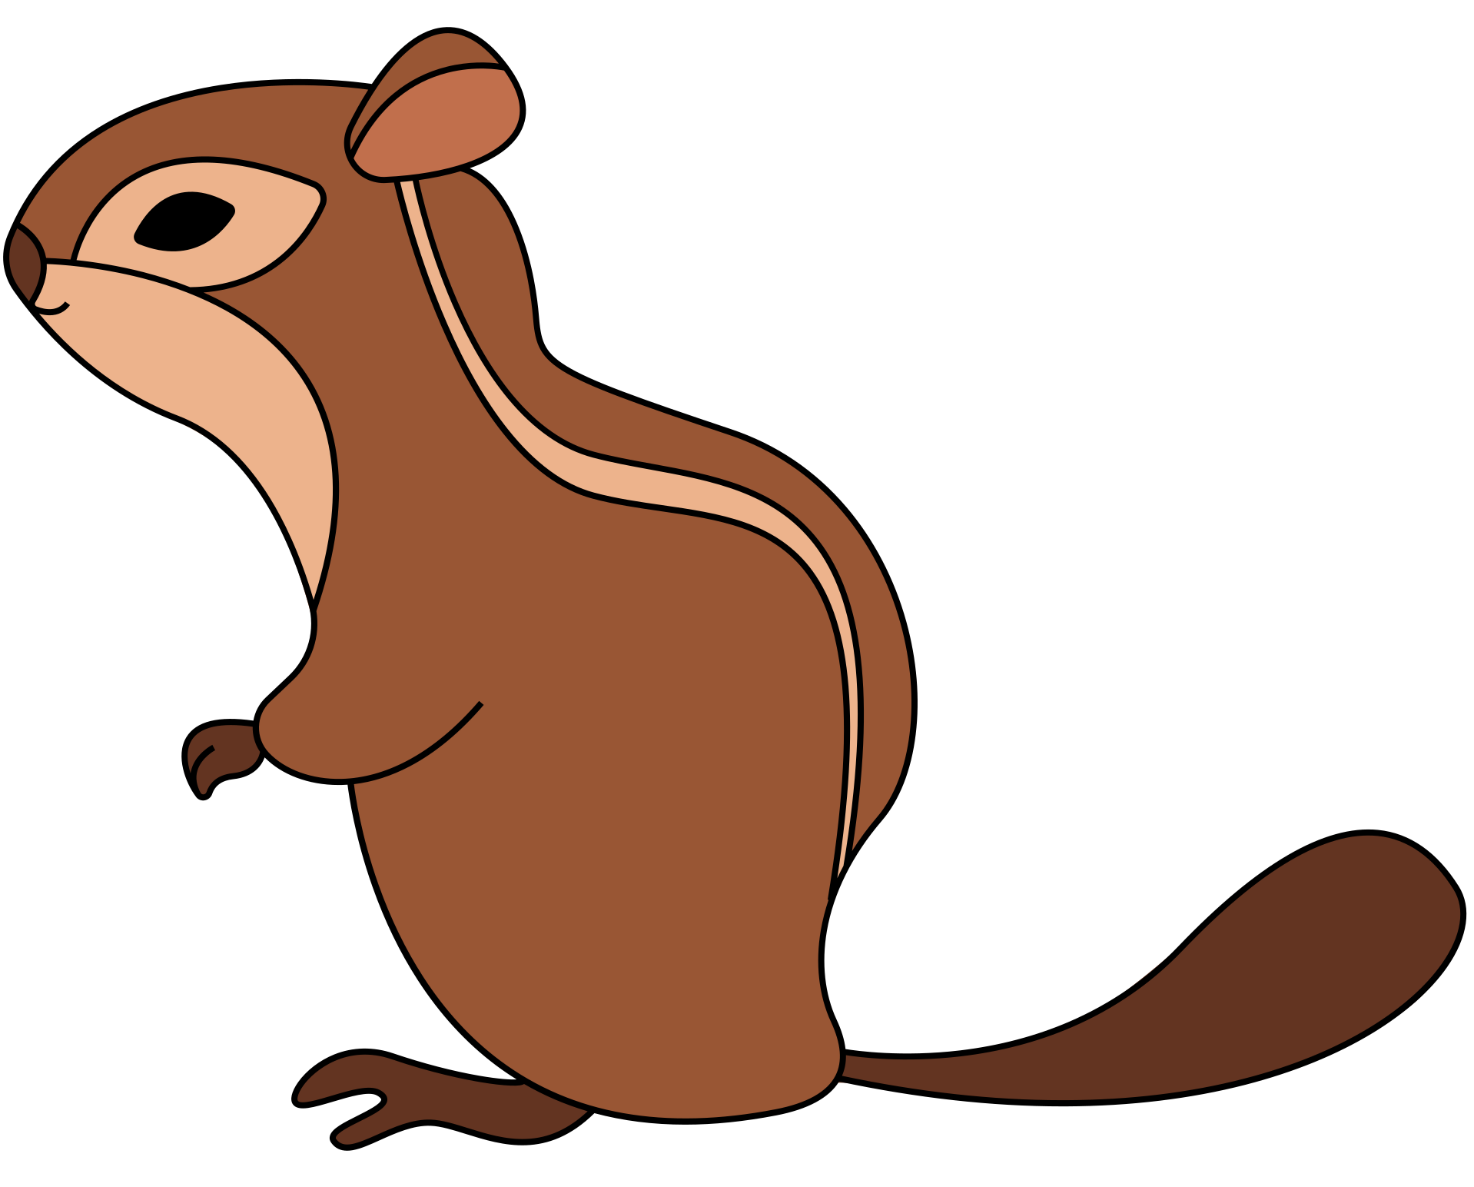

FOOD WEB AND WORDS
Using the food web relationships as an example, check out the different relationships between words.
PREDATOR
SYNONYM
HUNTER
predator means the same as hunter
PREDATOR
ANTONYM
PREY
predator eats prey and therefore opposites
PREY
ANTONYM
TARGET
prey is the "target" of predators

Slide 9
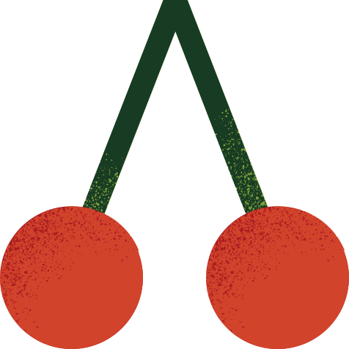
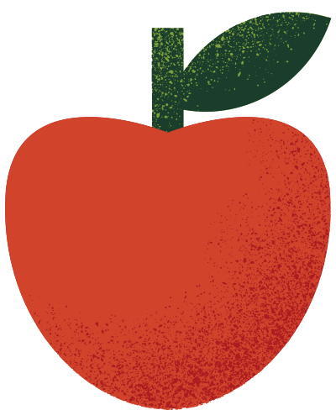
GROUP ACTIVITY
Get together in groups and discuss what
words should be under each column and why.
Synonyms (similar meaning words)
Happy | Funny | Brave
Joyful | Hilarious | Bold
Antonyms (opposite meaning words)
Careful | Strict | Good
Careless | Relaxed | Bad
Courageous
Faulty
Content
Gentle
Fearless
Comical
Amusing
Thoughtless
Negligent
Terrible
Delighted
Easy-going

Slide 10

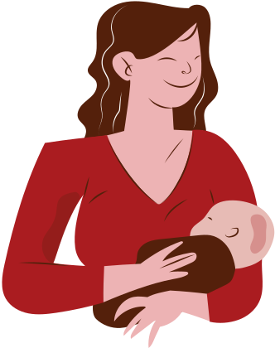
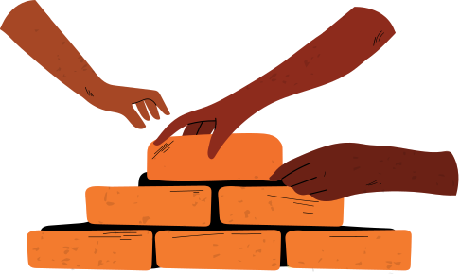

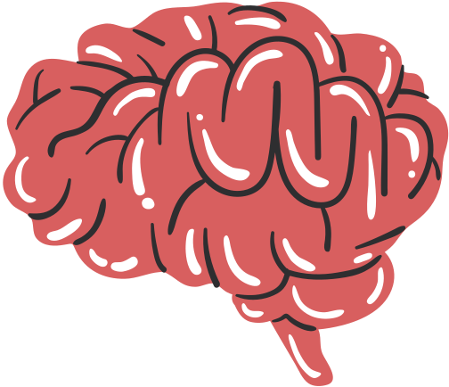
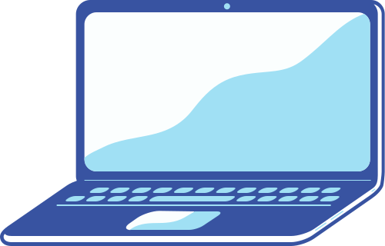

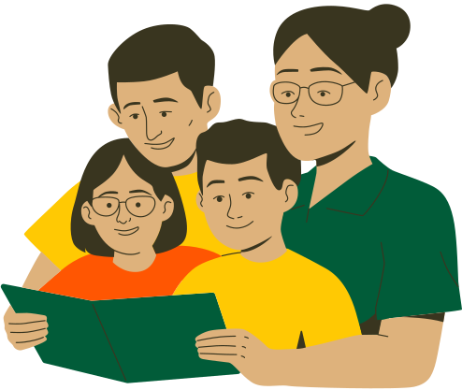
ANALOGY WORD MATCH
Which words share similar characteristics? Why do you think so?
life
foundation
brain
computer
family
journey

Slide 11





SUMMARY
SYNONYM
ANTONYM
ANALOGY
Synonyms can
help you deepen your knowledge of words by similar association.
Antonyms can help
you strengthen your knowledge of words by opposite association.
Analogies can help you understand that words can be linked to other words in unexpected ways to highlight similar characteristics and add depth of meaning.

Slide 12
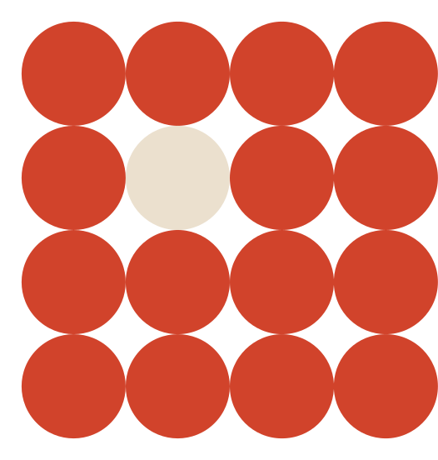
ASSIGNMENT
01
Prepare a list of eight (8) words.
02
Use a thesaurus to find a synonym and an antonym for each word
03
Find an analogy for at least five (5) of those words
04
Create flashcards using Canva for any of the
following categories: synonyms, antonyms, or analogies.

Slide 13

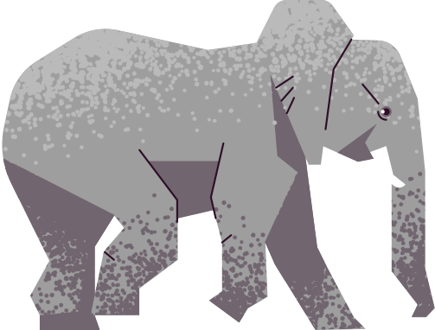
WORDS AND WILDLIFE
Use a thesaurus and look for three synonyms of the given words below. Then, choose one of the synonyms
and create a sentence describing one of the animals in the resource page. See the first example for reference.
Main Word | List three 3 synonyms | Write a sentence using one of the synonyms. | Can the main word replace the synonym in your sentence? Why or why not? | Add the animal you're describing below.
Gigantic | Enormous Massive Colossal | The colossal size of the elephant left the safari-goers in awe. | Yes, because both gigantic and colossal mean "very large" and often used to describe things.
Petite
Cheerful
Angry
Fierce

Slide 14
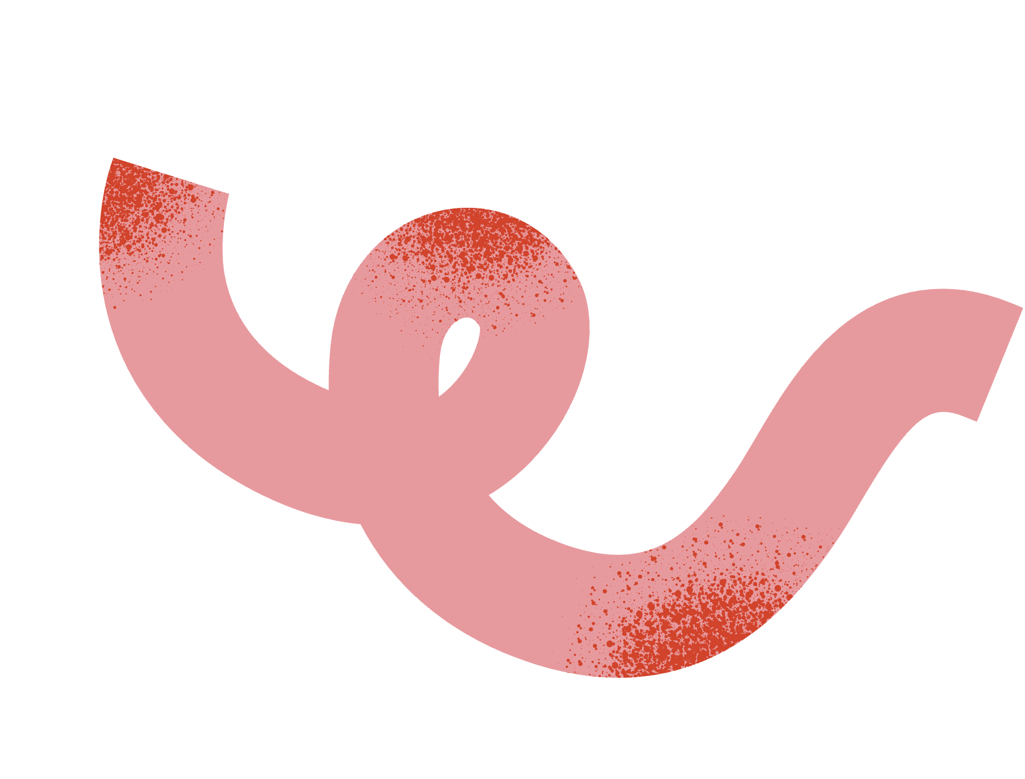


THANK
YOU
  Write a closing statement or call-to-action here.

Slide 15

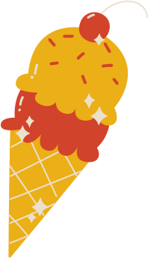











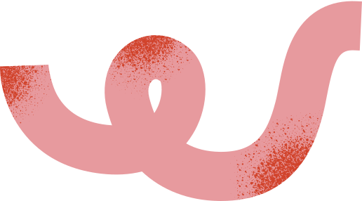
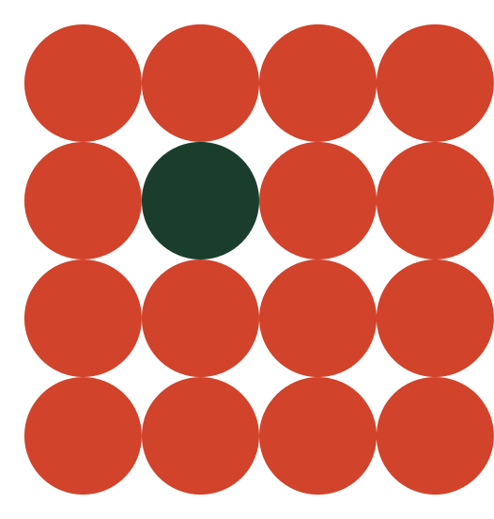
Resource
Page
Use these design resources
in your Canva Presentation.
This presentation template
uses the following free fonts:
Titles: Palanquin Dark
Headers: Palanquin
Body Copy: Palanquin
You can find these fonts
online too. Happy designing!
Don't forget to delete this
page before presenting.

Slide 16
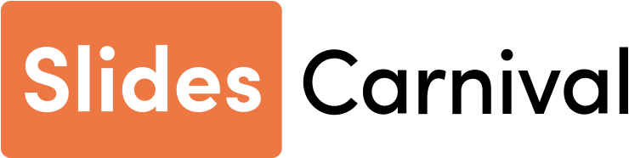
CREDITS
This presentation template is free
for everyone to use thanks to the following:
SlidesCarnival for the presentation template
Pexels for the photos
HAPPY DESIGNING!

