Slide 1
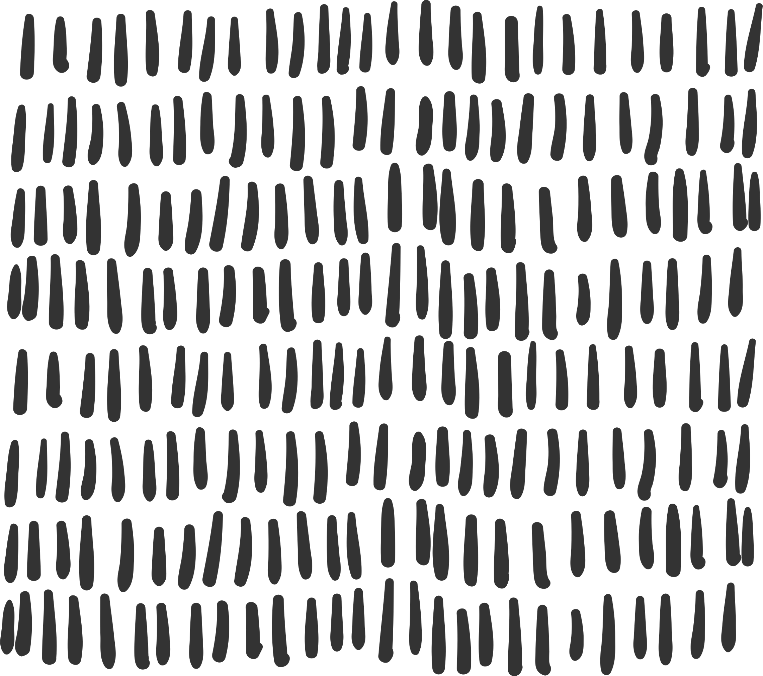


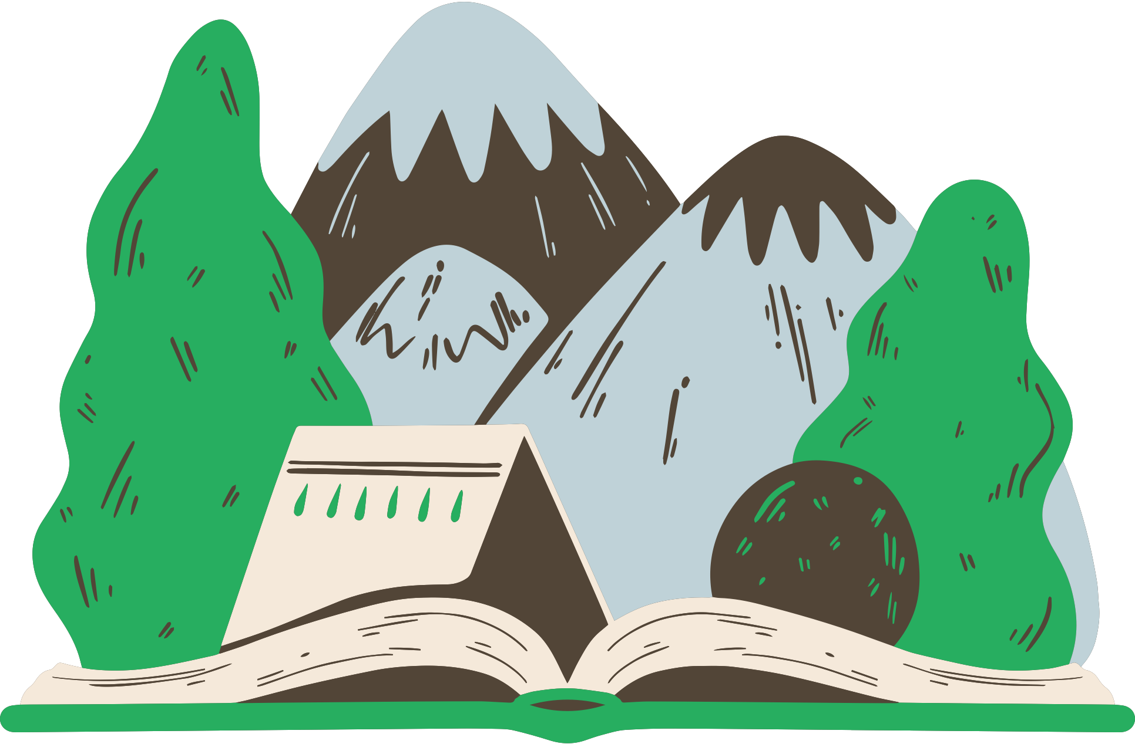
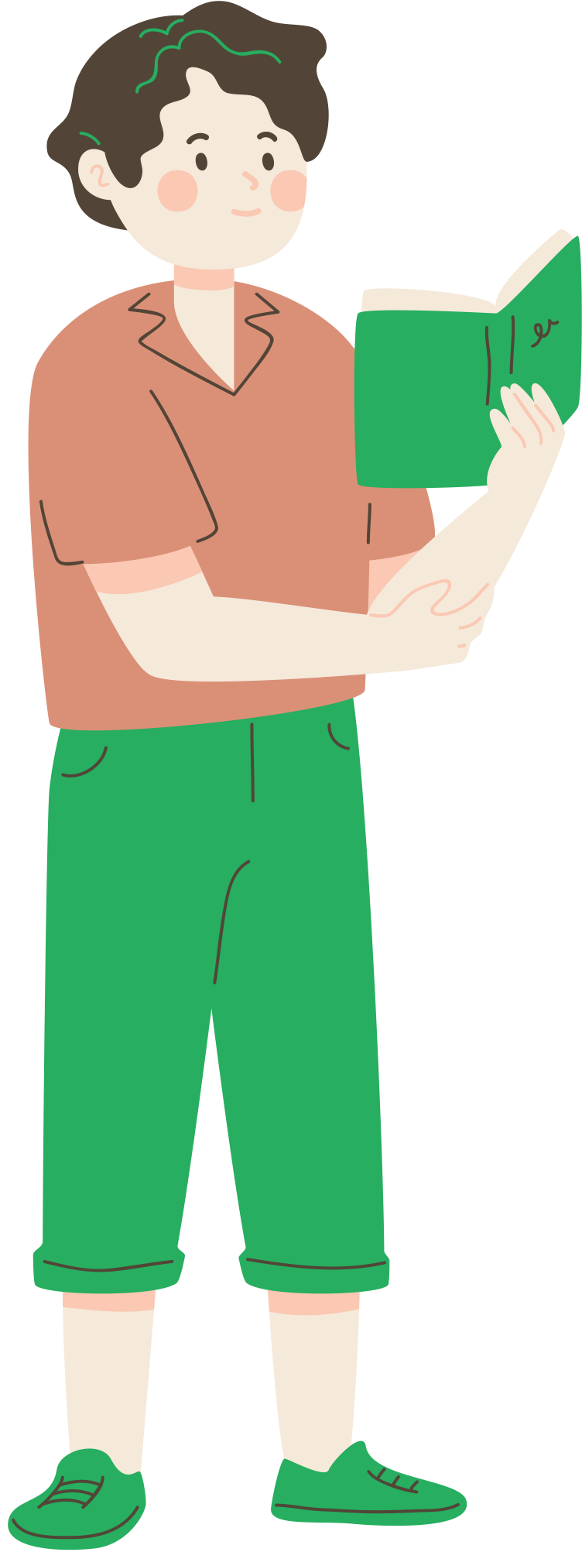
Story structures
How to structure narratives purposefully

Slide 2
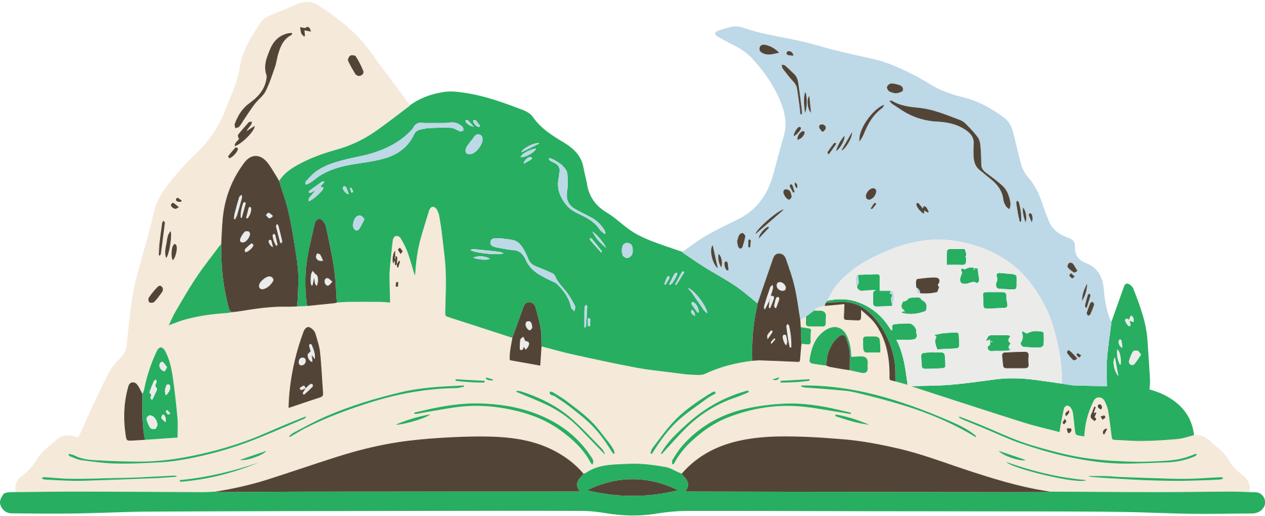
Learning Outcomes
Story structure is how the narrative elements of the story are arranged to develop the narrative.
Today you will:
Identify different story structures
Examine elements of different story structures
Identify the purpose of using each story structure

Slide 3
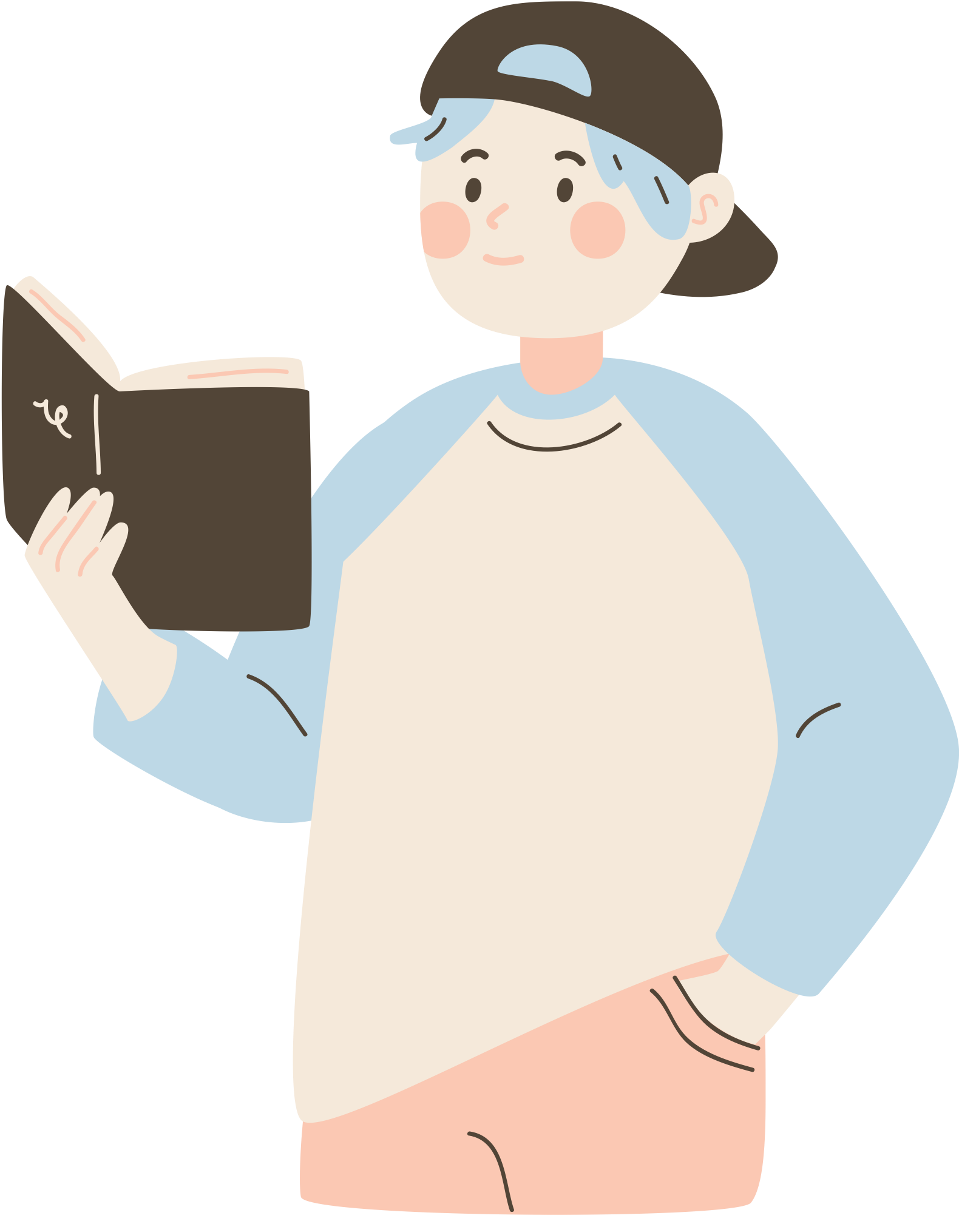



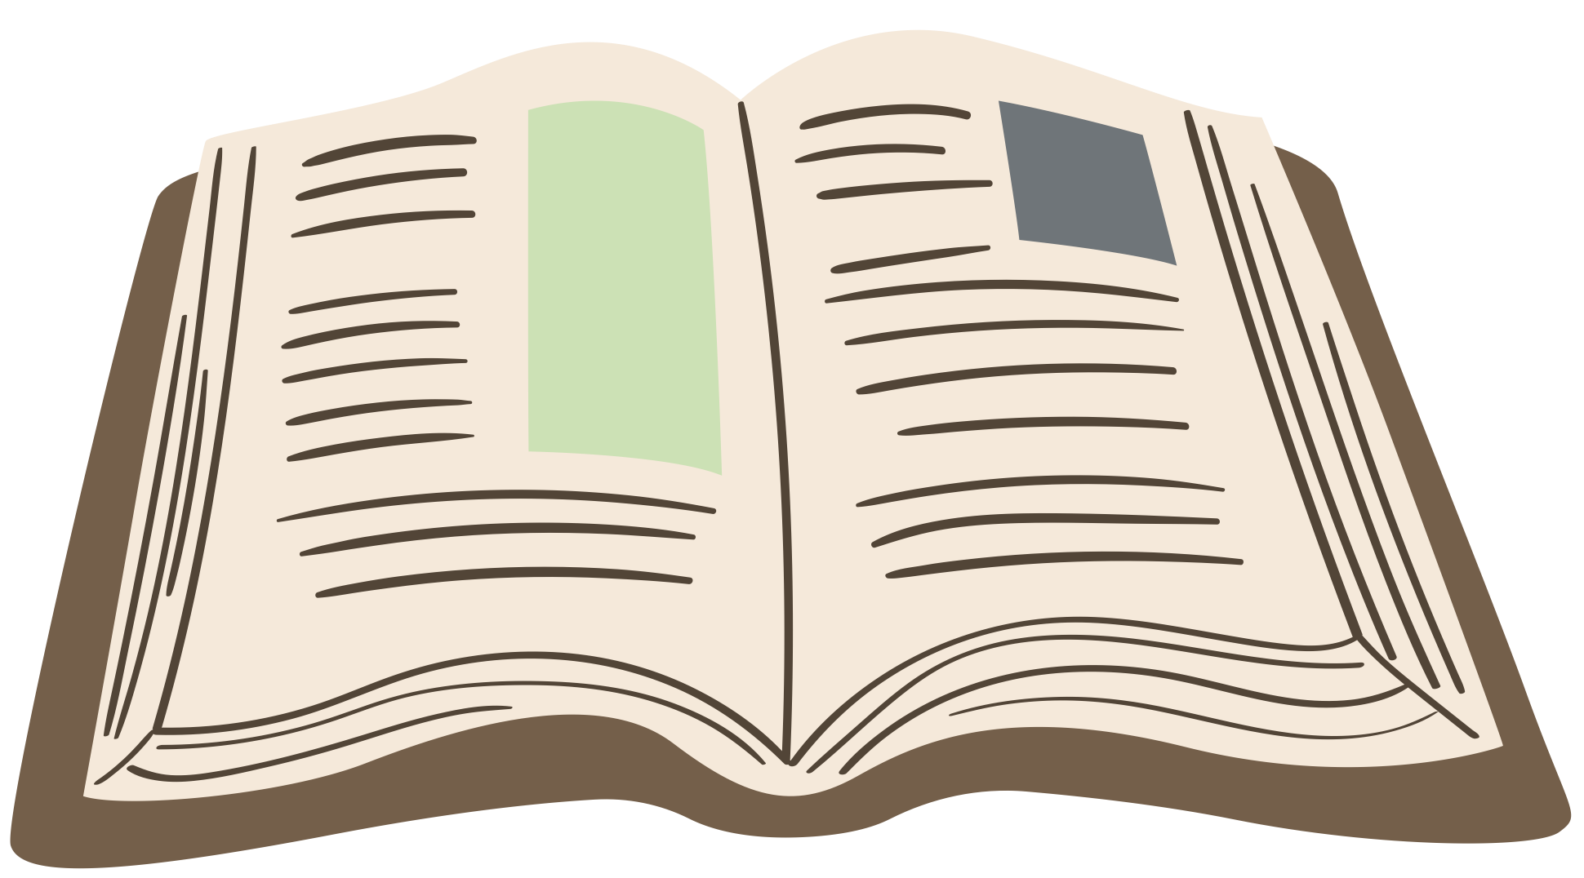
Story structures
Linear
Circular
Parallel
  Events unfold in a chronological or sequential structure: one building onto another until the resolution is reached.
  The story ends in a way that goes back to the beginning, creating a deeper understanding and a sense of completeness.
  This story structure has two separate storylines running at the same time. They are linked by common characters, events, or themes.

Slide 4
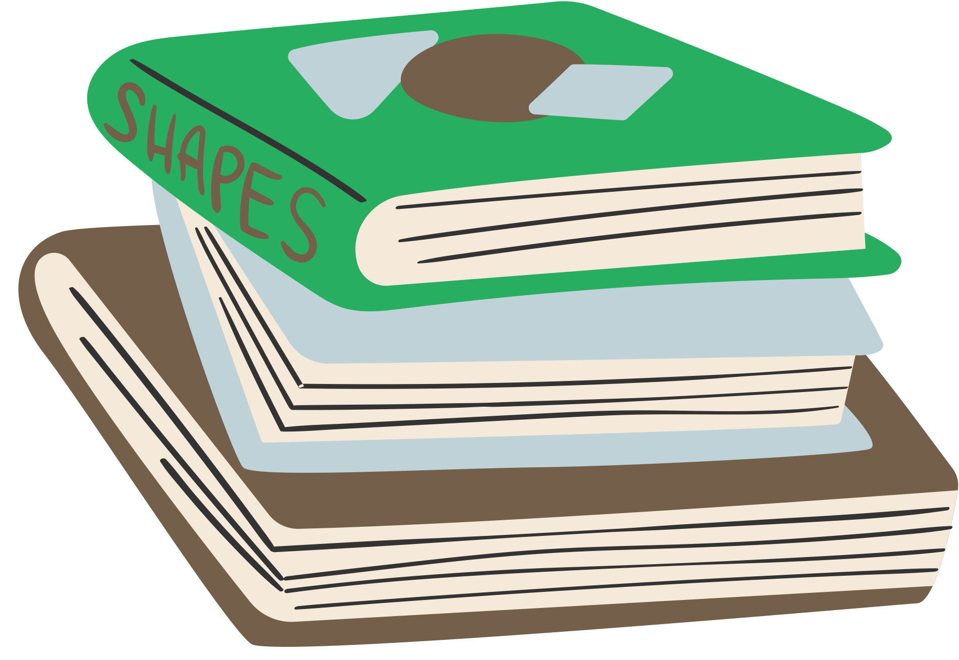
Narrative structure
Do you remember these keywords?
Orientation
Rising action
Resolution
  It sets the stage for the story and includes an introduction to characters, setting, and conflict.
  A series of events increasing in tension are retold, until the climax (highest point of tension) is reached.
  The main conflict is resolved and the story comes to an end.

Slide 5
Your turn!
Time to work individually or in groups to find the right answers and explain why.

Slide 6
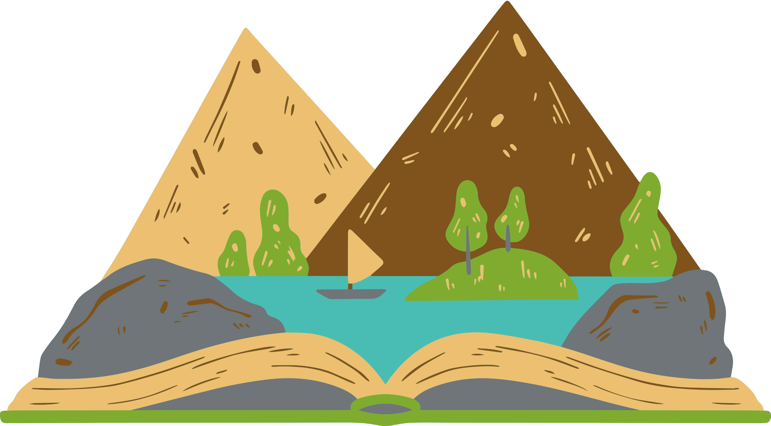
Wind in the Willows
(Move the sticker to the correct story structure)
Wind in the Willows follows a...
Linear structure
Circular structure
Parallel structure
This is because...
  Write your answer here.

Slide 7
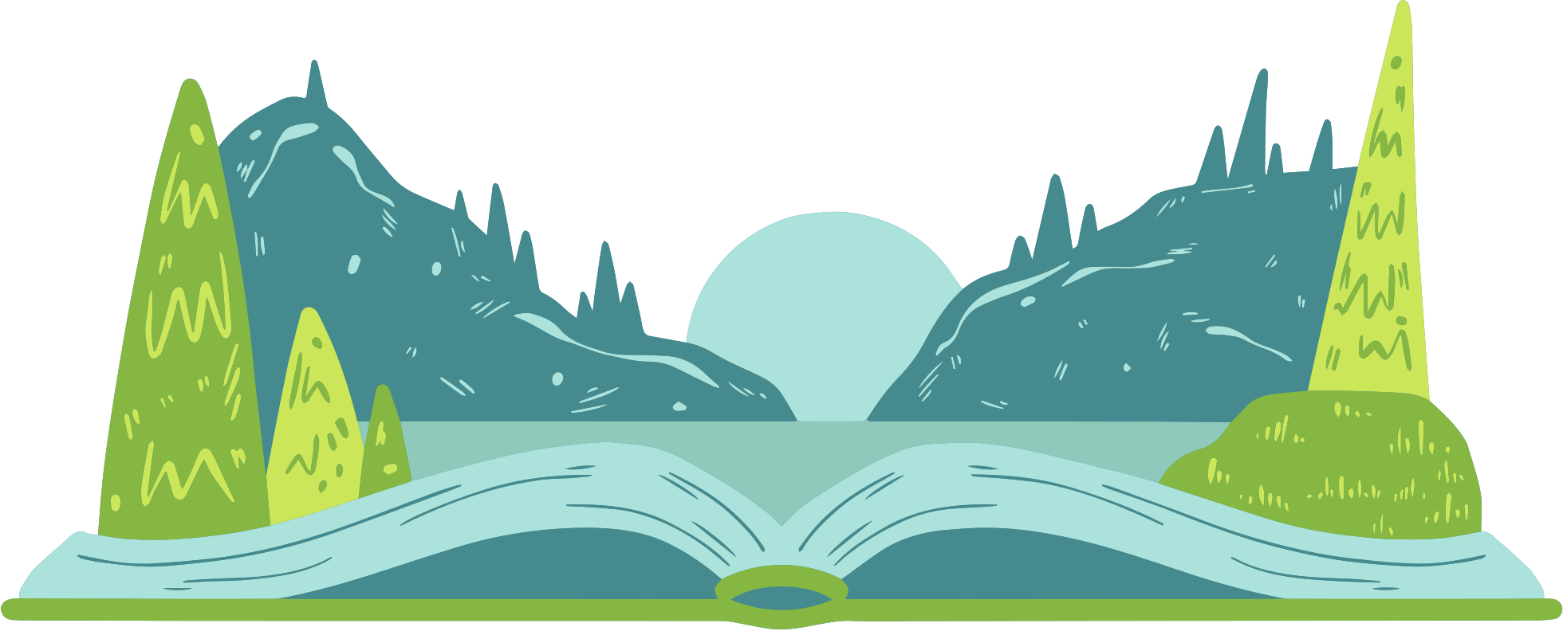
The Adventures of Pinocchio
Read the following summaries to help you identify what structure the story follows.
Orientation
Rising action
Resolution
  Geppetto creates Pinocchio, a puppet who dreams of becoming a real boy.
  As Pinocchio tries to become a real boy, he faces many problems. He meets tricky characters like the Fox and Cat and even turns into a donkey while working for a mean puppeteer. These challenges teach him important lessons about honesty and kindness, helping him grow up and get closer to becoming a real boy.
  After proving his bravery and kindness, Pinocchio becomes a real boy. He and Geppetto enjoy a loving father-son relationship.

Slide 8
The Adventures of Pinocchio
(Move the sticker to the correct story structure)
The Adventures of Pinocchio follows a...
Linear structure
Circular structure
Parallel structure
This is because...
  Write your answer here.

Slide 9
The Adventures of Pinocchio
Sample Answer
The Adventures of Pinocchio follows a...
Linear structure
Circular structure
Parallel structure
This is because...
  the story moves smoothly from its orientation to its rising action and climax, ending in the resolution.

Slide 10
Wind in the Willows
Read the following summaries to help you identify what structure the story follows.
Mole
Toad
Toad, Mole and Rat
  The main plot revolves around Mole. He meets Rat, a water-loving creature, along the way, and the two become fast friends.
  Rat introduces Mole to the joys of river boating, and they have a number of adventures together.
  Meanwhile, Toad becomes obsessed with new fads and engages in risky activities with automobiles. His reckless decisions caused a series of mishaps, including his arrest and imprisonment.
  Both plots intertwine as the story progresses, and Rat and Mole are drawn into Toad's adventures.

Slide 11
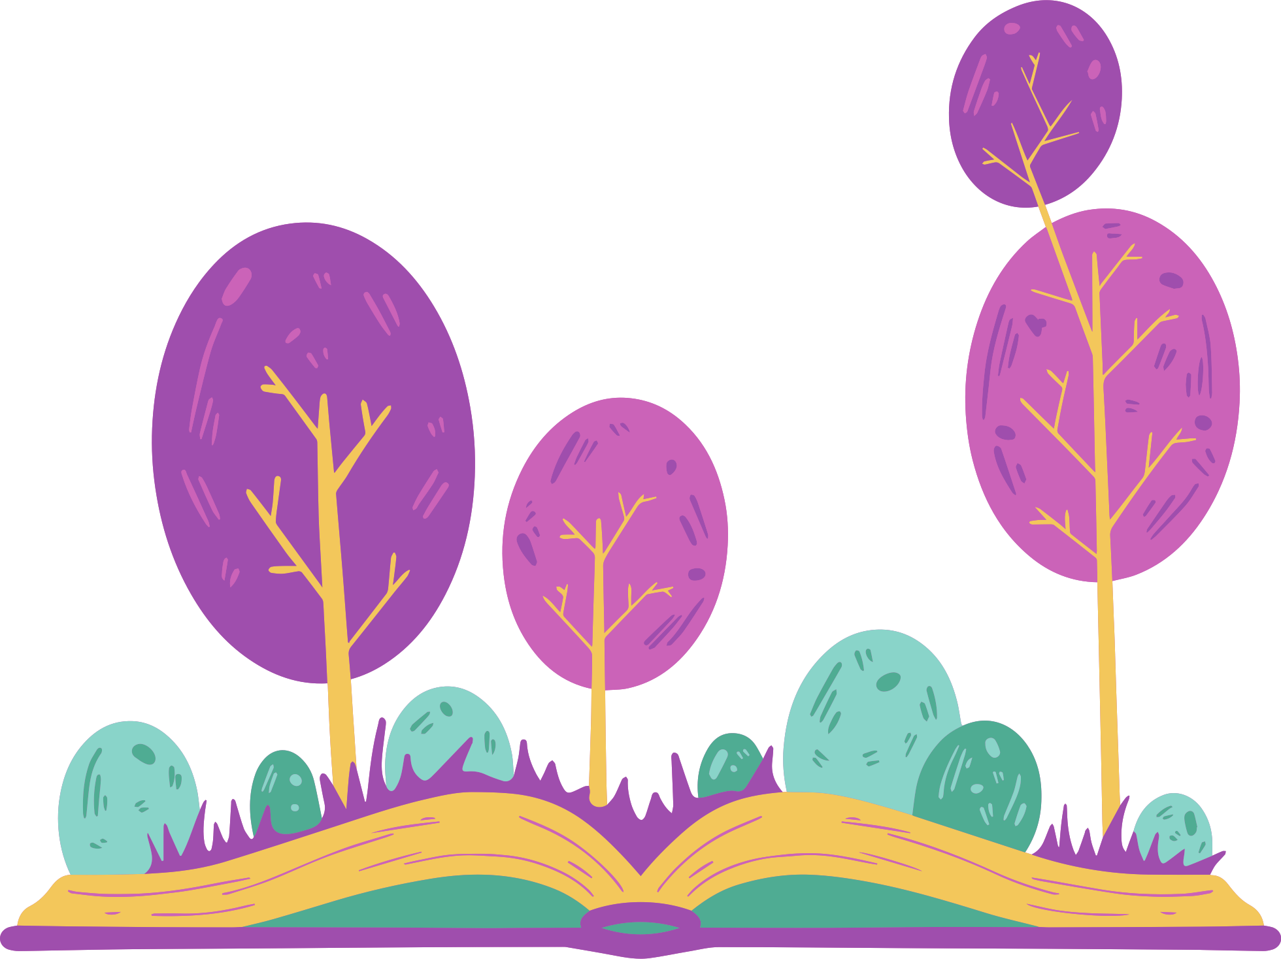
Wind in the Willows
Read the following summaries to help you identify what structure the story follows.
Setting
Characters
Themes
  The story starts with Alice sitting on the riverbank and finishes in the same place, where she wonders about her experiences "down the rabbit hole."
  Also, Alice meets recurring characters throughout the narrative such as the Cheshire Cat, the Mad Hatter and the Queen of Hearts.
  The theme of transformation, with Alice "growing and shrinking," is repeated. After shrinking for a last time after eating mushrooms, Alice returns to her original form in the final chapters during the trial of the Knave of Hearts.

Slide 12
Wind in the Willows
(Move the sticker to the correct story structure)
Wind in the Willows follows a...
Linear structure
Circular structure
Parallel structure
This is because...
  Write your answer here.

Slide 13
Sample Answers
Explanation
Wind in the Willows follows a parallel story structure.
  These parallel storylines involve various characters and their individual adventures, which eventually converge and influence one another.
Alice in Wonderland follows a circular story structure.
  The return to the original setting suggesting that her experiences are only imaginary and the recurring character and theme show the story structure is circular.

Slide 14
Purpose: Why use each?
Linear story structure
Circular story structure
Parallel story structure
  This allows readers to easily follow the story because it provides a clear and straightforward narrative progression.
  This allows a story to complete itself, providing a satisfying sense of closure. It can also emphasise important themes through repeated events, characters or motifs.
  This allows writers to tell stories from different viewpoints, follow different storylines, and introduce various characters. This creates more engaging stories.

Slide 15
Story Examples Hunt Activity
1
  Search for books or movies in the classroom or school library that exemplify each of the story structures we have studied today.
2
  Afterward, each student or group will share their findings and explain how they align with different story structures.

Slide 16

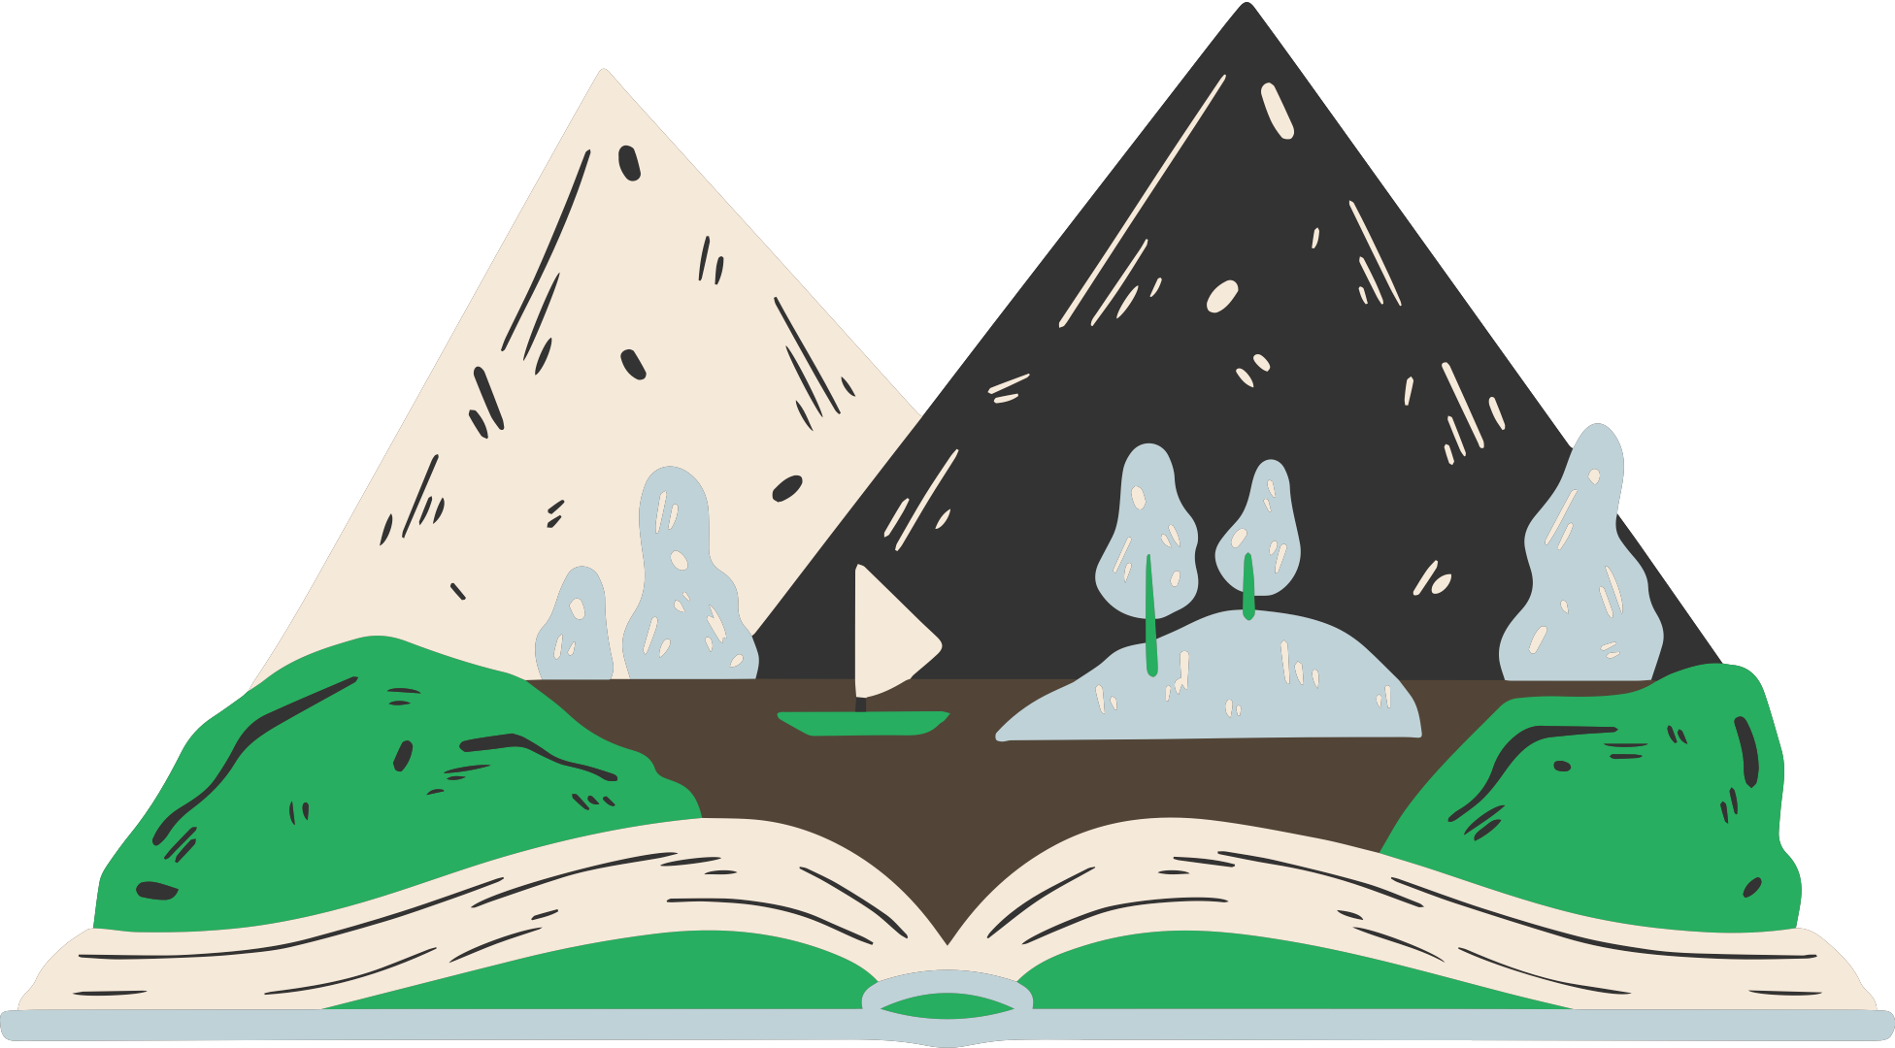
Credits
Happy designing!
This presentation template is free for everyone to use thanks to the following:
SlidesCarnival for the presentation template
Canva Creative Studio for the lesson plan
Pexels for the photos

Slide 17
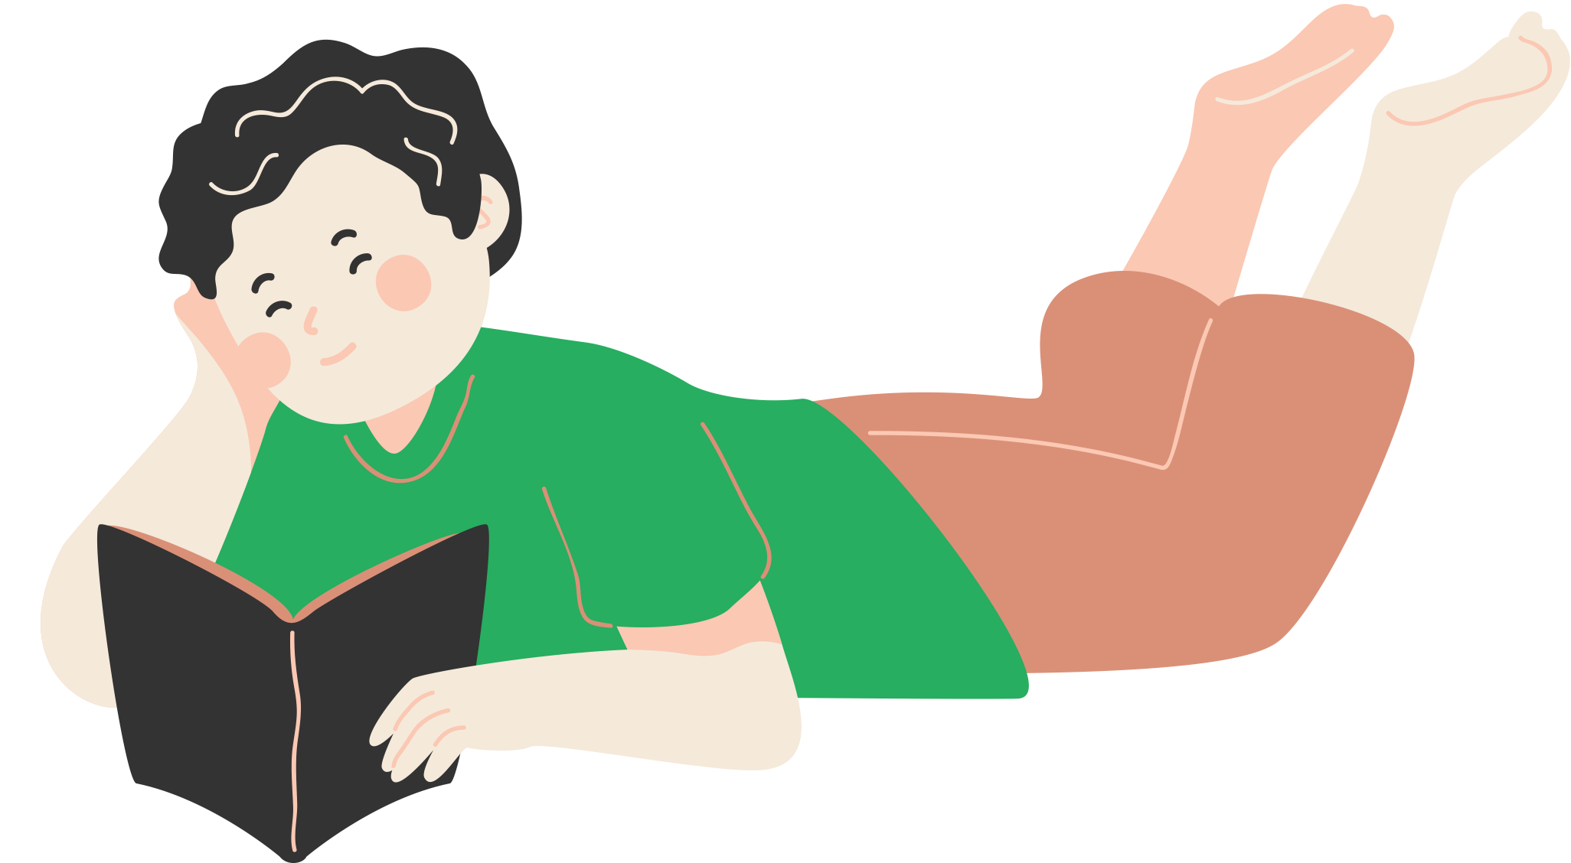

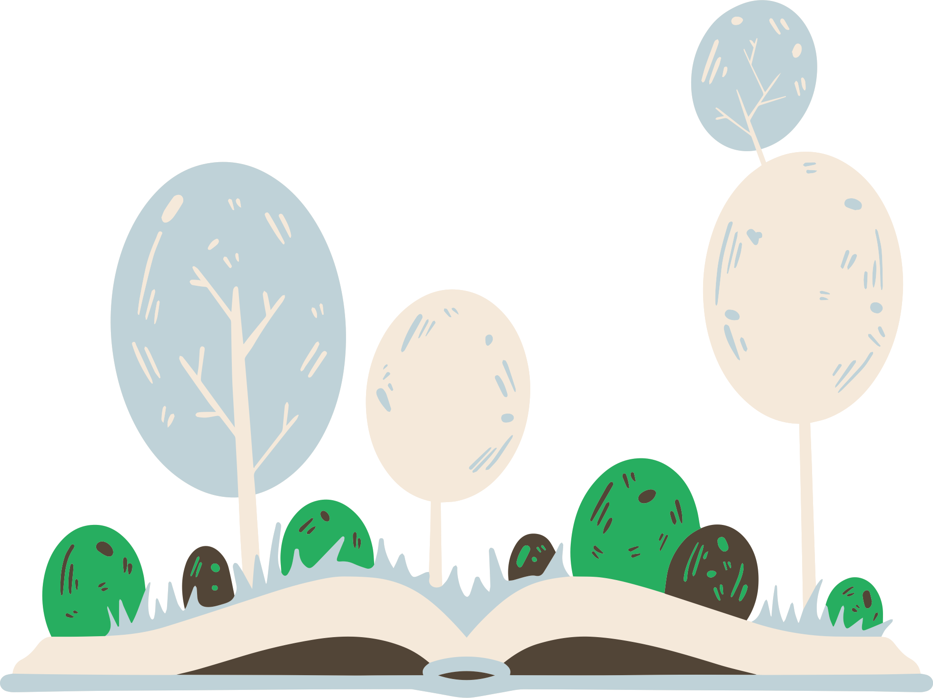
Use these design resources in your Canva Presentation.
Resource
Page
This presentation template
uses the following free fonts:
Titles: Grenze
Headers: Grenze
Body Copy: Noto Serif
You can find these fonts
online too. Happy designing!
Don't forget to delete this
page before presenting.

