Slide 1



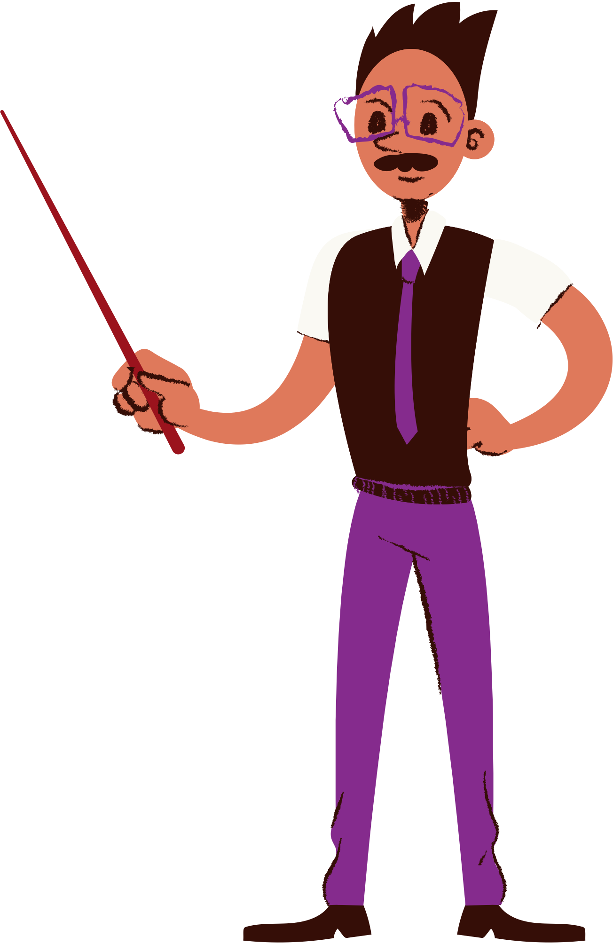

Lesson for Middle School
Verbals,
Gerunds and Participles

Slide 2


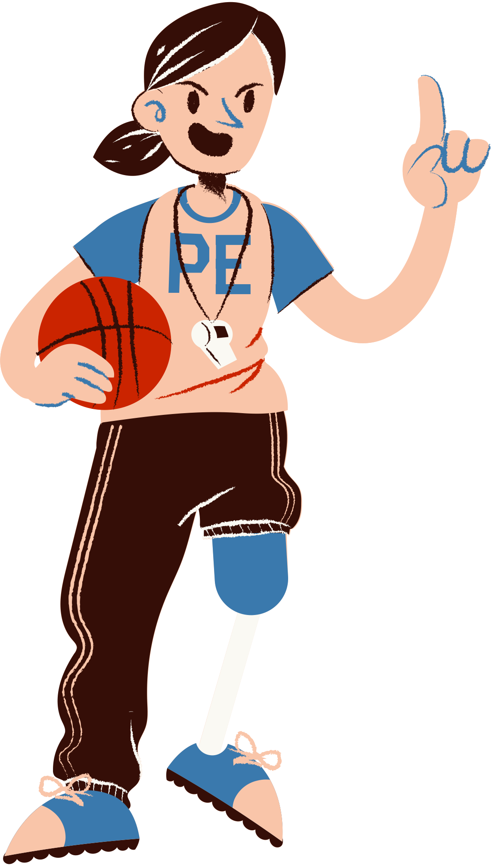
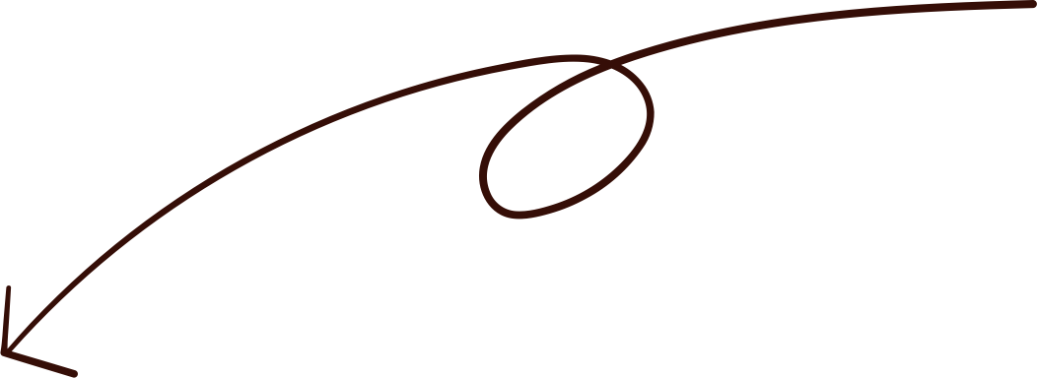
Let's break it down.
  Running is my favorite form of exercise.
Running:
This is a gerund, which is a verbal that functions as a noun.
  It acts as the subject of the sentence.
is:
  This is a linking verb, which connects the subject and predicate.
My favorite form of exercise:
This is a noun phrase that serves as the complement
of the linking verb "is."
  It describes what "Running" is.

Slide 3


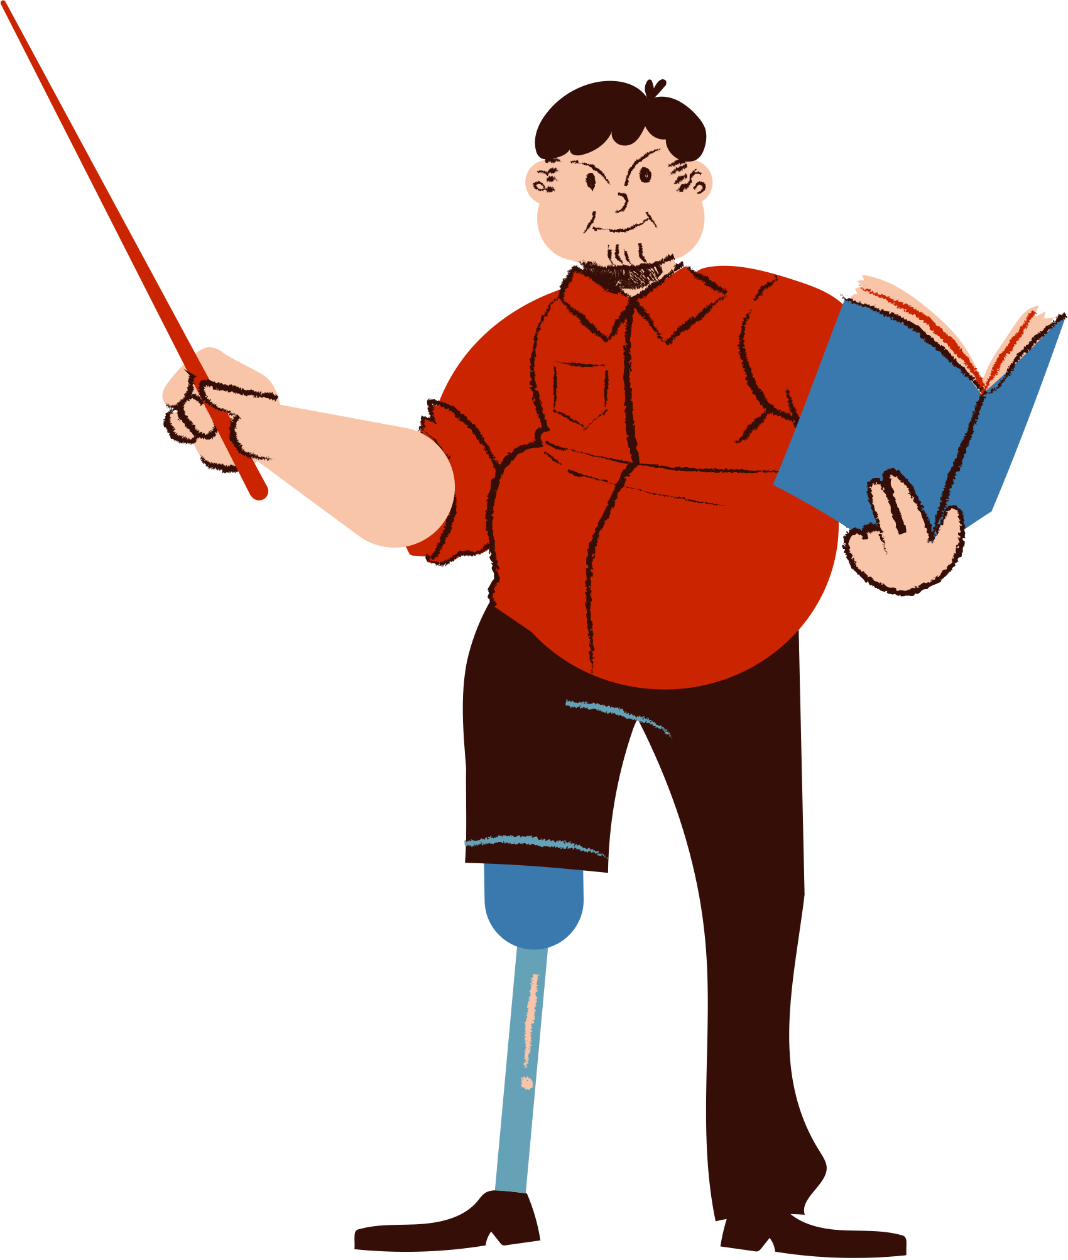

Lesson Outline
Definition of verbals
Introduction to gerunds
Introduction to participles
Introduction to infinitives

Slide 4


Look at the underlined words. They look like
verbs but don't quite act like verbs, right?
Cooking is my favorite hobby.
The excited crowd waved and cheered in unison.
To climb Mt. Everest is my dream.

Slide 5


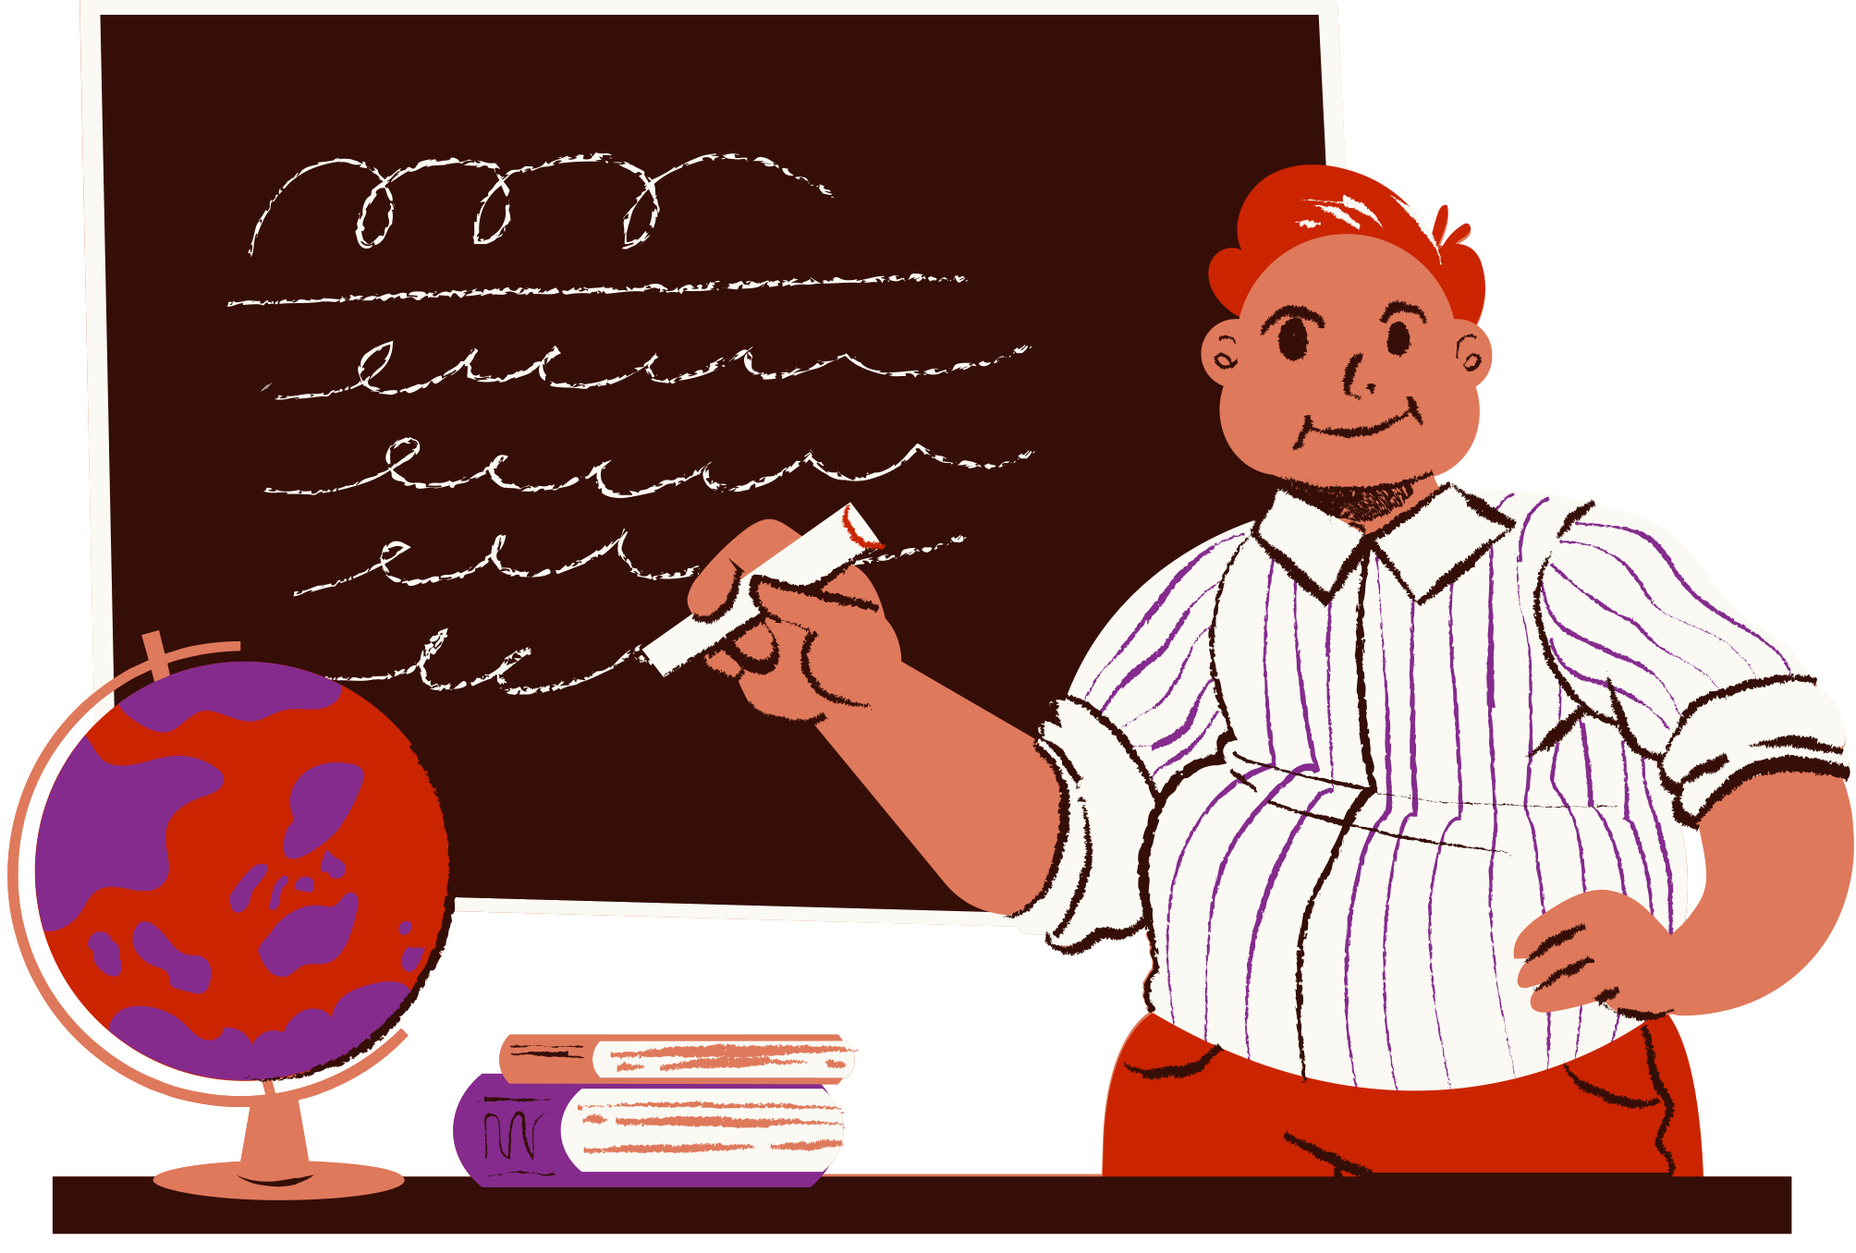

They are words or parts of speech called:
Verbals
They're the masters of disguise, adding flair, depth, and a touch of mystery to our language. Get ready to unravel their secrets and uncover the fascinating
  world of verbals!

Slide 6
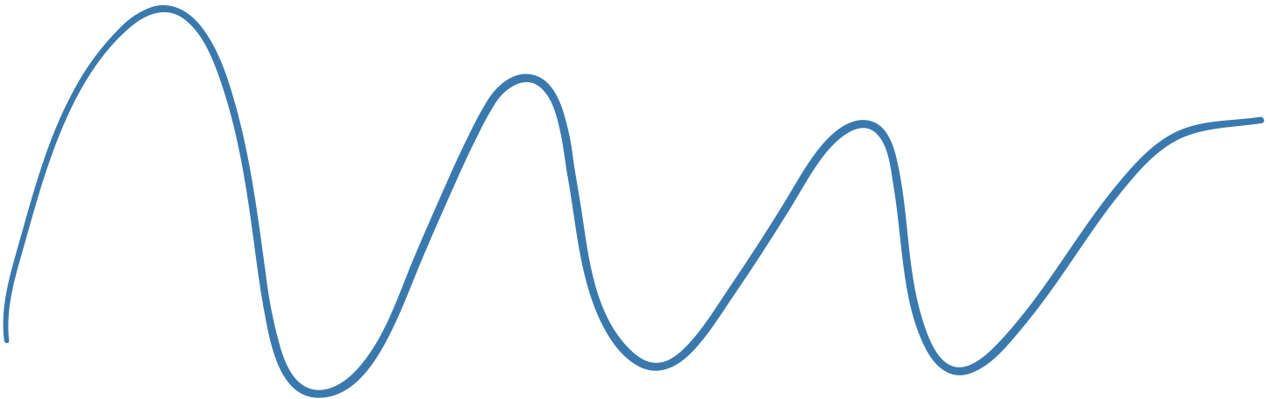

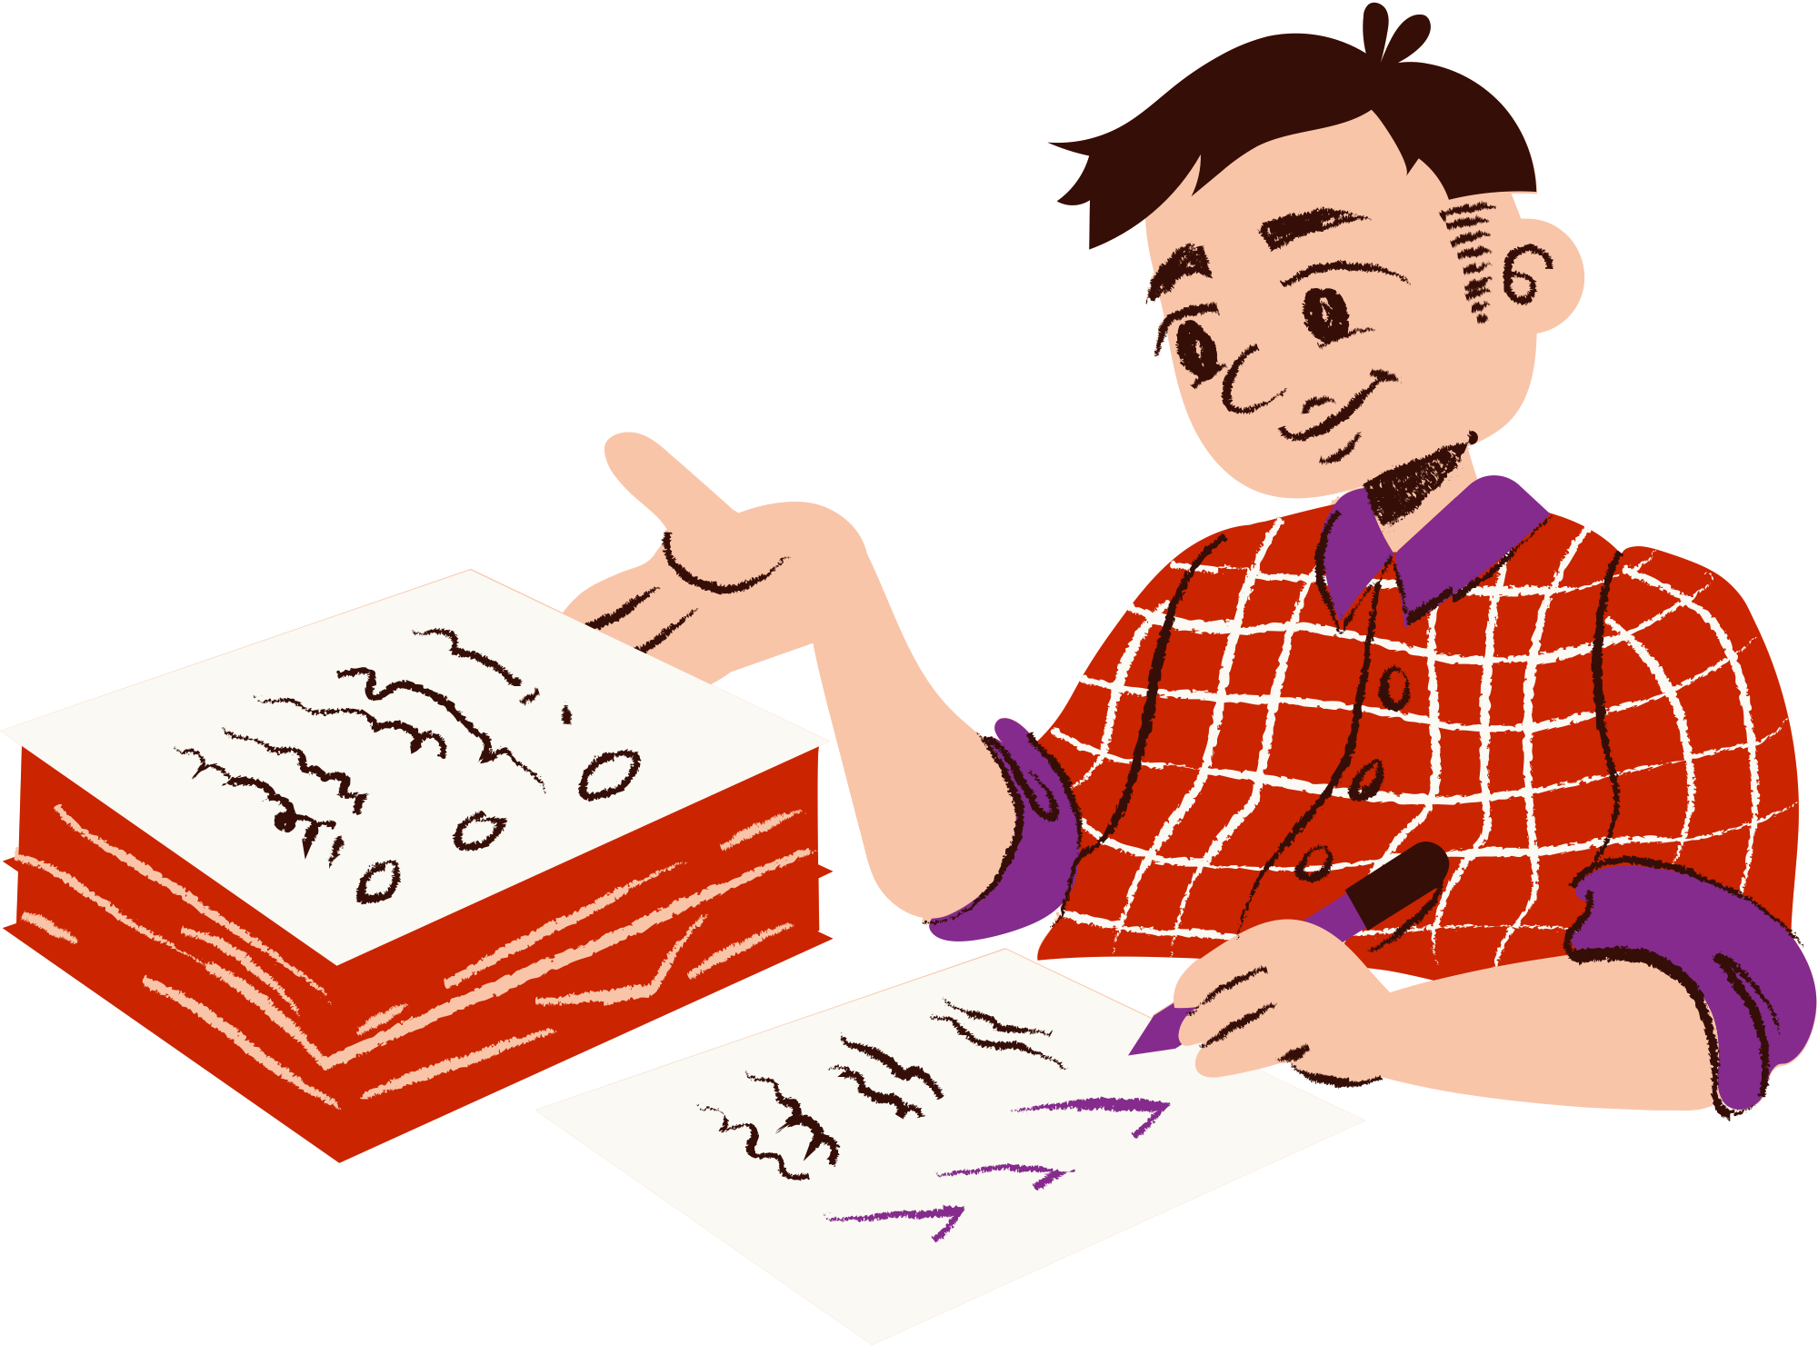
Learning Outcomes
Identify and differentiate between gerunds, participles, and infinitives as verbals.
Determine the specific functions of gerunds, participles, and infinitives.
Apply the knowledge of verbals to effectively use them in writing.

Slide 7

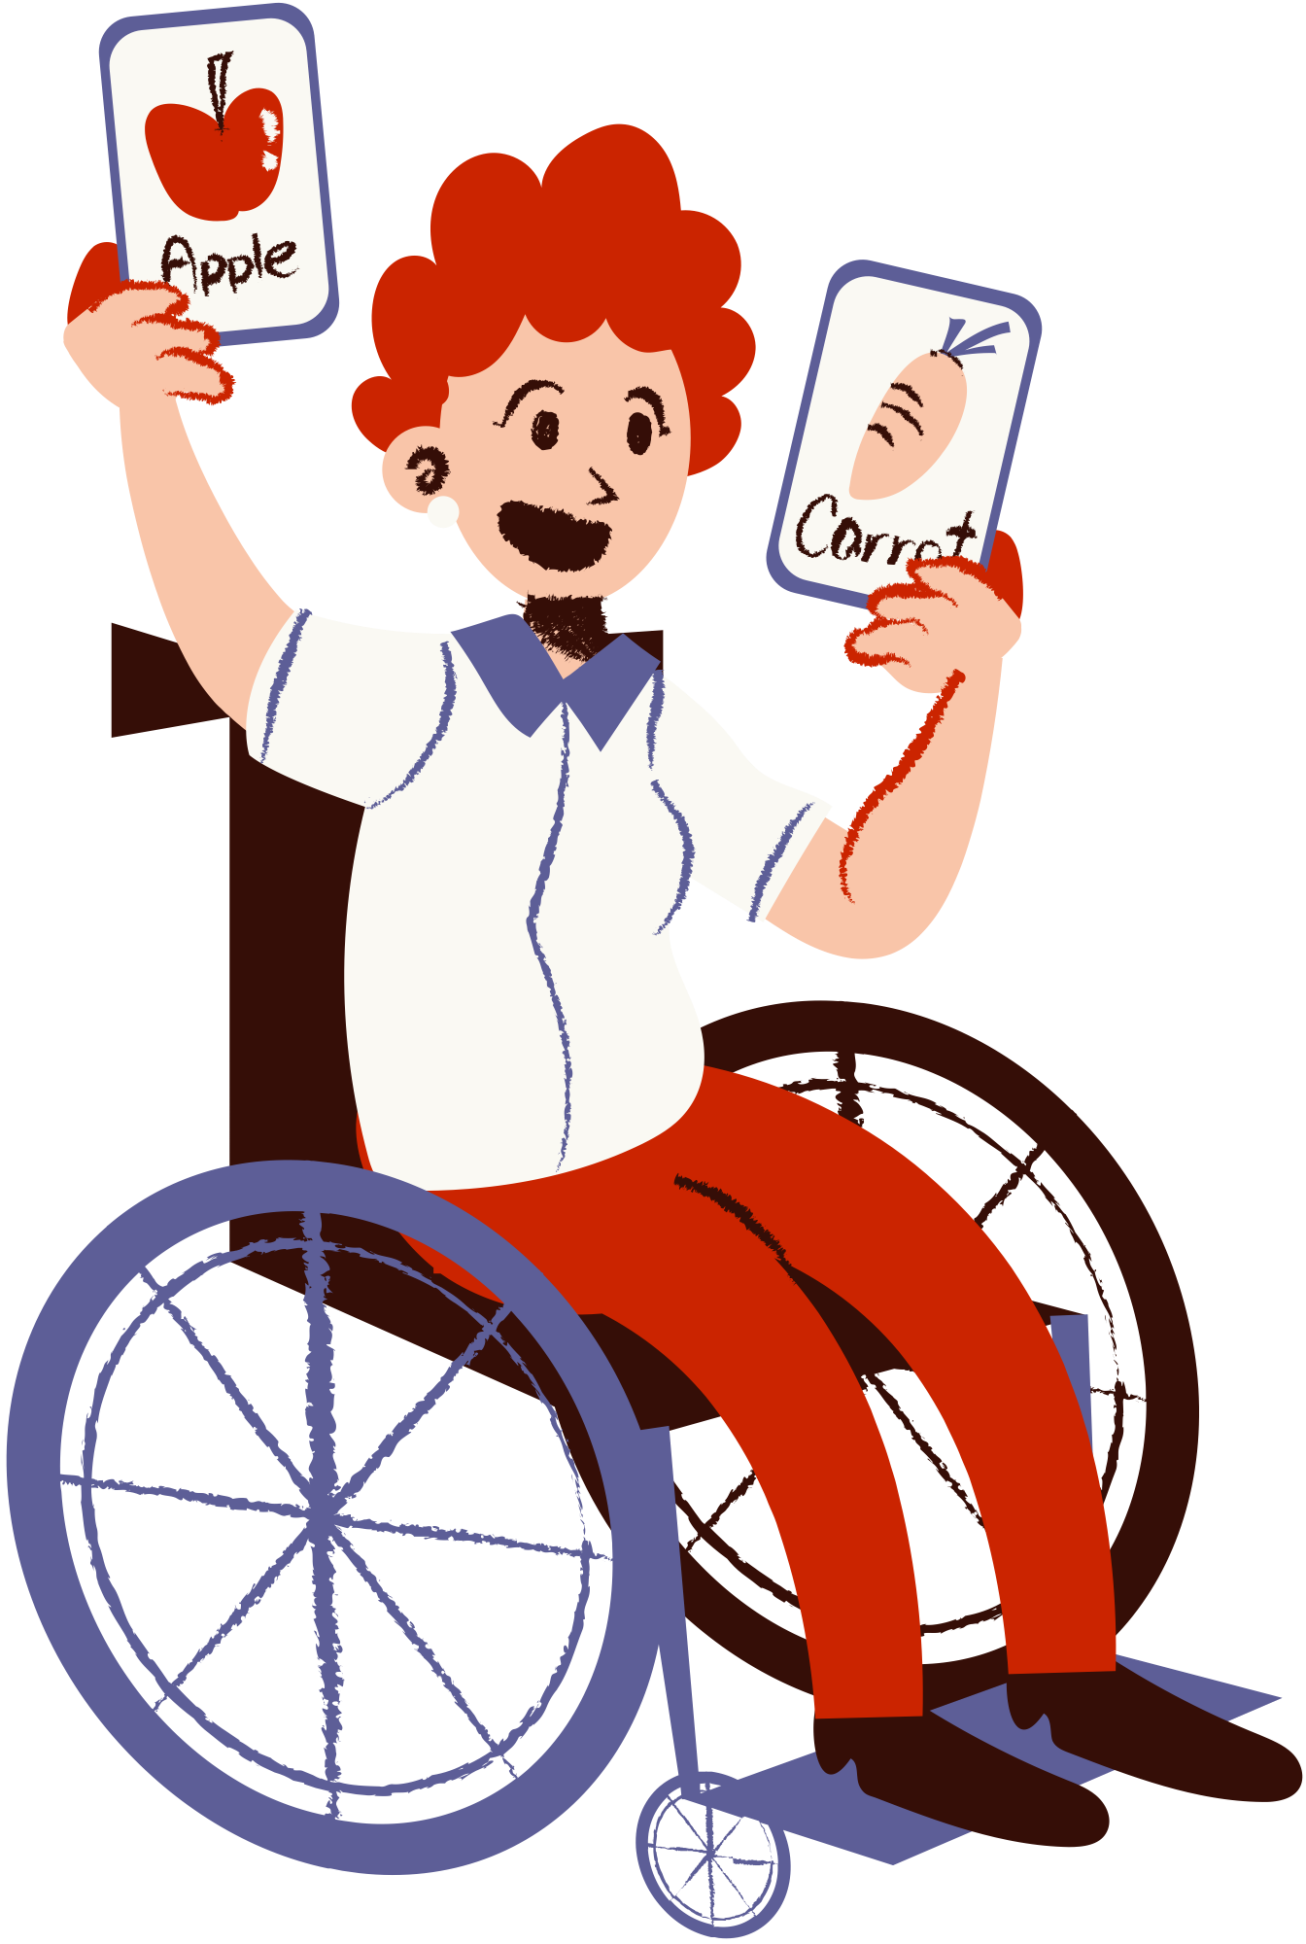


Verbals
  Verbals are verb forms that function as different parts of speech, such as nouns (gerunds), adjectives (participles), or adverbs (infinitives), while retaining some characteristics of verbs.
Can you spot the verbal
in this sentence?
  Running is my favorite form of exercise.

Slide 8

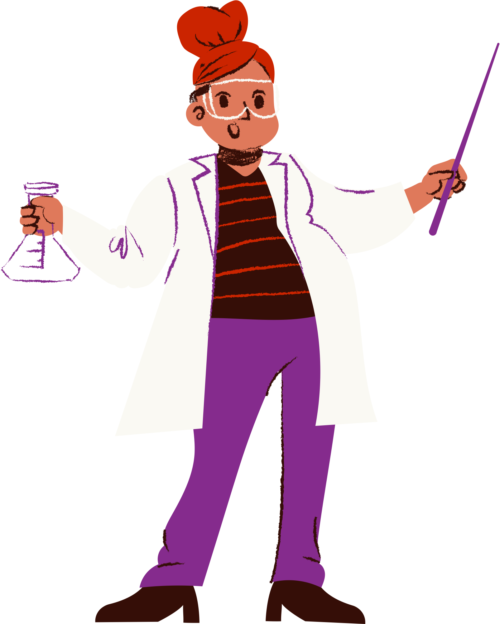
Gerunds
  are verbals ending in "-ing" that function as nouns.
  Gerunds can function as subjects, objects, subject complements, and objects of prepositions in sentences.
Can you spot the gerund in this sentence?
  I enjoy swimming in the ocean during the summer.

Slide 9
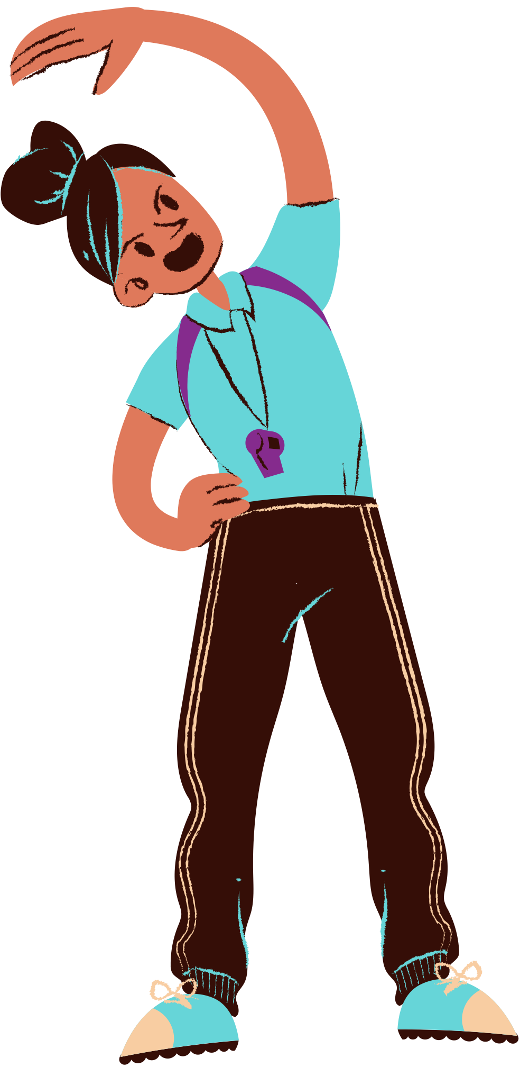

Gerunds
  I enjoy swimming in the ocean during the summer
pronoun
verb
gerund
prepositional phrase
prepositional phrase
noun, functioning
as the direct
object of the
verb "enjoy"
"in the ocean"
adverbial, modifying
the gerund "swimming
"during the summer"
adverbial, modifying the verb "enjoy"

Slide 10


Participles
  are verbals that function as adjectives and can end in "-ing" (present participles) or "-ed" (past participles).
Can you match these functions to the correct participle? Which nouns are they modifying?
  The smiling child waved goodbye.
  The running dog chased the ball.
As Past Participle
As Present Participle
  The broken vase lay on the floor.
As Adjective

Slide 11

Participles
  They can function as verb forms, adjectives, or part of progressive tenses in sentences.
As Adjective
  The smiling child waved goodbye.
It modifies the noun "child" and provides additional information about the child's appearance.
As Present Participle
  The running dog chased the ball.
It modifies the noun "dog"
and indicates that the dog
is in the act of running.
As Past Participle
  The broken vase lay on the floor.
It modifies the noun "vase" and indicates its state or condition.

Slide 12
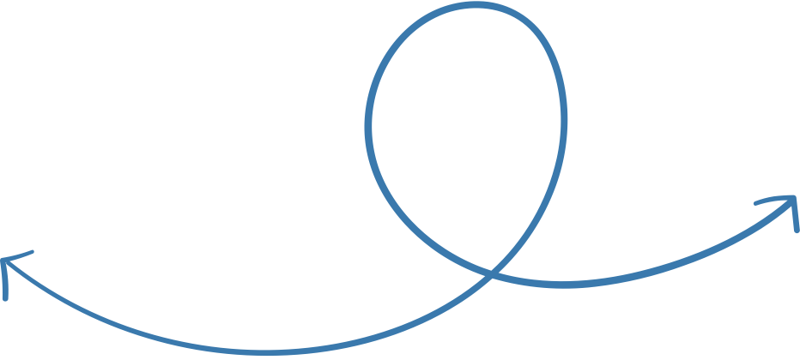
Roll a Participle
cake
flower
Roll a number from an online dice roller. Add "-ing" (present participle)
  or "-ed" (past participle) to a noun below and use it in a sentence.
vacation
school
parents
house
Example:
An exciting vacation is waiting for me after this academic year.

Slide 13

  are verbals that are formed using the base form of a verb with the word "to" before it.
Infinitives
Can you match these functions to the correct infinitive?
  To learn is essential for personal growth.
  I have a book to read during my vacation.
As a Noun
  She exercises daily to stay healthy.
As an Adverb
As an Adjective

Slide 14
Infinitives
Infinitives can function as nouns, adjectives,
  or adverbs in sentences.
functions as the subject of the sentence
As a Noun
  To learn is essential for personal growth.
modifies the noun "book," describing its purpose or intended use.
As an Adjective
  I have a book to read during my vacation.
modifies the verb "exercises," indicating the purpose or reason for the action.
As an Adverb
  She exercises daily to stay healthy.

Slide 15

Remember this!
Gerund
  Ends with -ing and functions as a noun.
  To + Base Form and functions as a noun adjective, and adverb.
Infinitives
  Ends with -ing or -ed and functions as adjective, present participle, and past participle.
Participles

Slide 16

Writing with Verbals
  Complete the sentences below with appropriate gerunds, participles, or infinitives.
1.
Sarah enjoys at the park.
(gerund)
2.
The plant attracted some butterflies.
(participle)
3.
It is important in a team.
(infinitive)
4.
The students gasped at their test results.
(participle)

Slide 17


Resource Page
Use these design resources in your Canva Presentation.
You can find these fonts online too. Happy designing!
This presentation template uses the following free fonts:
  Titles: Courgette
  Headers: Arturo
  Body Copy: Diphylleia,

Slide 18



Credits
This presentation template is free for everyone to use thanks to the following:
SlidesCarnival for the presentation template
Pexels for the photos
Happy designing!

