Slide 1







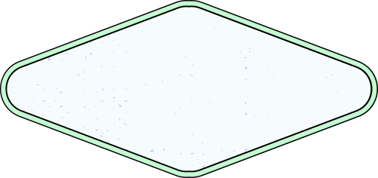
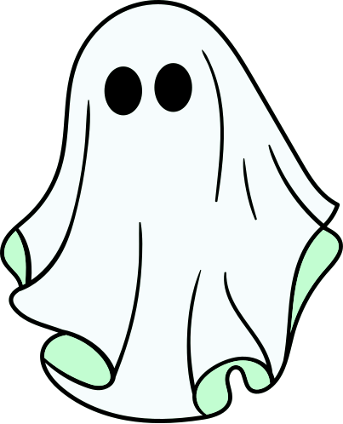
HALLOWEEN EDITION BACKGROUND
Family
Feud
SPOOKY FUN FOR THE WHOLE FAMILY

Slide 2





Game Rules
01
Create teams with captains
02
Features Fast Money & Main Game rounds
03
Based on real responses
04
Points earned from popular answers

Slide 3



Gaming Rounds
Round 2
2 questions
Round 1
Round 3
3 questions
3 questions

Slide 4

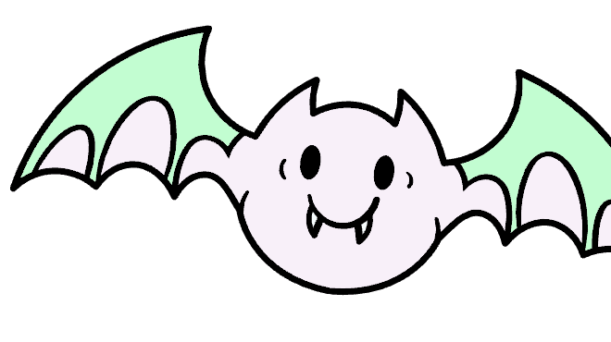
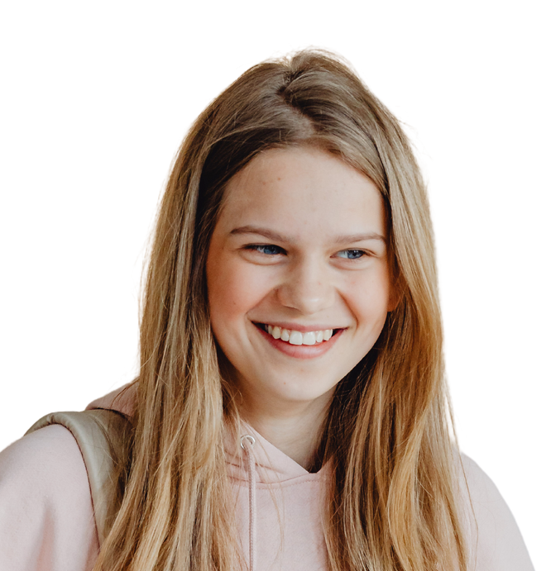


Our Team
Sally
John
Mary

Slide 5






START

Slide 6
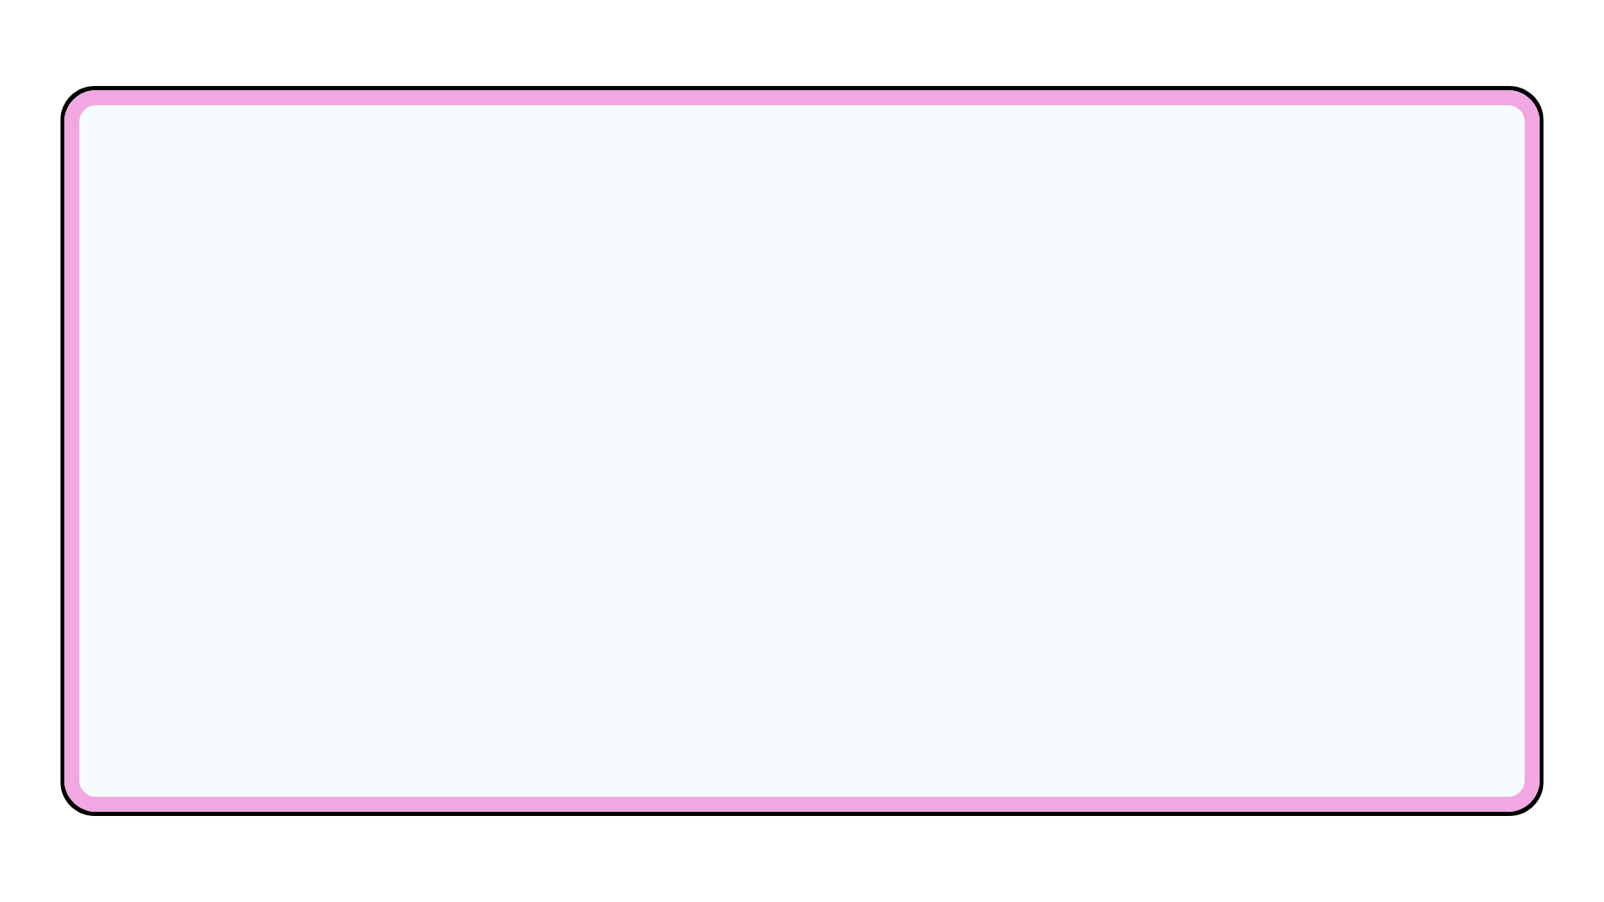


Question 1
  Name a popular Halloween candy.
1
2
3
4

Slide 7

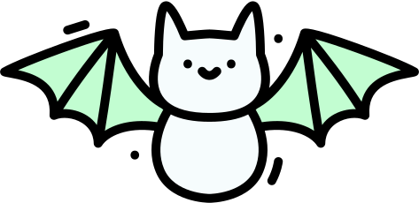
Answer 1
  Name a popular Halloween candy.
53
21
Peanut Butter Cups
Peanut M&M's
16
10
Peanut Butter Cups
Regular M&M's

Slide 8


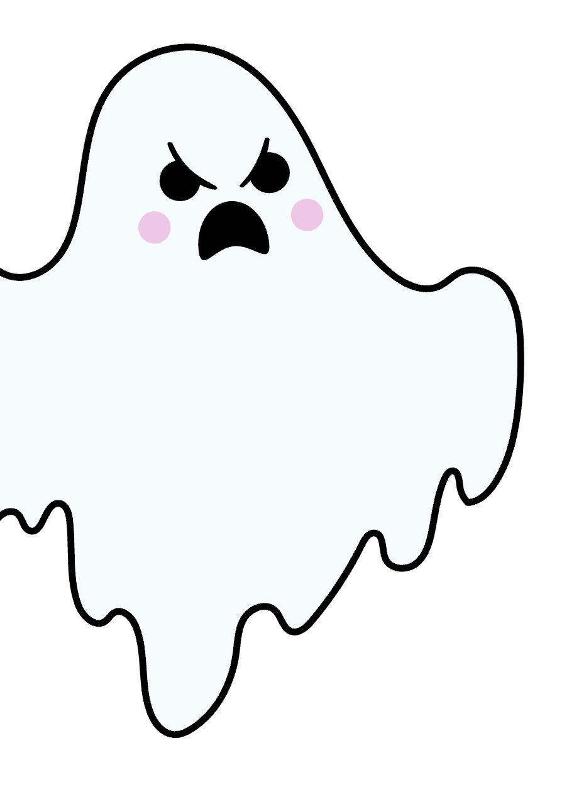

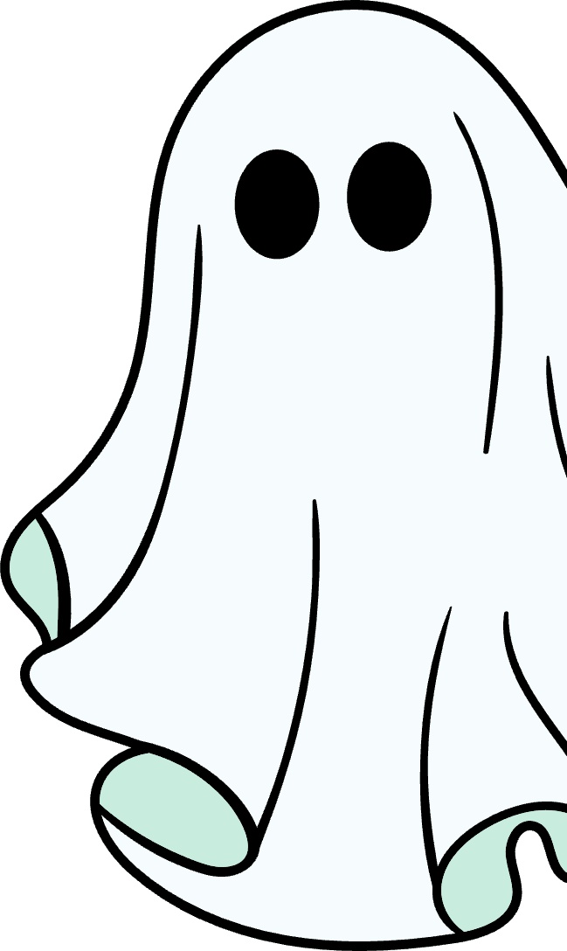




Strike!

Slide 9


Question 2
  Name a popular Halloween decoration.
1
2
3
4

Slide 10


Answer 2
  Name a popular Halloween decoration.
53
21
Pumpkin
Ghosts
16
10
Skeletons
Spider webs

Slide 11








Next Question

Slide 12

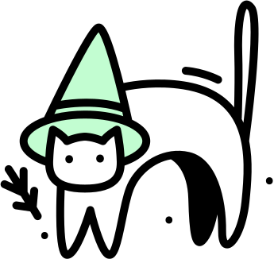

Question 3
What's the scariest part
of a haunted house?
1
2
3
4

Slide 13


Answer 3
  What's the scariest part
  of a haunted house?
53
21
Jump scares
Dark corridors
16
10
Creepy sounds
Ghost sightings

Slide 14



  TEAM A
  TEAM B
72
81

Slide 15




  WINNER IS
Team B

Slide 16
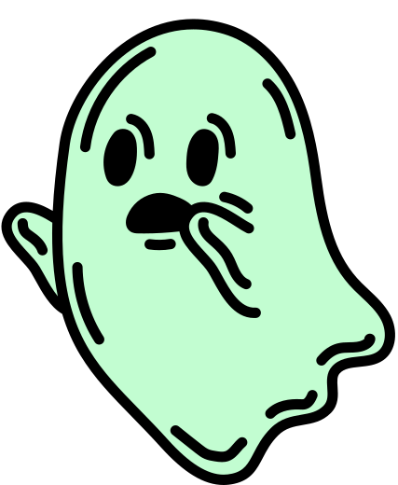
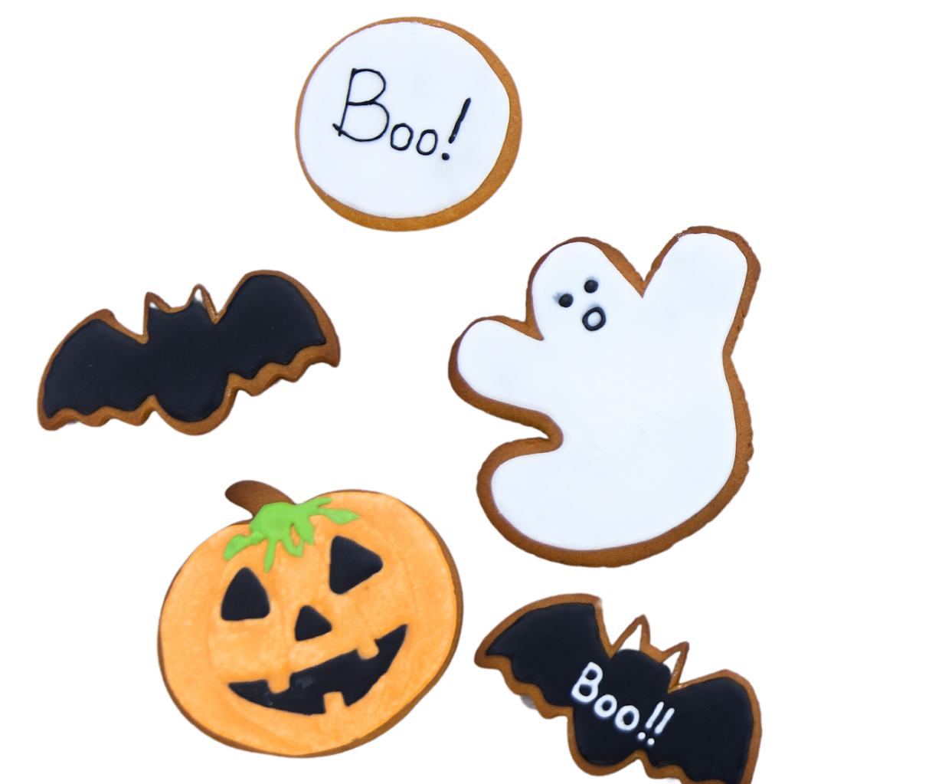



Frighteningly Fantastic
Prizes Await!

Slide 17


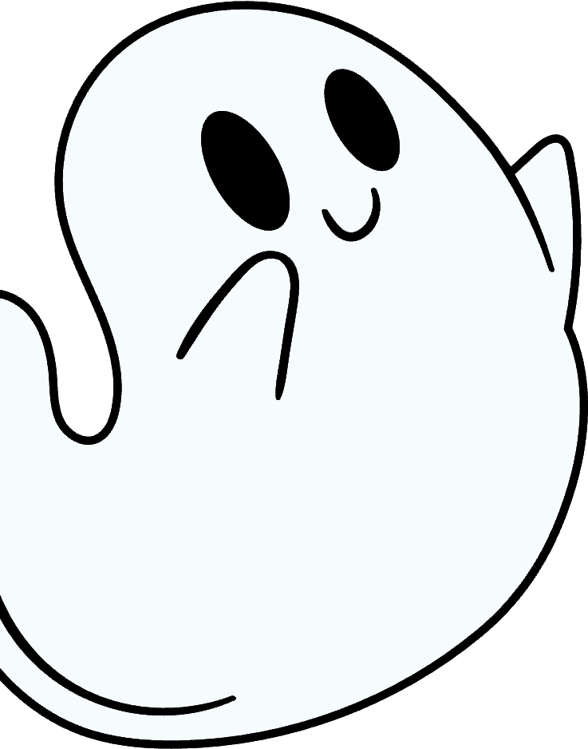



Thank
You

Slide 18

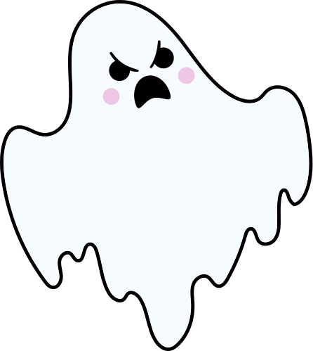

Resource Page
  Use these design resources in your Canva Presentation.
  Fonts
This presentation template uses the following free fonts:
Titles :
  Berkshire Swash
  Headers :
  Nunito Sans
  Body Copy :
  Nunito Sans
You can find these fonts online too.
  Colors
#CDC2FD
#C2FDD1
#F1A7E1

Slide 19




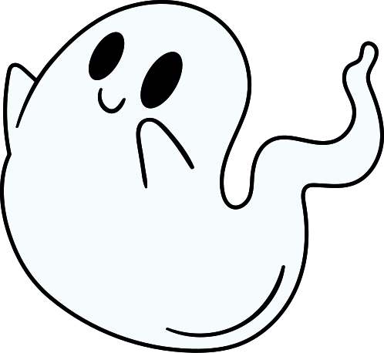





Slide 20
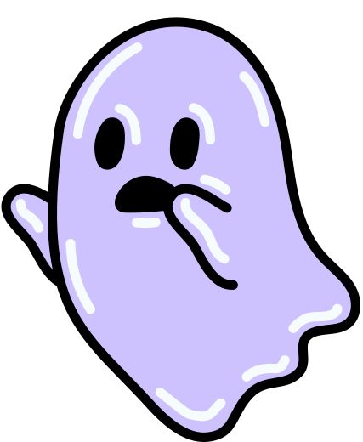

Credits
  This presentation template is free for everyone to use thanks to the following:
  for the presentation template
Pexels & Pixabay
  for the photos

