Slide 1



CYCLONE DONATIONS
and FUNDRAISING
PROPOSAL
PRESENTATION

Slide 2

Table Of Contents
01
OBJECTIVES
04
SOLUTIONS
RESOURCES
COMMUNICATION
PLAN
02
05
03
BUDGET
06
CONCLUSION

Slide 3



HOW TO solve
the AFTERMATH
Creating a project proposal can be done in five steps:
  Define the project objectives and timeline.
  Identify resources needed to complete the project
  Develop a budget for the project and estimate any potential risks associated with it.
  Write down your proposed solution and provide supporting documents or evidence that prove its feasibility if necessary. Develop a communication plan to ensure key stakeholders are kept informed of progress throughout the entire process

Slide 4


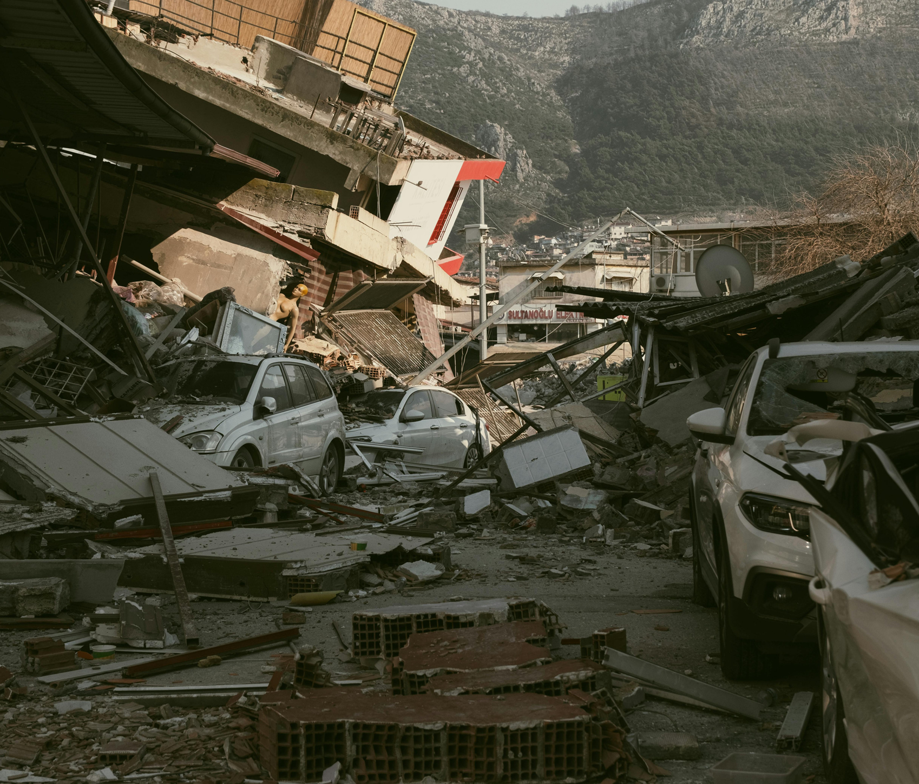
01
OBJECTIVES
OF THE PROJECT

Slide 5



OBJECTIVES
OUR AIM
THE GOAL
An aim in a corporate context is a goal or desired result that the organization seeks to achieve. The aim should be clear and achievable, and often serves as the basis for further planning actions inside
Goals inside a company are usually specific and measurable, with clearly defined deadlines and outcomes. The company’s goals help focus the actions of the organization and ensure resources are used effectively

Slide 6





RESOURCES
HUMAN
RESOURCES
FINANCIAL
RESOURCES
PHYSICAL
RESOURCES
The project team is responsible for the successful execution of the project. Our team is composed of experienced professionals with the necessary skills and expertise to complete the project on time
Our project budget is $100,000. This budget includes all expenses associated with the project, including salaries and equipment. We have allocated these resources to ensure that we are able to complete the project within budget
Our project requires a number of specialized pieces of equipment. We will be using [insert equipment and their functions]. All equipment is in good working condition and has been tested and calibrated prior to use

Slide 7






BUDGET
SOURCES OF FUNDING
PERSONNEL COSTS
Funding for a company can come from personal savings or investments, bank loans and other loan options, venture capital and angel investors, grants, competitions or programs
Personnel costs refer to the expenses incurred in hiring, training and retaining staff for a company. This can include salaries, bonuses, benefits and other payroll-related costs
EQUIPMENT AND MATERIALS
TRAVEL AND MISCELLANEOUS
Equipment and materials costs refer to all the expenses related to the purchasing, maintenance and upkeep of any physical items used in production or other business processes inside the company
Travel and miscellaneous costs refer to expenses related to any travel-related activities, such as conferences, trainings or business trips. It may also include office supplies, communications services, licenses and other miscellaneous expenses

Slide 8




04
SOLUTIONS

Slide 9








SOLUTIONS
SOLUTION 1
SOLUTION 2
SOLUTION 5
Implementing a new CRM (Customer Relationship Management) system to improve customer data management
Outsourcing specific business functions (such as accounting or IT) to a third-party provider to reduce costs and increase time efficiency
Implementing a cost-saving initiative, such as energy-efficient practices or process automation, to reduce expenses
SOLUTION 3
SOLUTION 4
SOLUTION 6
Launching an e-commerce platform to expand the reach of the business and increase online sales
Developing a new product or service to diversify the business and increase revenue streams
Establishing strategic partnerships with other businesses to gain access to new markets or
innovative technologies

Slide 10



$500,000
BUdget of the project
200 UNITS
Break-even point
25%
Donations level

Slide 11




10 MILLION
First-year revenue of the project

Slide 12

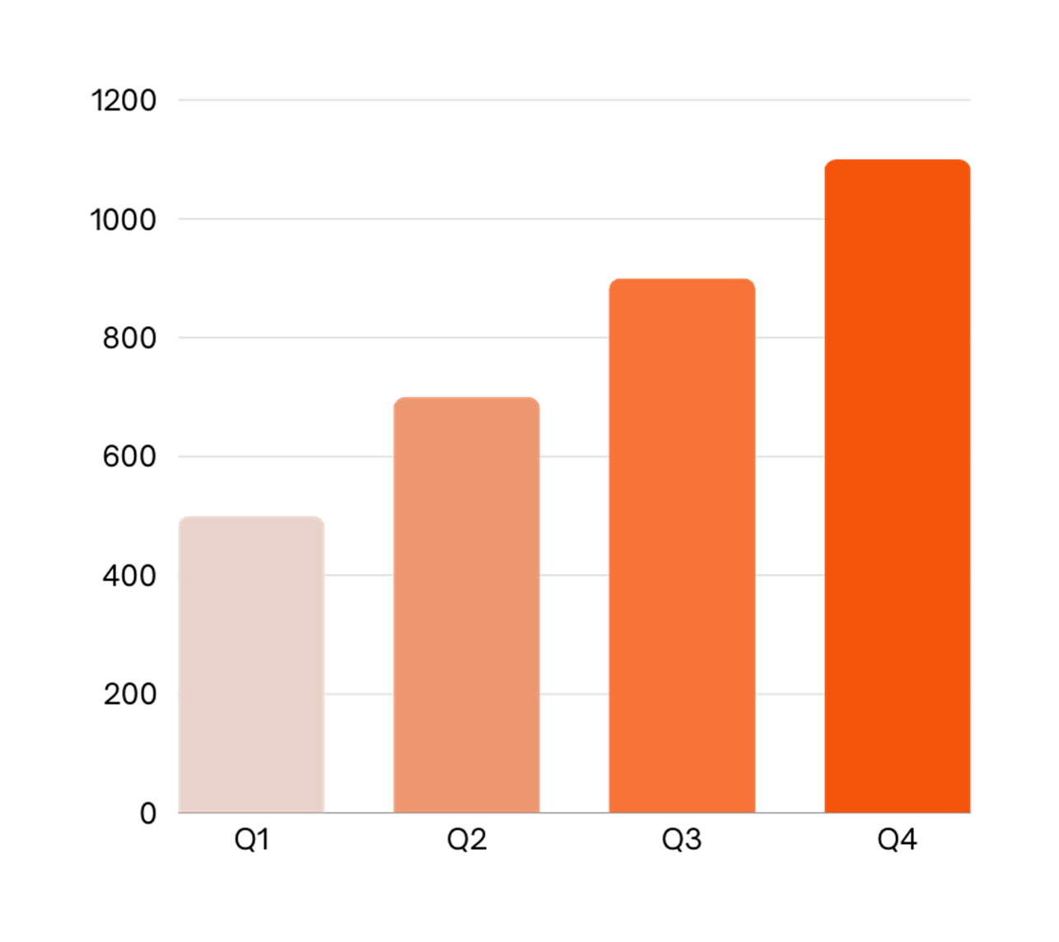

PROJECT DATA
BENEFITS OF USING GRAPHS
Graphs in project proposals offer visual organization, enabling clear presentation of information in a structured format. They enhance the visual appeal, facilitate data comparison and improve overall clarity and professionalism of your project proposal

Slide 13


PROJECT ACTIVITIES
ACTIVITY | START DATE | END DATE | RESOURCE | COST | REVENUE
MARKET RESEARCH | 1/1/20XX | 1/15/20XX | Marketresearch firm | $20,000
PRODUCT DEVELOPMENT | 1/16/20XX | 6/30/20XX | R&D team | $200,000
BETA TESTING | 7/1/20XX | 8/15/20XX | Beta testers | $10,000
MARKETING CAMPAIGN | 1/1/20XX | 1/15/20XX | Advertising agency | $100,000
PRODUCT LAUNCH | 1/16/20XX | 6/30/20XX | Sales team | $50,000 | $500,000
POST-LAUNCH SUPPORT | 7/1/20XX | 8/15/20XX | Support team | $50,000 | $800,000

Slide 14


WHAT TO SHOW IN A MOCKUP
01
Product/website description: A brief overview of the product/website, including its key features, dimensions, and materials used
Features and benefits: A detailed explanation of the product's/website's features and how they will benefit the user
Technical specifications: A list of the product's/website's technical specifications, such as dimensions, weight, power requirements, connectivity options and hosting platform
02
03

Slide 15









PROJECT TIMELINE
Conduct market research and analyze the target audience to identify opportunities
Create the product or service by defining features, design, and functionality
Test the product with a group of users to receive feedback and improve the product
Execute a marketing campaign to promote the product to the target audience
Release the product or service to the market with a comprehensive launch plan
Provide customer support to ensure customer satisfaction
Explore opportunities for growth and expansion of the product or service
Continuously improve the product based on customer feedback and market trends

Slide 16


PROJECT ROADMAP
 |  | JAN | FEB | MAR | APR | MAY | JUN | JUL | AUG | SEP | OCT | NOV | DES
Market research | Increase brand awareness by 30% within the first year
Product development | Achieve a customer satisfaction rate of 90%
Marketing campaign | Increase revenue by 20% within the first year
Product launch | Achieve a customer satisfaction rate of 90% within the first year
Expansion | Reduce costs by 15% within the first year by expanding the product
Partnership | Reach profitability within 18 months of launch

Slide 17


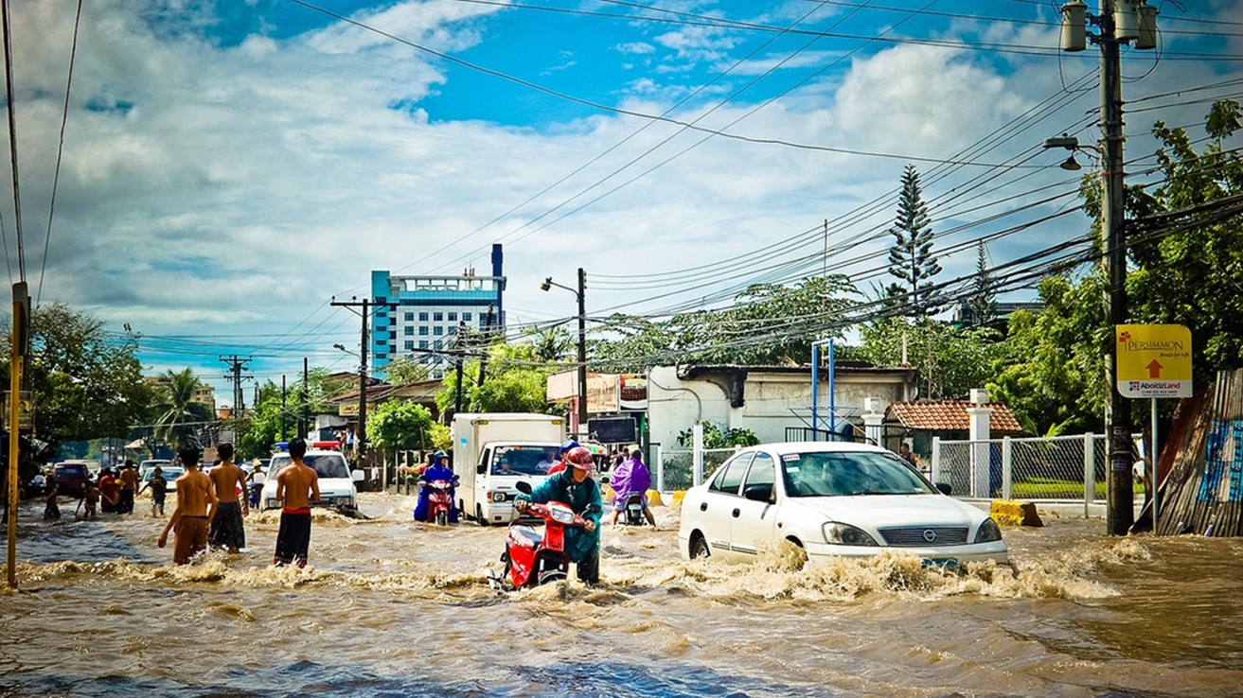
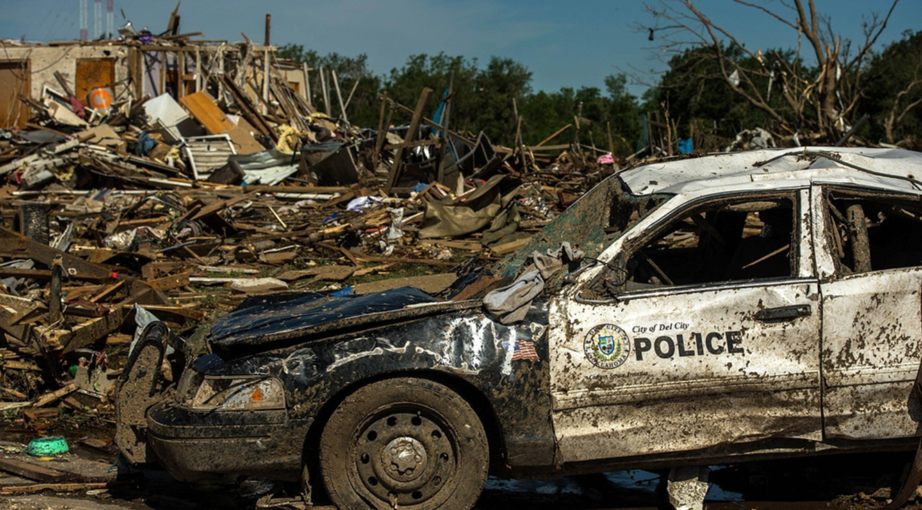

PHOTO SHOWCASE
A photo showcase can be a useful addition to a business project proposal as it can help to visually communicate the concept or idea being proposed

Slide 18


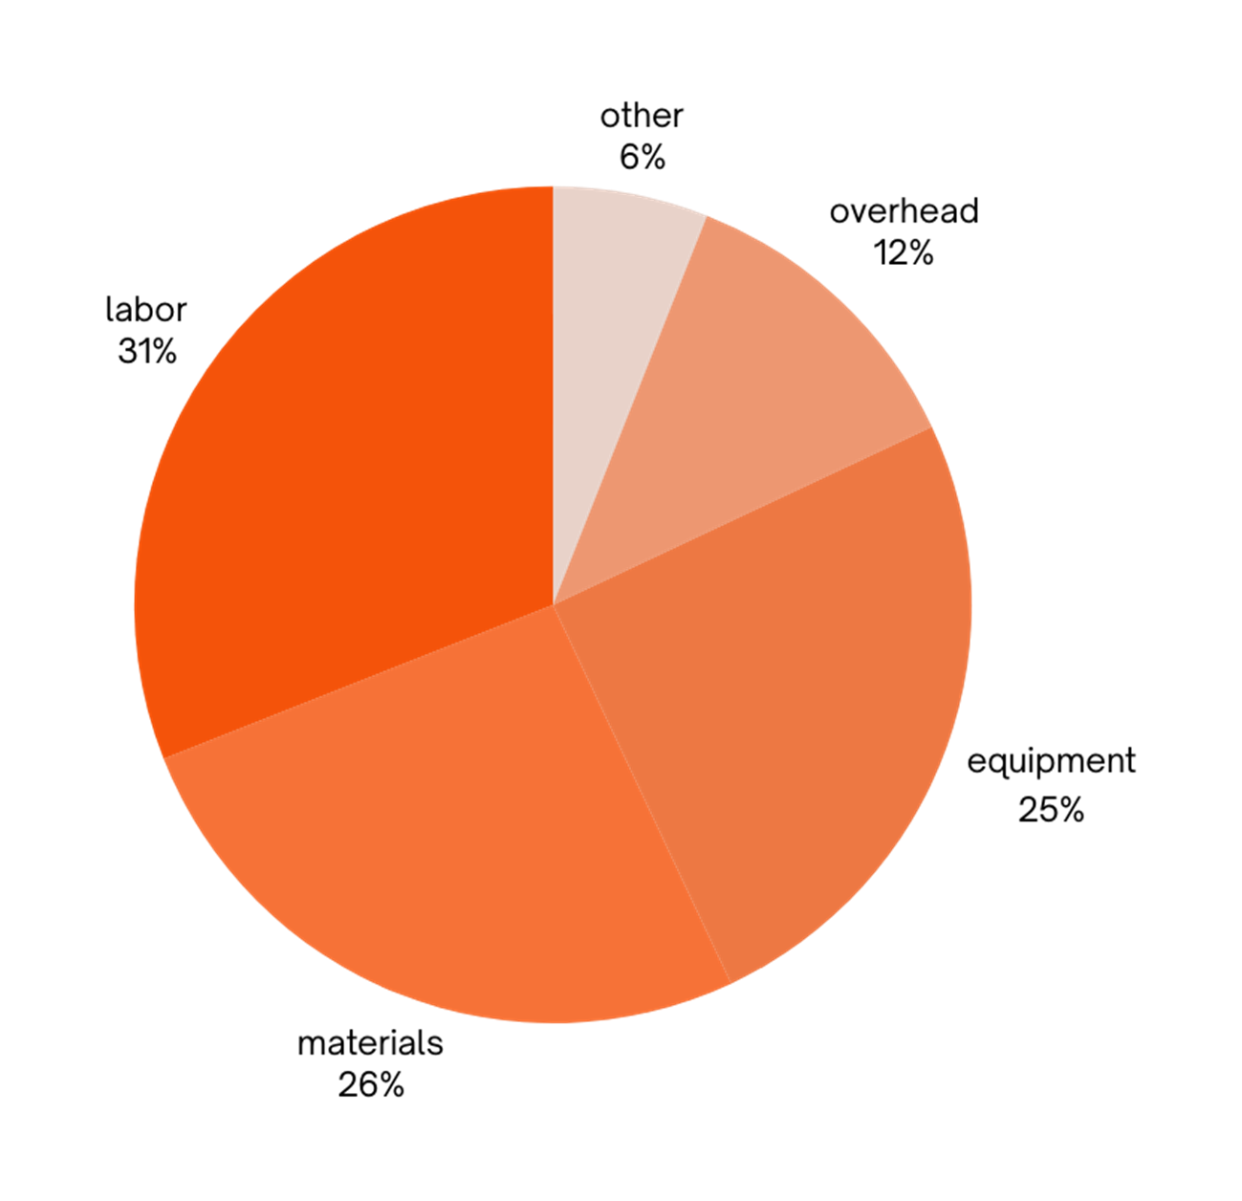

PROJECT EXPENSES
LABOR
MATERIALS
EQUIPMENT
OVERHEAD
OTHER

Slide 19

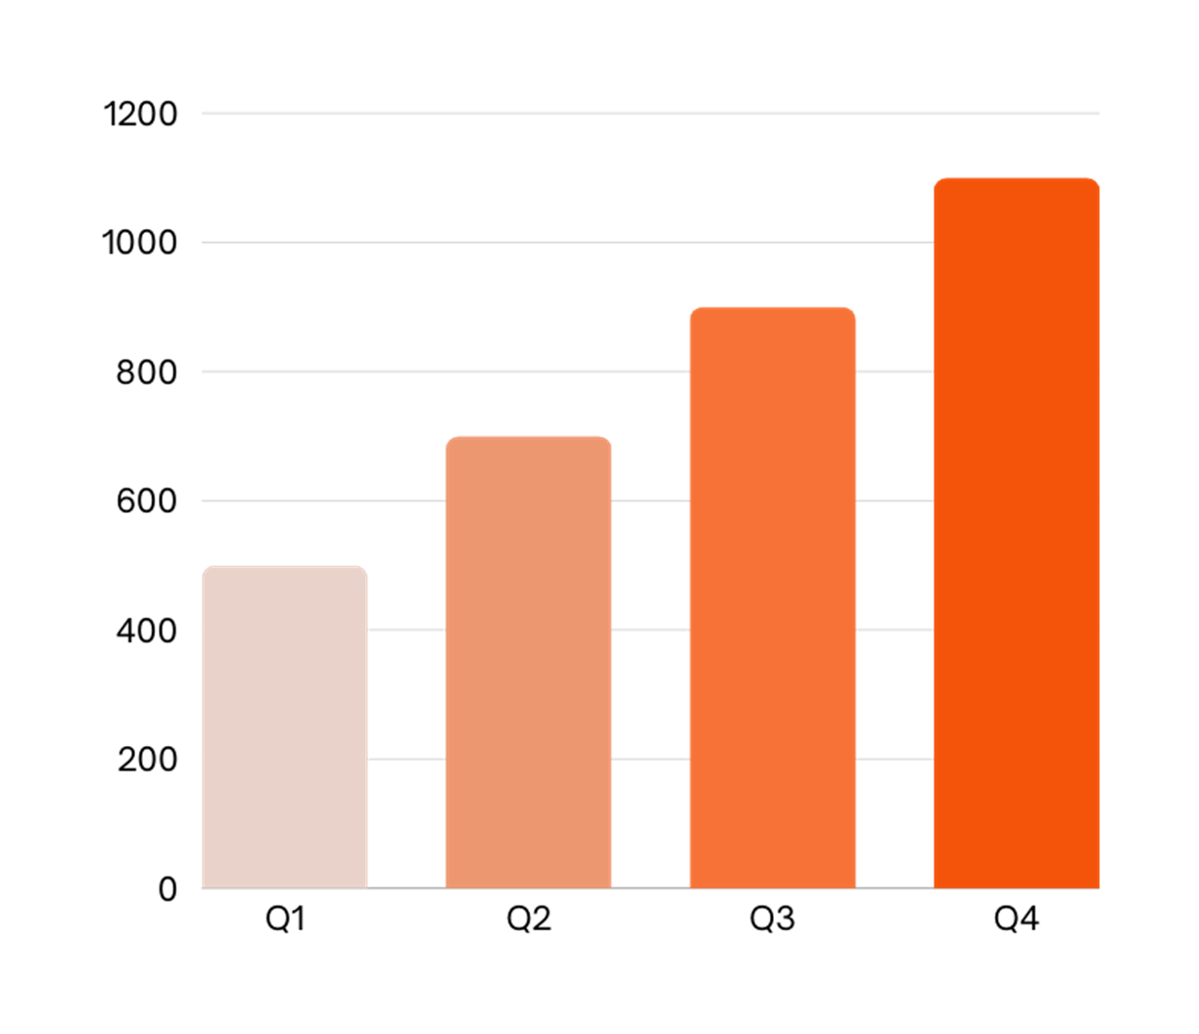

KPI DASHBOARD
120 U/DAY
2H
RESOURCE | UTILIZATION RATE | COST PER UNIT
Labor | 85% | $50
Equipment | 70% | $100
Materials | 95% | $20
Rent | 90% | $1,000
Energy | 80% | $80
Software licenses | 80% | $200
Advertising | 60% | $500
Output per worker
Time to complete a task

Slide 20





THANKS!
Do you have any questions?
youremail@donation.com
+18 654 321 432
yourwebsite.com

Slide 21







Resource Page
This presentation template
uses the following free fonts:
Titles: BEABS NEUE KYRILLIC
Headers: BEABS NEUE KYRILLIC
Body Copy: Web Servroff
You can find these fonts
online too. Happy designing!
Don't forget to delete this
page before presenting.

Slide 22


Credits
This presentation template is free for everyone to use thanks to the following:
SlidesCarnival for the presentation template
Pexels for the photos
Happy designing!

