Slide 1
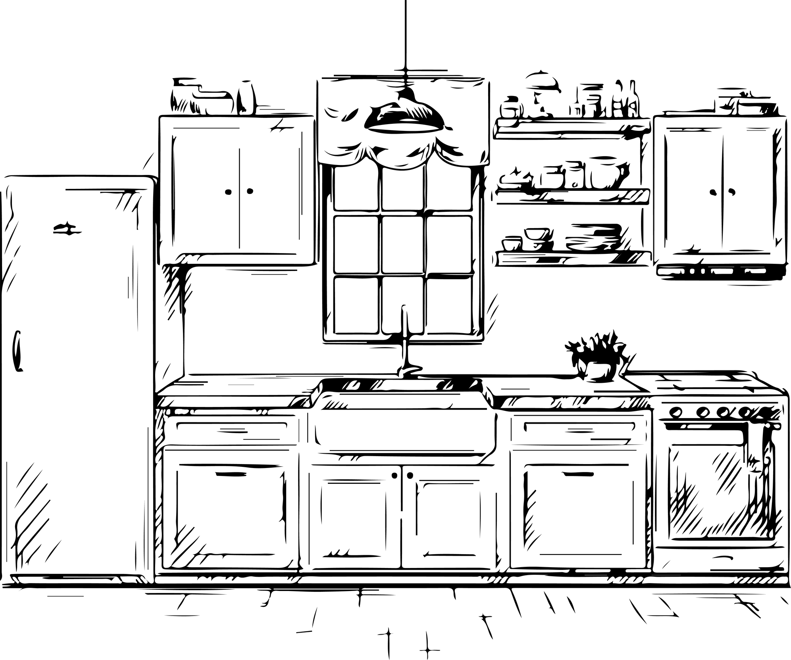

Yes,
Chef!

Slide 2
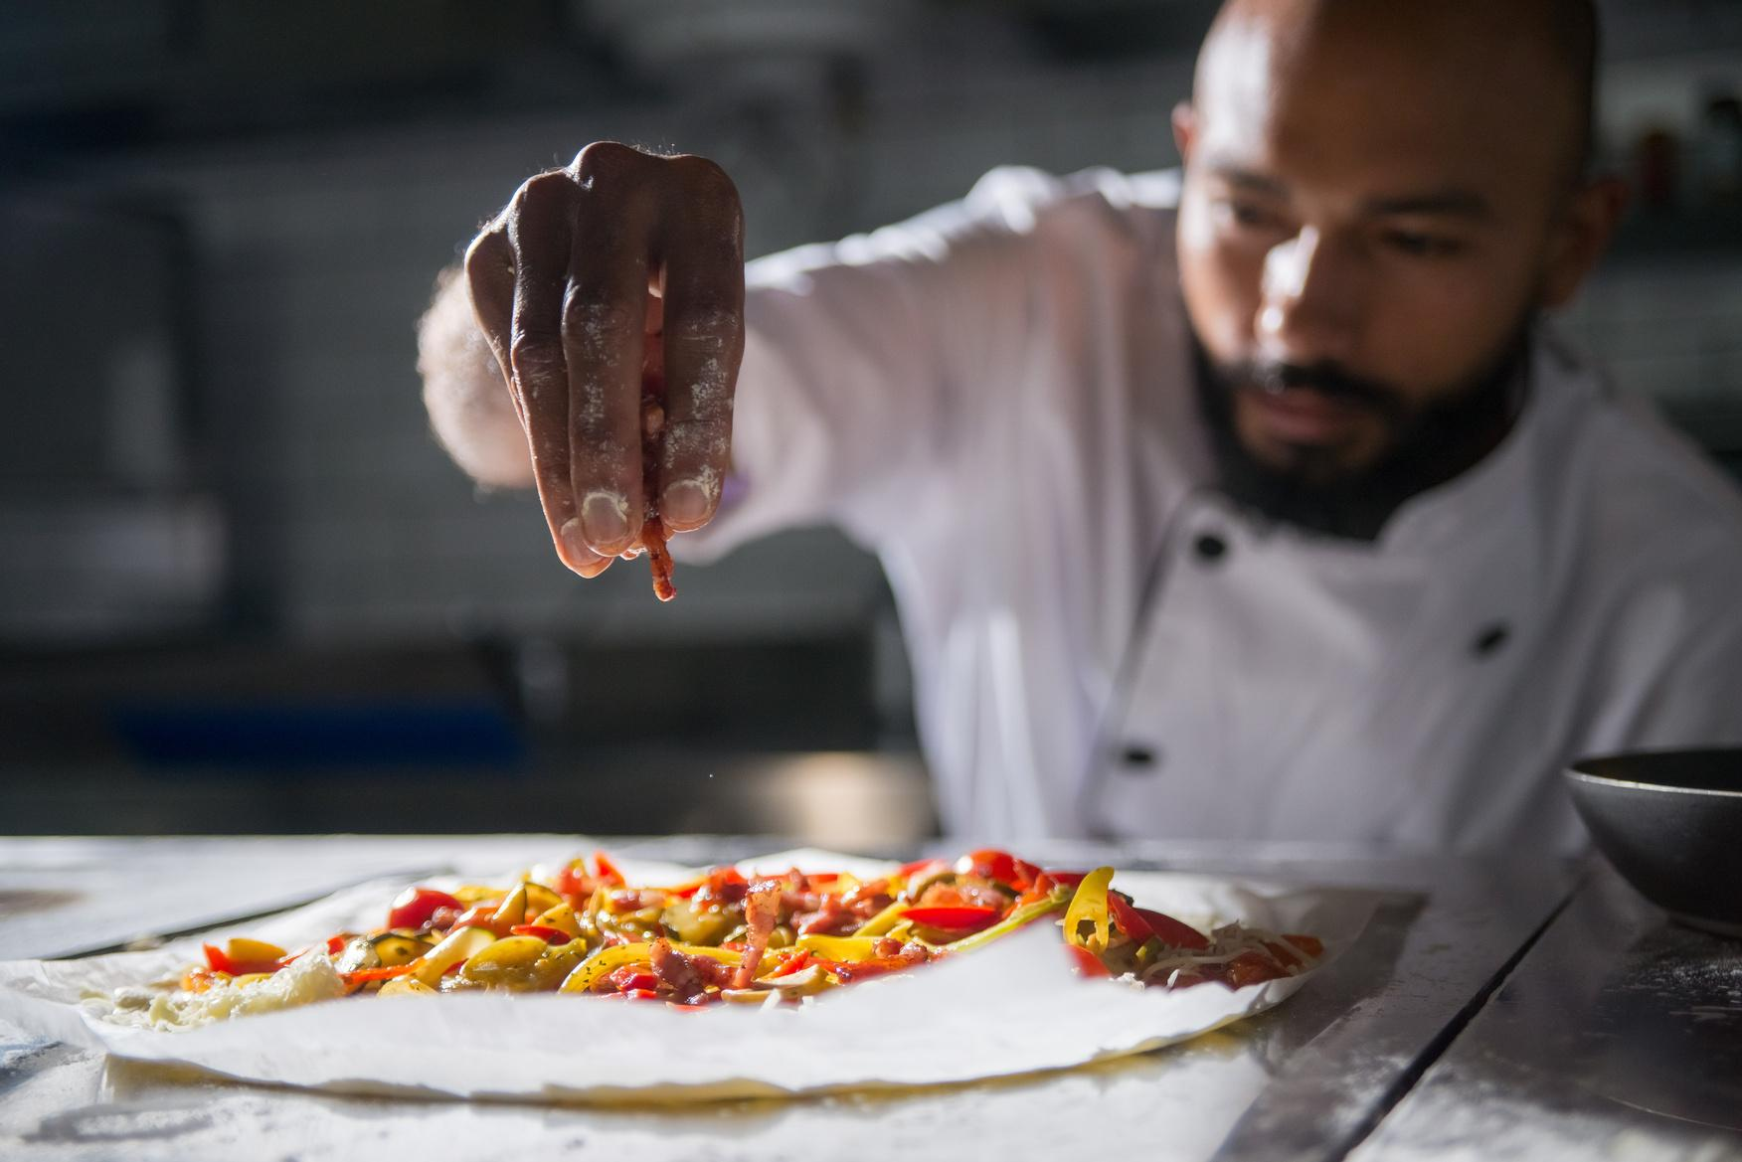
when i add red pepper flakes to
every slice of pizza i eat

Slide 3
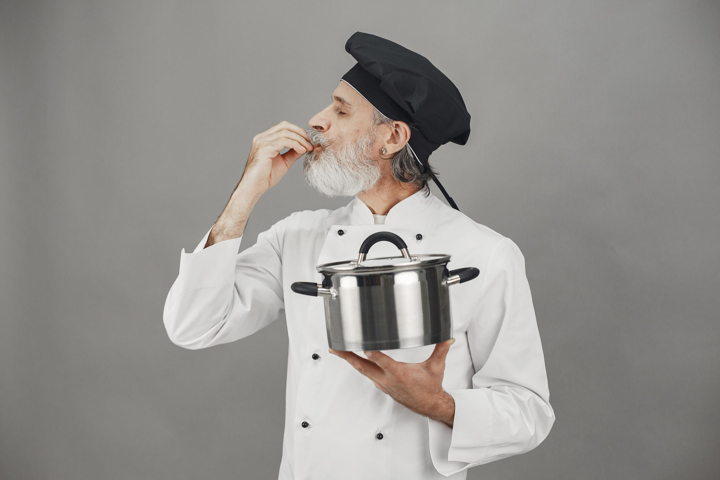
ME AFTER ADDING GARLIC AND ONION
POWDER TO MY INSTANT RICE

Slide 4
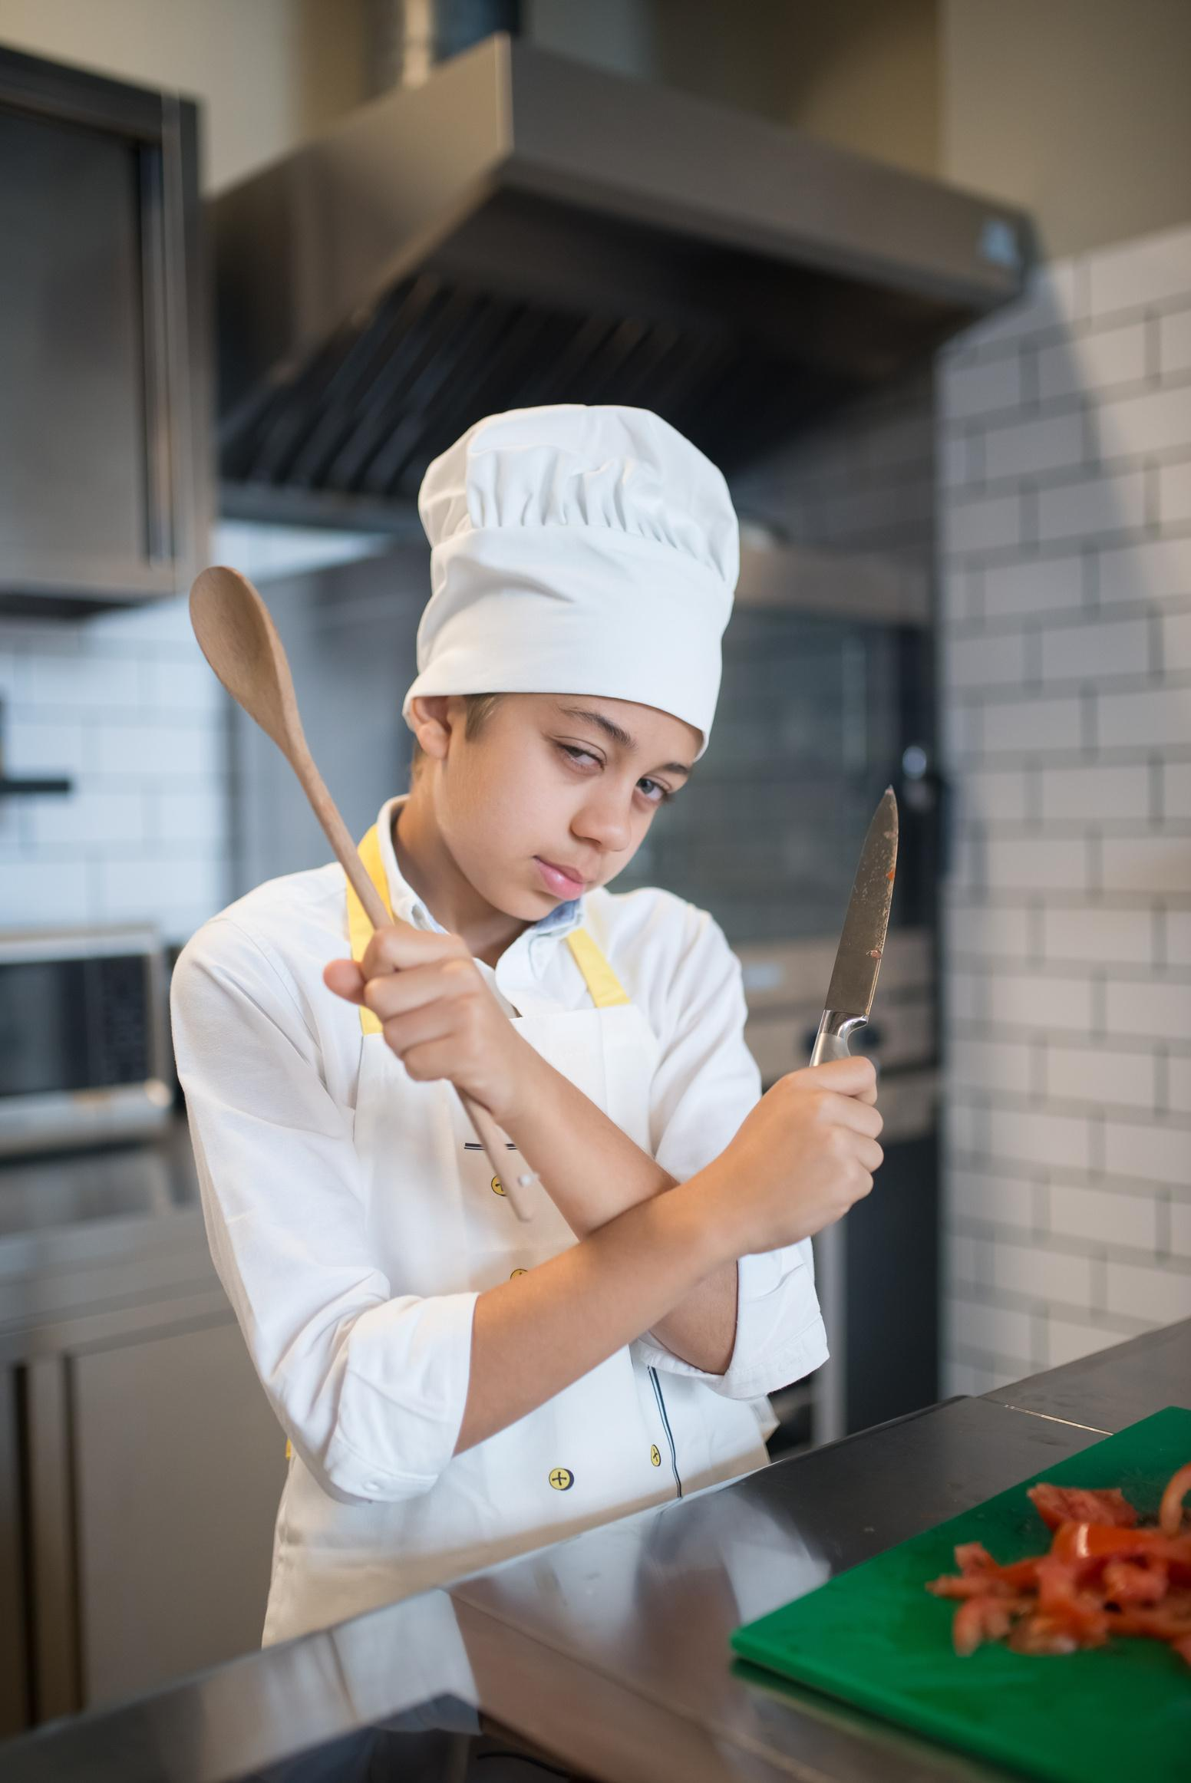
ME AFTER 1 EPISODE OF THE BEAR

Slide 5







































RESOURCE PAGE
  Use these design resources in your Canva Presentation.
Fonts
Design Elements
This presentation template
uses the following free fonts:
TITLES:
LUCKIEST GUY
BODY COPY:
LUCKIEST GUY
You can find these fonts online too.
  DON'T FORGET TO DELETE THIS PAGE BEFORE PRESENTING.

Slide 6

CREDITS
  This presentation template is free for everyone to use thanks to the following:
  for the presentation template
Pexels, Pixabay
  for the photos
  HAPPY DESIGNING!

