Slide 1
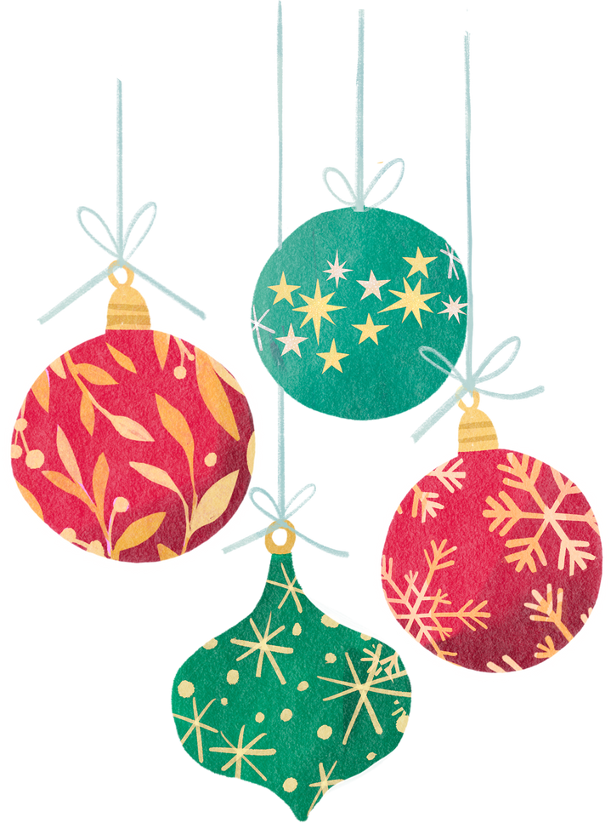
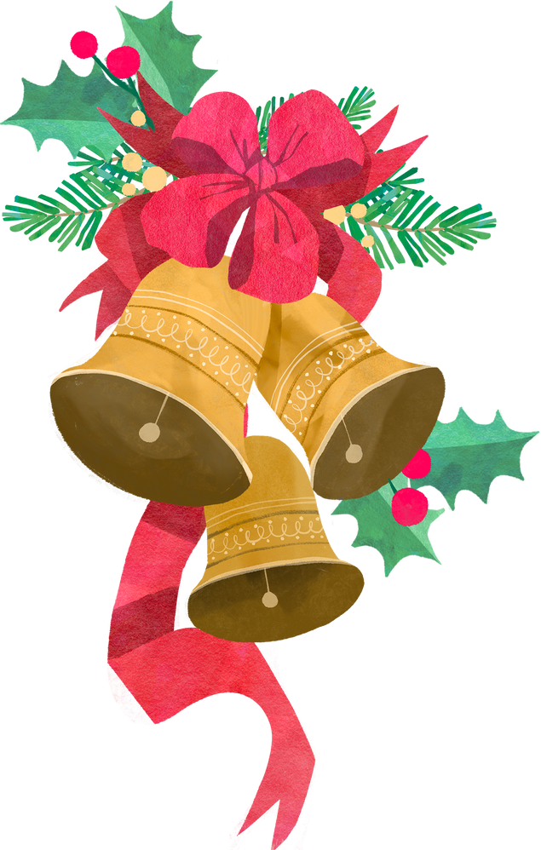

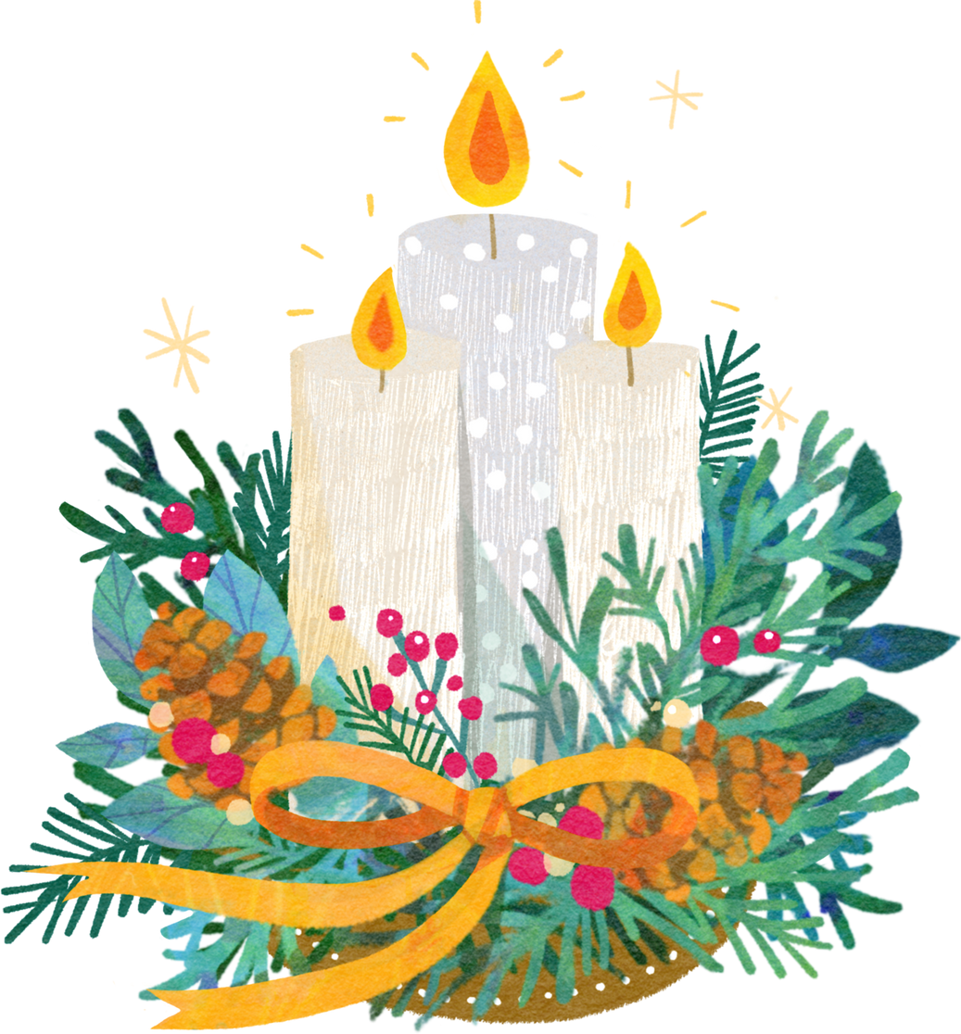

Noël en France
Christmas In France
Illustrated Slides

Slide 2

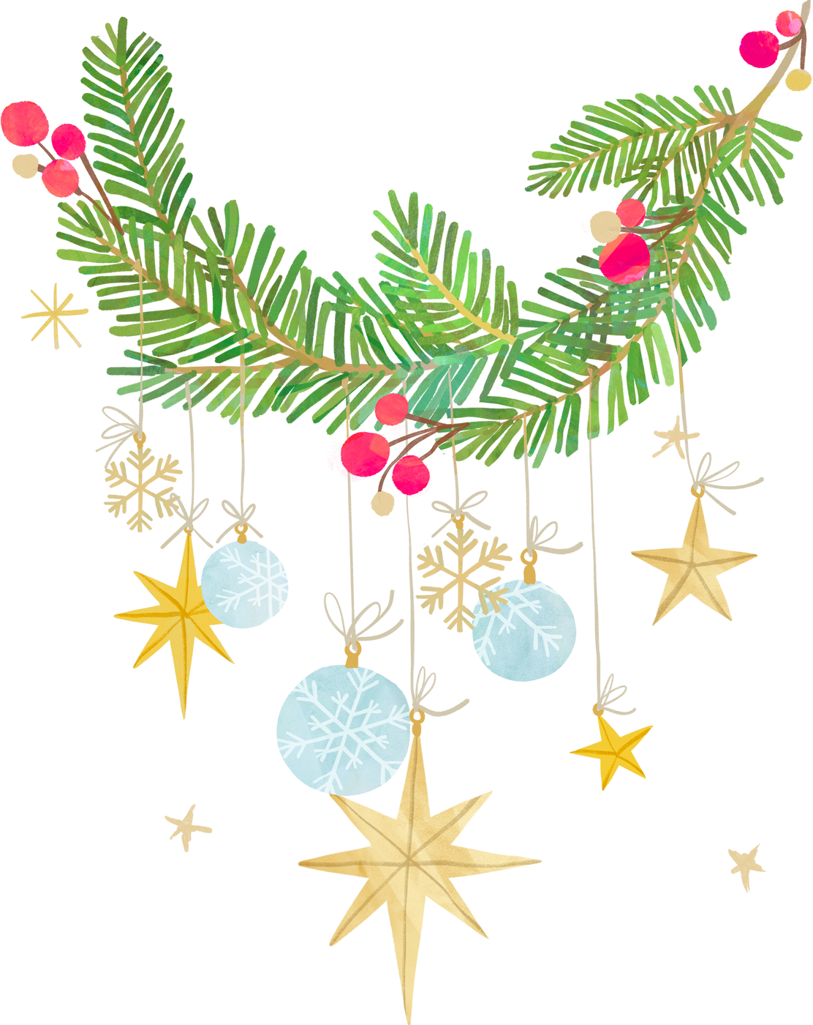
Christmas Holiday
25th December is a public holiday in France. However, Boxing Day on the 26th is not a holiday, because it’s an English, not French, tradition. So everyone goes to work the day after Christmas Day!

Slide 3
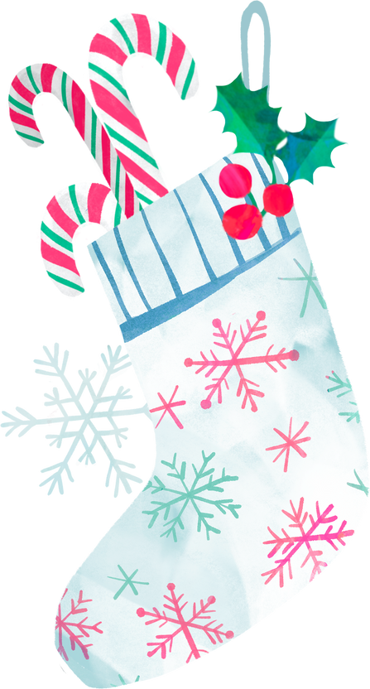
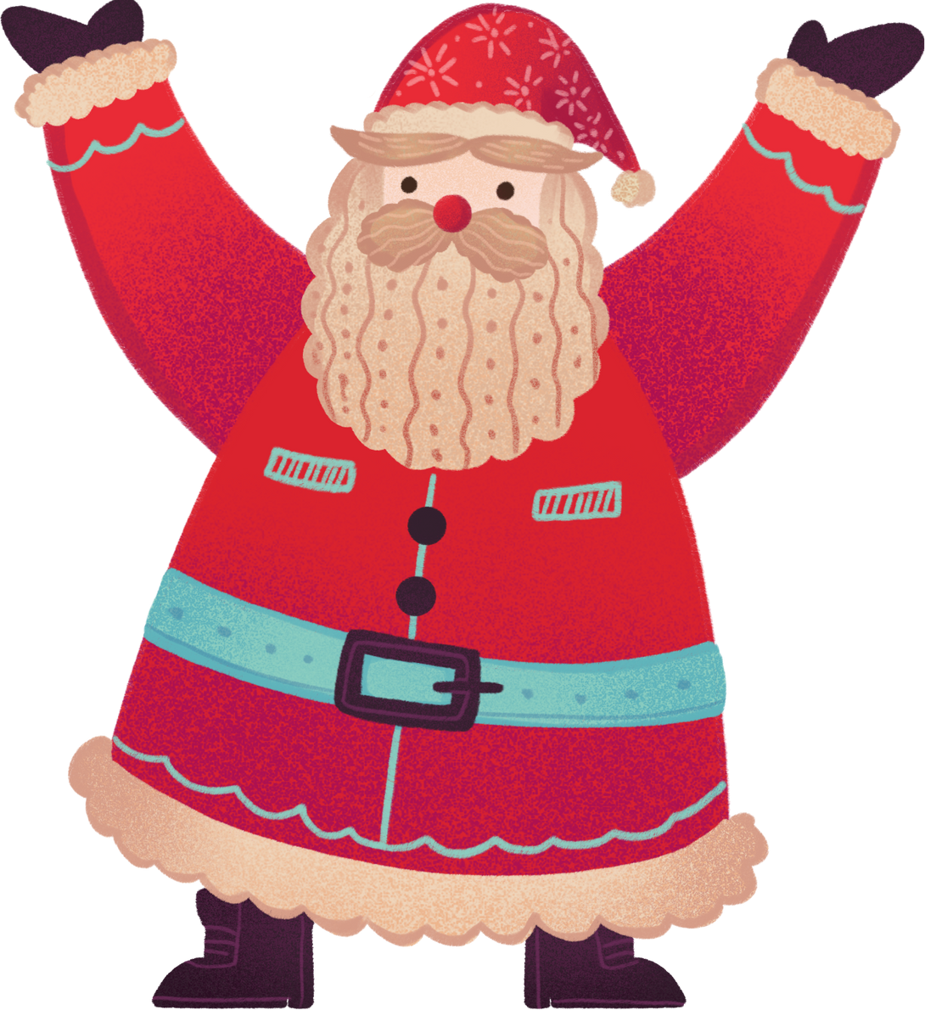

Saint Nicolas
It was Saint Nicholas who was the original Father Christmas, or 'Père Noël' as he is known in France.
Traditionally, it was St Nicholas who brought the presents to children.

Slide 4
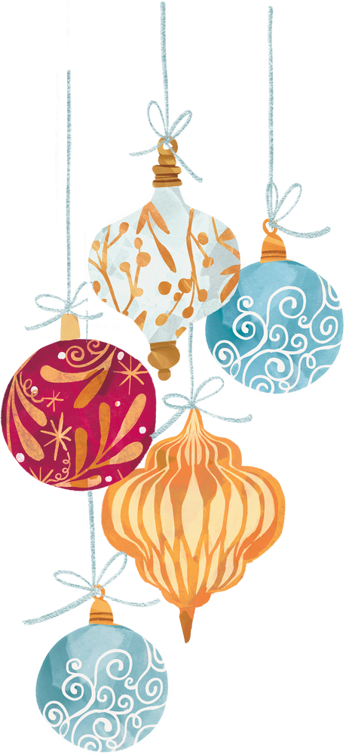
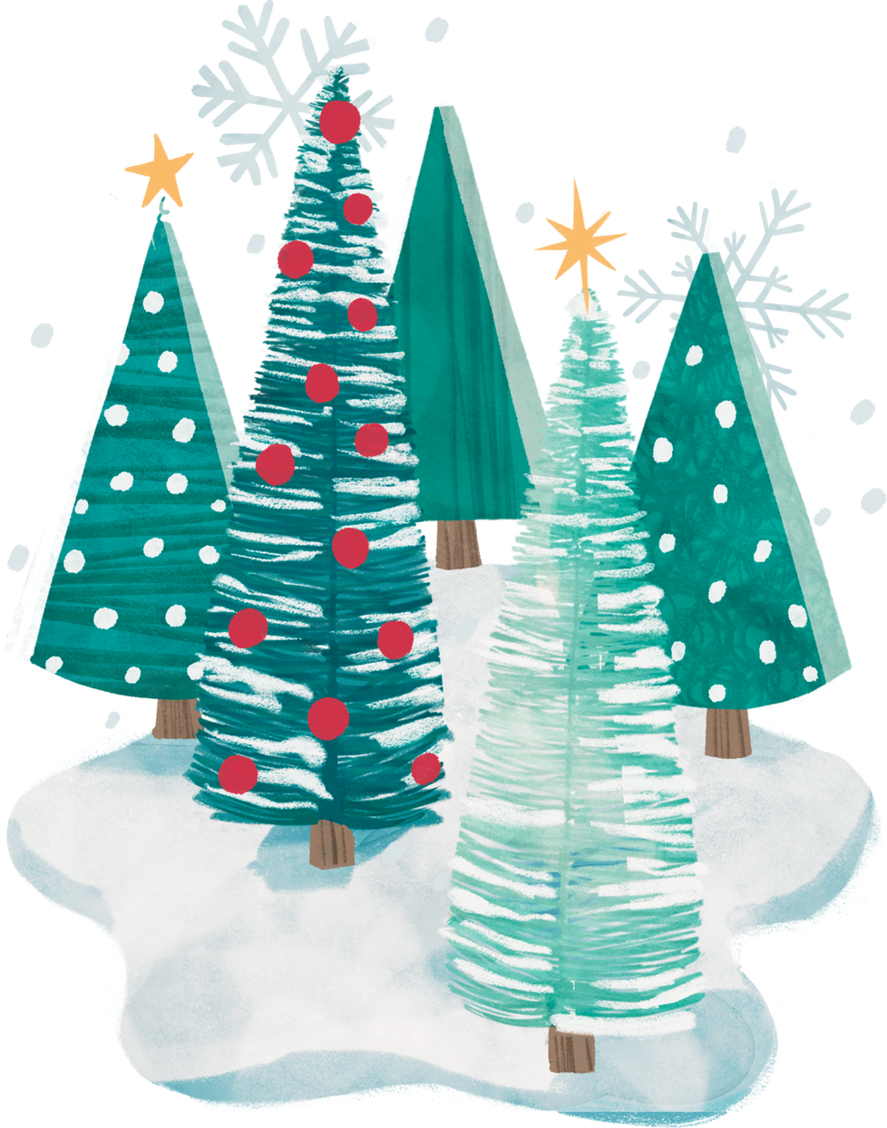

Decorations
- In France, one of the most important decorations at Christmas time is the Sapin de Noël (Christmas tree). It is used in homes, streets, shops, offices, and factories. The trees in the streets are real, not plastic.
- The idea of the Christmas tree came from a French region called Alsace in the 14th century.

Slide 5


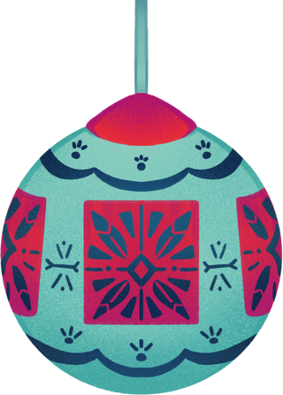

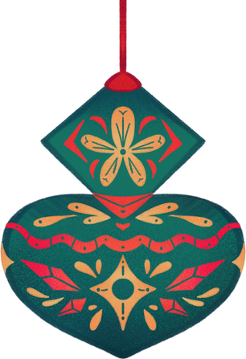
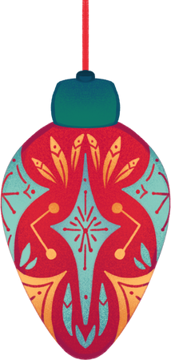
Bienvenue chez nous!
A Christmas wreath is hung on the door of French homes to say "soyez la bienvenue chez nous" (Welcome to our house). Originally, this was an Anglo-Saxon tradition which was later adopted by the French. The wreath is round shaped, to represent the sun hanging at the door.

Slide 6



History
of the Christmas Wreath
In the past, the Christmas wreath had four candles which represented the four weeks before Christmas, called Advent. Each Sunday, one of the candles was lit as a count down to the special day.
The crown is often decorated with holly (le houx), the spiky leaves representing the Passion of Christ, and the red berries the blood of Christ.

Slide 7
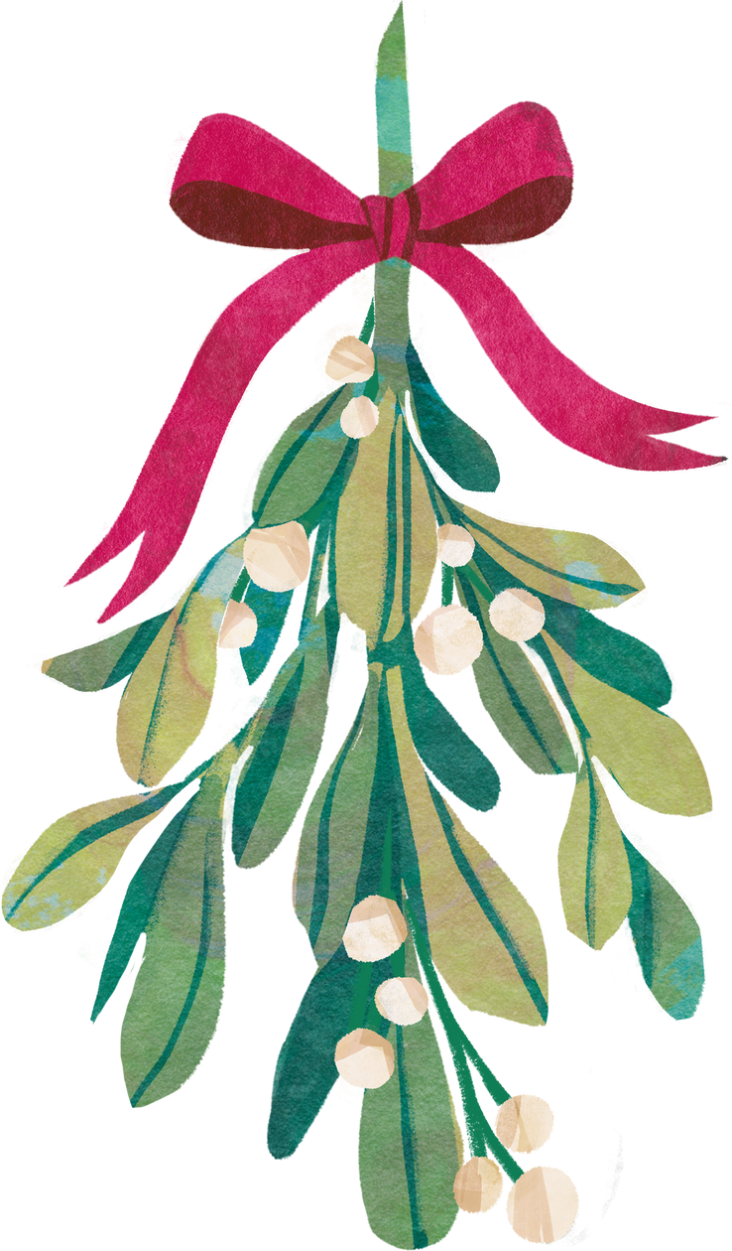
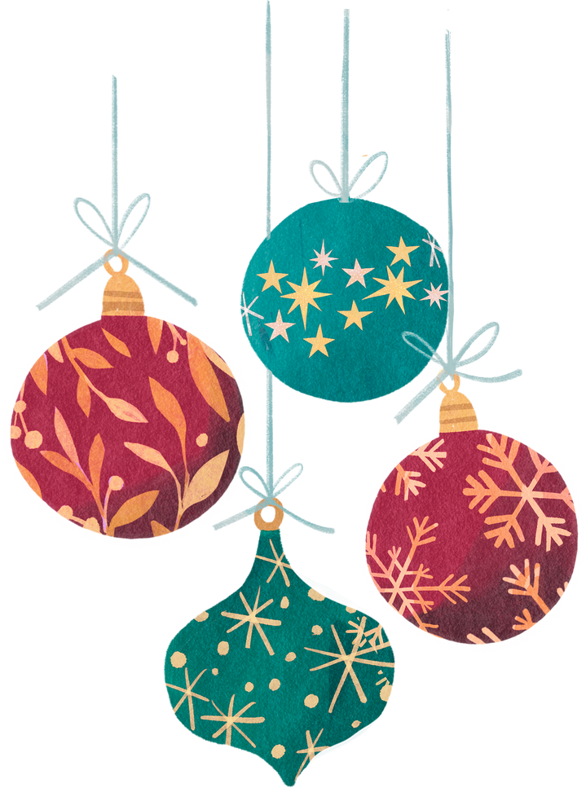
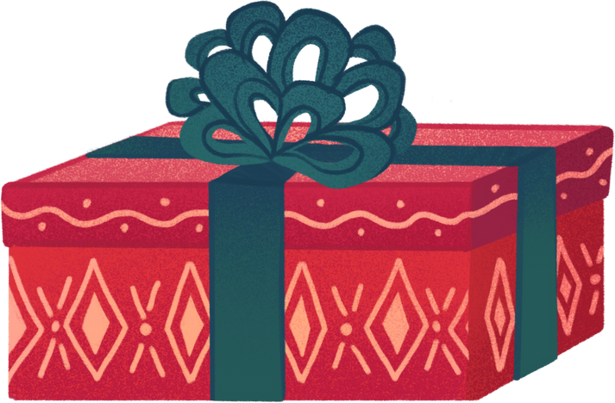
History
of the Mistletoe
Main Point
This plant has a long history. For the ancient Celtic Druids, it was considered sacred because of its miraculous properties - in healing, protection against all sorts of evils, and witchcraft.
Main Point
At Christmas, and more especially on New Year's Eve, mistletoe is hung - either from the ceiling, a rafter or in a doorway. It's a tradition to kiss under the mistletoe, a symbol of prosperity and a long life.

Slide 8


La veille de Noël
On Christmas Eve the bells of the churches and cathedrals ring to call people to the Mass at midnight. Midnight Mass is a tradition in France and in Europe.

Slide 9
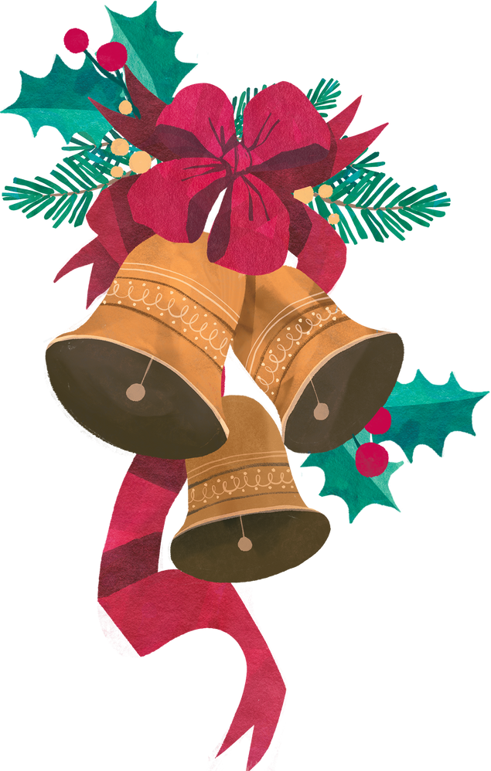
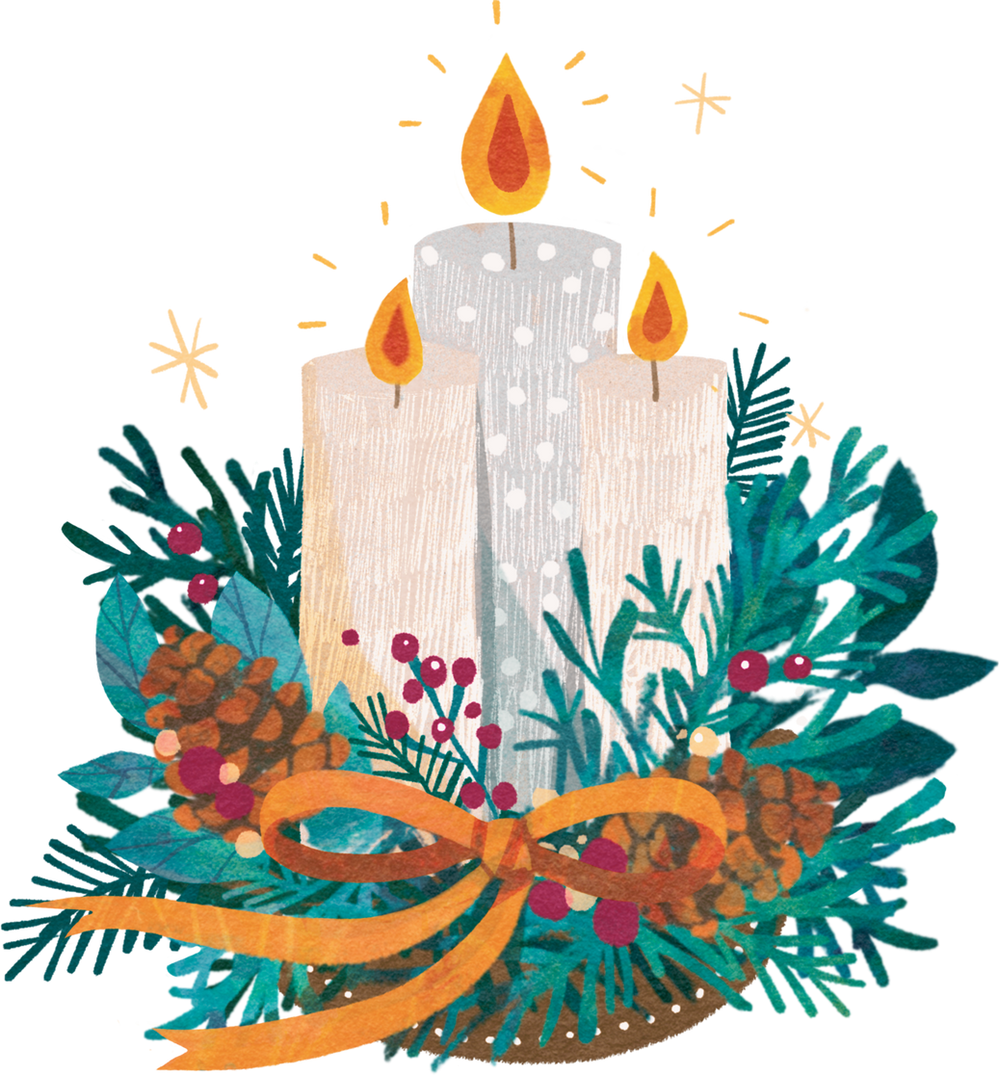
Le Calendrier
de l'Avent
Advent is the period of four weeks before the birth of Christ. With the Advent Calendar you can count down the days before Christmas. Behind each window or door, there are pictures or little chocolates.

Slide 10
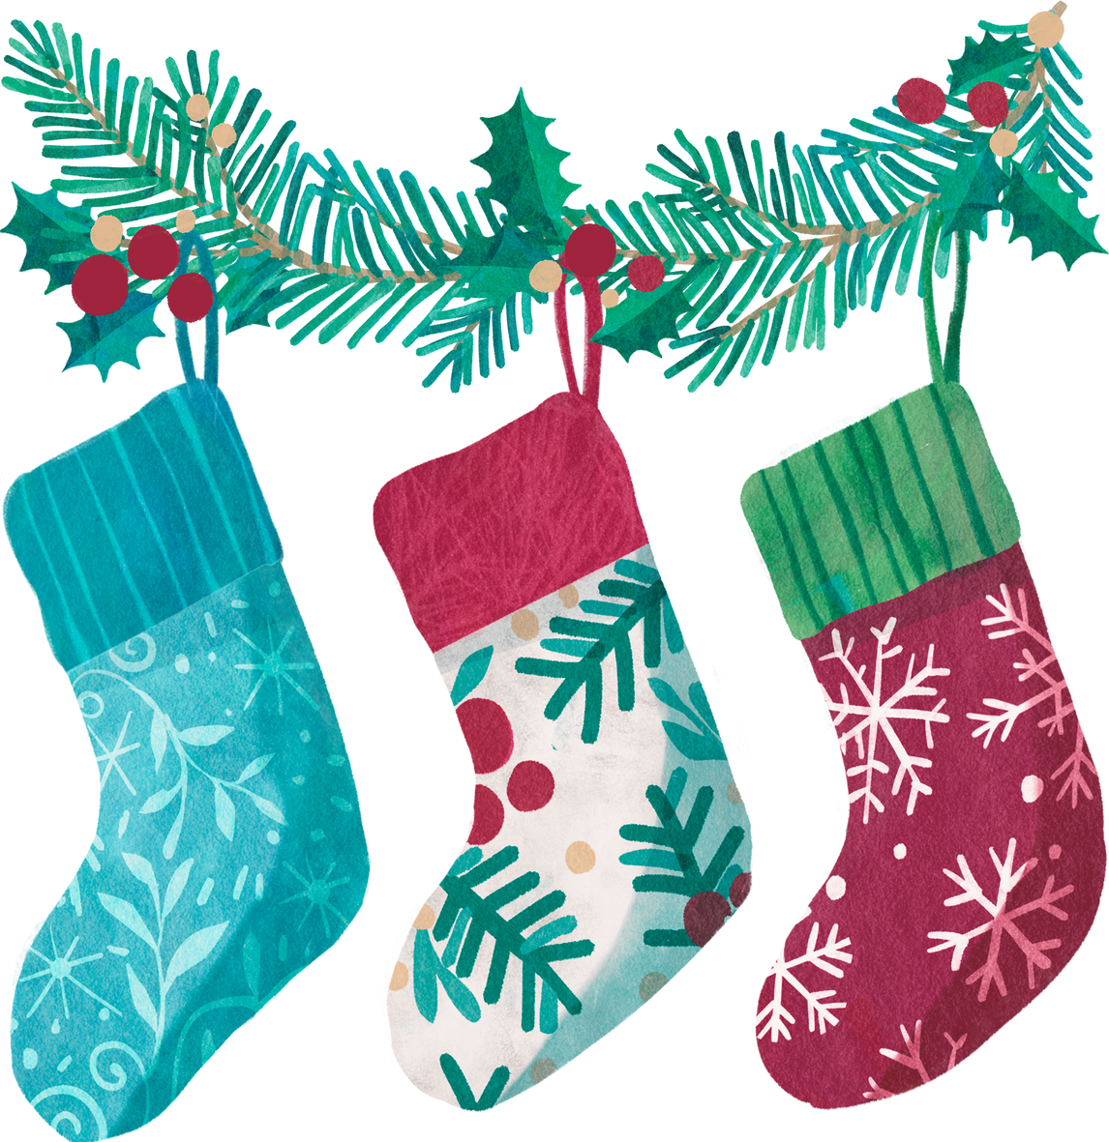


Christmas Eve
French children don't just leave out stockings or socks, they may also leave their shoes by the fireplace to be filled with gifts from Père Noël.

Slide 11

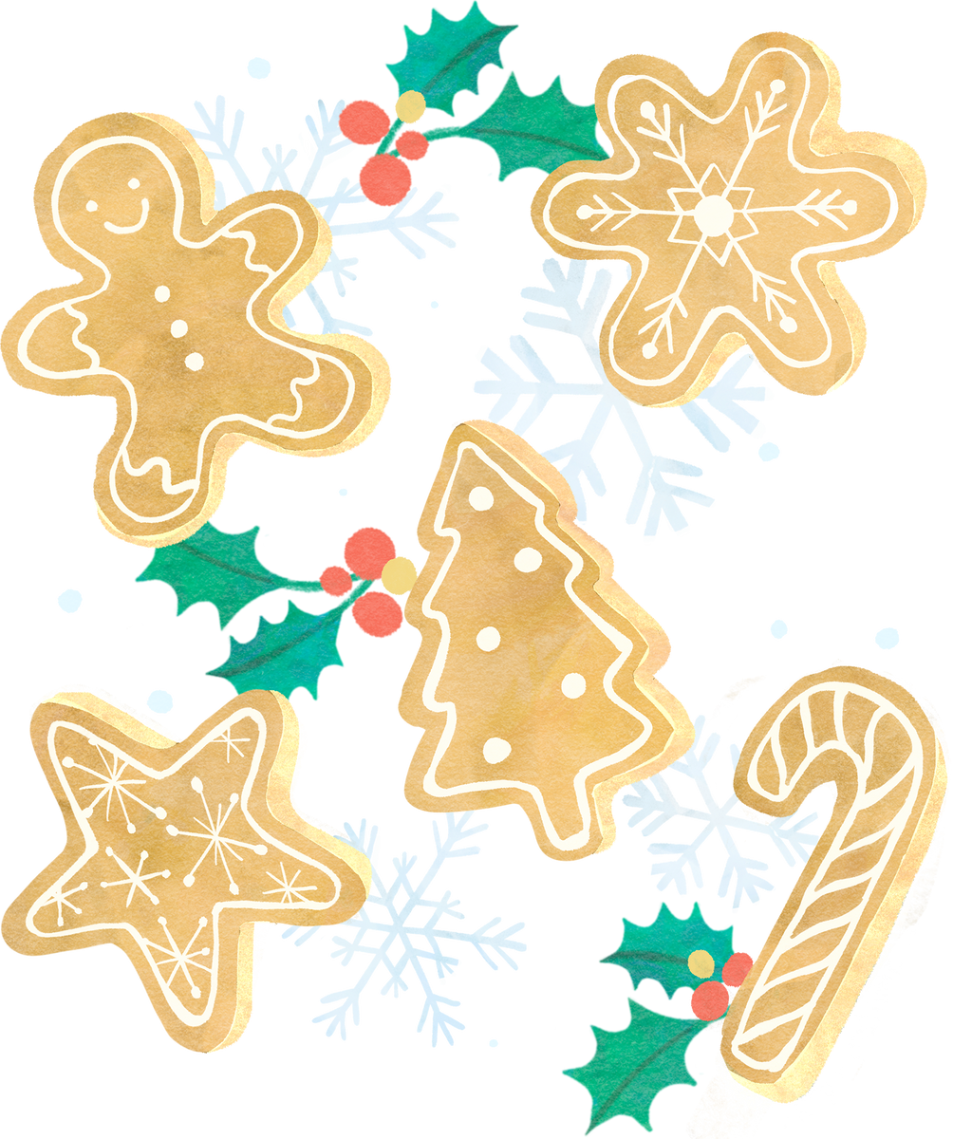
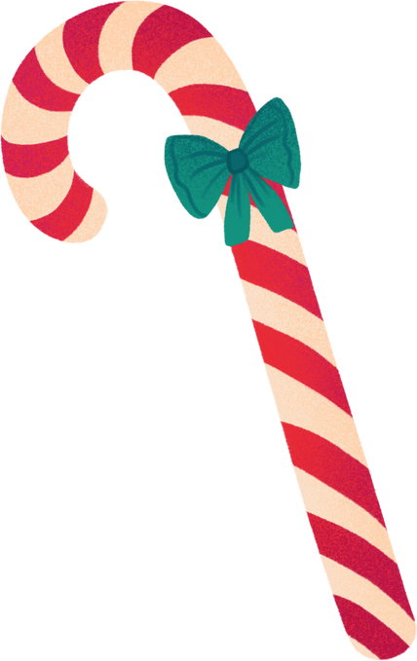
Jour de Noël
In the morning they also find that sweets, fruit, nuts and small toys have been left by Santa. In other places it is 'Le Petit Jésus' who brings the gifts.
Adults have no gifts at Christmas but wait until New Year's Day to exchange presents.

Slide 12
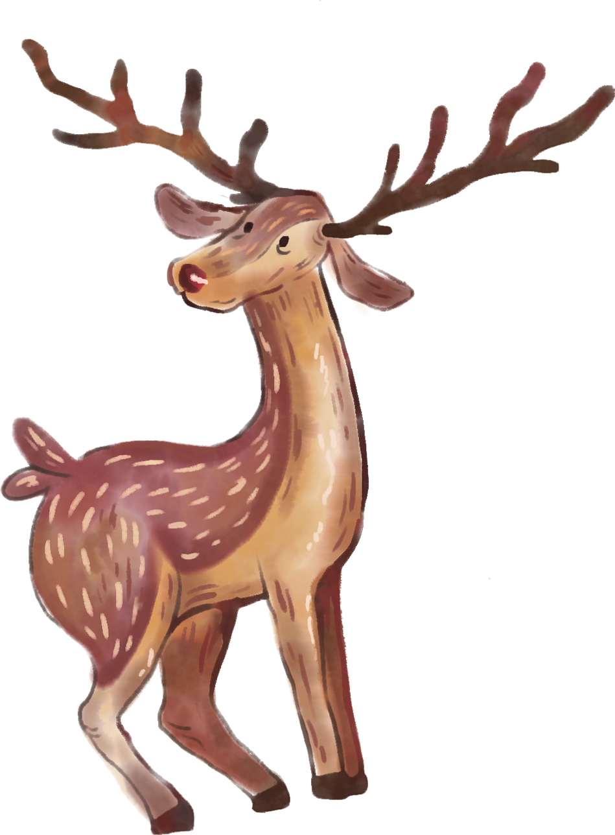

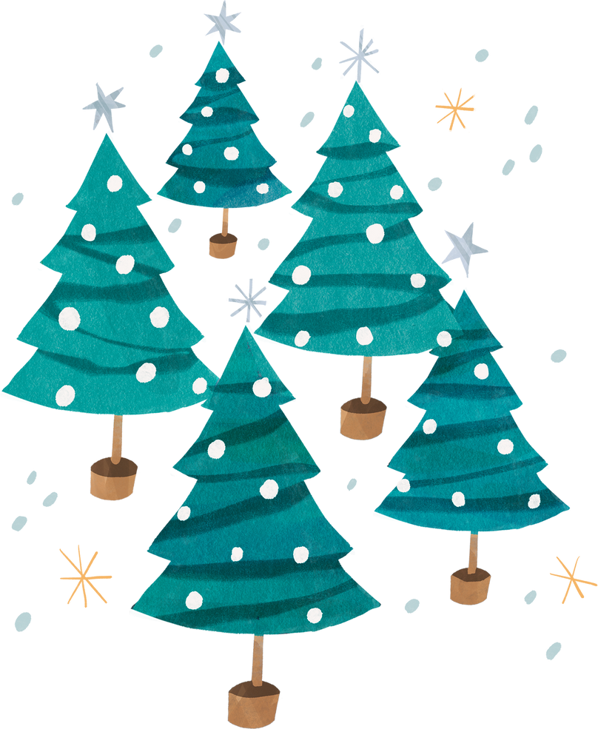
Santa’s reindeer
Fougueux (Dasher)
Danseur (Dancer)
Fringant (Prancer)
Mégère (Vixen)
Comète (Comet)
Cupidon (Cupid)
Tonnerre (Donner or Thunder)
Eclair (Blixen or Lightning)

Slide 13
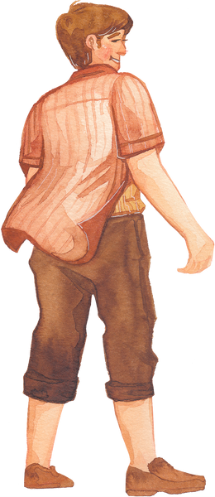
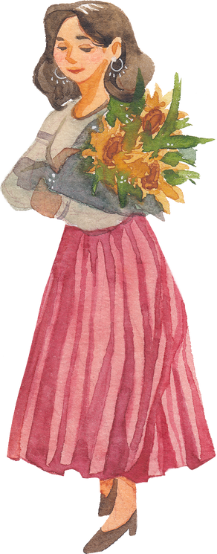
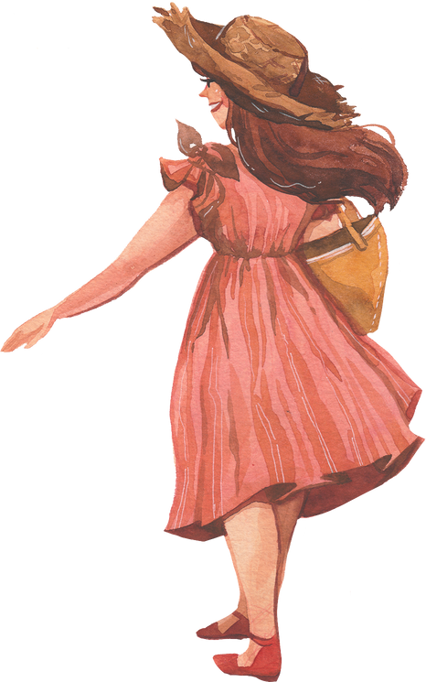
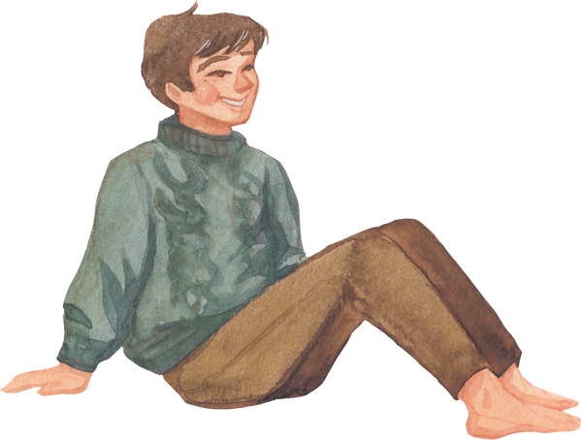
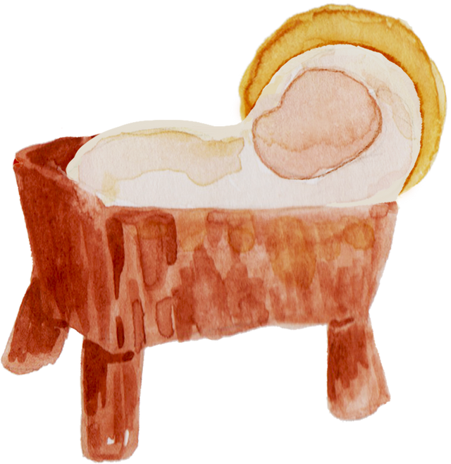
La crèche
Main Point
Many French homes have a crib or crèche at Christmas time. They may also be seen in shops, town centers and churches.
Main Point
'Santons' or 'little saints' are small figurines that make the crib more like real life in a village. The characters are traditional and you can see them mostly in the South of France.

Slide 14
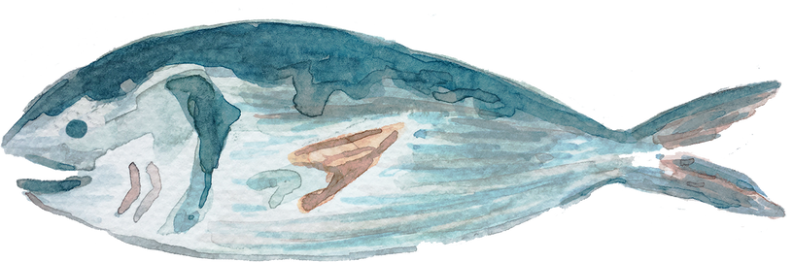
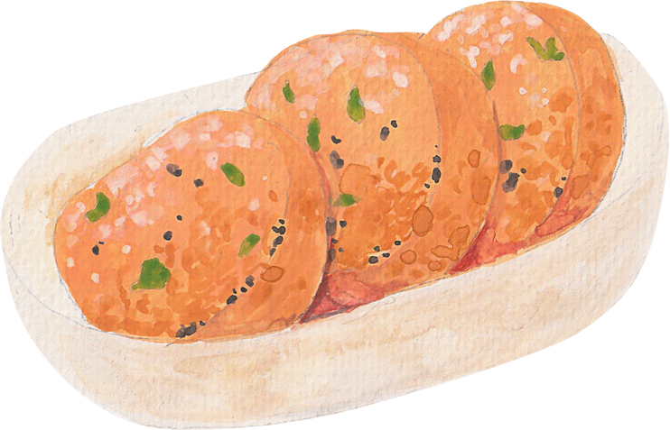

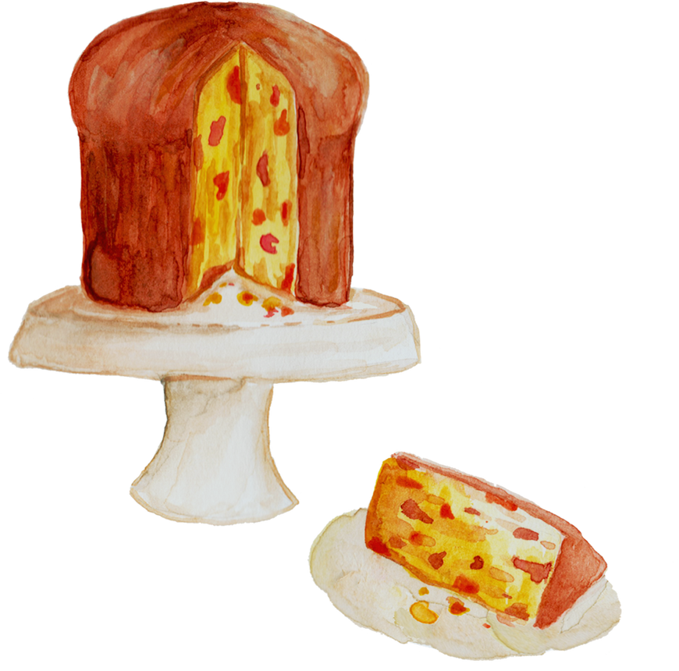
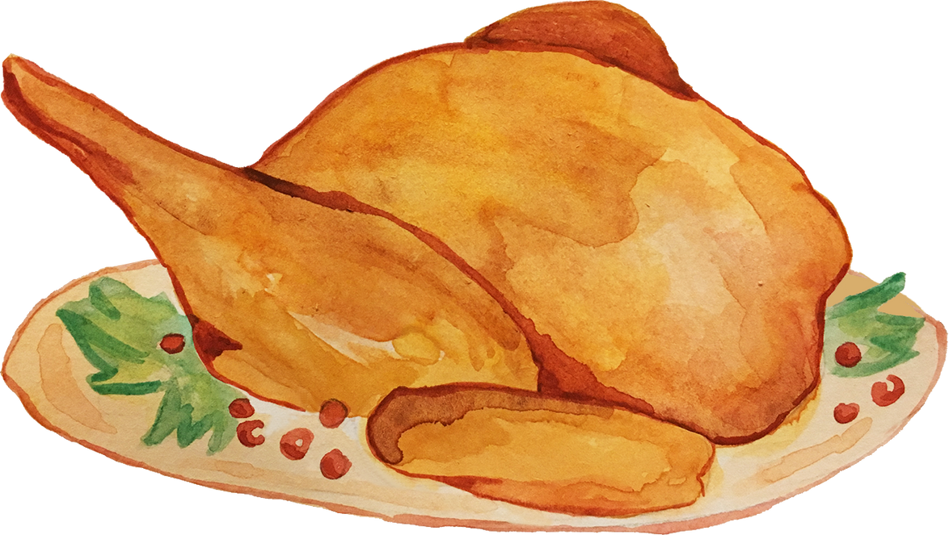
Le réveillon
On Christmas Eve, when people have finished buying their last minute purchases, the streets become deserted. It’s time for ‘le réveillon’ or the special Christmas meal. All the family eat together at this time.
People traditionally have seafood, such as oysters, roast turkey and ‘une bûche de Noël’.

Slide 15


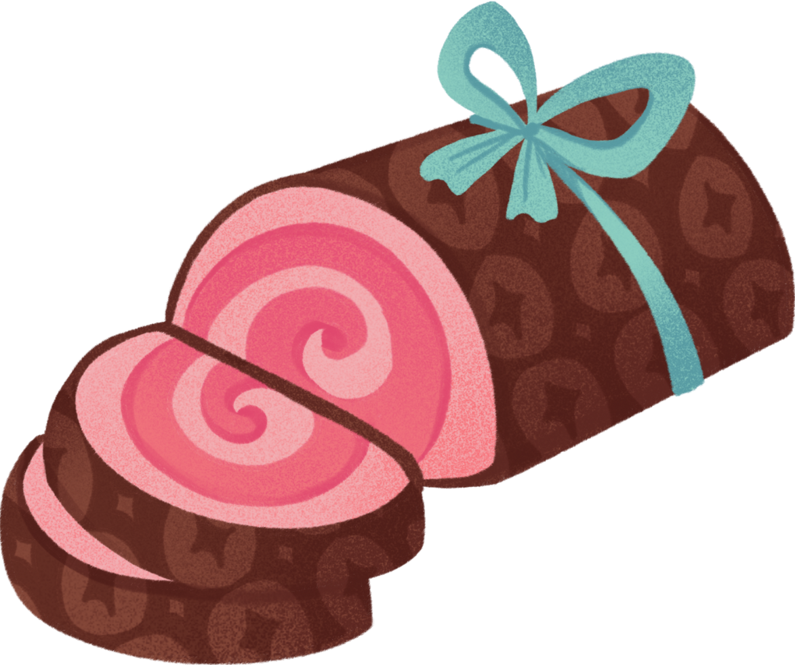
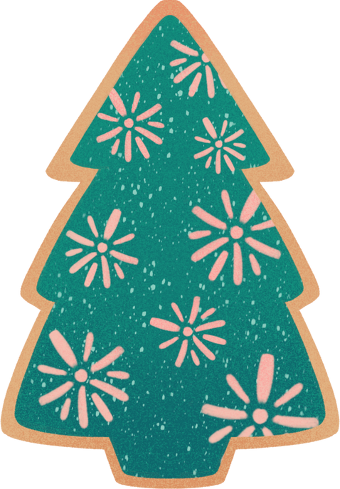
La Bûche de Noël
The Bûche de Noël (or Christmas log) is a special cake for Christmas. It’s a sponge cake which is rolled and shaped like a log. Inside there is often a creamy filling and then it is covered in chocolate."

Slide 16


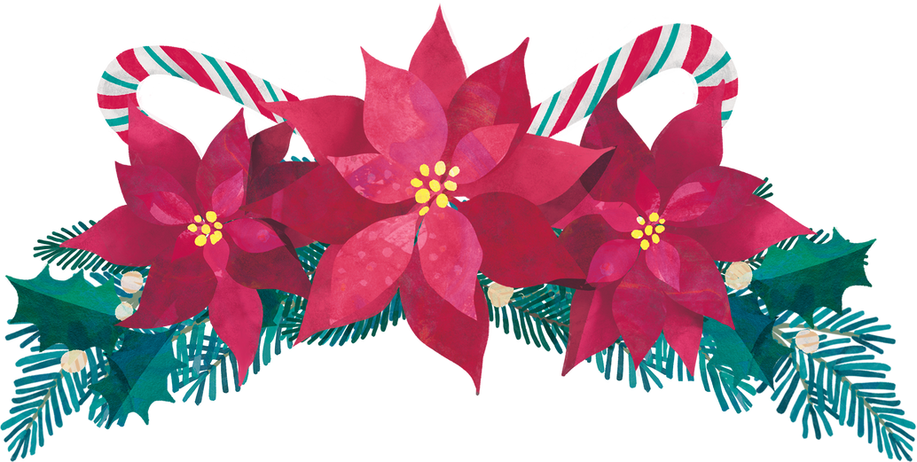
Joyeux Noël et
Bonne année

Slide 17

Resource Page
Use these design resources in your Canva Presentation.
Fonts
Design Elements
This presentation template
uses the following free fonts:
TITLES:
GIRASSOL
HEADERS:
CHARMONMAN
BODY COPY:
GILDA DISPLAY
You can find these fonts online too.
Colors
#17576D
#E1283C
#DECEC0
#11807B
  DON'T FORGET TO DELETE THIS PAGE BEFORE PRESENTING.

Slide 18
Resource Page
Use these design resources in your Canva Presentation.
Fonts
Design Elements
This presentation template
uses the following free fonts:
TITLES:
GIRASSOL
HEADERS:
CHARMONMAN
BODY COPY:
GILDA DISPLAY
You can find these fonts online too.
Colors
#17576D
#E1283C
#DECEC0
#11807B
  DON'T FORGET TO DELETE THIS PAGE BEFORE PRESENTING.

Slide 19

Credits
This presentation template is free for everyone to use thanks to the following:
  for the presentation template
Pexels, Pixabay
  for the photos
Happy designing!

