Slide 1




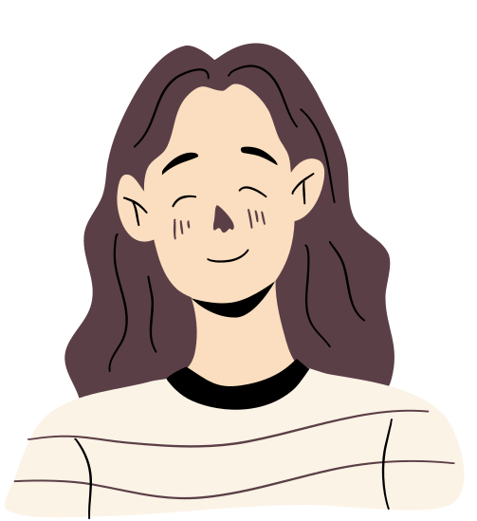
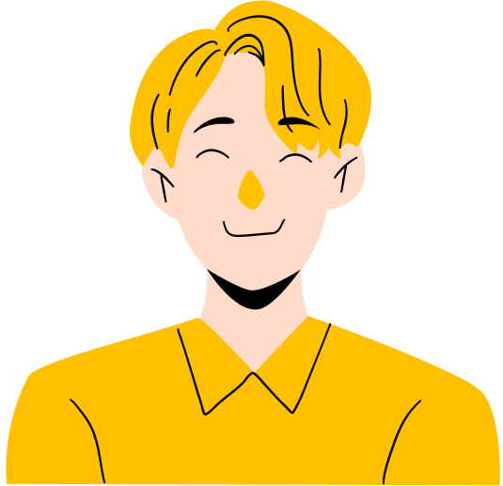



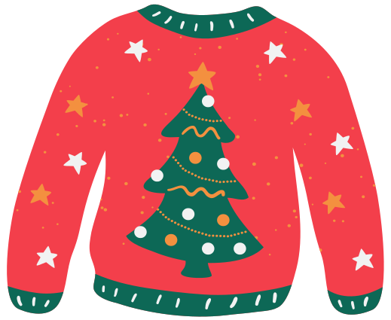


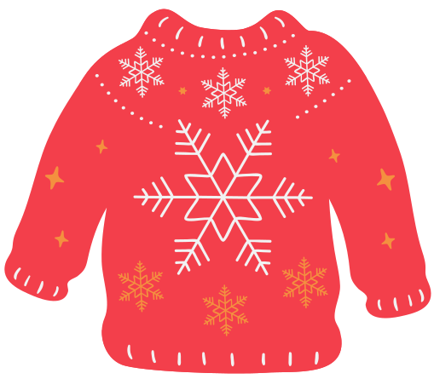
French Advent
Calendar

Slide 2




Hello!
Welcome to our presentation on the French Advent Calendar and Christmas traditions in France.

Slide 3

Christmas
in
France

Slide 4

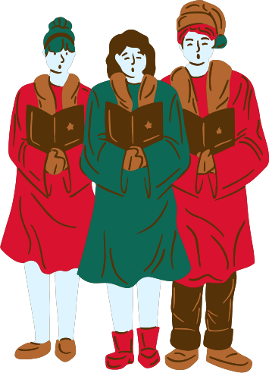
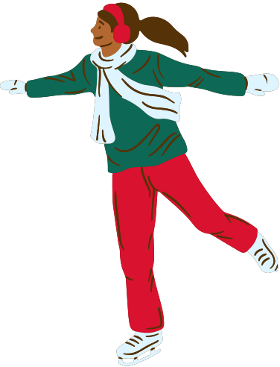
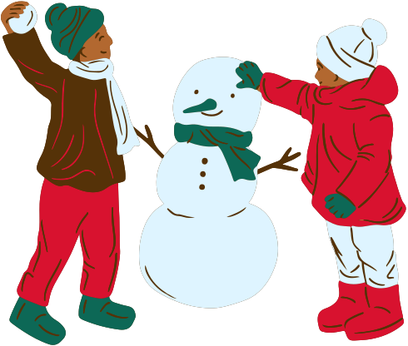
Christmas
Celebrations
in France
Christmas in France is marked by various charming traditions that bring families together. The holiday season kicks off with the decoration of homes, featuring nativity scenes (crèches) and beautifully adorned Christmas trees (sapins de Noël). Streets and shops are filled with festive lights and decorations, creating a magical atmosphere. A key part of the celebration is the Christmas markets (Marchés de Noël), where people gather to enjoy festive foods, buy handmade crafts, and soak in the holiday spirit.

Slide 5
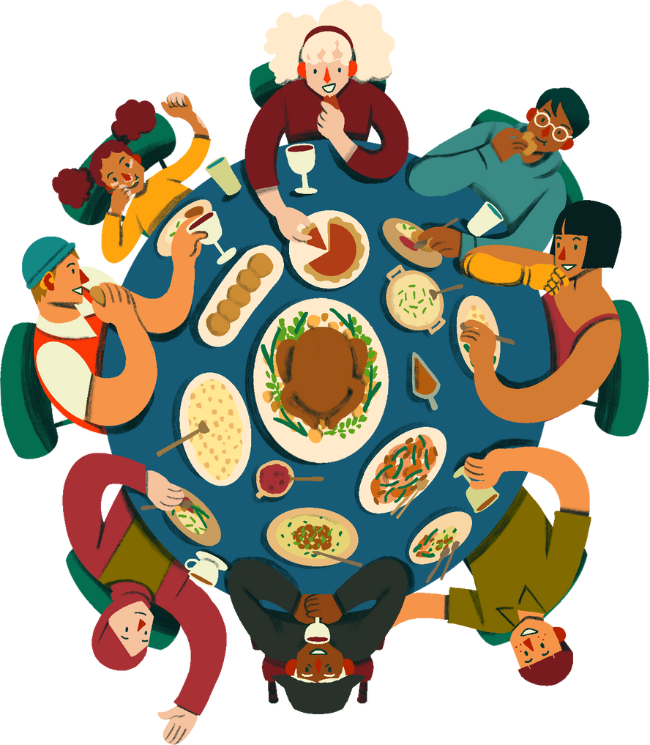
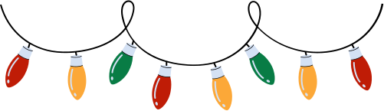
Le Réveillon de Noël
Traditional Feast
Festive Dishes
Le Réveillon is the traditional Christmas Eve dinner, often a grand feast with family and friends.
Common dishes include foie gras, smoked salmon, roasted meats, and the Bûche de Noël (Yule log cake).

Slide 6


Traditional
Decorations
French homes are adorned with nativity scenes (crèches), which hold a central place in the holiday décor, depicting the birth of Jesus with figurines. Christmas trees (sapins de Noël) are also a staple, often decorated with sparkling lights, colorful ornaments, and shimmering tinsel, bringing festive cheer into households.
sapins de Noël
Christmas trees (sapins de Noël) are also popular, often adorned with lights, ornaments, and tinsel.

Slide 7
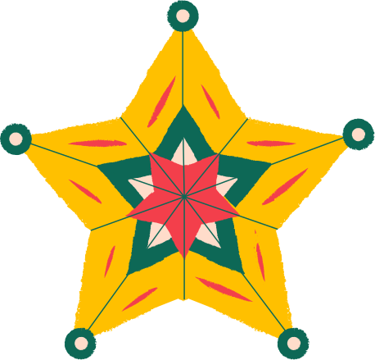
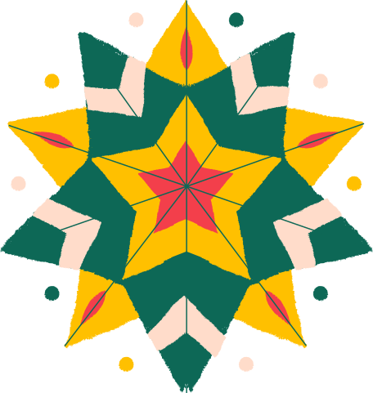
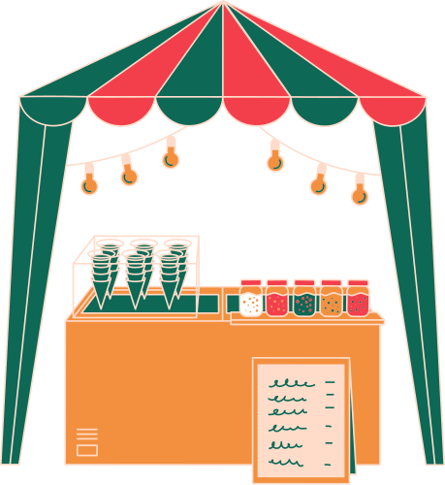
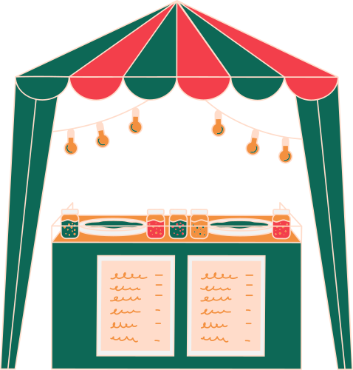
Christmas Markets
Christmas markets are a beloved tradition in France, with famous ones in cities like Strasbourg, Paris, and Lyon. These markets create a festive atmosphere with stalls selling an array of festive foods, handmade crafts, and holiday decorations.
Visitors can enjoy seasonal treats, shop for unique gifts, and immerse themselves in the holiday spirit amidst the twinkling lights and cheerful music.

Slide 8
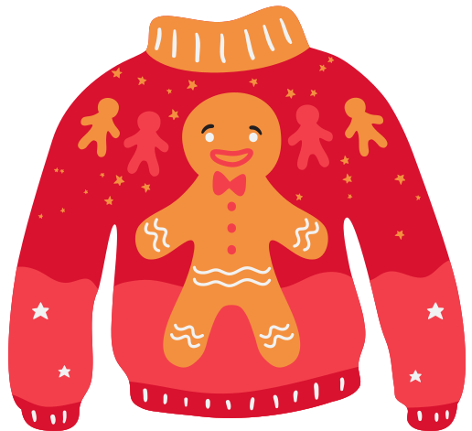
French Advent
Calendar

Slide 9
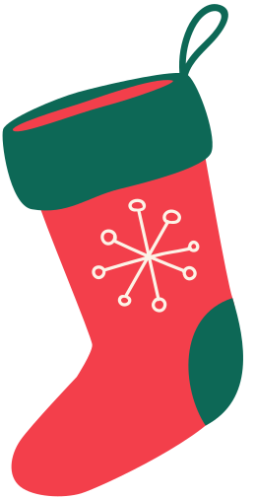

History of the
Advent Calendar
The Advent calendar originated in Germany in the 19th century and gradually spread to France and other parts of Europe. Initially, it was a simple practice where families would mark the days of Advent by drawing a chalk line on the door or lighting a candle each day.
The first printed Advent calendars appeared in the early 20th century, featuring small doors or windows to open, each revealing a religious image or Bible verse. Over time, these calendars became more elaborate, including pictures of festive scenes and small treats. By the mid-20th century, the tradition had become popular in France, where it continues to be a cherished way of counting down the days to Christmas.

Slide 10
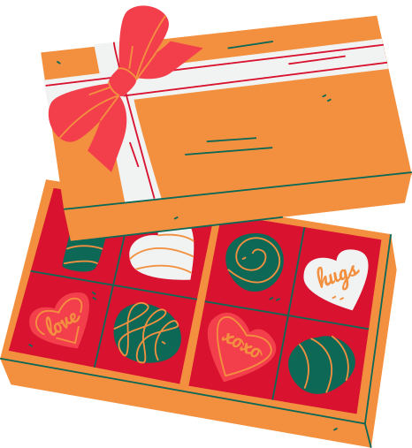
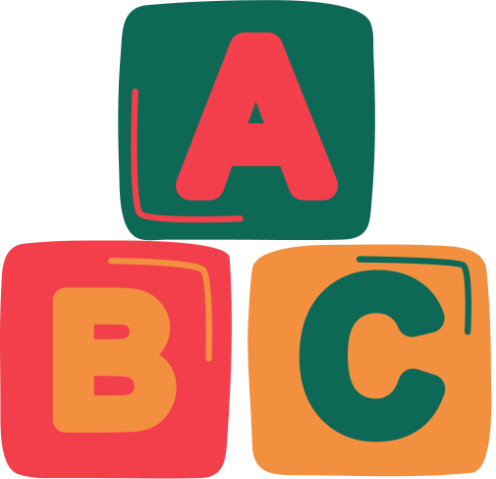
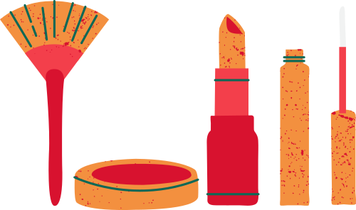
Modern Advent Calendars
Chocolate
Treats
Toy
Surprises
Beauty
Products
Advent calendars filled with chocolates are popular.
Calendars with toys are loved
by children.
Beauty advent calendars cater
to adults.

Slide 11
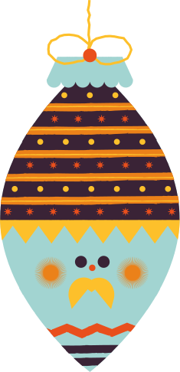
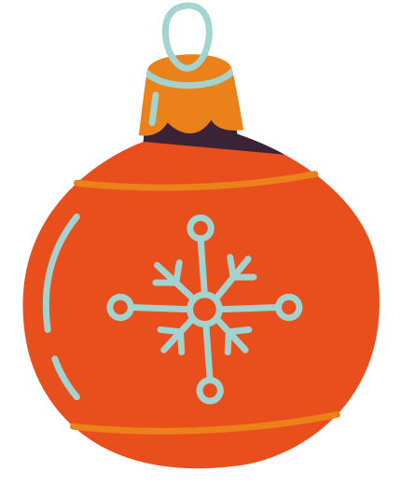
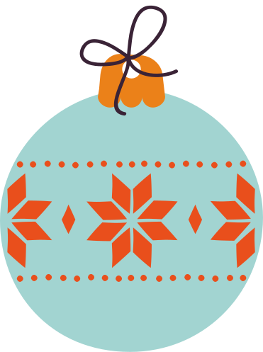

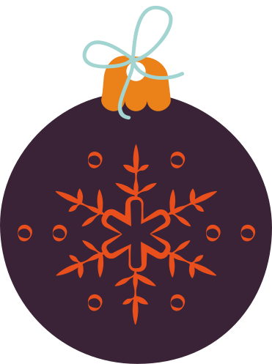







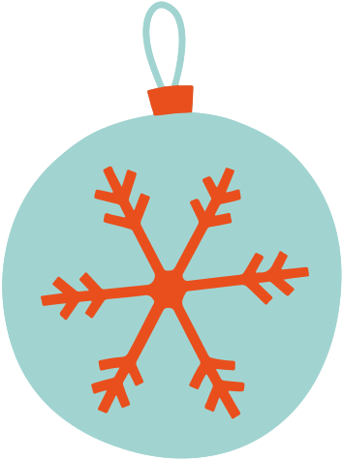


1
7
8
2
3
5
6
4
9
16
15
10
11
14
12
13
17
18
20
23
24
25
19
22
21

Slide 12
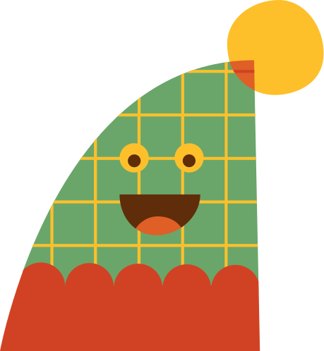
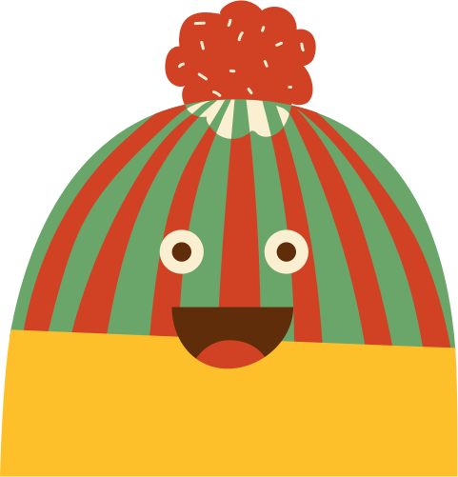
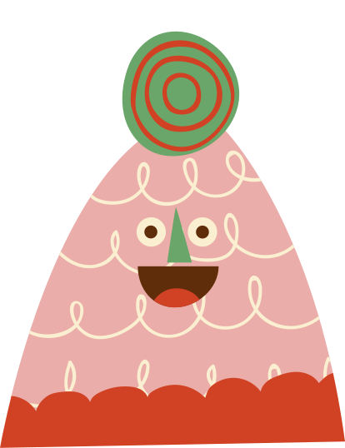



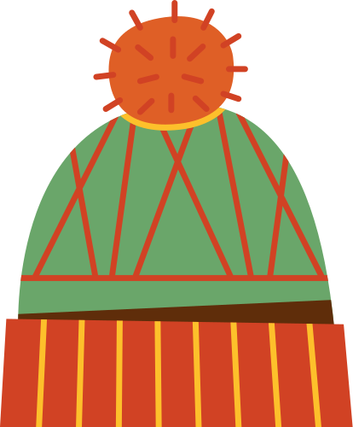
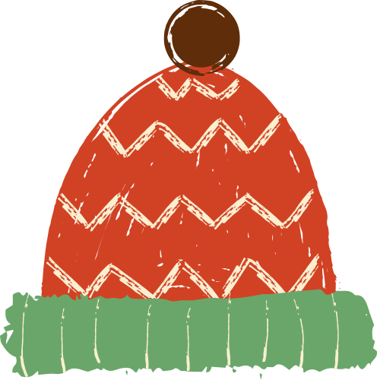
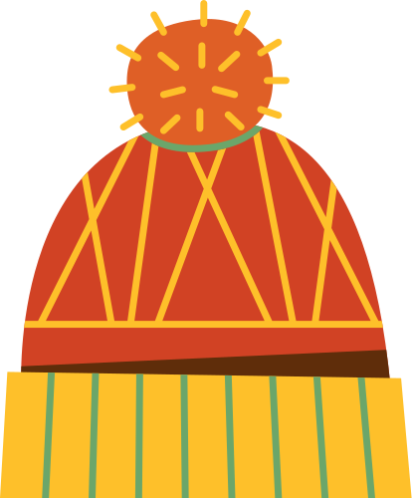
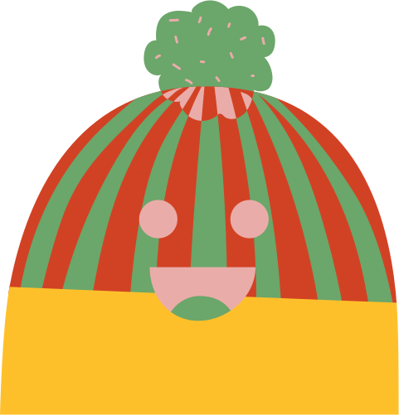
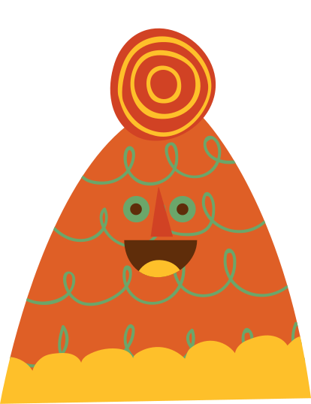

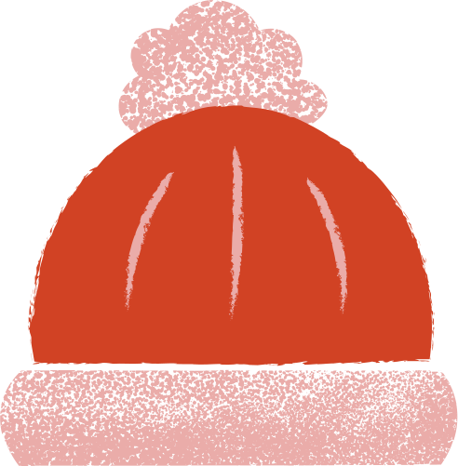
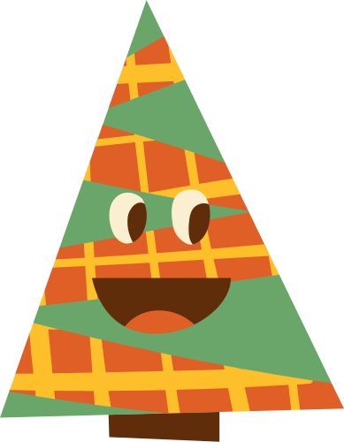
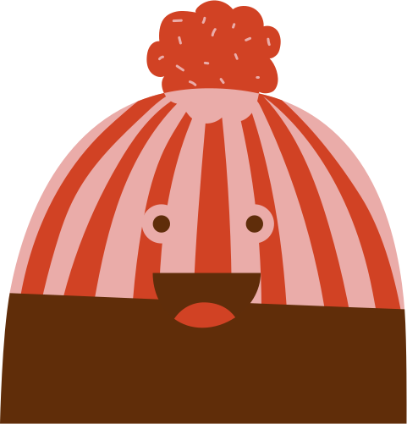

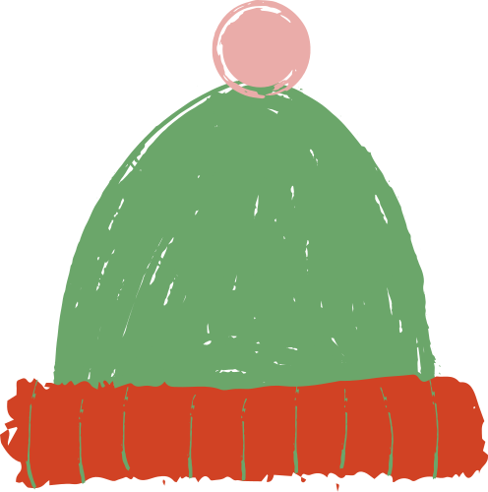
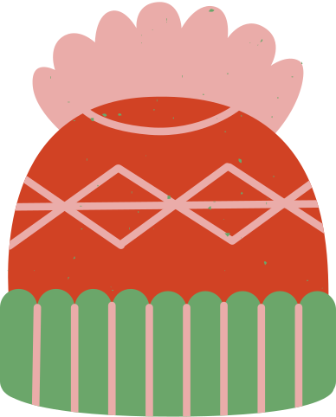

4
5
6
7
8
1
2
3
9
10
11
12
15
16
13
14
17
18
20
19
25
22
23
24
21

Slide 13

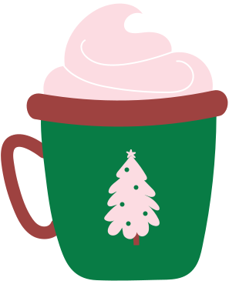
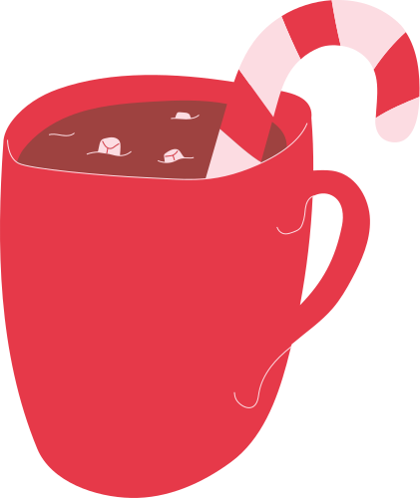


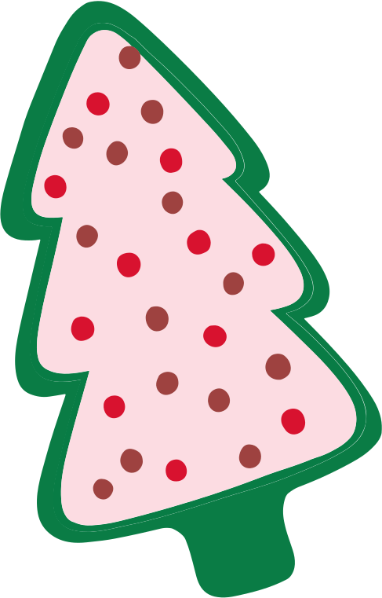

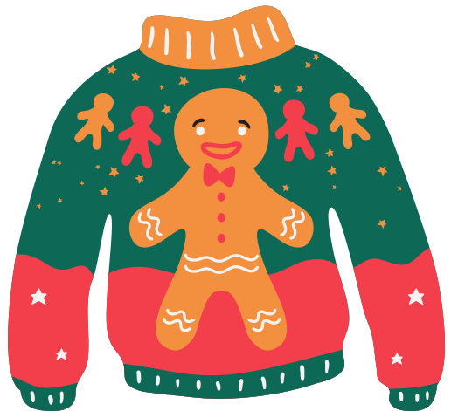
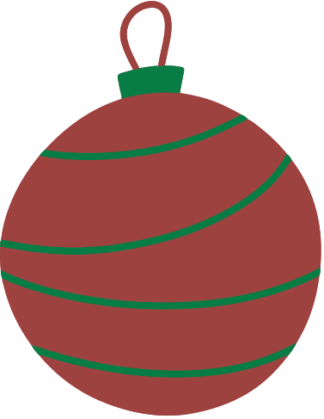
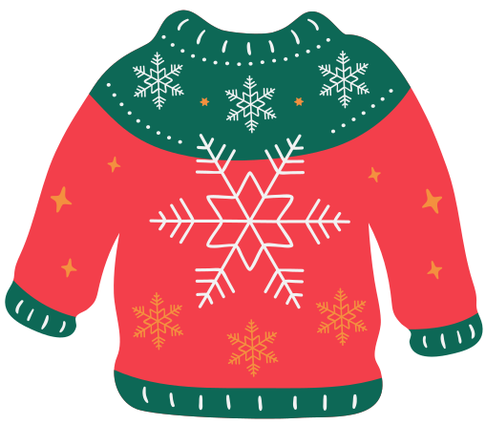

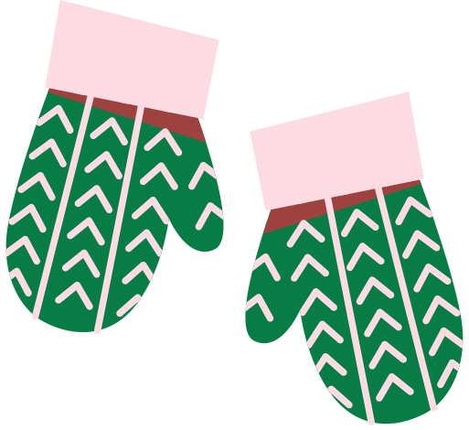

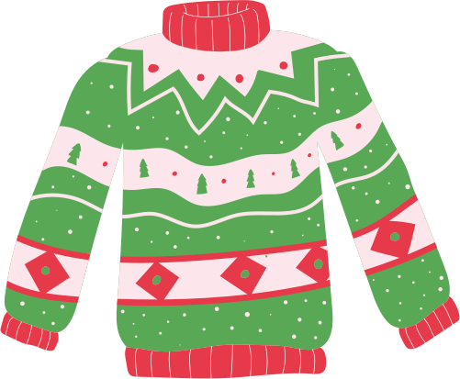

3
2
4
6
7
8
1
5
9
10
12
13
14
15
16
11
17
21
23
18
19
20
22
24
25

Slide 14


Resource Page
Use these design resources in your Canva Presentation.
Fonts
Design Elements
This presentation template
uses the following free fonts:
TITLES:
OLEO SCRIPT
HEADERS:
OLEO SCRIPT
BODY COPY:
NUNITO BOLD
You can find these fonts online too.
Colors
#0F6856
#F33F4B
#FCF3E7
#C39A6C
  DON'T FORGET TO DELETE THIS PAGE BEFORE PRESENTING.

Slide 15

Credits
This presentation template is free for everyone to use thanks to the following:
  for the presentation template
Pexels, Pixabay
  for the photos
Happy designing!

