Slide 1
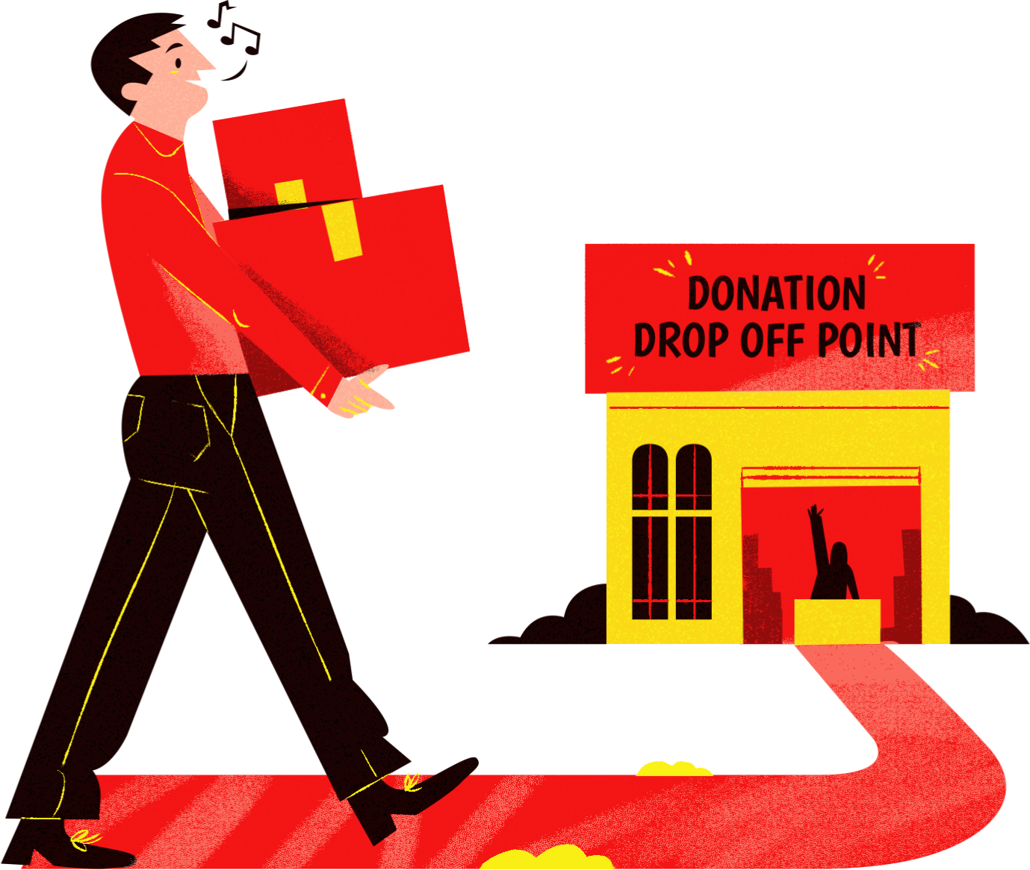
FUNDRAISING
Make a Difference with Your Donation!
SEPTEMBER 11, 2025 | 8AM | COMMUNITY CENTER
WHAT YOU CAN DONATE?
  Foods
  Clothes
  Medicine
  Sanitary Supplies
  Books
  School Supplies
  Child Toys
  Money

Slide 2
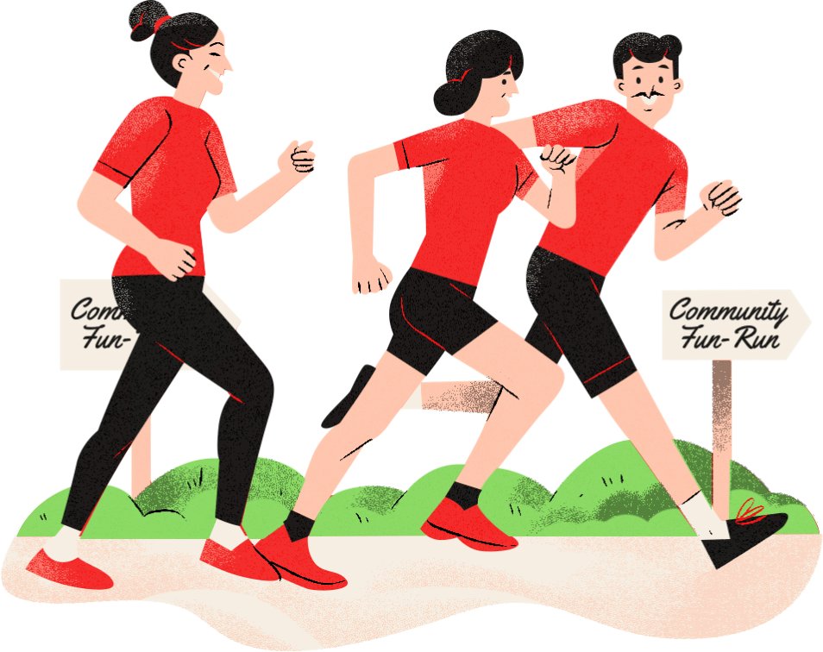
CHARITY RUN
JOIN THE COMMUNITY RUN DAY!
Saturday
Live Performances | Fun Games
Sep 11, 2025
This isn't just a race; it's a fabulous fiesta of grit, guts, and the electrifying vibes of the running tribe! Lace up those sneakers and dive into an event that’s all about the journey, not just the finish line!
Race Start at 6 AM
at Community Park

Slide 3
RESOURCE PAGE
  Use these design resources in your Canva Presentation.
Fonts
This presentation template
uses the following free fonts:
TITLES:
ANTON
BODY COPY:
KALAM
POPPINS
You can find these fonts online too.
Design Elements

Slide 4

CREDITS
This presentation template is free for everyone to use
  thanks to the following:
  for the presentation template
Pexels, Pixabay
  for the photos
  HAPPY DESIGNING!

