Slide 1

FUNDRAISING PYRAMID
infographic
MAJOR Donors
Largest gifts, often 40-60%
of total funds raised.
Leadership Donors
Substantial contributions, but smaller than major donors, often 20-30% of total funds.
MID-LEVEL DONORS
Substantial contributions, but smaller than major donors, often 20-30% of total funds.
GRASSROOT DONORS
Moderate gifts, collectively making
up 15-25% of total funds.

Slide 2

FUNDRAISING PYRAMID
Major
Donors
Largest gifts, often 40-60%
of total funds raised.
Leadership Donors
Substantial contributions, but smaller than major donors, often 20-30% of total funds.
Mid-Level Donors
Moderate gifts, collectively making up
15-25% of total funds.
Grassroots Donors
Moderate gifts, collectively making up
15-25% of total funds.

Slide 3

Major
Donors
Leadership
Donors
Mid-Level
Donors
Grassroots
Donors
FUNDRAISING PYRAMID

Slide 4
























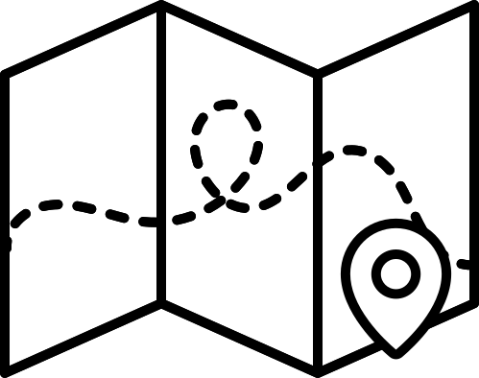














RESOURCE PAGE
  Use these design resources in your Canva Presentation.
Fonts
This presentation template
uses the following free fonts:
TITLES:
STAATLICHES
BODY COPY:
STAATLICHES
You can find these fonts online too.
Design Elements

Slide 5

CREDITS
This presentation template is free for everyone to use
  thanks to the following:
  for the presentation template
Pexels, Pixabay
  for the photos
  HAPPY DESIGNING!

