Slide 1



I'm loving angels instead
And through it all,
she offers me protection
A lot of love and affection
Whether I'm right or wrong
IN LOVING MEMORY OF
Name

Slide 2

INTRODUCTION
Honoring
Name
Today, we gather to celebrate the life of [Name]. As we reflect on the memories and moments shared with [him/her], we find solace in music, a universal language that speaks to the heart.

Slide 3
Angels
I'm loving angels instead
And through it all,
she offers me protection
A lot of love and affection
Whether I'm right or wrong
BY ROBBIE WILLIAMS

Slide 4


Finding
Solace in
Prayer
Heavenly Father, in this time of grief, we turn to you for comfort and strength. Surround us with your love and peace, and ease the pain of our hearts. Help us to find solace in prayer and in the knowledge that you are always with us, holding us in your loving embrace.

Slide 5
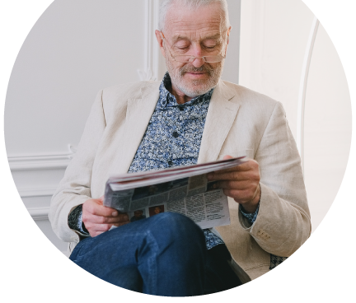
Cherished Memories
[Name] was a [loving spouse/partner, devoted parent, caring friend, etc.]. Their warmth, kindness, and [list positive attributes] left an indelible mark on all who knew them.

Slide 6

GIVING THANKS FOR
Name Surname
We thank you for the gift of [Name]'s life and the love they shared with us. We are grateful for the memories we hold dear and the time we were blessed to spend together. May their legacy of love continue to inspire us and guide us in the days ahead.

Slide 7

Write your topic
TOPIC ONE
TOPIC TWO
Briefly elaborate on what you want to discuss.
Briefly elaborate on what you want to discuss.

Slide 8
Prayer of Hope
FINDING HOPE IN THE PROMISE OF TOMORROW
God of hope, as we say goodbye to [Name], we hold onto the promise of tomorrow. May the light of your love shine upon us, guiding us through the darkness of grief and illuminating the path ahead. Help us to trust in your plan and to find hope in the assurance of eternal life.
Amen.

Slide 9

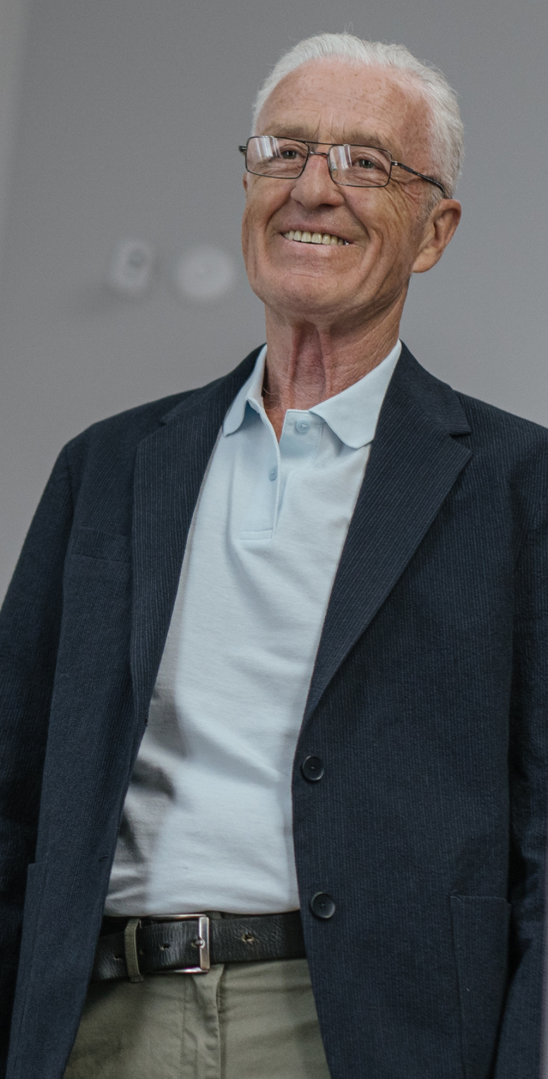
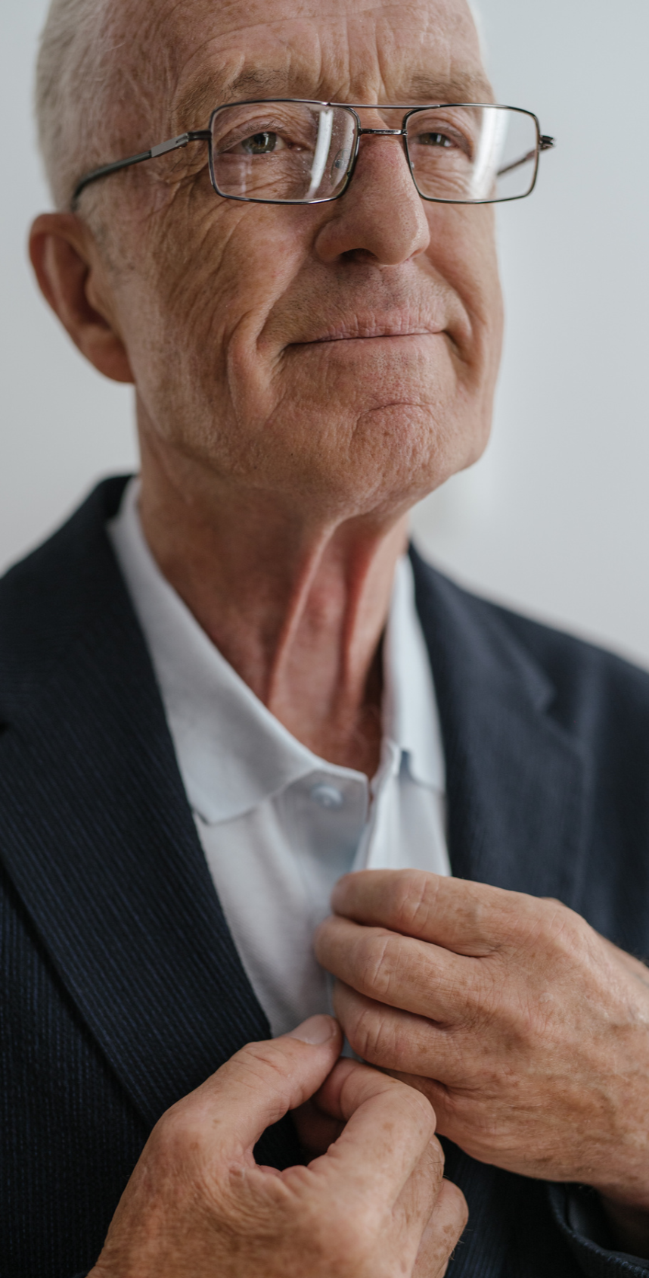

Slide 10


Words of Comfort
ADD A MAIN POINT
Briefly elaborate on what you want to discuss.
ADD A MAIN POINT
Briefly elaborate on what you want to discuss.

Slide 11



Legacy and Impact
ADD A MAIN POINT
ADD A MAIN POINT
ADD A MAIN POINT
Briefly elaborate on what you want to discuss.
Briefly elaborate on what you want to discuss.
Briefly elaborate on what you want to discuss.

Slide 12
CLOSING PRAYER
Gracious and loving God
As we depart from this place, may we carry with us the lessons learned from [Name]'s life – lessons of love, kindness, and compassion. May we honor their memory by living our lives with purpose and integrity, always striving to make the world a better place.
Bless each person gathered here today, O God, with your grace and peace. May we find strength in one another and in the knowledge that you are with us always.
In your holy name, we pray. Amen.

Slide 13
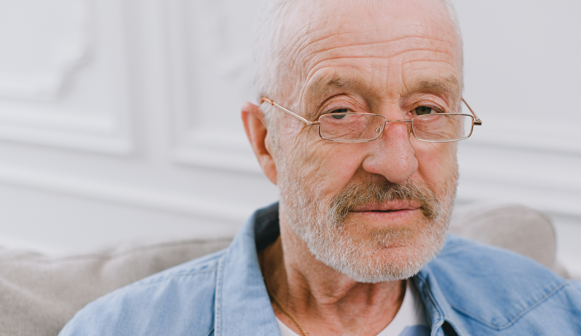
A PICTURE IS WORTH
A THOUSAND WORDS

Slide 14


Family
CHERISHED MEMORIES
CHERISHED MEMORIES
Briefly elaborate on what you want to discuss.
Briefly elaborate on what you want to discuss.

Slide 15
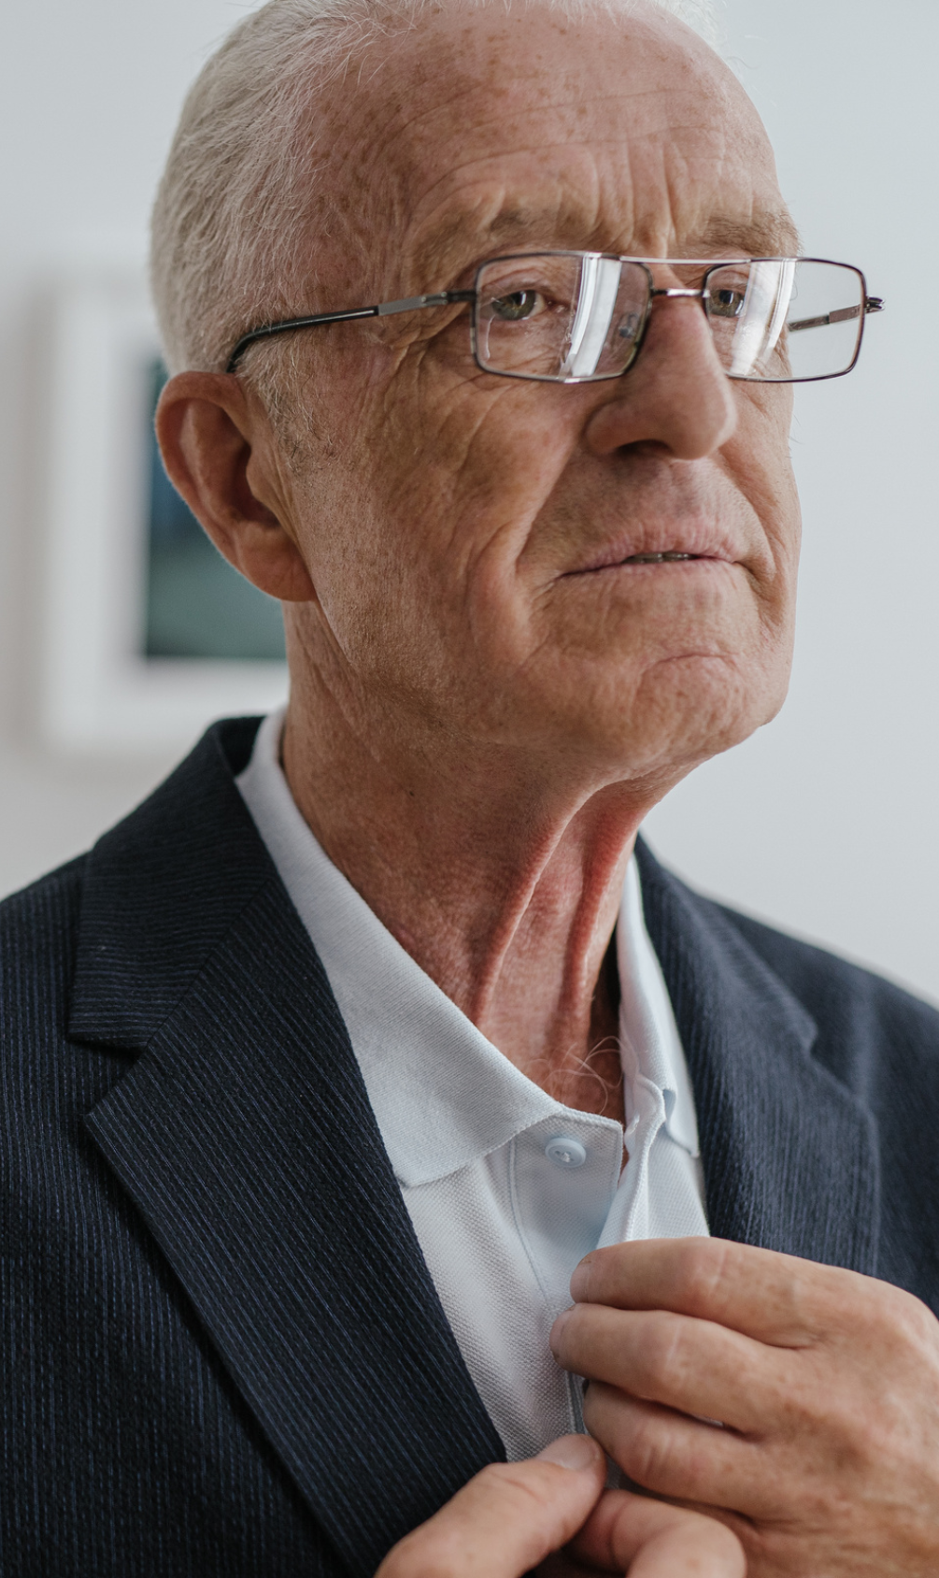
Words of Comfort
TOPIC ONE
TOPIC TWO
Briefly elaborate on what you want to discuss.
Briefly elaborate on what you want to discuss.
TOPIC THREE
TOPIC FOUR
Briefly elaborate on what you want to discuss.
Briefly elaborate on what you want to discuss.

Slide 16
Legacy of
Love
Though [Name] may no longer be with us in person, their legacy of love and kindness lives on. Let us carry forward the lessons they taught us and the love they bestowed upon us, keeping their memory alive in our thoughts and actions.
Let us also honor their memory by embracing the values they held dear. Through acts of compassion, generosity, and understanding, we can perpetuate the essence of who they were, ensuring that their presence continues to illuminate our lives and those of others.

Slide 17
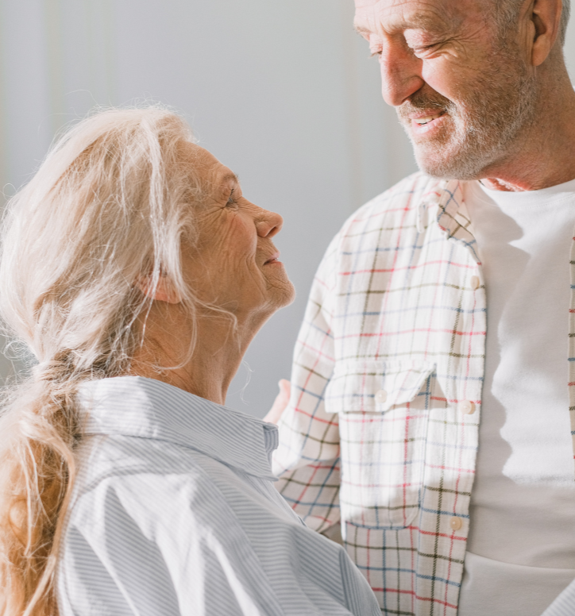
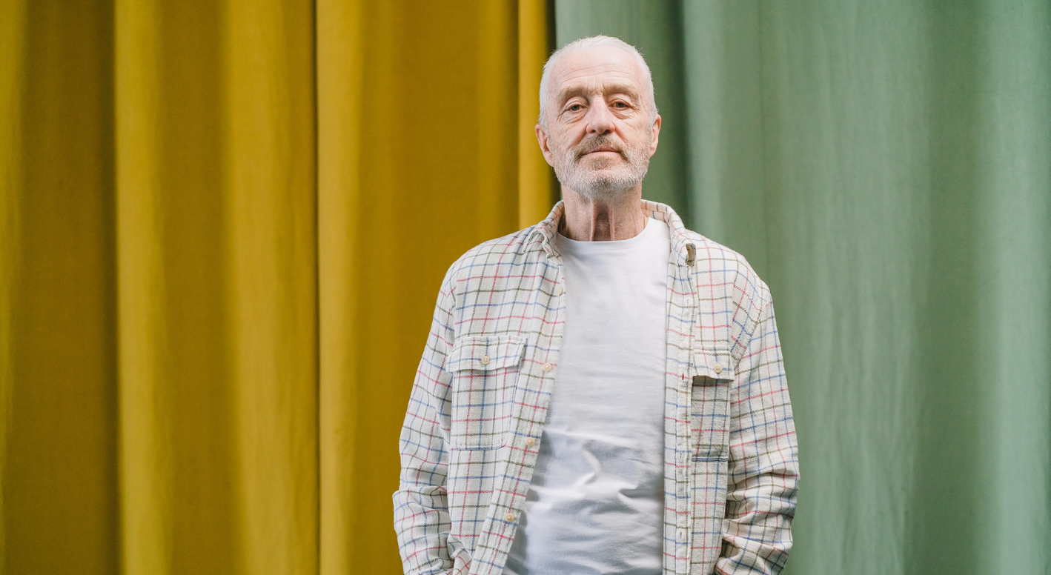

Finding Comfort
In times of loss, it's natural to seek solace in memories. Let us take a moment to reflect on the special moments we shared with [Name]. Through laughter and tears, their spirit remains alive in our hearts, guiding us with love and strength.

Slide 18
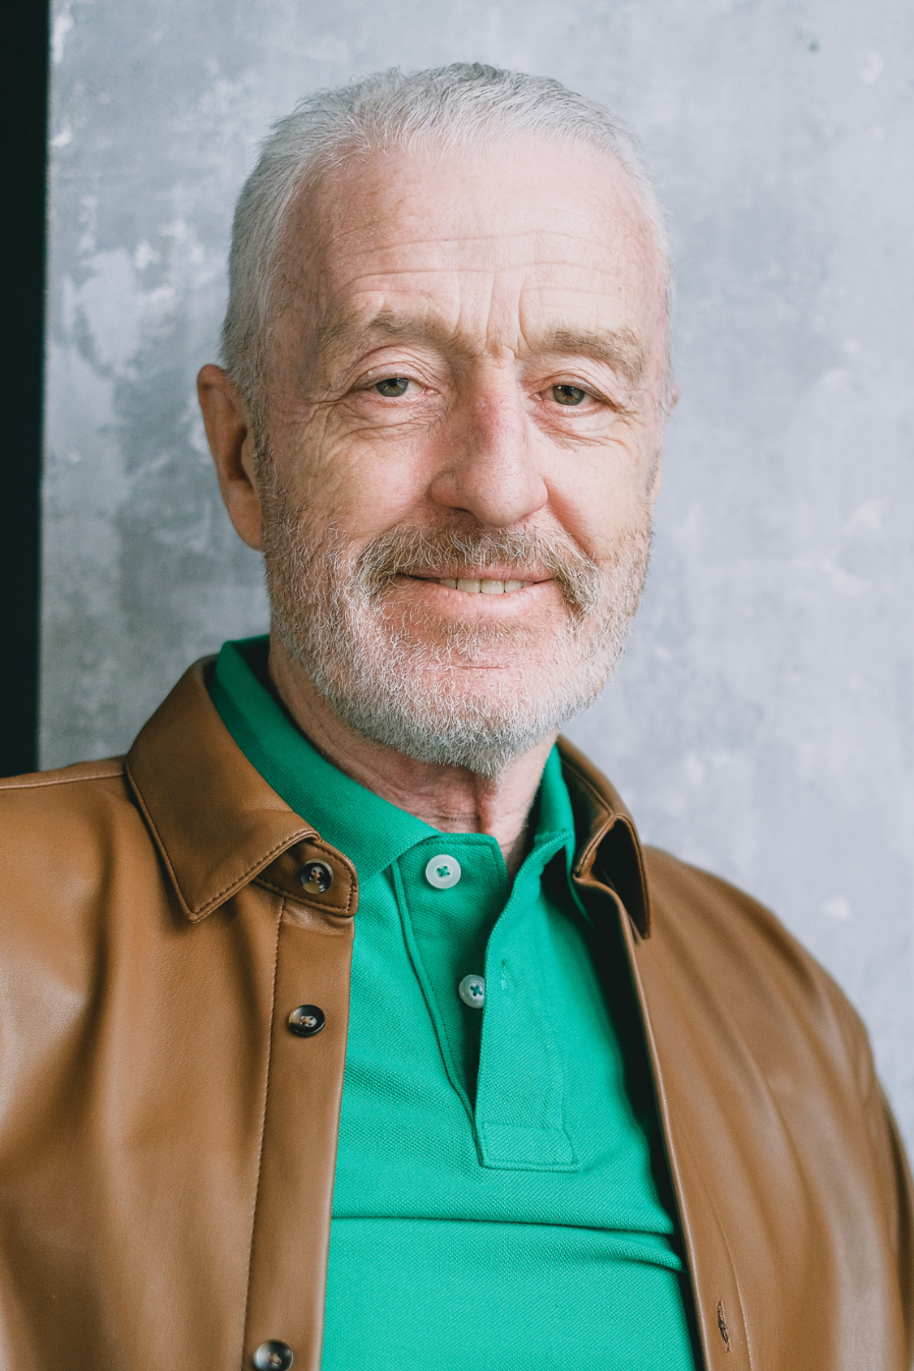
Prayer of Hope
FINDING HOPE IN
THE PROMISE OF TOMORROW
God of hope, as we say goodbye to [Name], we hold onto the promise of tomorrow. May the light of your love shine upon us, guiding us through the darkness of grief and illuminating the path ahead. Help us to trust in your plan and to find hope in the assurance of eternal life.
Amen.

Slide 19
Resource Page
Use these design resources in your Canva Presentation.
Fonts
Design Elements
This presentation template
uses the following free fonts:
TITLES:
PETIT FORMAL SCRIPT
HEADERS:
NUNITO
BODY COPY:
MONTSERRAT
You can find these fonts online too.
Colors
#D5DCDD
#F4F1EB
  DON'T FORGET TO DELETE THIS PAGE BEFORE PRESENTING.

Slide 20

Credits
This presentation template is free for everyone to use thanks to the following:
  for the presentation template
Pexels, Pixabay
  for the photos
HAPPY DESIGNING!

