Slide 1



In Loving Memory of
NAME
SURNAME
Tribute Slides Funeral Slides

Slide 2


Introduction
HONORING
NAME
Today, we gather to celebrate the life of [Name]. As we reflect on the memories and moments shared with [him/her], we find solace in music, a universal language that speaks to the heart.

Slide 3
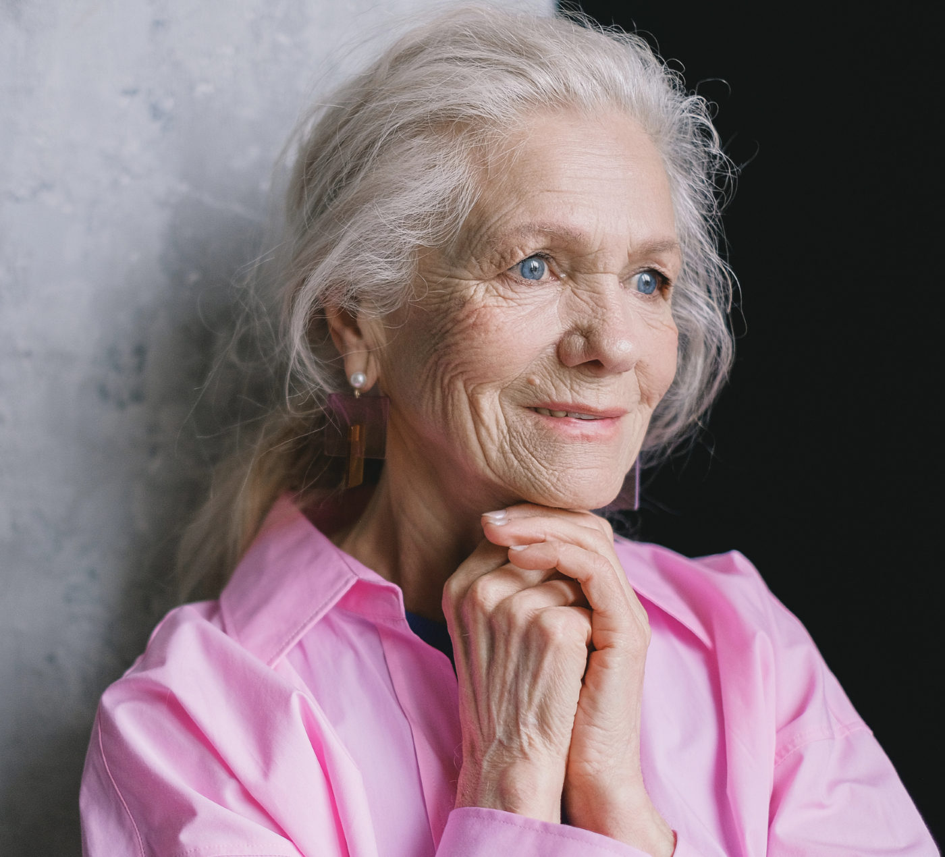
ANGELS
I'm loving angels instead
And through it all,
she offers me protection
A lot of love and affection
Whether I'm right or wrong
by Robbie Williams

Slide 4
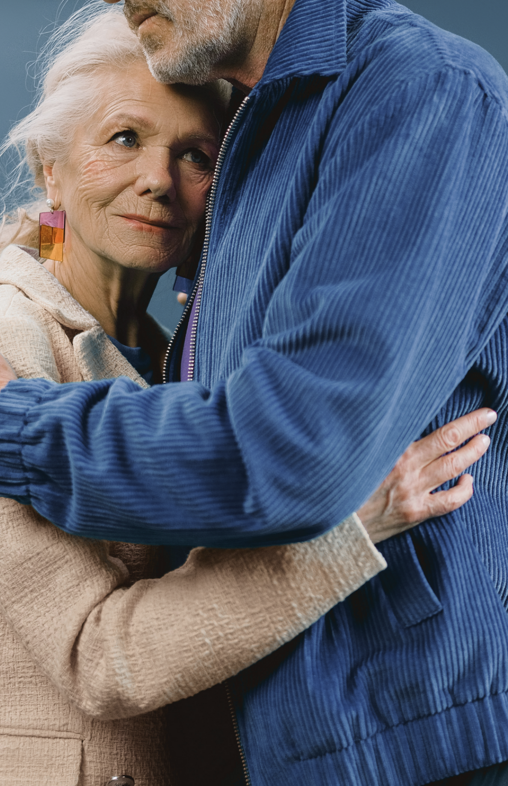
FINDING
SOLACE IN PRAYER
Heavenly Father, in this time of grief, we turn to you for comfort and strength. Surround us with your love and peace, and ease the pain of our hearts. Help us to find solace in prayer and in the knowledge that you are always with us, holding us in your loving embrace.
Amen.

Slide 5
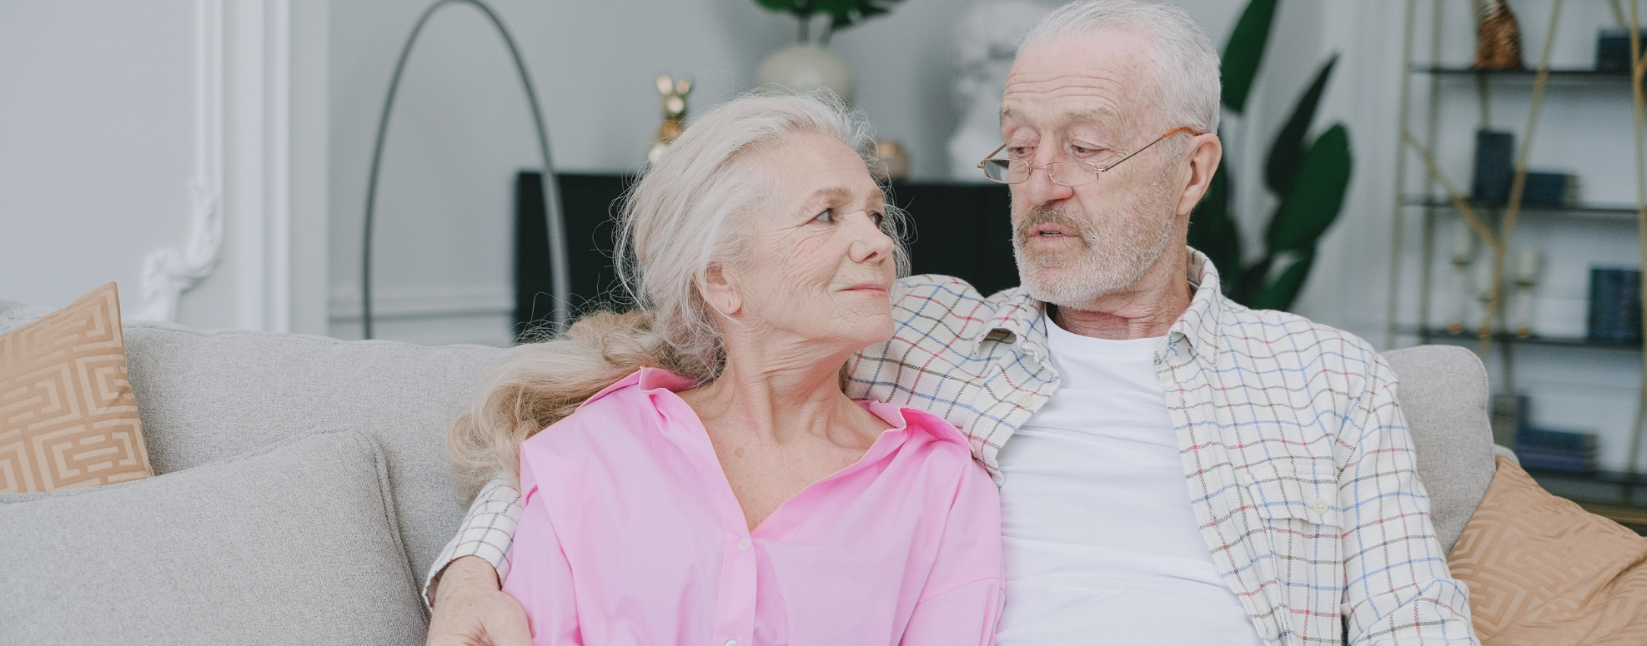
CHERISHED MEMORIES
[Name] was a [loving spouse/partner, devoted parent, caring friend, etc.]. Their warmth, kindness, and [list positive attributes] left an indelible mark on all who knew them.

Slide 6

Giving Thanks for
NAME
We thank you for the gift of [Name]'s life and the love they shared with us. We are grateful for the memories we hold dear and the time we were blessed to spend together. May their legacy of love continue to inspire us and guide us in the days ahead.

Slide 7


WRITE YOUR TOPIC
Topic One
Topic Two
Briefly elaborate on what you want to discuss.
Briefly elaborate on what you want to discuss.

Slide 8
WRITE AN ORIGINAL
STATEMENT OR
INSPIRING QUOTE
— Include a credit, citation, or supporting message

Slide 9
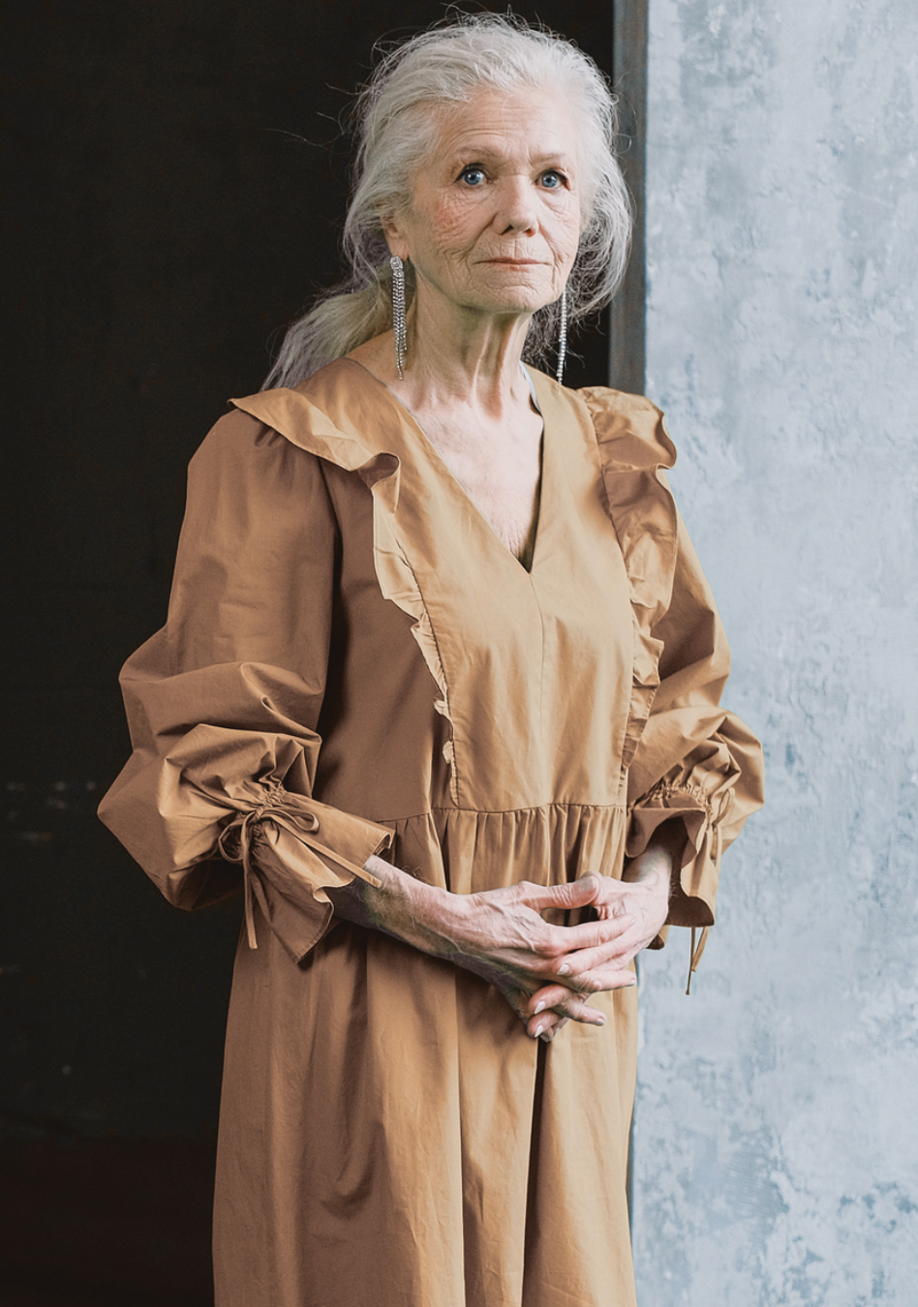
WORDS OF COMFORT
Add a main point
Briefly elaborate on what you want to discuss.
Add a main point
Briefly elaborate on what you want to discuss.

Slide 10

A picture is worth
a thousand words

Slide 11



LEGACY AND IMPACT
Add a main point
Add a main point
Add a main point
Briefly elaborate on what you want to discuss.
Briefly elaborate on what you want to discuss.
Briefly elaborate on what you want to discuss.

Slide 12
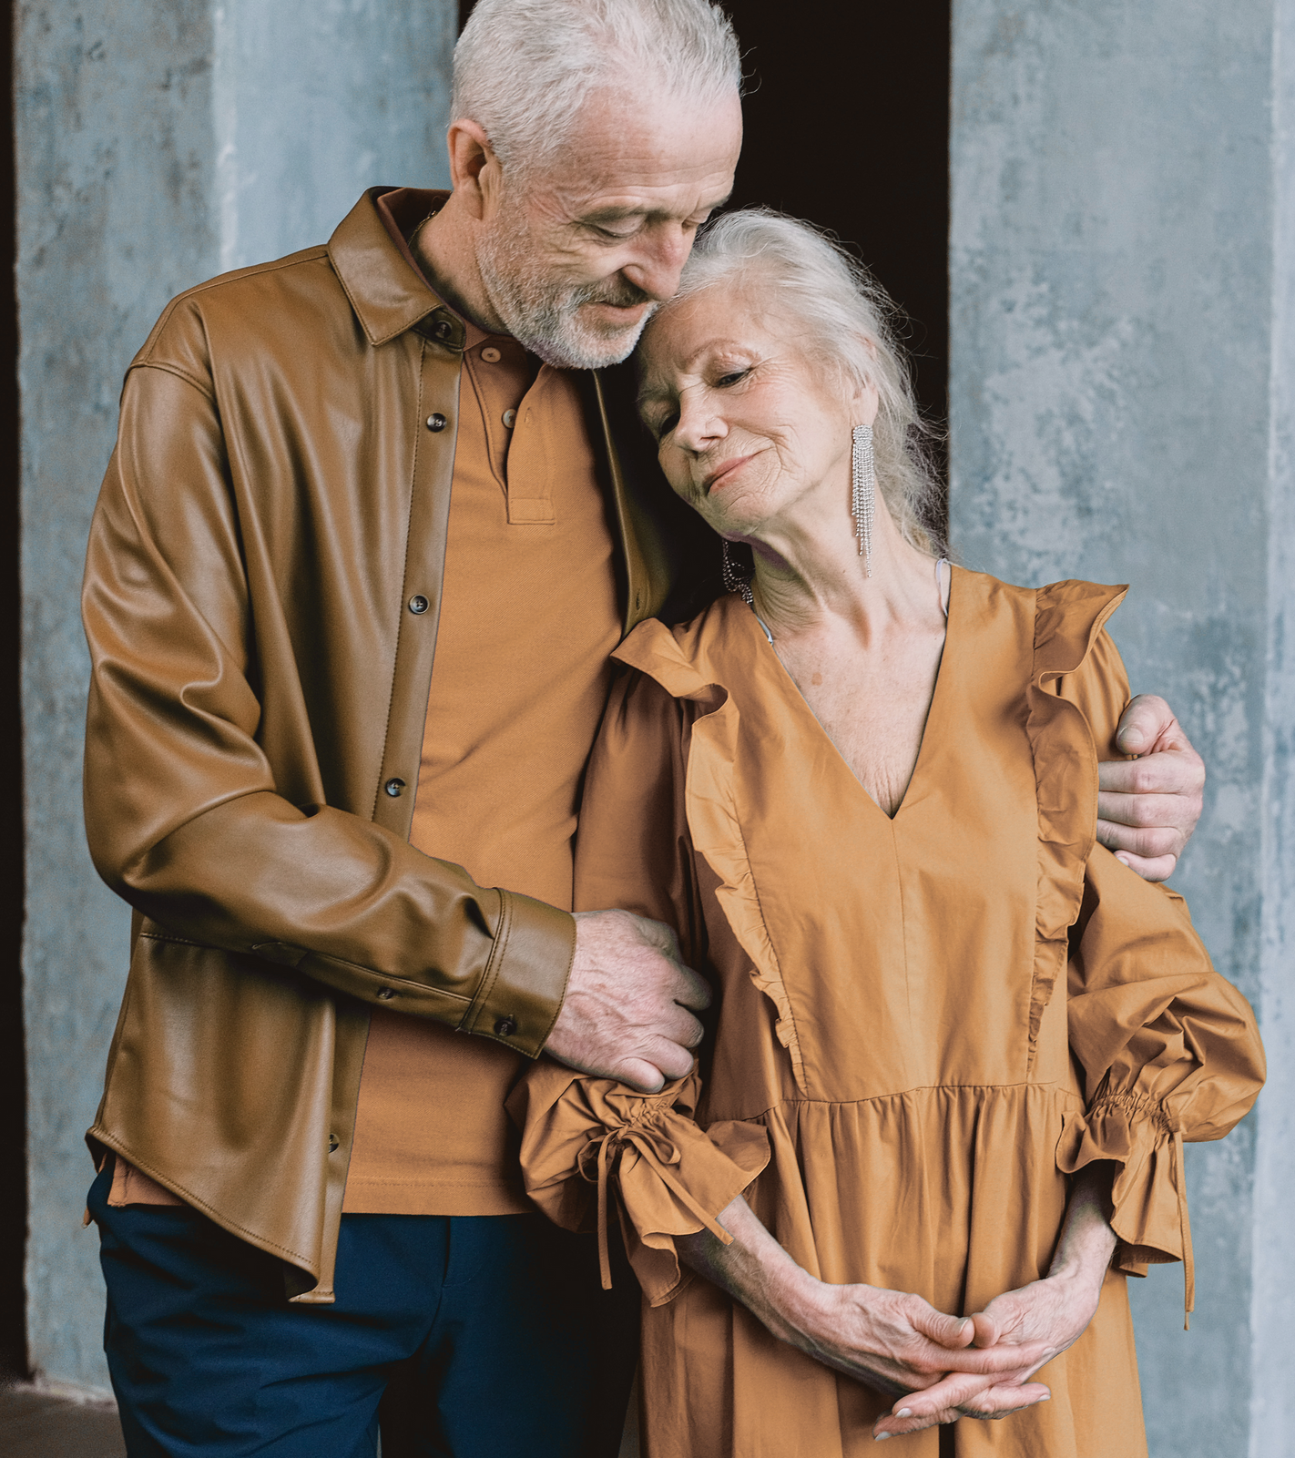
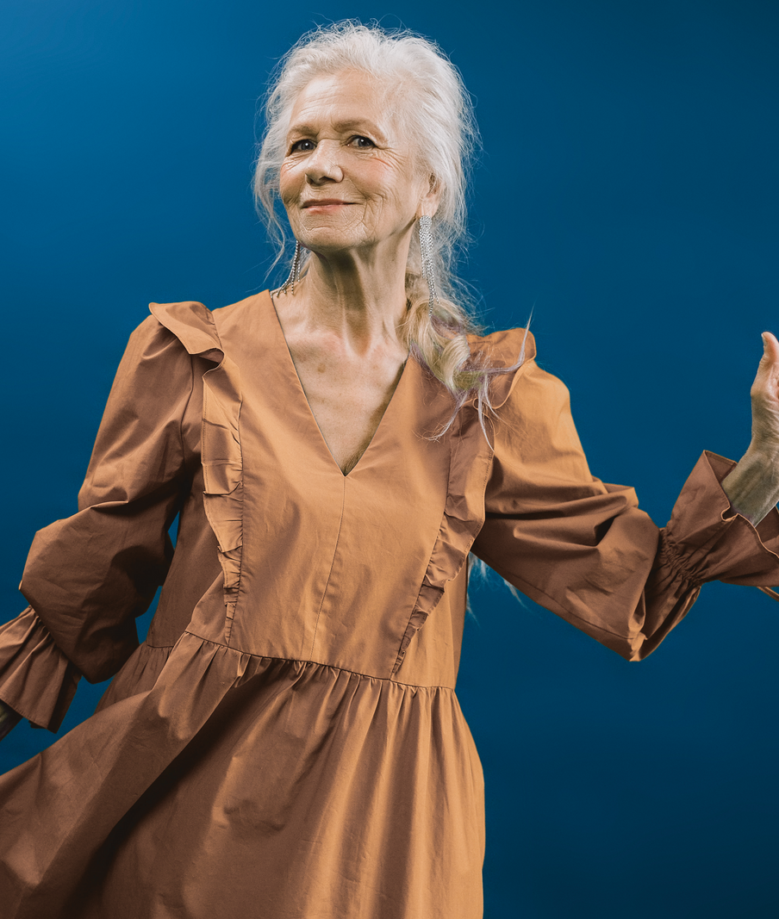

Slide 13
LEGACY
OF LOVE
Though [Name] may no longer be with us in person, their legacy of love and kindness lives on. Let us carry forward the lessons they taught us and the love they bestowed upon us, keeping their memory alive in our thoughts and actions.
Let us also honor their memory by embracing the values they held dear. Through acts of compassion, generosity, and understanding, we can perpetuate the essence of who they were, ensuring that their presence continues to illuminate our lives and those of others.

Slide 14

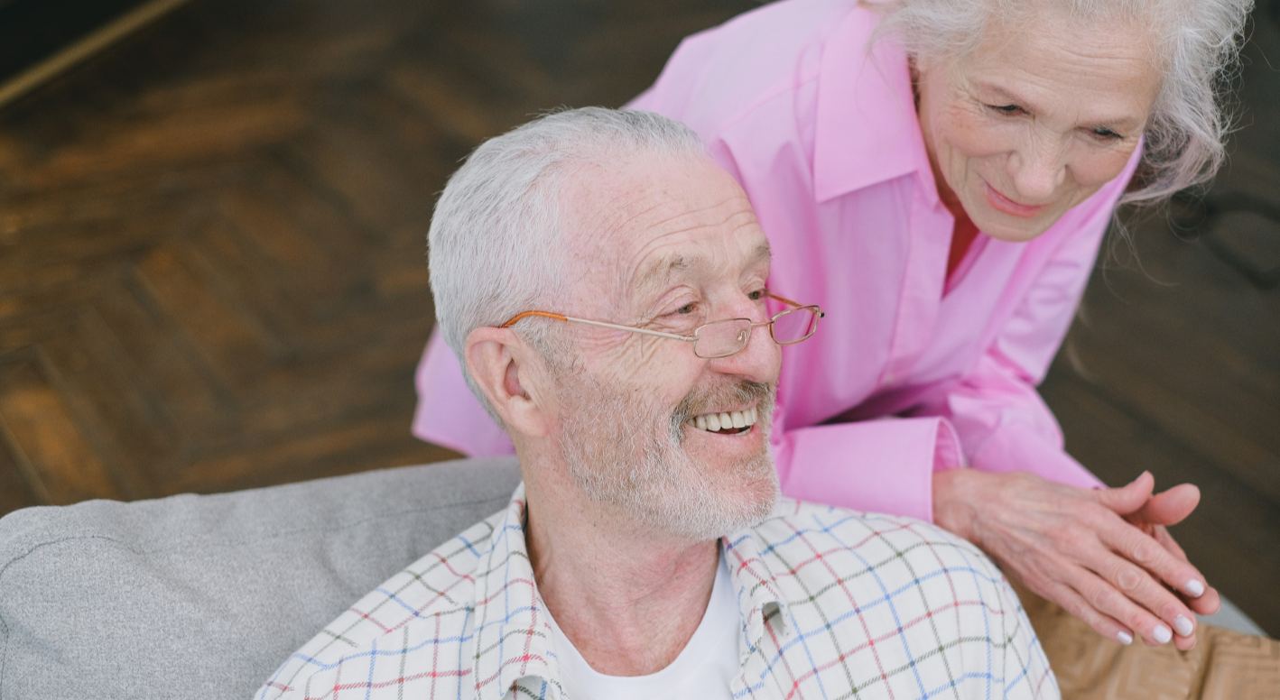

FINDING COMFORT IN REMEMBRANCE
In times of loss, it's natural to seek solace in memories. Let us take a moment to reflect on the special moments we shared with [Name]. Through laughter and tears, their spirit remains alive in our hearts, guiding us with love and strength.

Slide 15
PRAYER OF HOPE
Finding Hope in the Promise of Tomorrow
God of hope, as we say goodbye to [Name], we hold onto the promise of tomorrow. May the light of your love shine upon us, guiding us through the darkness of grief and illuminating the path ahead. Help us to trust in your plan and to find hope in the assurance of eternal life.
Amen.

Slide 16
RESOURCE PAGE
Use these design resources in your Canva Presentation.
Fonts
Design Elements
This presentation template
uses the following free fonts:
TITLES:
MONTSERRAT
HEADERS:
ITALIANNO
BODY COPY:
MONTSERRAT
Colors
#000000
#EADFDF
  DON'T FORGET TO DELETE THIS PAGE BEFORE PRESENTING.

Slide 17

CREDITS
This presentation template is free for everyone to use thanks to the following:
  for the presentation template
Pexels, Pixabay
  for the photos
Happy designing!

