Slide 1

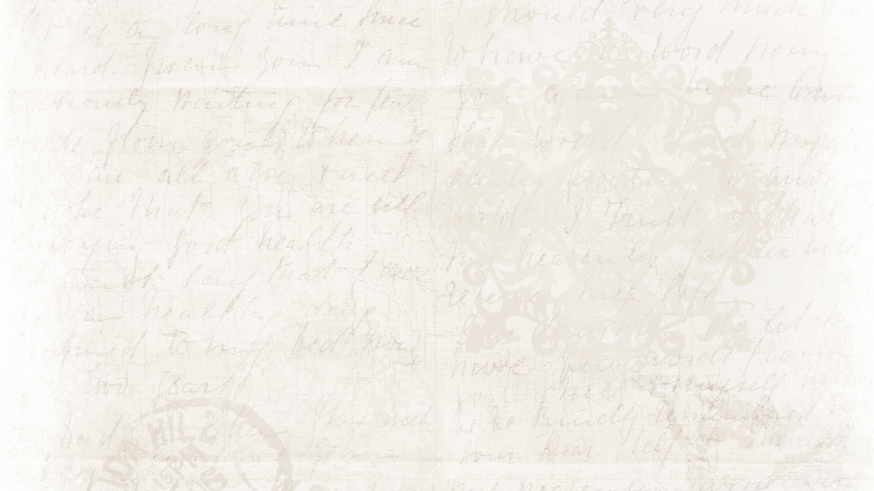

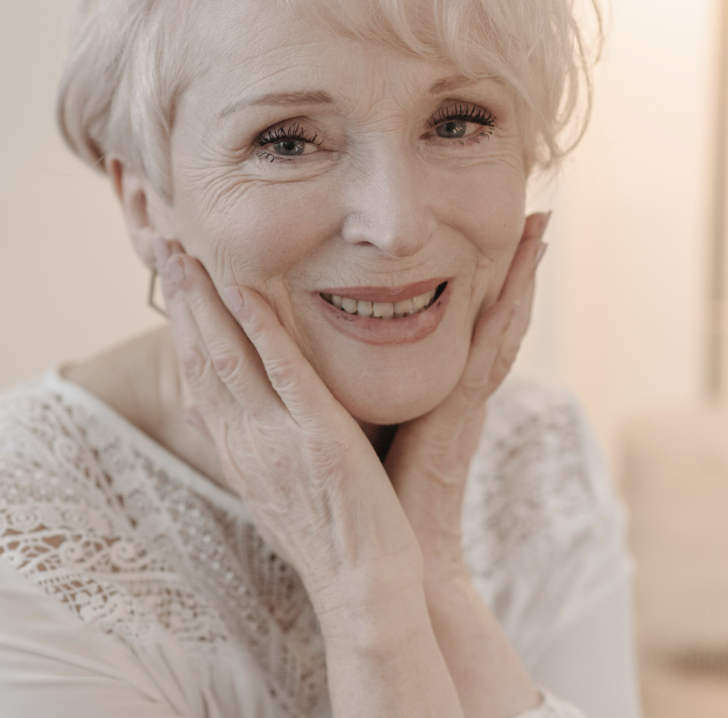
Songs For A
1956
2024
Mother's Funeral

Slide 2



Honoring
Mom
Today, we gather with heavy hearts to honor the life and legacy of our beloved mother. As we reflect on the memories shared, the lessons taught, and the love given, we find solace in music, a universal language that speaks to the depths of our emotions.

Slide 3


Melodic Tribute
Music has the extraordinary ability to convey emotions that words alone cannot express.
As we navigate through the depths of grief
From heartfelt ballads to uplifting anthems, let us embark on a musical journey that celebrates the beauty of [Name]'s legacy.
Music has the power to transcend words, evoking emotions and memories that resonate deeply within us. Each song included in this presentation has been carefully chosen to reflect the essence of [Name]'s life and the sentiments shared by those who knew [him/her] best.

Slide 4

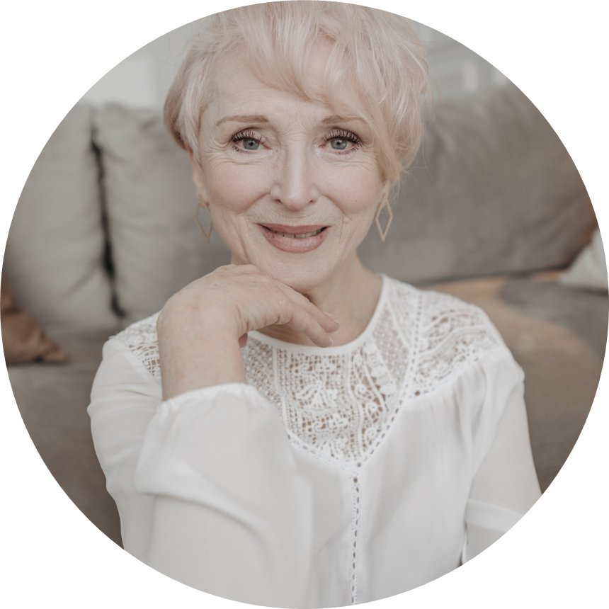


Forever in memory
Name Surname

Slide 5


Remembrance
Remembering mom
Dad touched our lives in countless ways, leaving behind cherished memories and a legacy of love and guidance. As we embark on this journey of remembrance, let us reflect on the laughter shared, the wisdom imparted, and the love that will forever endure. Through the songs selected for this presentation, we honor the essence of Dad and the profound impact he had on each of us.

Slide 6


Write an original statement or inspiring quote
— Include a credit, citation,
or supporting message

Slide 7


Song Title
Artist
Song Title
Artist
Song Title
Artist
Briefly elaborate on what you want to discuss.
Briefly elaborate on what you want to discuss.
Briefly elaborate on what you want to discuss.

Slide 8


Musical Journey
Topic One
Topic two
Briefly elaborate on what you want to discuss.
Briefly elaborate on what you want to discuss.
Topic three
Topic four
Briefly elaborate on what you want to discuss.
Briefly elaborate on what you want to discuss.

Slide 9
Finding Comfort in
Melodies
Music has the extraordinary ability to convey emotions that words alone cannot express. As we navigate through the depths of grief, let us find solace in the melodies that embrace the essence of [Name]'s spirit.

Slide 10

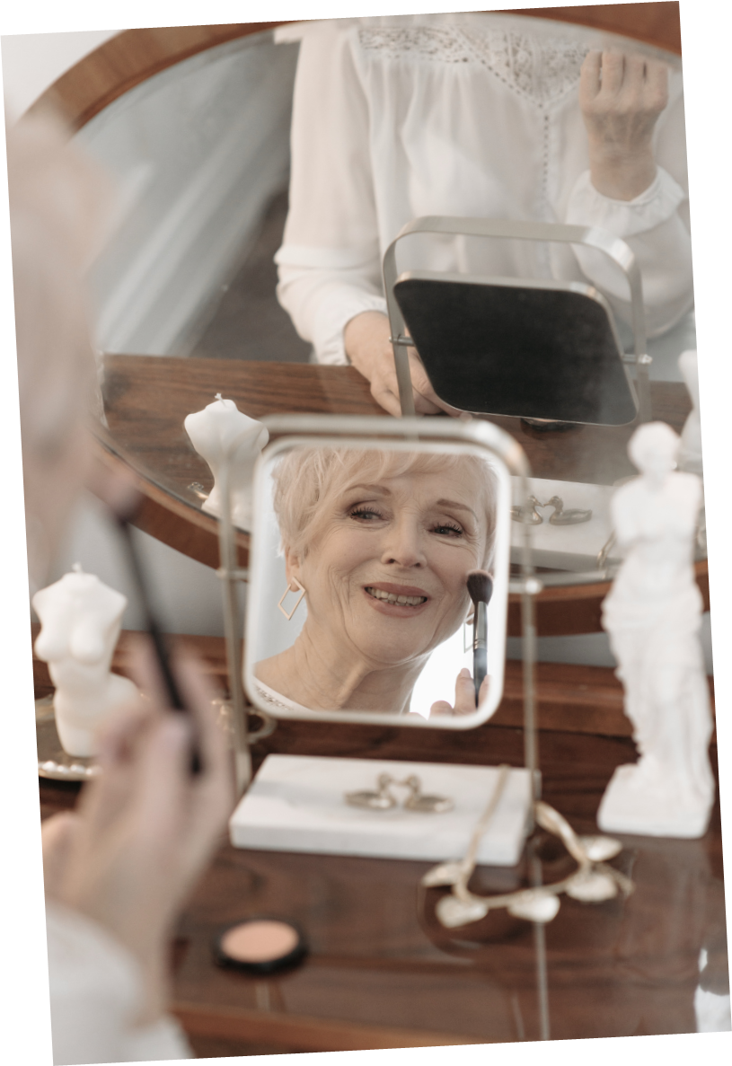
Celebrating Her Spirit
Eternal Love
oday, we celebrate the beautiful spirit of our beloved mother—a woman whose kindness, strength, and resilience touched the lives of all who knew her. These songs resonate with the joy she brought into our lives and the lasting imprint she leaves behind.

Slide 11


Arms of an Angel
In the arms of the angel
Fly away from here
From this dark, cold hotel room
And the endlessness that you fear
by Sarah McLachlan

Slide 12
Angels
My Way
I'm loving angels instead
And through it all,
she offers me protection
A lot of love and affection
Whether I'm right or wrong
And now, the end is near
And so I face the final curtain
My friend, I'll say it clear
I'll state my case,
of which I'm certain
Robbie Williams
Frank Sinatra

Slide 13
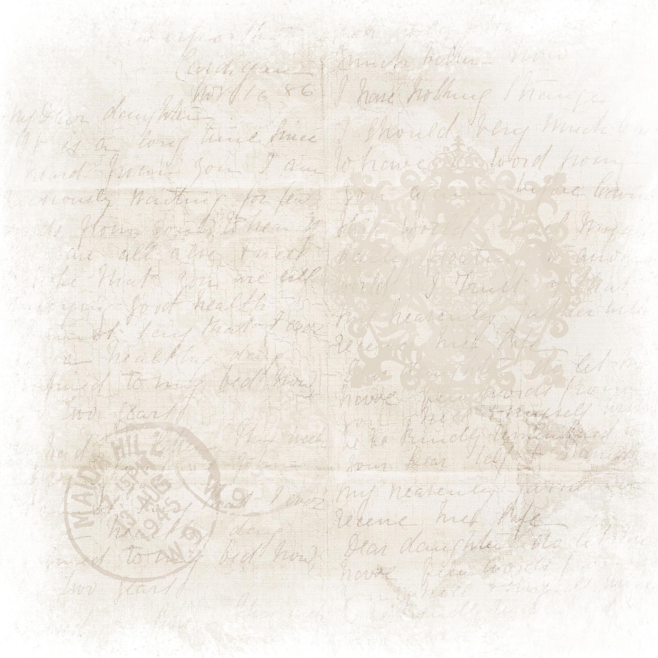




You Raise Me Up
artist name
Did you ever know that you're my hero
And everything I would like to be?
I can fly higher than an eagle
For you are the wind beneath my wings

Slide 14
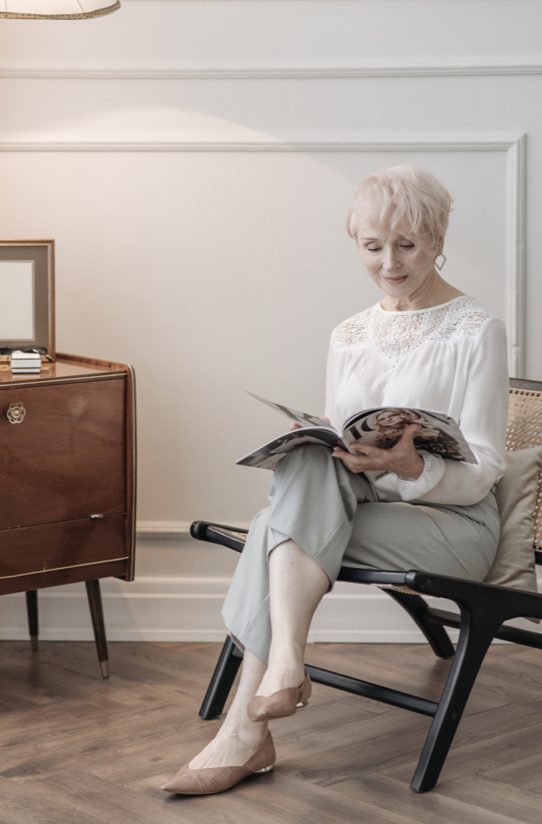
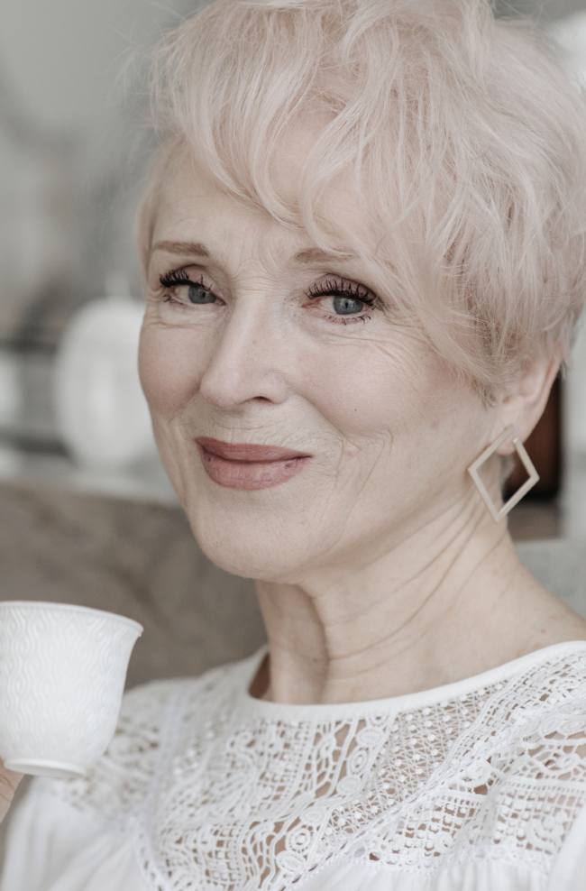
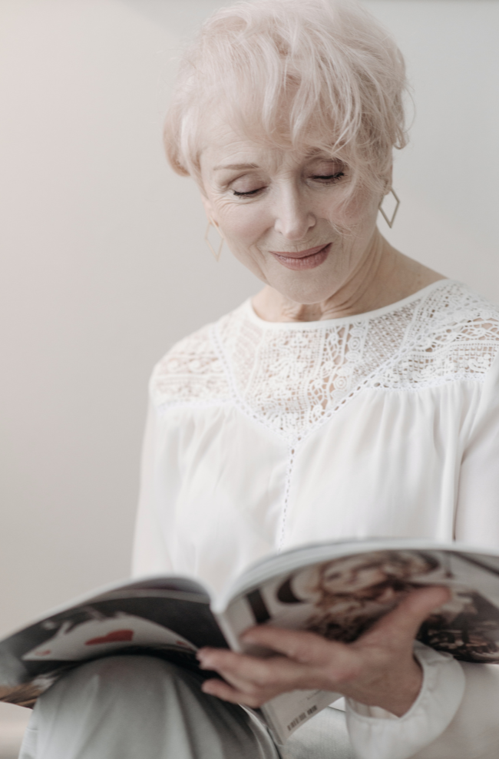
Rest in peace

Slide 15


by Traditional
Amazing Grace
Amazing grace, how sweet the sound
That saved a wretch like me
I once was lost, but now I'm found
Was blind, but now I see

Slide 16


Con te partirò
Time to say goodbye,
Paesi che non ho mai
Veduto e vissuto con te,
Adesso sì, li vivrò
by Andrea Bocelli
and Sarah Brightman

Slide 17

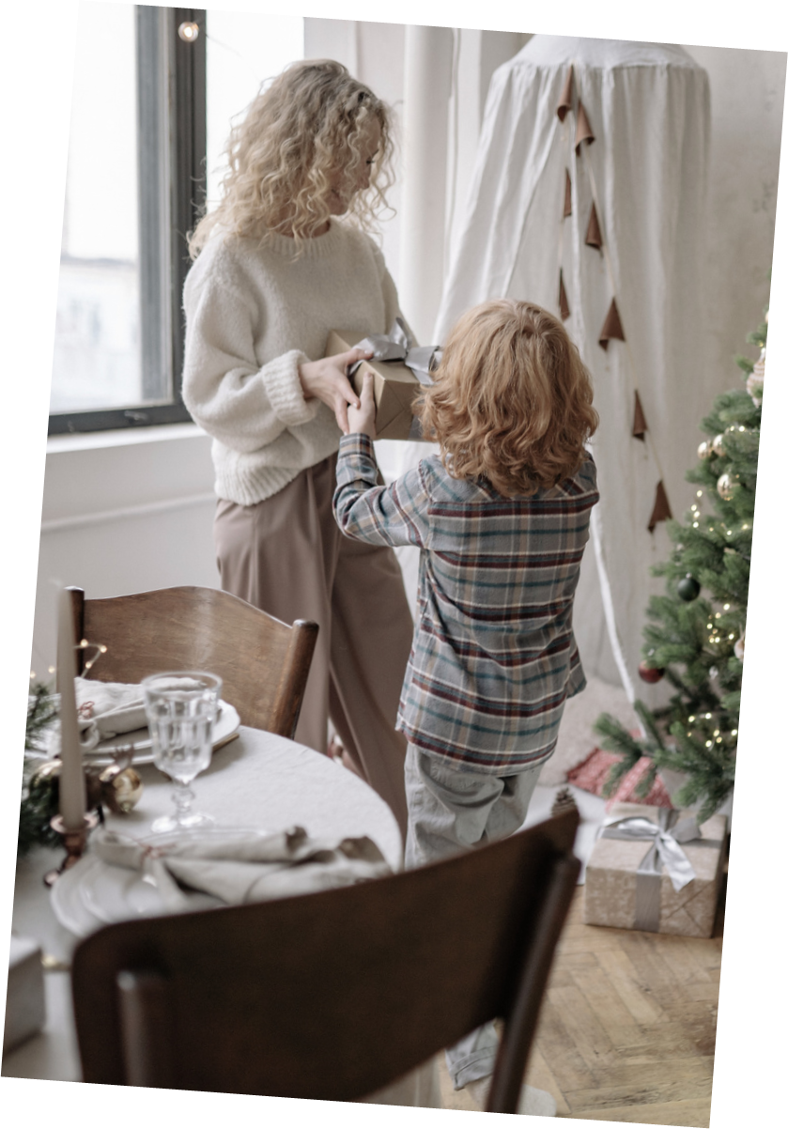
Dance With
My Mother
Back when I was a child
Before life removed all the innocence
artist name

Slide 18

love you forever

Slide 19
Resource Page
Use these design resources in your Canva Presentation.
Fonts
Design Elements
This presentation template
uses the following free fonts:
TITLES:
CARDO
HEADERS:
ALLURA
BODY COPY:
NUNITO
You can find these fonts online too.
Colors
#156770
#4B3800
#E1BA4F
#FDEF9E
  DON'T FORGET TO DELETE THIS PAGE BEFORE PRESENTING.

Slide 20

Credits
This presentation template is free for everyone to use thanks to the following:
  for the presentation template
Pexels, Pixabay
  for the photos
Happy designing!

