Slide 1


SONGS FOR
FUNERAL
Your Presentation
Starts here

Slide 2
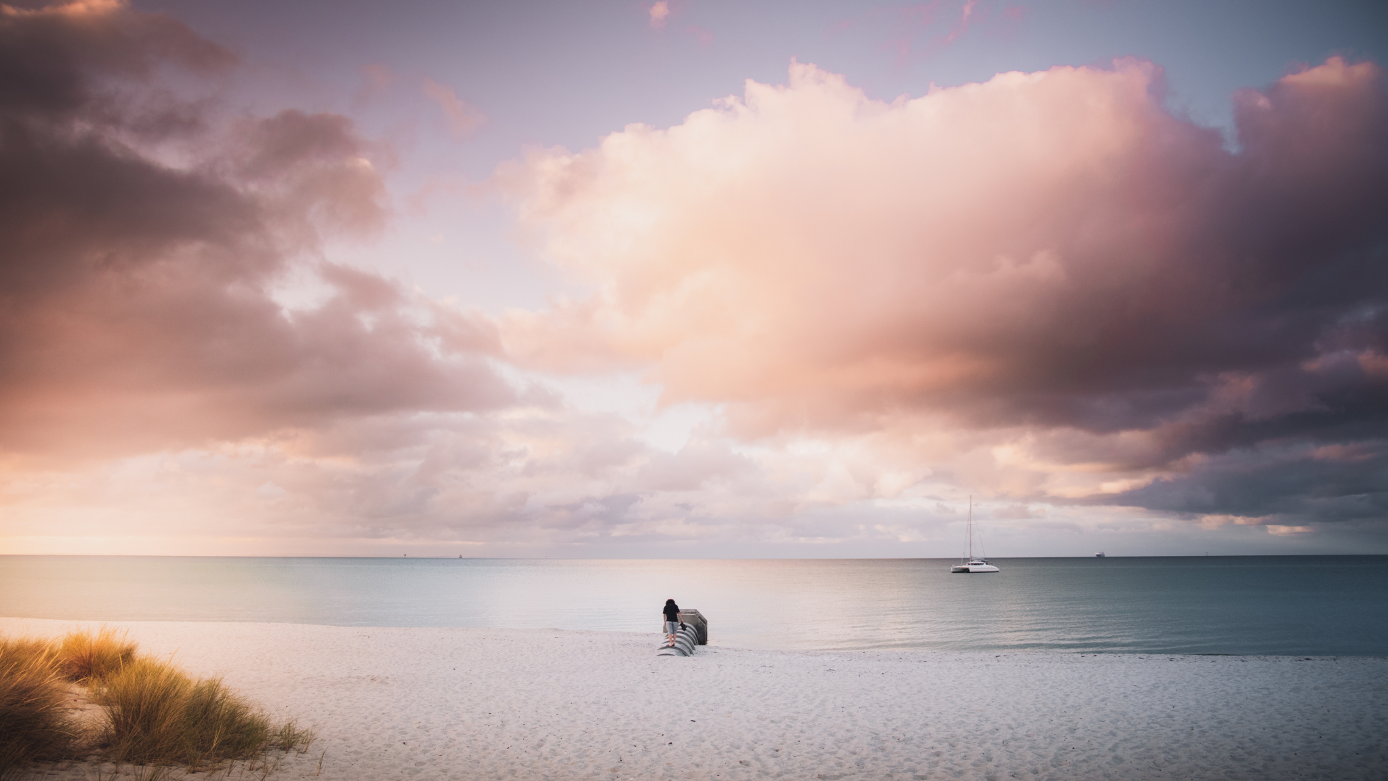
SONGS OF
REMEMBRANCE:
A TRIBUTE
TO NAME
Date and Location of Funeral Service

Slide 3

INTRODUCTION
HONORING
NAME
Today, we gather to celebrate the life of [Name]. As we reflect on the memories and moments shared with [him/her], we find solace in music, a universal language that speaks to the heart.

Slide 4

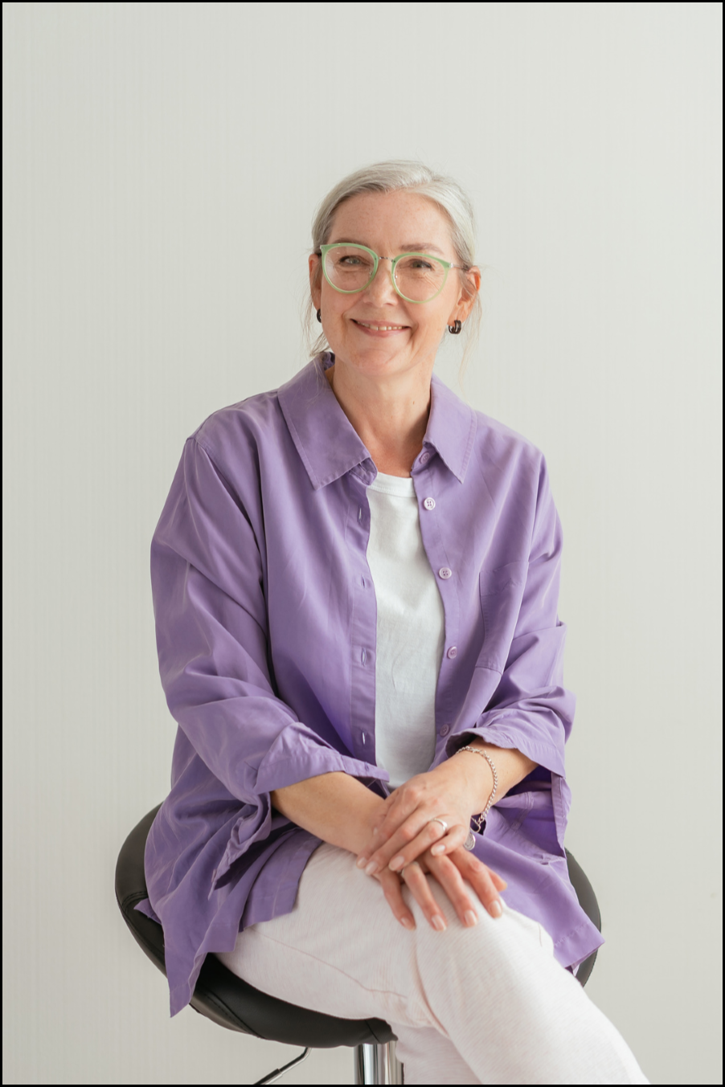

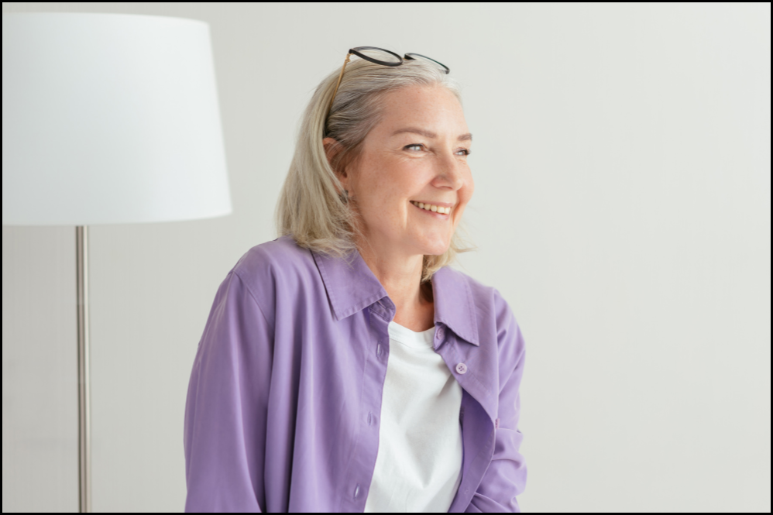


Slide 5
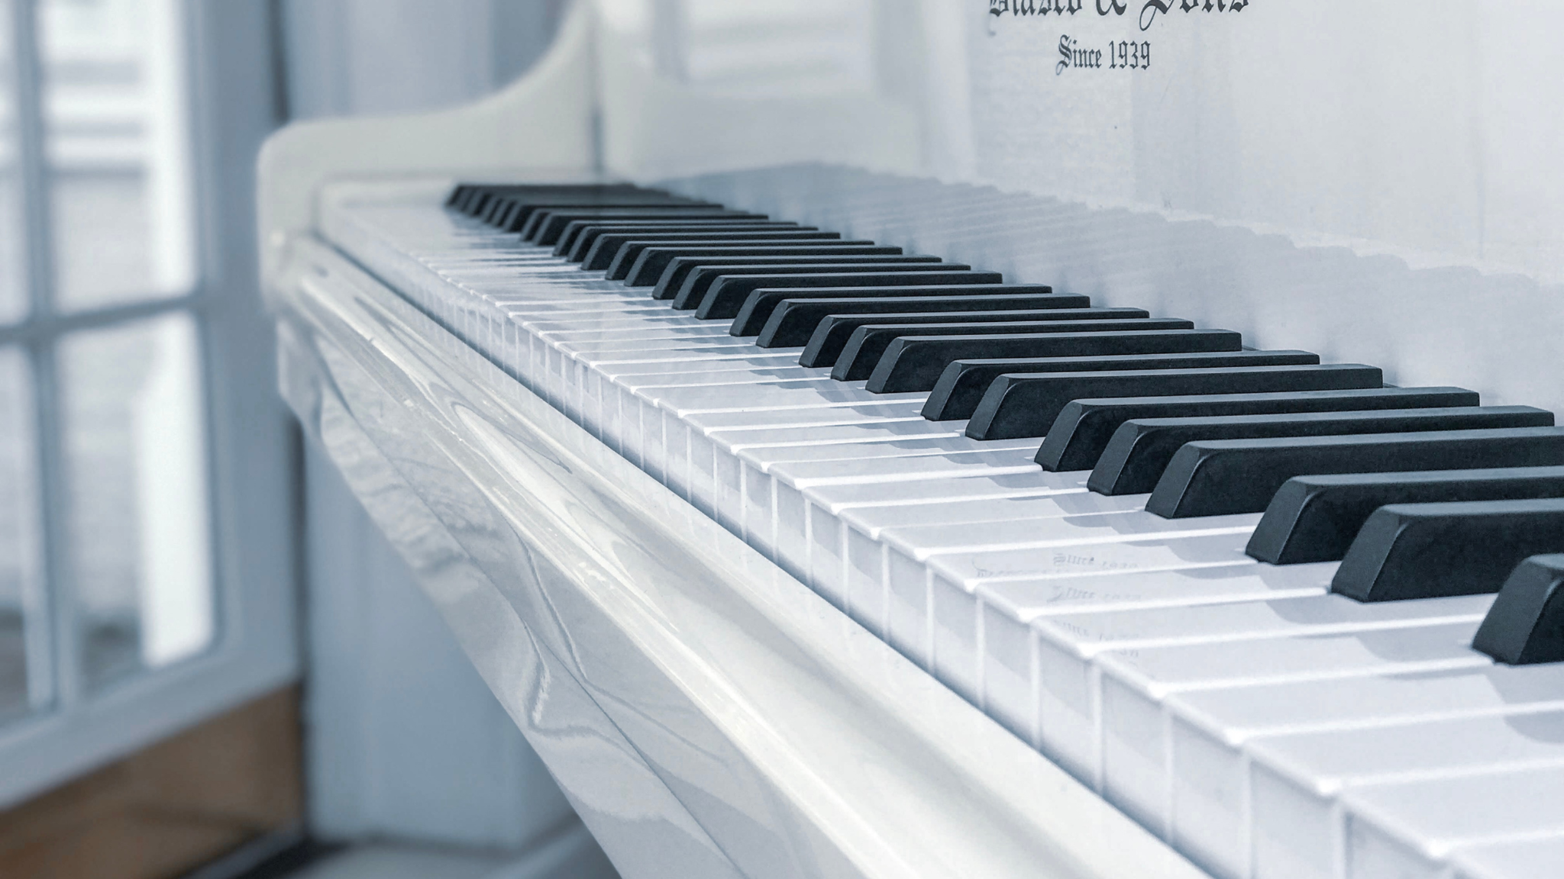
A MELODIC
TRIBUTE
Music has the power to transcend words, evoking emotions and memories that resonate deeply within us. Each song included in this presentation has been carefully chosen to reflect the essence of [Name]'s life and the sentiments shared by those who knew [him/her] best. From heartfelt ballads to uplifting anthems, let us embark on a musical journey that celebrates the beauty of [Name]'s legacy.

Slide 6

SONG TITLE
ARTIST
SONG TITLE
ARTIST
01.
02.
Briefly elaborate on what you want to discuss.
Briefly elaborate on what you want to discuss.
SONG TITLE
ARTIST
SONG TITLE
ARTIST
03.
04.
Briefly elaborate on what you want to discuss.
Briefly elaborate on what you want to discuss.

Slide 7
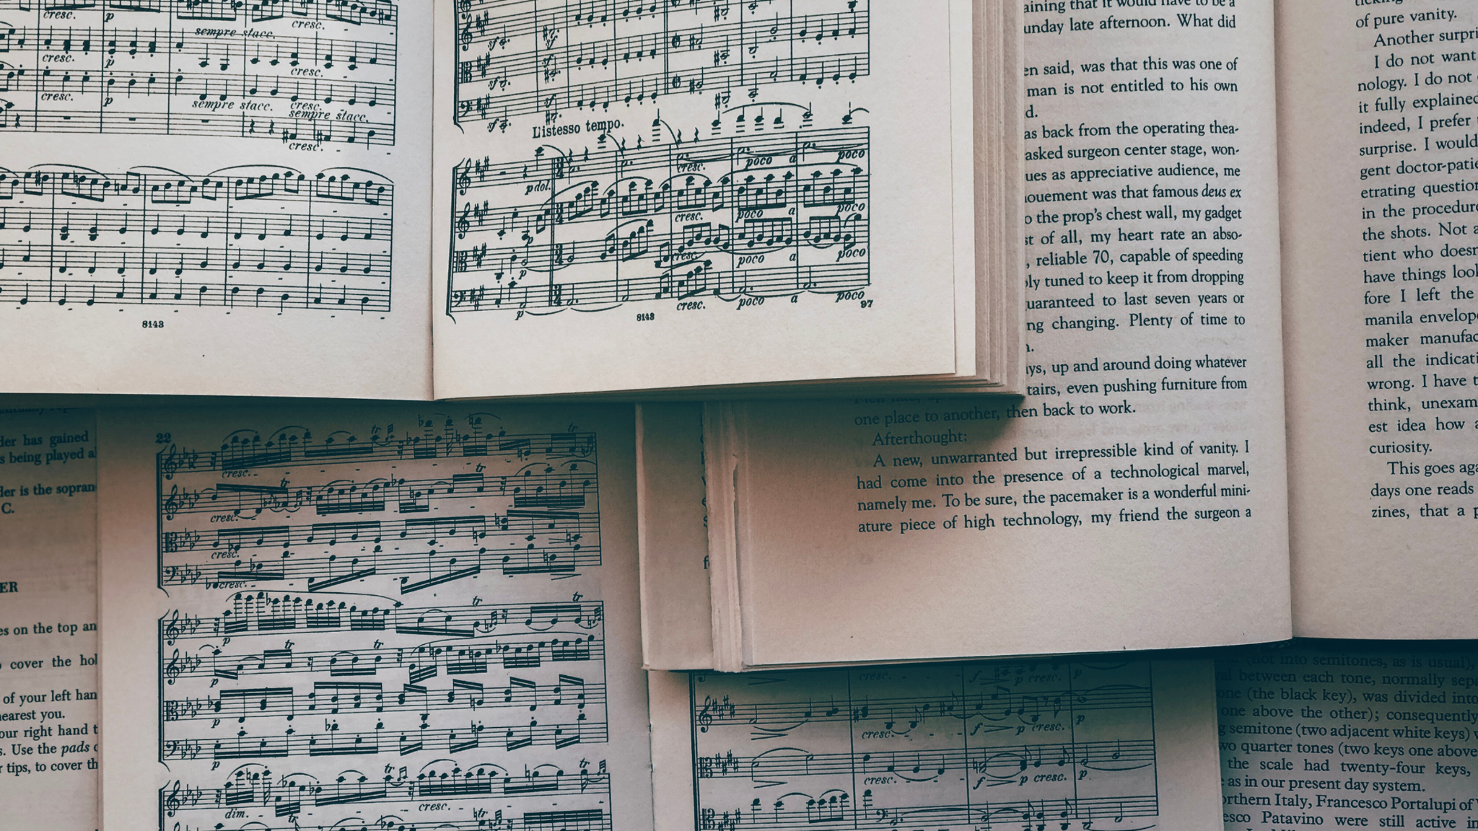
FINDING COMFORT IN MELODIES
Music has the extraordinary ability to convey emotions that words alone cannot express. As we navigate through the depths of grief, let us find solace in the melodies that embrace the essence of [Name]'s spirit.

Slide 8


ARTIST NAME
YOU RAISE ME UP
Did you ever know that you're my hero
And everything I would like to be?
I can fly higher than an eagle
For you are the wind beneath my wings

Slide 9
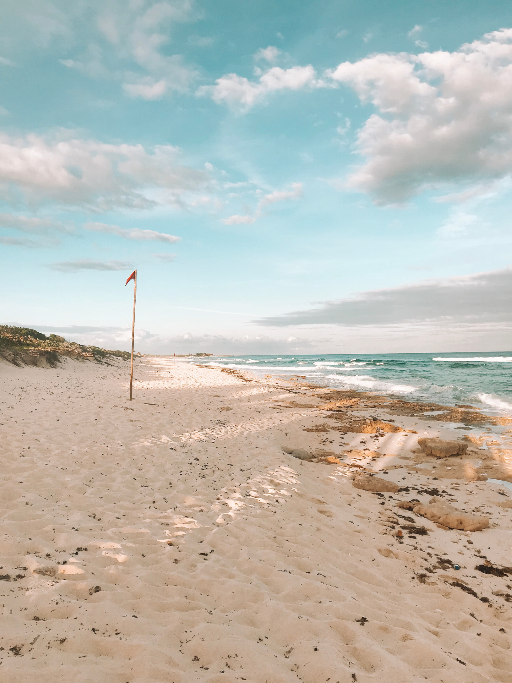
IN THE ARMS
OF AN ANGEL
BY SARAH MCLACHLAN
In the arms of the angel
Fly away from here
From this dark, cold hotel room
And the endlessness that you fear

Slide 10

ANGELS
MY WAY
I'm loving angels instead
And through it all,
she offers me protection
A lot of love and affection
Whether I'm right or wrong
And now, the end is near
And so I face the final curtain
My friend, I'll say it clear
I'll state my case,
of which I'm certain
BY ROBBIE
WILLIAMS
BY FRANK SINATRA

Slide 11


BY TRADITIONAL
AMAZING GRACE
Amazing grace, how sweet the sound
That saved a wretch like me
I once was lost, but now I'm found
Was blind, but now I see

Slide 12


THE ROSE
It's the heart afraid of breaking
That never learns to dance
It's the dream afraid of waking
That never takes the chance
BY BETTE MIDLER

Slide 13


BY ANDREA BOCELLI
AND SARAH BRIGHTMAN
CON TE PARTIRÒ
Time to say goodbye,
Paesi che non ho mai
Veduto e vissuto con te,
Adesso sì, li vivrò

Slide 14


FLY
Fly, fly, do not fear
Don't waste a breath, don't shed a tear
Your heart is pure, your soul is free
Be on your way, don't wait for me
BY CELINE
DION

Slide 15

IN LOVING MEMORY
As we conclude this tribute, let us carry with us the cherished memories of [Name]. Though [he/she] may no longer be with us in body, [his/her] spirit lives on in the hearts of all who knew [him/her]. May the music shared today continue to bring comfort and solace in the days ahead, reminding us of the love and light that [Name] brought into our lives.

Slide 16








































RESOURCE PAGE
Use these design resources in your Canva Presentation.
Fonts
Design Elements
This presentation template
uses the following free fonts:
TITLES:
PLAYFAIR DISPLAY
HEADERS:
NUNITO
BODY COPY:
MONTSERRAT
You can find these fonts online too.
Colors
#000000
#FAEBE8
  DON'T FORGET TO DELETE THIS PAGE BEFORE PRESENTING.

Slide 17

CREDITS
This presentation template is free for everyone to use thanks to the following:
  for the presentation template
Pexels, Pixabay
  for the photos
HAPPY DESIGNING!

