Slide 1




Never Have
I Ever
CHRISTMAS PARTY GAME

Slide 2



Welcome, everyone!
Let’s spread some joy and laughter with a fun Christmas game.

Slide 3



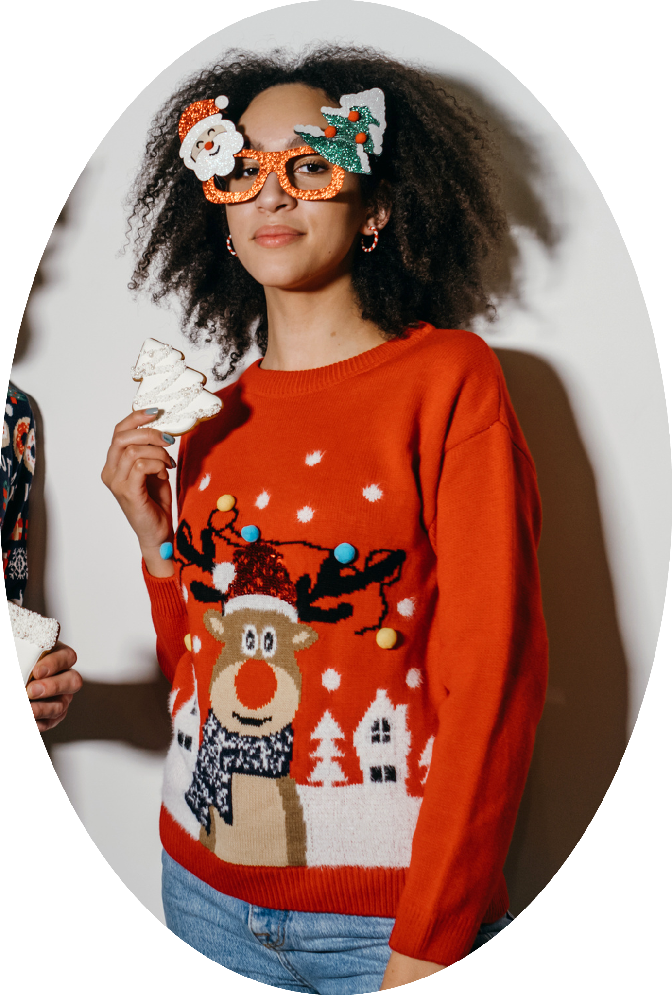

Game master Jamie
What’s crackin’, party people! Get ready, because I’m your host for the night!

Slide 4



Here
are the
Rules

Slide 5
How to Play
1
2
3
Each person have five minutes to give three "Never Have I Ever" questions to the game master.
The game master will show a randomized question on the screen.
If the players have done it, raise your hand and take a shot!
Feel free to share a quick story about your experience! Keep it light and fun—this is a no-judgment zone!

Slide 6
Round 1
Let the games begin, and may the best player win!

Slide 7



Never Have I Ever
Sung Christmas carols in public

Slide 8


Never Have I Ever
Worn an ugly Christmas sweater

Slide 9

Never Have I Ever
Re-gifted
a present

Slide 10

Round 2
Are you ready?

Slide 11


Never Have I Ever
Made a
snow angel

Slide 12



Never Have I Ever
Celebrated Christmas in a different country

Slide 13



Never Have I Ever
Watched the same Christmas movie twice.

Slide 14


Thanks for joining!
Happy Holidays!

Slide 15
Resource Page
Use these design resources in your Canva presentation.
Fonts
Design Elements
This presentation template
uses the following free fonts:
Titles:
Headers:
Body:
Chango
Chango
Fira Code
You can find these fonts online too.
Colors

Slide 16


Credits
This presentation template is free for
everyone to use thanks to the following:
Pexels and Pixabay
for the presentation template
For the photos
Happy designing!

