Slide 1



Let’s Go
on a Safari
BACKGROUND SLIDES

Slide 2



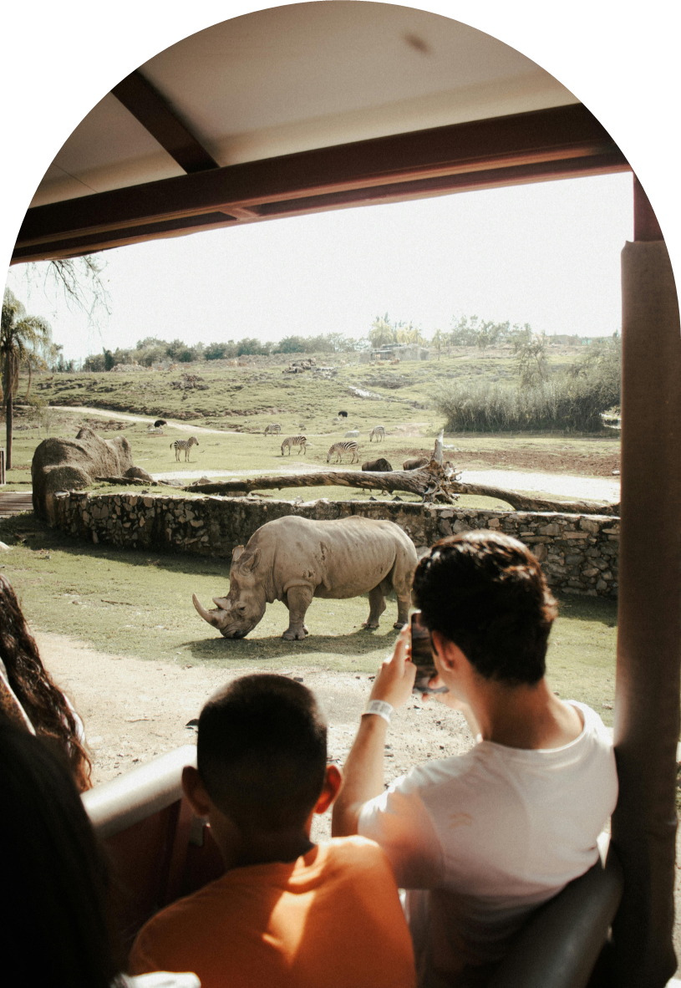
Table Of Contents
1
Elaborate on what you want to discuss.
Introduction
2
Elaborate on what you want to discuss.
Activities
3
Elaborate on what you want to discuss.
About Safari

Slide 3


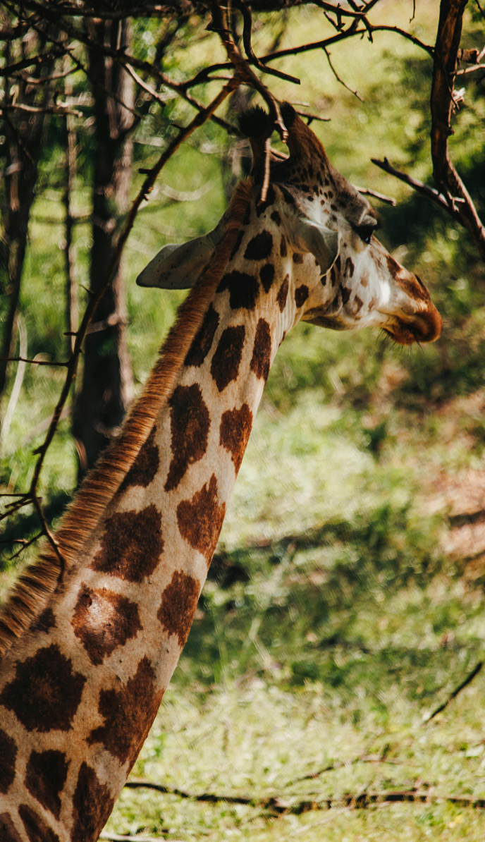


1
Introduction
Elaborate on what you want to discuss.

Slide 4


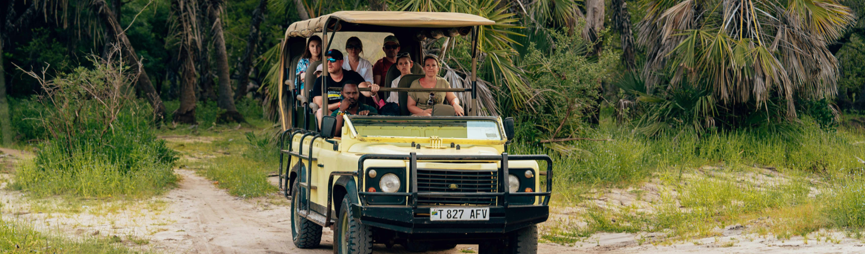
Welcome To Presentation
I'm Rain, and I'll be sharing with you my beautiful ideas. Follow me at @reallygreatsite to learn more.

Slide 5

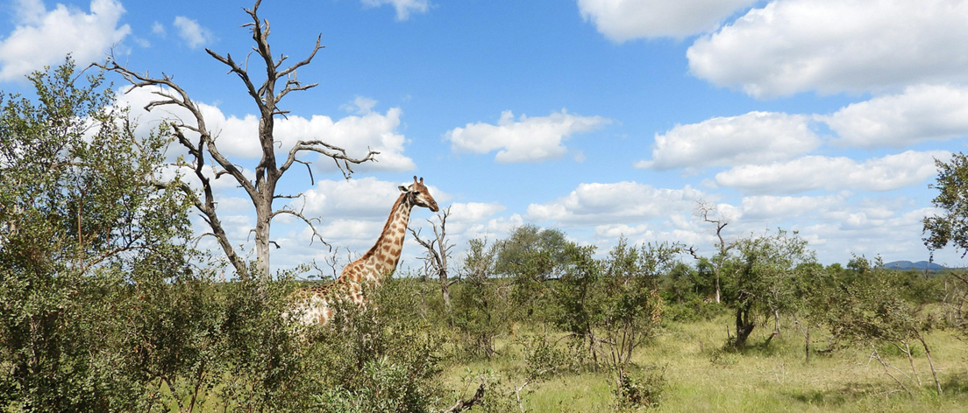

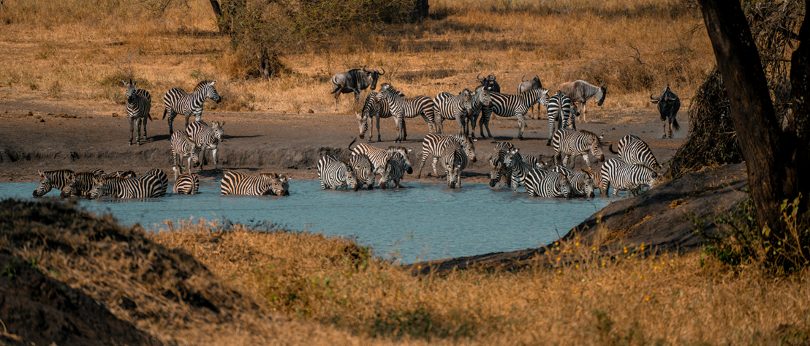


Safari: A Journey Into The Wild
What Are the Best Safari Destinations?
Briefly elaborate on what you want to discuss.
What Wildlife Can You Expect to See on Safari?
Briefly elaborate on what you want to discuss.

Slide 6



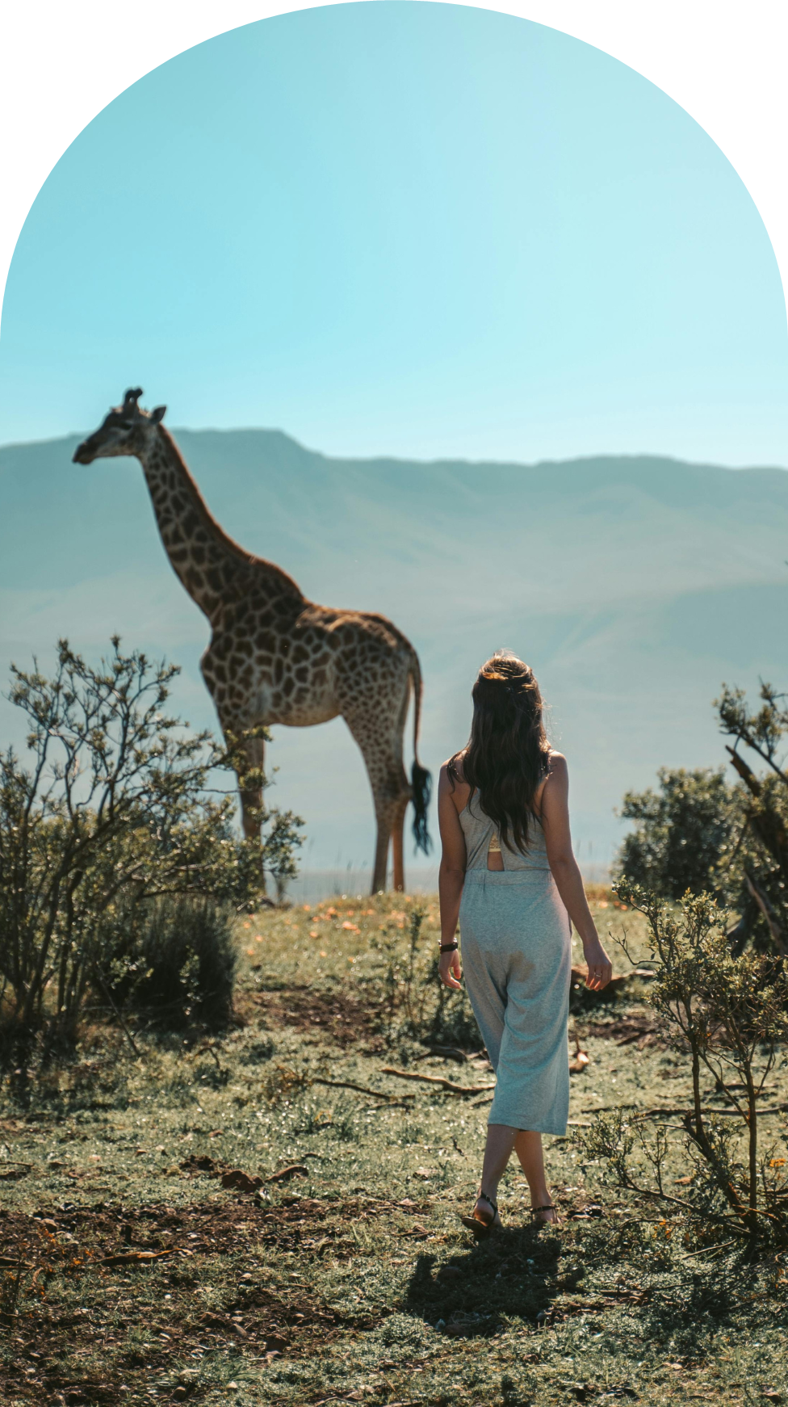


Conservation And Responsible Tourism
Sustainable Practices in Tourism
Ethical Wildlife Encounters
Enter your grand vision statement!
Enter your grand vision statement!

Slide 7

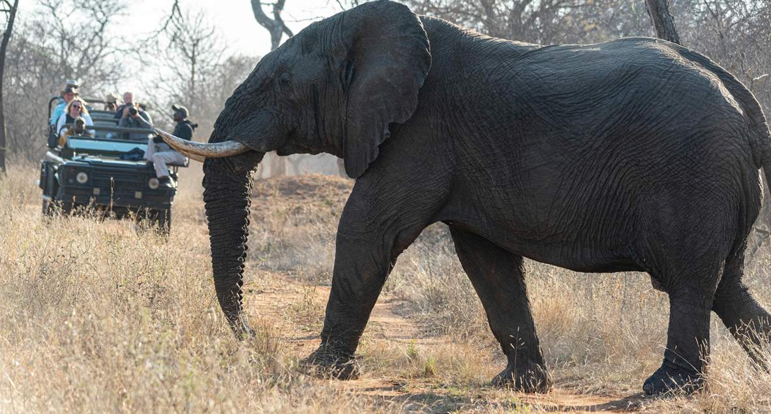
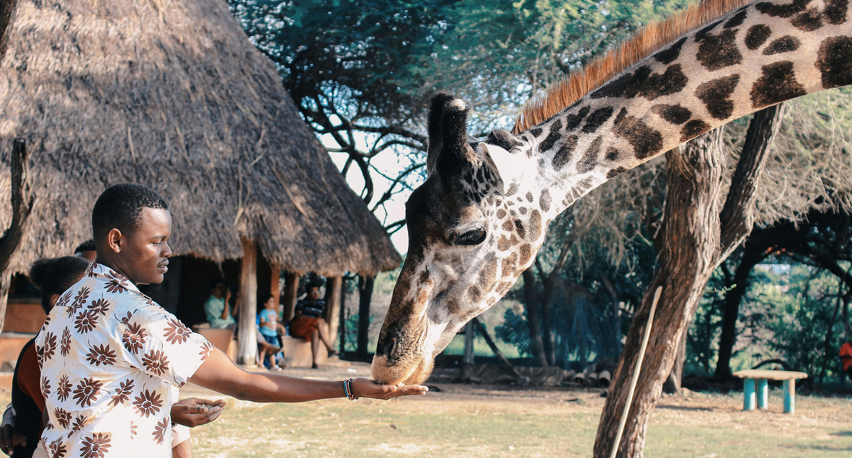


2
Activities
Elaborate on what you want to discuss.

Slide 8

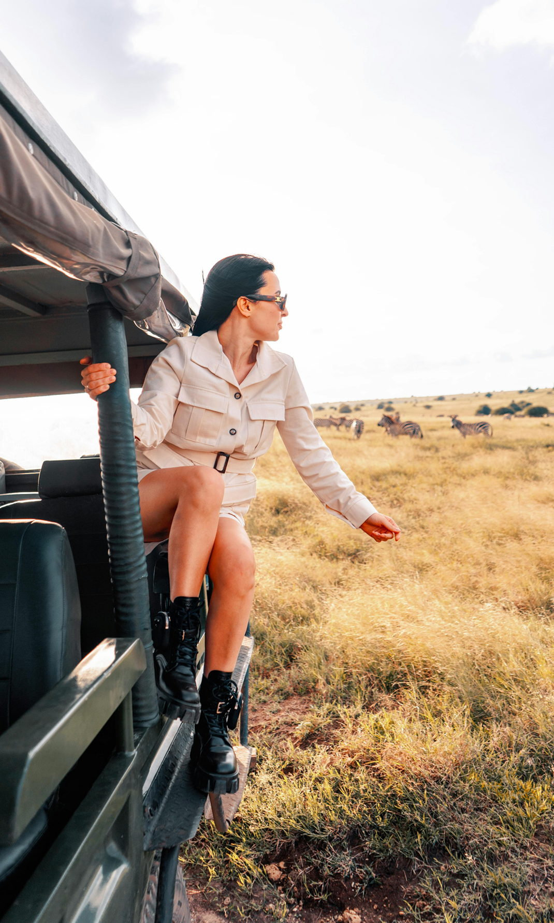

Here Are Four Important Ideas
One
Elaborate on what you want to discuss.
Two
Elaborate on what you want to discuss.
Three
Elaborate on what you want to discuss.
Four
Elaborate on what you want to discuss.

Slide 9




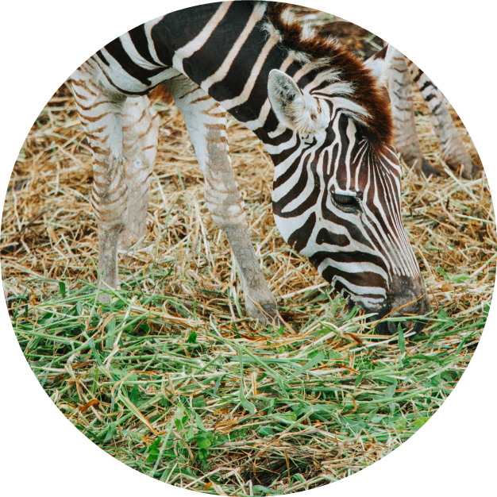

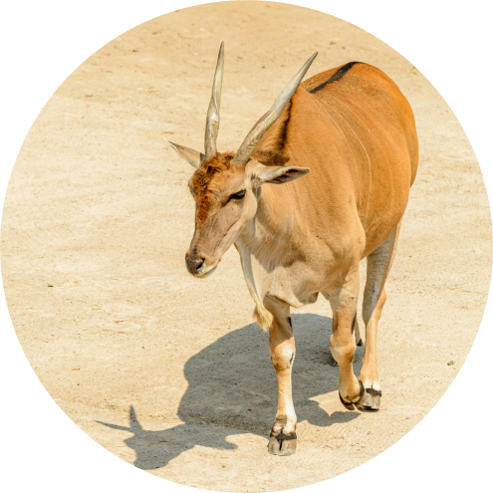
Photo Portfolio
What can you say about your projects?
Share it here!

Slide 10





Interesting Data
Elaborate on the featured statistic
56%
47%
68%
Elaborate on the featured statistic.
Elaborate on the featured statistic.
Elaborate on the featured statistic.

Slide 11



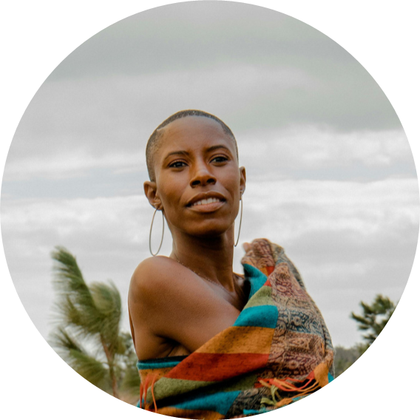


Our Testimonials
Jane Doe
Mary Smith
Elaborate on what you want to discuss.
Elaborate on what you want to discuss.

Slide 12



3
About Safari
Elaborate on what you want to discuss.

Slide 13


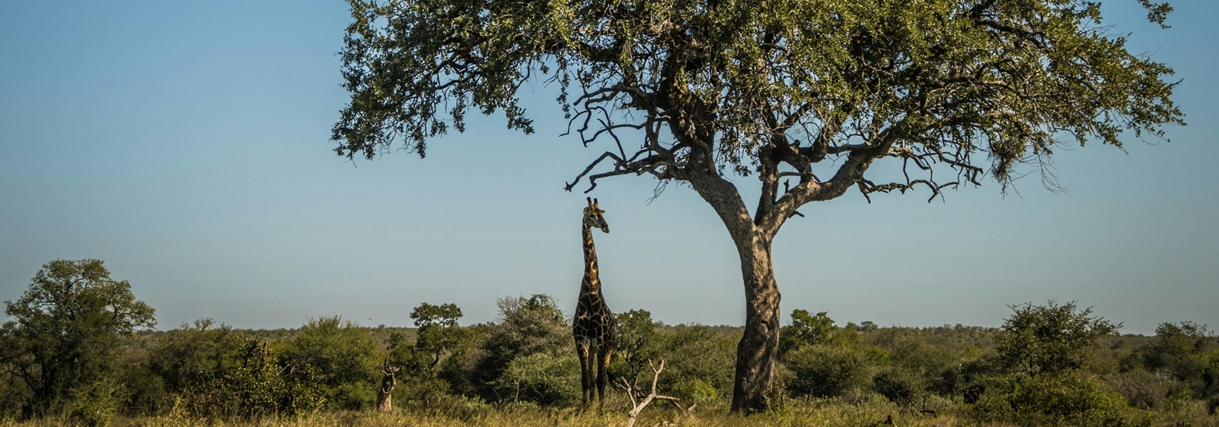
History a Safari
Presentations are communication tools that can be used as demonstrations, lectures, speeches, reports, and more. It is mostly presented before an audience.
Presentations are communication tools that can be used as demonstrations, lectures, speeches, reports, and more. It is mostly presented before an audience. Presentations are communication tools that can be used as demonstrations, lectures, speeches, reports, and more. It is mostly presented before an audience.

Slide 14







Let’s Go On a Safari
Add a main point
Add a main point
Elaborate on what you
want to discuss.
Elaborate on what you
want to discuss.
Add a main point
Add a main point
Elaborate on what you
want to discuss.
Elaborate on what you
want to discuss.

Slide 15

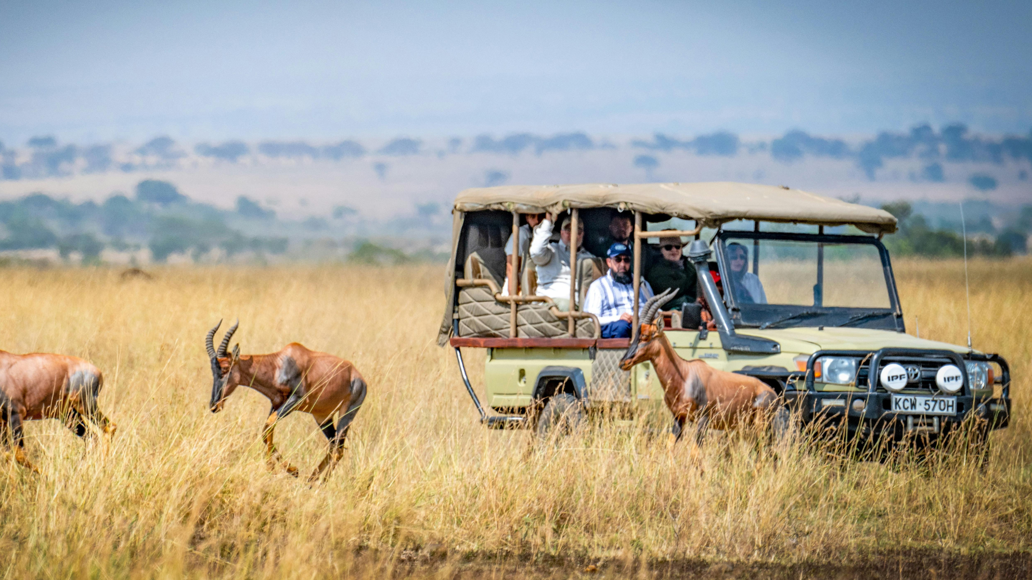
A picture is worth a thousand words

Slide 16


Write an original statement or inspiring quote
— Include a credit, citation, or supporting message

Slide 17


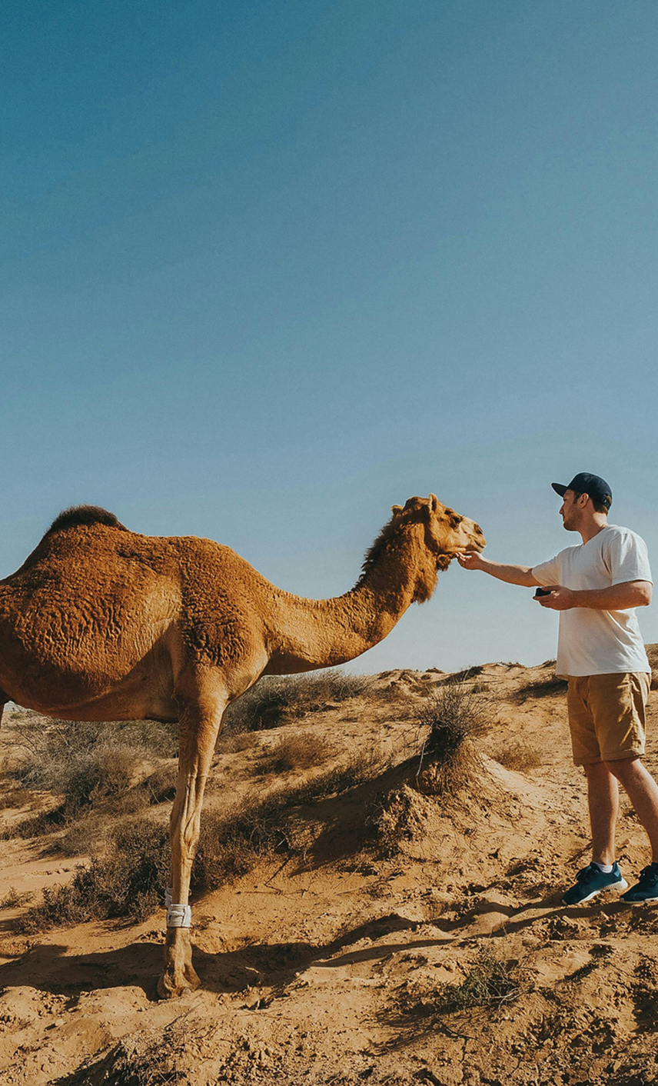



Contact Us
123 Anywhere St., Any City,ST 12345
123-456-7890
hello@reallygreatsite.com
@reallygreatsite
reallygreatsite.com

Slide 18










Resource Page
Use these design resources in your Canva Presentation.
You can find these fonts online too. Happy designing!
Don't forget to delete this page before presenting.
This presentation template uses the following free fonts:
  Titles: Ubuntu
  Headers: Poppins
  Body Copy: Fira Sans

Slide 19



Credits
This presentation template is free for everyone to use thanks to the following:
SlidesCarnival for the presentation template
Pexels for the photos
Happy designing!

