Slide 1



November 1st & 2nd
Celebrating Undas
Virtually
Alternative ways to honor your deceased loved ones at home
  Offer solemn prayers
  Reschedule your visit
  Send flowers
  Attend virtual mass
  Connect with family and friends online

Slide 2
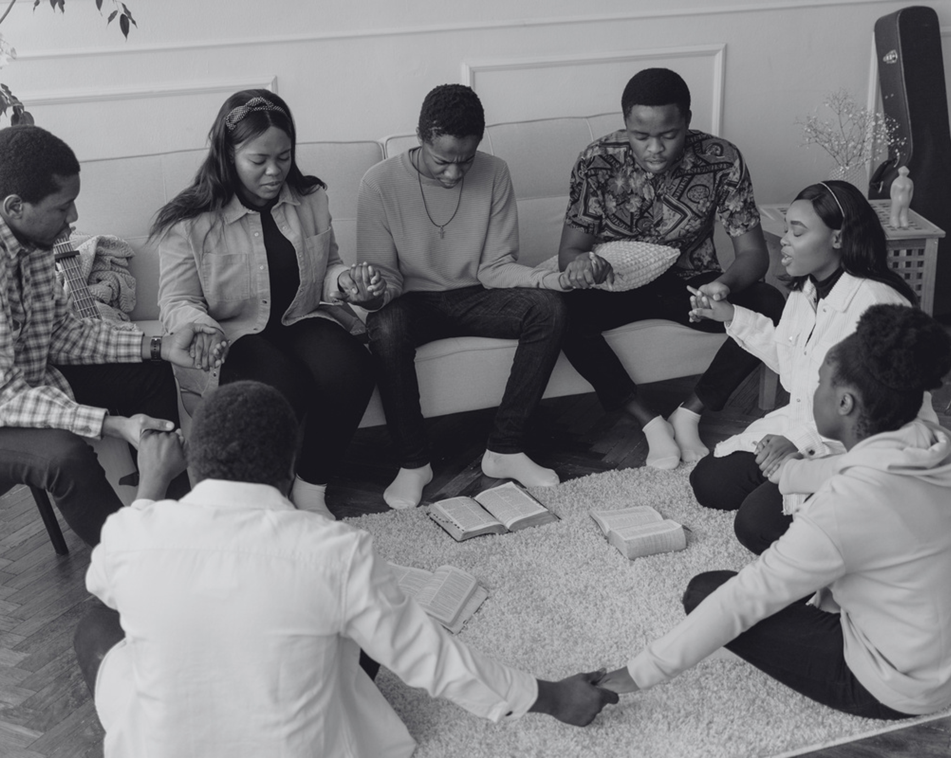

November 1st & 2nd
Celebrating Undas
Virtually
Alternative ways to honor your deceased loved ones at home
  Offer solemn prayers
  Reschedule your visit
  Send flowers
  Attend virtual mass
  Connect with family and friends online

Slide 3

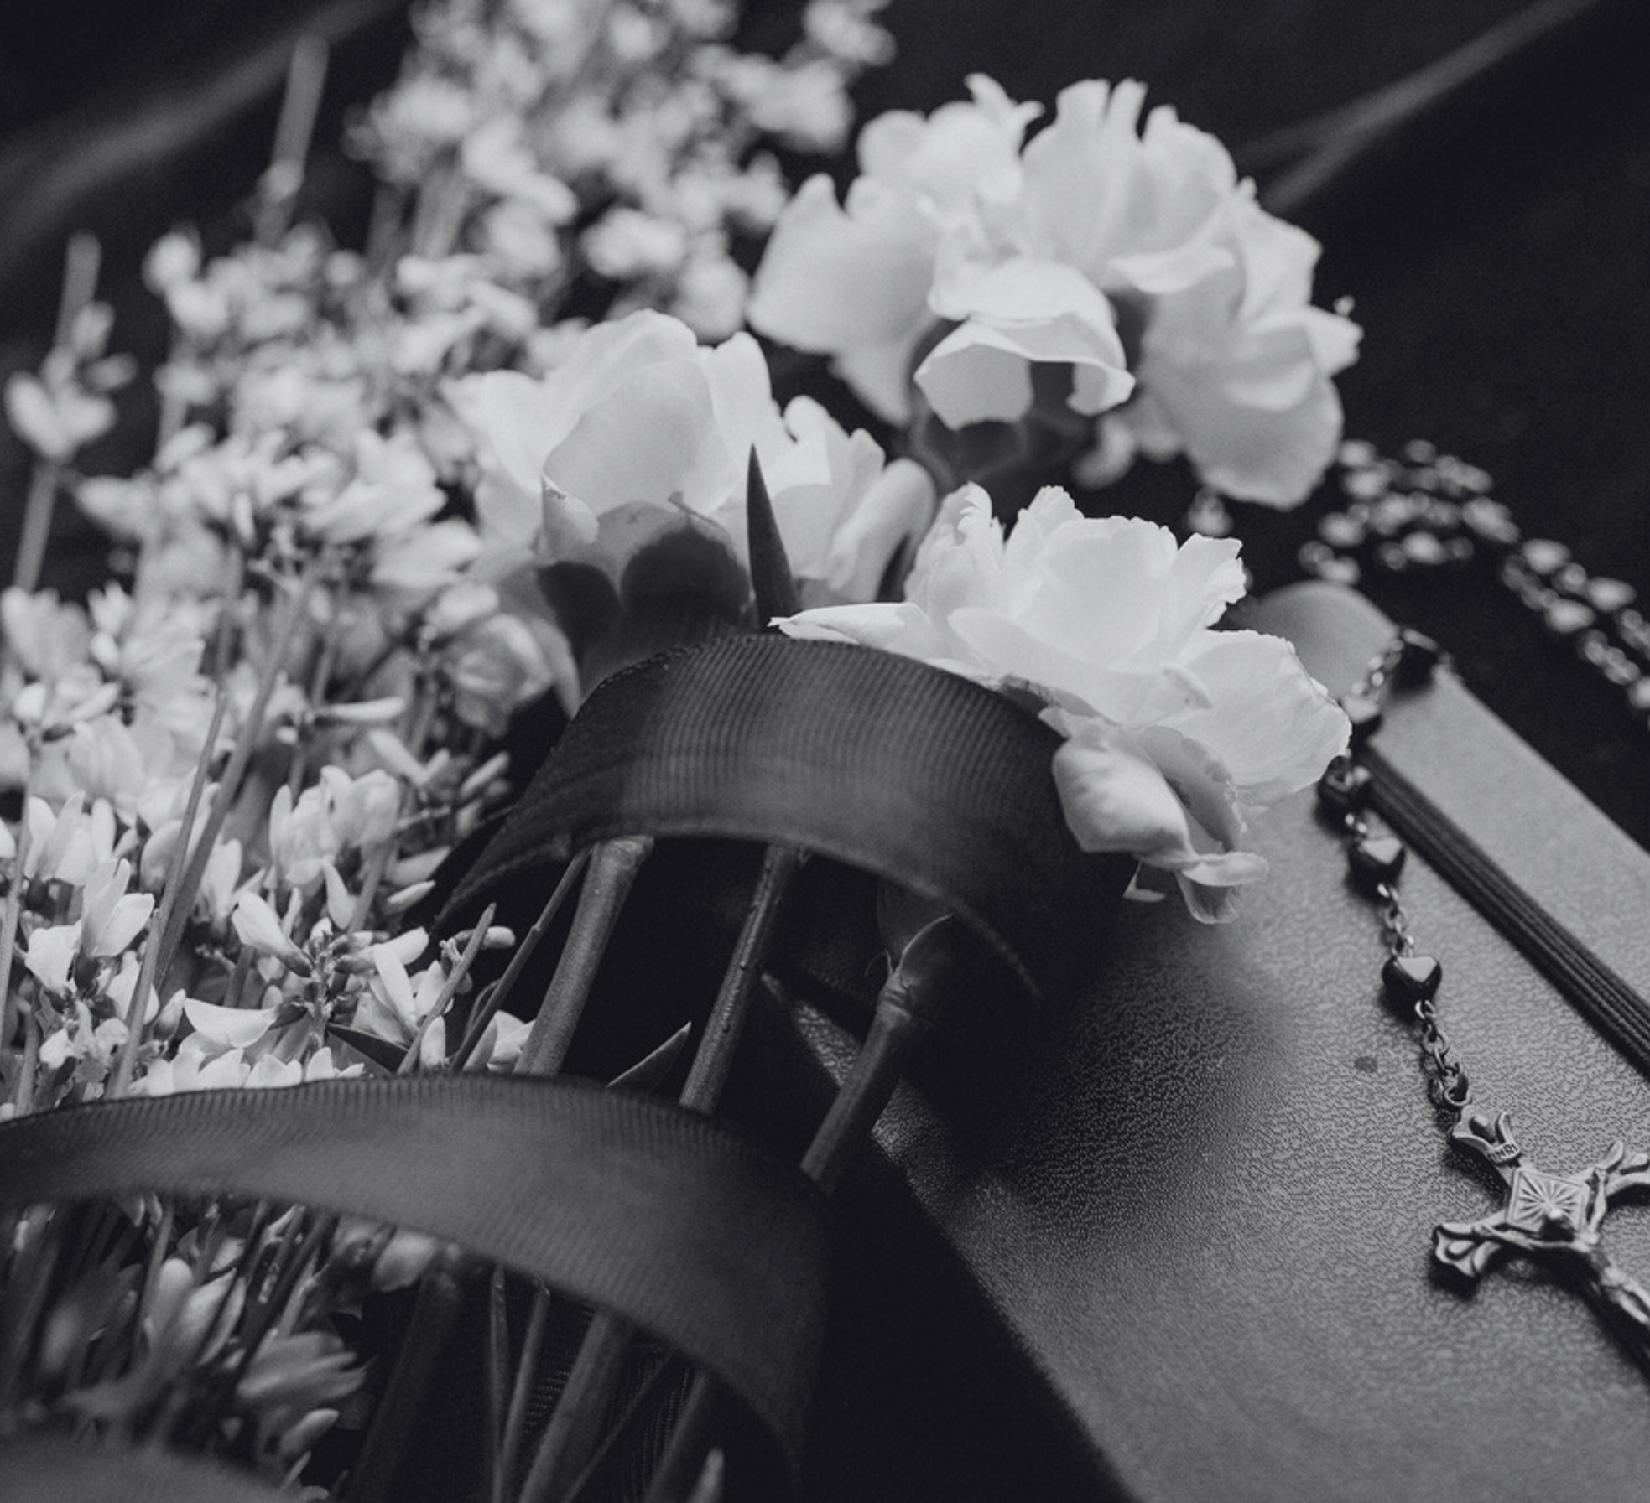


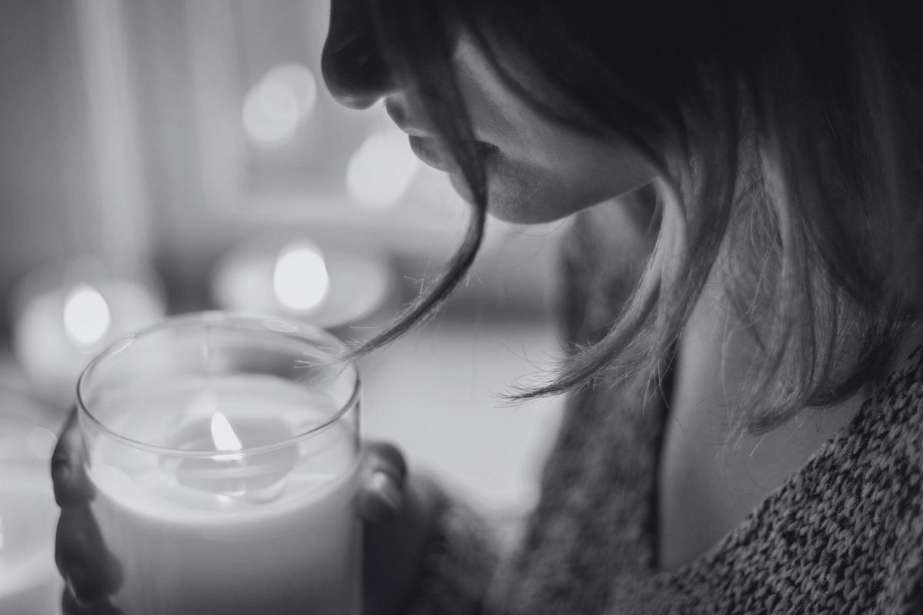
November 1st & 2nd
Celebrating Undas
Virtually
Alternative ways to honor your deceased loved ones at home
  Offer solemn prayers
  Reschedule your visit
  Send flowers
  Attend virtual mass
  Connect with family and friends online

Slide 4
Resources
  Use these design resources in your Canva Presentation.
Fonts
Design Elements
This presentation template
uses the following free fonts:
TITLES AND HEADER:
Libre Franklin
Italianno
BODY COPY:
Libre Franklin
You can find these fonts online too.
Colors

Slide 5
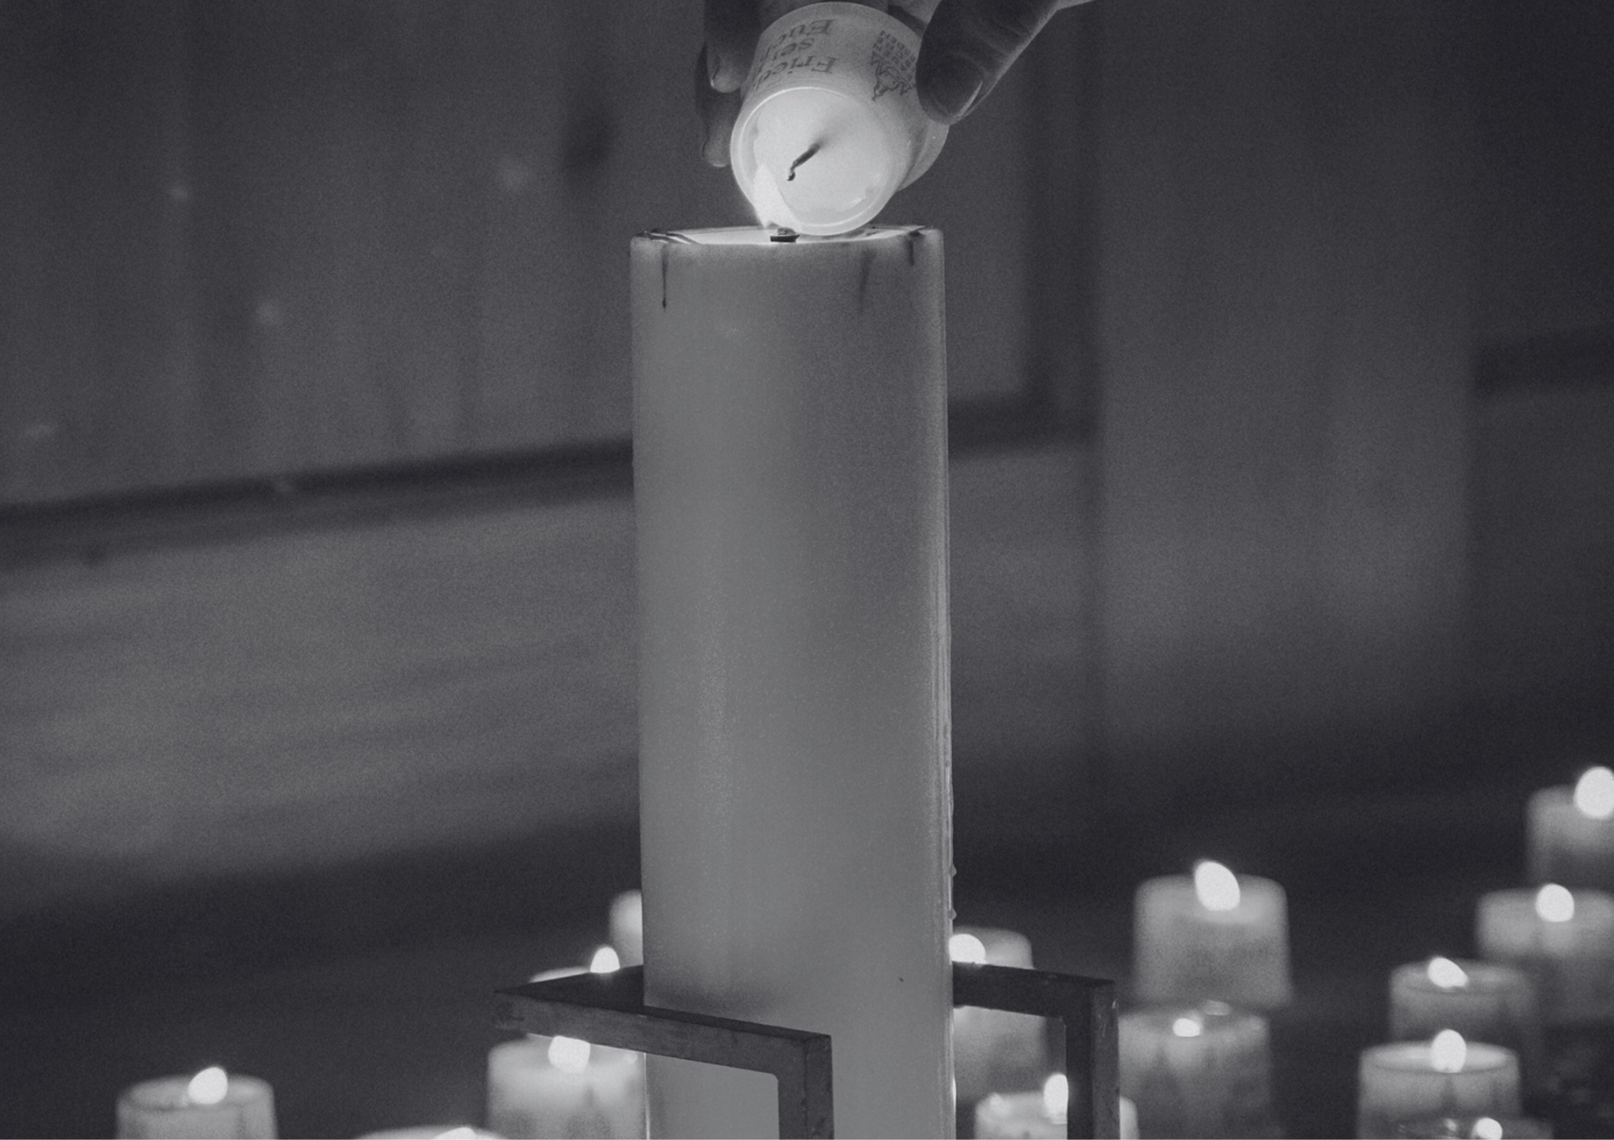

Credits
  This design template is free for
  everyone to use thanks to the following:
Pexels and Pixabay
  for the presentation template
  For the photos
Happy designing!

