Slide 1
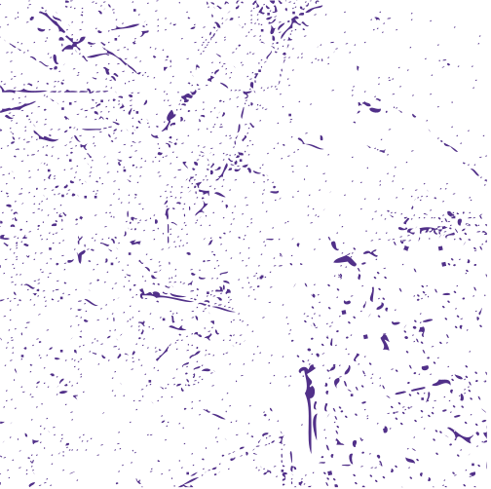
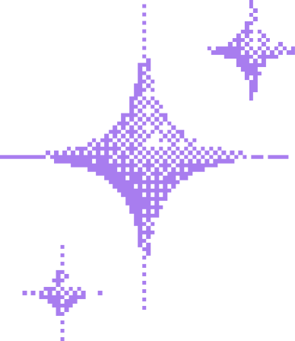

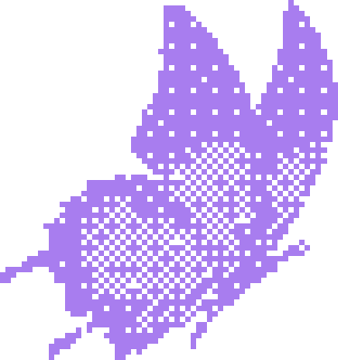

Gothic
Pop Night
DANCE TO YOUR DARK SIDE
3.30
FOR INQUIRIES &
RESERVATIONS
NEON & OAK BAR
+123-456-7890
HellO@REALLYGREATSITE.COM
DOORS OPEN AT 7PM

Slide 2
Resource Page
  Use these in your template, then delete or hide this page afterward.
Fonts
Colors
This presentation template
uses the following free fonts:
TITLES:
UnifrakturMaguntia
#A87DEF
#1E1E1E
#513089
BODY TEXT:
Red Hat Display Bold
You can find these fonts online too.
Design Elements / Icons

Slide 3

Credits
This template is free for everyone to use,
  thanks to the following:
  for this template
Pexels, Pixabay, Sketchify
  for the photos, graphics, and elements
  Happy designing!

