Slide 1




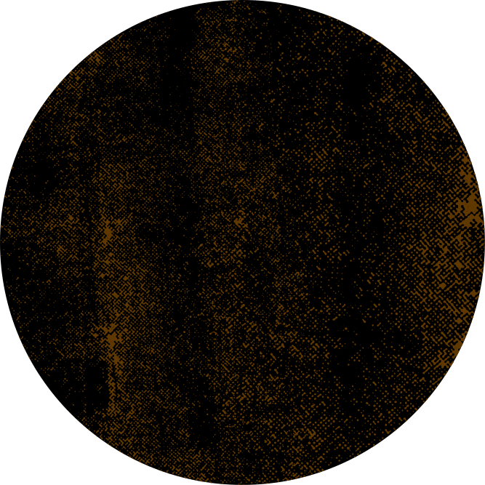
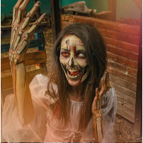
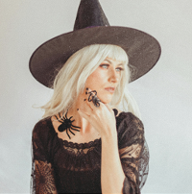
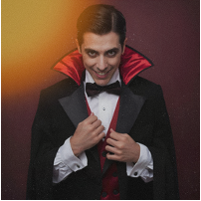
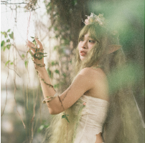
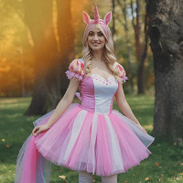
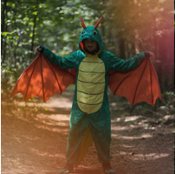

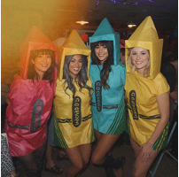
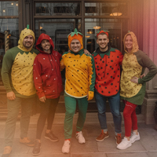
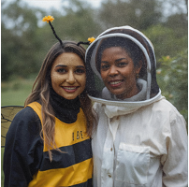
Halloween
for
All Ages
Costume Ideas
Timeless and frightfully fun looks for everyone
Classic icons
The Skeleton
The Witch
The Vampire
Whimsical
& magical
The Forest Fairy
The Unicorn
The Dragon
Creative group &
duo ideas
The Crayon Box
The Fruit Basket
The Bee and Beekeeper

Slide 2
Resource Page
Use these in your template, then delete or hide this page afterward.
Fonts
Colors
This presentation template
uses the following free fonts:
TITLES:
Pirata One
#F1EBE3
#F3BE72
#ED7843
BODY TEXT:
Eczar
You can find these fonts online too.
#C68019
#9B5C01
#301602
Design Elements / Icons

Slide 3


Credits
This template is free for everyone to use,
thanks to the following:
for this template
Pexels, Pixabay, Sketchify
for the photos, graphics, and elements
Happy designing!

