Slide 1











High School Party Invitations

Slide 2


High School Halloween Bash!
You're invited to our high school Halloween bash,
where spooky fun and thrilling costumes come to life!
Join us this Saturday at 8 pm
in the school courtyard.
Costumes are a must!

Slide 3
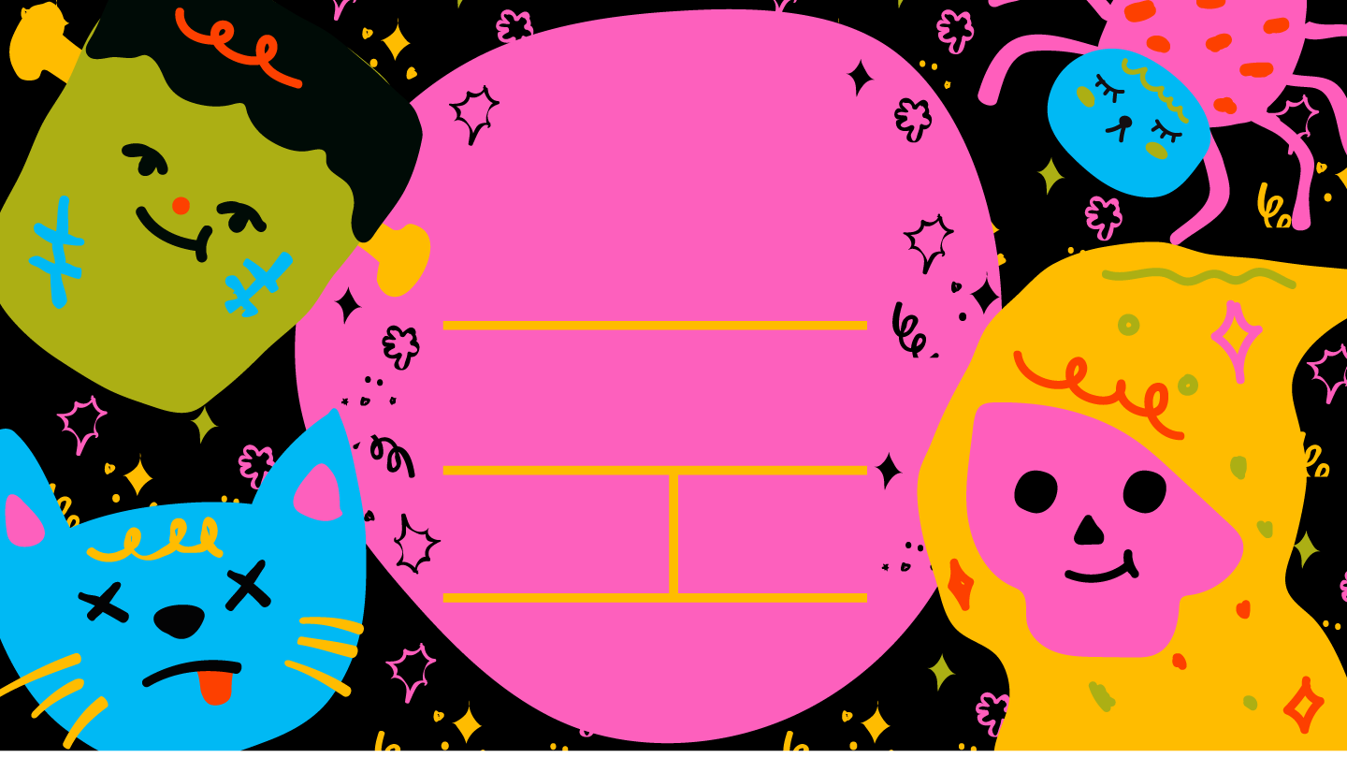
SPOOKY
HALLOWEEN
PARTY!
You're Invited to a Night of Frightful Fun
Join us for a spine-tingling evening of
Halloween mayhem!
When: Saturday,
7:00 PM until
the witches go home
Location:
Add your
address here
Costumes Encouraged: Dress to impress in your most ghoulish, creative,
or eerie attire. Prizes await the
best-dressed souls!

Slide 4
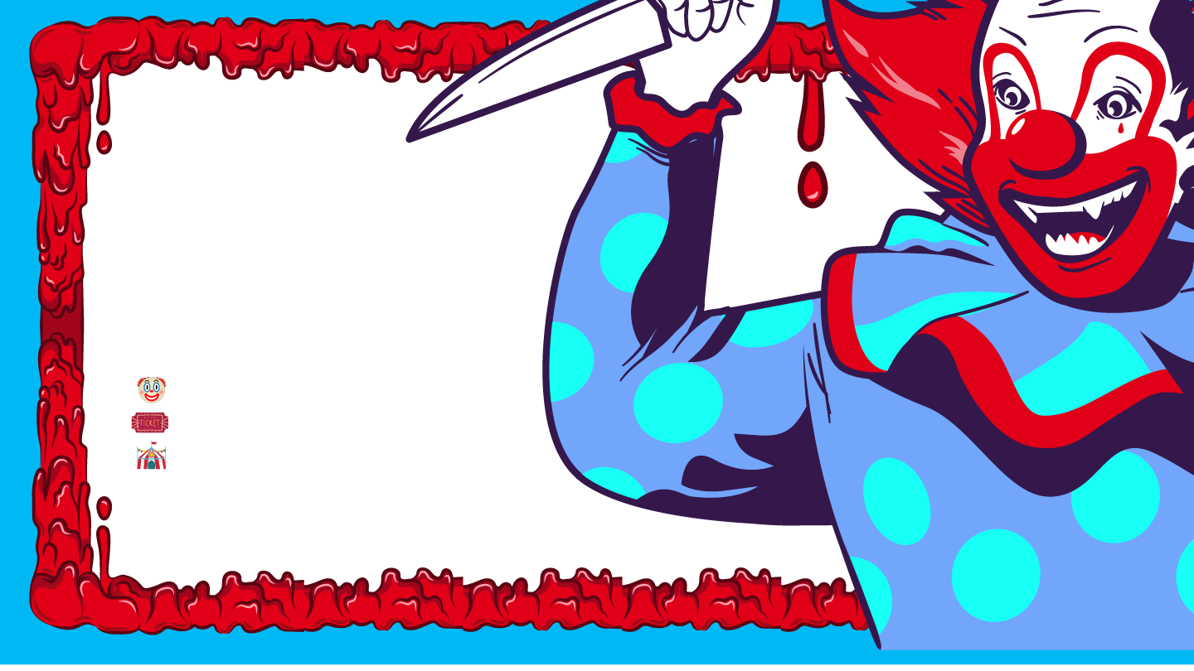
A Night of Horror Unleashed:
The Scary Clown
Halloween Party
You are invited to a spine-chilling night of fright, where laughter meets terror and the circus turns sinister!
Date: [Date]
Time: [Time]
Location: [Address]
Step right up and join the sinister circus of the macabre. Bring your friends,
but beware, as this night promises to be a carnival of horror you won't soon forget.
Come, laugh, scream, and shiver...

Slide 5







A Night of
Magic Awaits!
High School Halloween Bash
You are cordially invited to a mystical and enchanting Halloween celebration.
Join us this Saturday at 8 pm in the school courtyard – costumes are a must!

Slide 6

You're Invited!
Join us for a spooktacular Halloween party that's sure to send shivers down your spine!
When: Saturday,
7:00 PM until
the witches go home
Location:
Add your
address here
Come for the tricks, stay for the treats, and prepare for a night of ghoulish delight with friends and fiends alike!

Slide 7

MYSTIC HALLOWEEN GATHERING
EMBRACE THE ENCHANTMENT!
You are cordially invited to a night of mystical
wonder and eerie enchantment under the stars.
Date:
[Date]
Time:
[Time]
Location:
[Address]
Dress Code: Adorn yourself in your most bewitching and mystical attire.
Think witches, wizards, fortune tellers, and otherworldly beings.

Slide 8





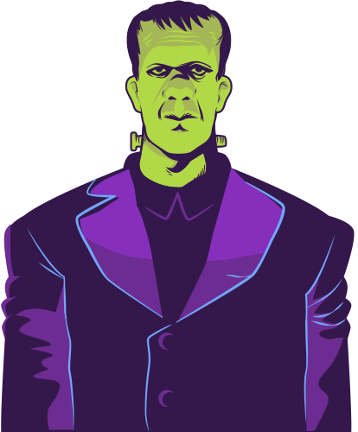

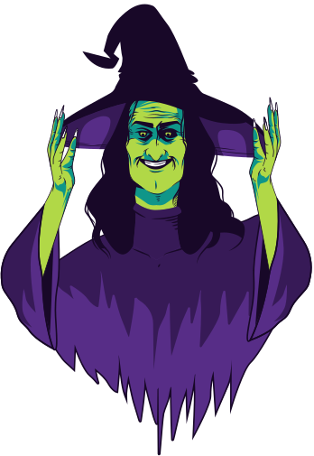
You're Invited to a
Fright Night to Remember!
You are cordially invited to a mystical and enchanting Halloween celebration.
Join us this Saturday at 8 pm in the school courtyard.
Dress Code: Adorn yourself in your most bewitching and mystical attire.
Think witches, wizards, fortune tellers, and otherworldly beings.

Slide 9
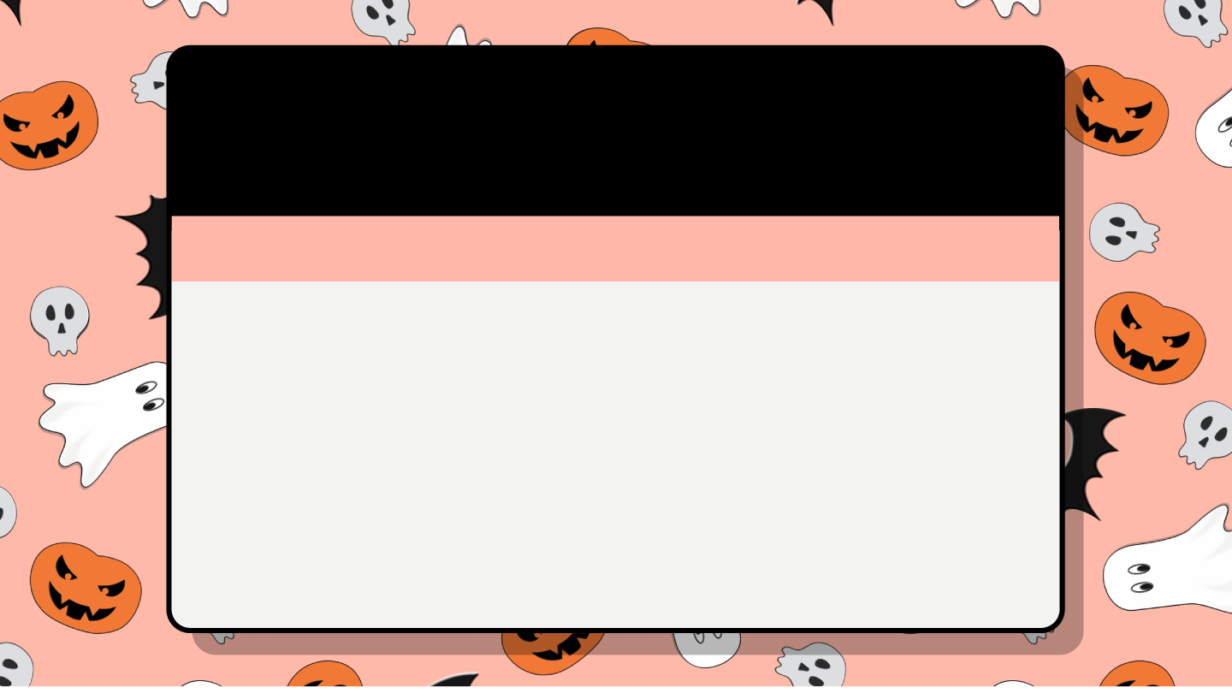
BOO-TIFUL HALLOWEEN BASH!
GET READY FOR A NIGHT OF SPOOKY FUN WITH FRIENDS!
Prepare for a night of eerie enchantment and wicked fun.
Bring your friends and your courage to face the darkness.
Date:
[Date]
Time:
[Time]
Location:
[Address]
Costume Required: Dress up in your most bone-chilling, terrifying, or whimsical Halloween attire.
Prizes await the most frightful and creative costumes!

Slide 10
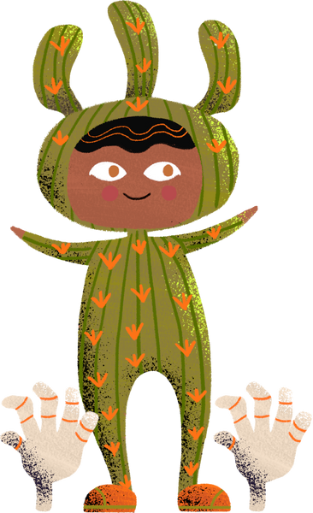
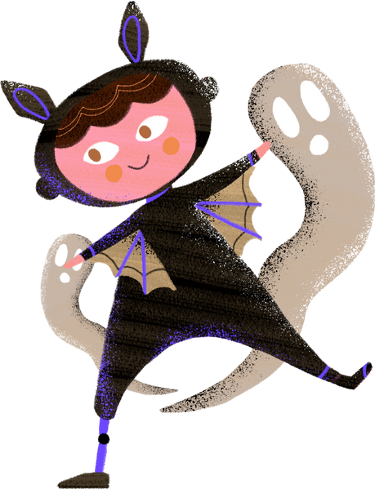

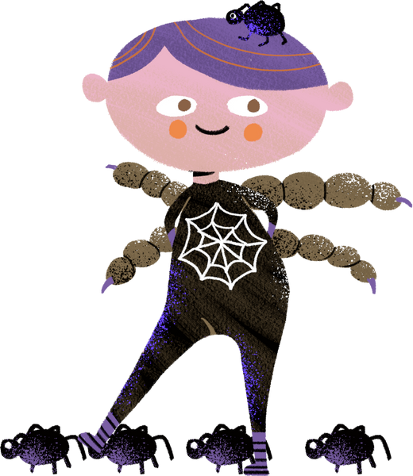

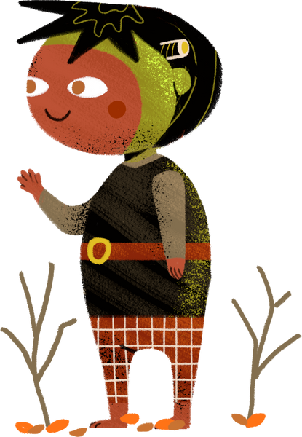
High School Halloween Bash!
Date:
[Date]
Time:
[Time]
Location:
[Address]
Costumes Required: Dress to impress in your spookiest, wackiest, or most creative costumes.
There will be prizes for the most unique and scariest outfits!

Slide 11













Witches and Wizards
High School Halloween Bash
A Night of Magic Awaits!
You are cordially invited to a mystical and enchanting Halloween celebration.
Join us this Saturday at 8 pm in the school courtyard – costumes are a must!

Slide 12





HIGH SCHOOL HALLOWEEN BASH!
DATE:
[DATE]
TIME:
[TIME]
LOCATION:
[ADDRESS]
Costumes Required: Dress to impress in your spookiest, wackiest, or most creative costumes.
There will be prizes for the most unique and scariest outfits!

Slide 13






SPOOKY
HALLOWEEN
PARTY!
You're Invited to a Night of Frightful Fun
Join us for a spine-tingling evening of
Halloween mayhem!
When: Saturday,
7:00 PM until
the witches go home
Location:
Add your
hddress here
Costumes Encouraged: Dress to impress in your most ghoulish, creative,
or eerie attire. Prizes await the
best-dressed souls!

Slide 14

RESOURCE PAGE
Use these design resources in your Canva Presentation.
This presentation template uses the following free fonts:
Calistoga
Jua
Josefin Sans
Oswald
Bangers
Kirang Hearang
Architect Daughter
Economica
Josefin Slab
Walter Turncoat
You can find these fonts online too. Happy designing!
Don't forget to delete this page
before presenting.

Slide 15

THIS PRESENTATION TEMPLATE IS FREE FOR EVERYONE TO USE THANKS TO THE FOLLOWING:
SlidesCarnival for the presentation template
Pexels for the photos
HAPPY DESIGNING!

