Slide 1







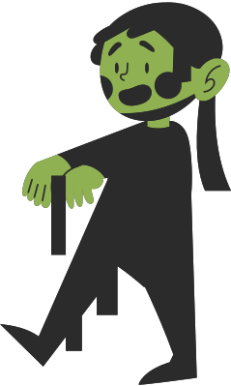
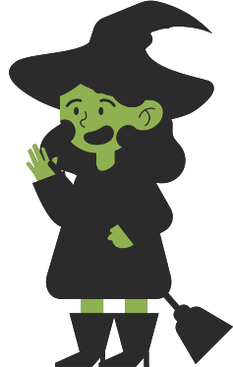
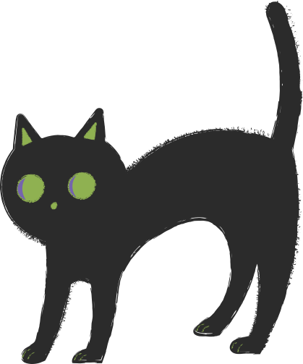
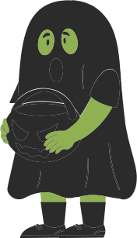

TRICK TRIVIA
or
Halloween Trivia Night
October 10, 2030 | 08:00 PM

Slide 2
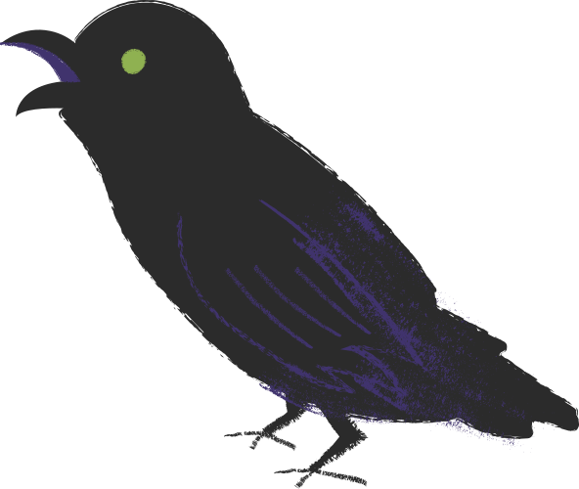
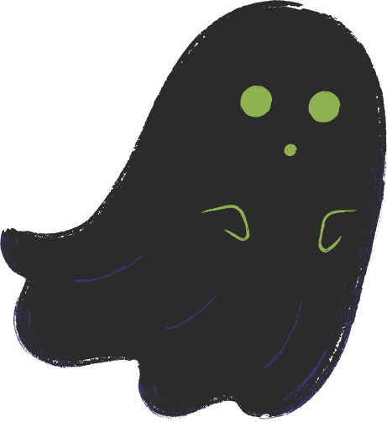

HOW TO PLAY
2
4
1
3
5
Each team writes down one answer per question and turns in their answers no later than 2 minutes after the round ends.
Some rounds include a Trick or Treat slide. Choose wisely.
  Treat = bonus points, steals, or other rewards
  Trick = surprise twists or silly challenges
Teams compete by answering trivia questions.
No phones, tablets, or outside help allowed during the game.
Have Fun!

Slide 3



ROUND 1
halloween origins

Slide 4

IN WHAT COUNTRY DID JACK-O’-LANTERN CARVING FIRST BEGIN?
QUESTION 1

Slide 5

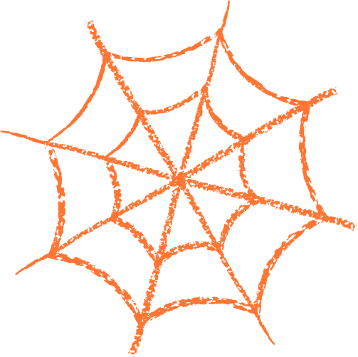
IN WHAT COUNTRY DID JACK-O’-LANTERN CARVING FIRST BEGIN?
1
Ireland
2
ANOTHER QUESTION HERE
ANSWERS
Answer here
ANOTHER QUESTION HERE
3
Answer here
ANOTHER QUESTION HERE
4
Answer here

Slide 6
ROUND 2
Halloween Facts

Slide 7

QUESTION 1
WHAT ANIMAL IS COMMONLY ASSOCIATED WITH WITCHES?

Slide 8
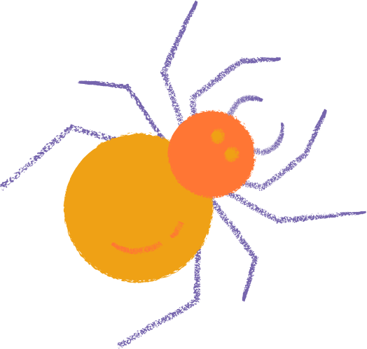
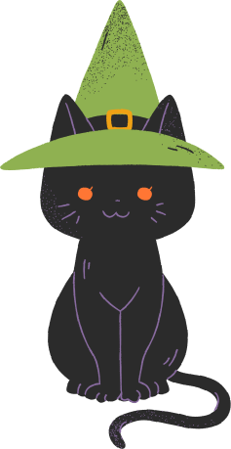
WHAT ANIMAL IS COMMONLY ASSOCIATED WITH WITCHES?
1
Black Cats
2
ANOTHER QUESTION HERE
ANSWERS
Answer here
ANOTHER QUESTION HERE
3
Answer here
ANOTHER QUESTION HERE
4
Answer here

Slide 9



TRICK OR TREAT
PICK ONE TO REVEAL YOUR TEAM’S FATE.

Slide 10

OH NO, IT’S A TRICK!
TEAM LOSES 2 POINTS
TO THE “SPIRIT WORLD.”

Slide 11
YOU FOUND A TREAT!
TEAM EARNS +3 BONUS POINTS.

Slide 12
ENJOY YOUR TREAT!
TEAM DOUBLES THEIR POINTS ON THE NEXT CORRECT ANSWER.

Slide 13

YOU’VE BEEN
A SPOOK-TACULAR CROWD
THANKS FOR JOINING OUR HALLOWEEN TRIVIA NIGHT!

Slide 14

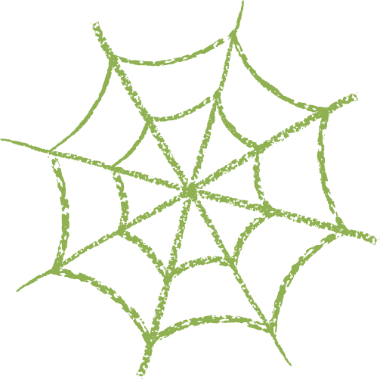
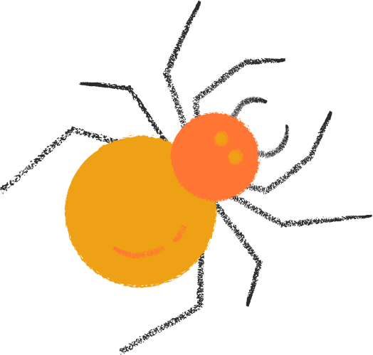
RESOURCE PAGE
  USE THESE IN YOUR PRESENTATION. DELETE OR HIDE THIS PAGE BEFORE PRESENTING.
Fonts
Design Elements / Icons
This presentation template
uses the following free fonts:
TITLES:
LONDRINA SOLID
BODY TEXT:
Homemade Apple
You can find these fonts online too.
Colors
#FD8503
#40346E
#2B2B2B
#EEA117
#FFE2BF

Slide 15

CREDITS
  This presentation template is free for everyone to use, thanks to the following:
  for this presentation template
Pexels, Pixabay, Sketchify
  for the photos, graphics, and elements
  Happy designing!

