Slide 1











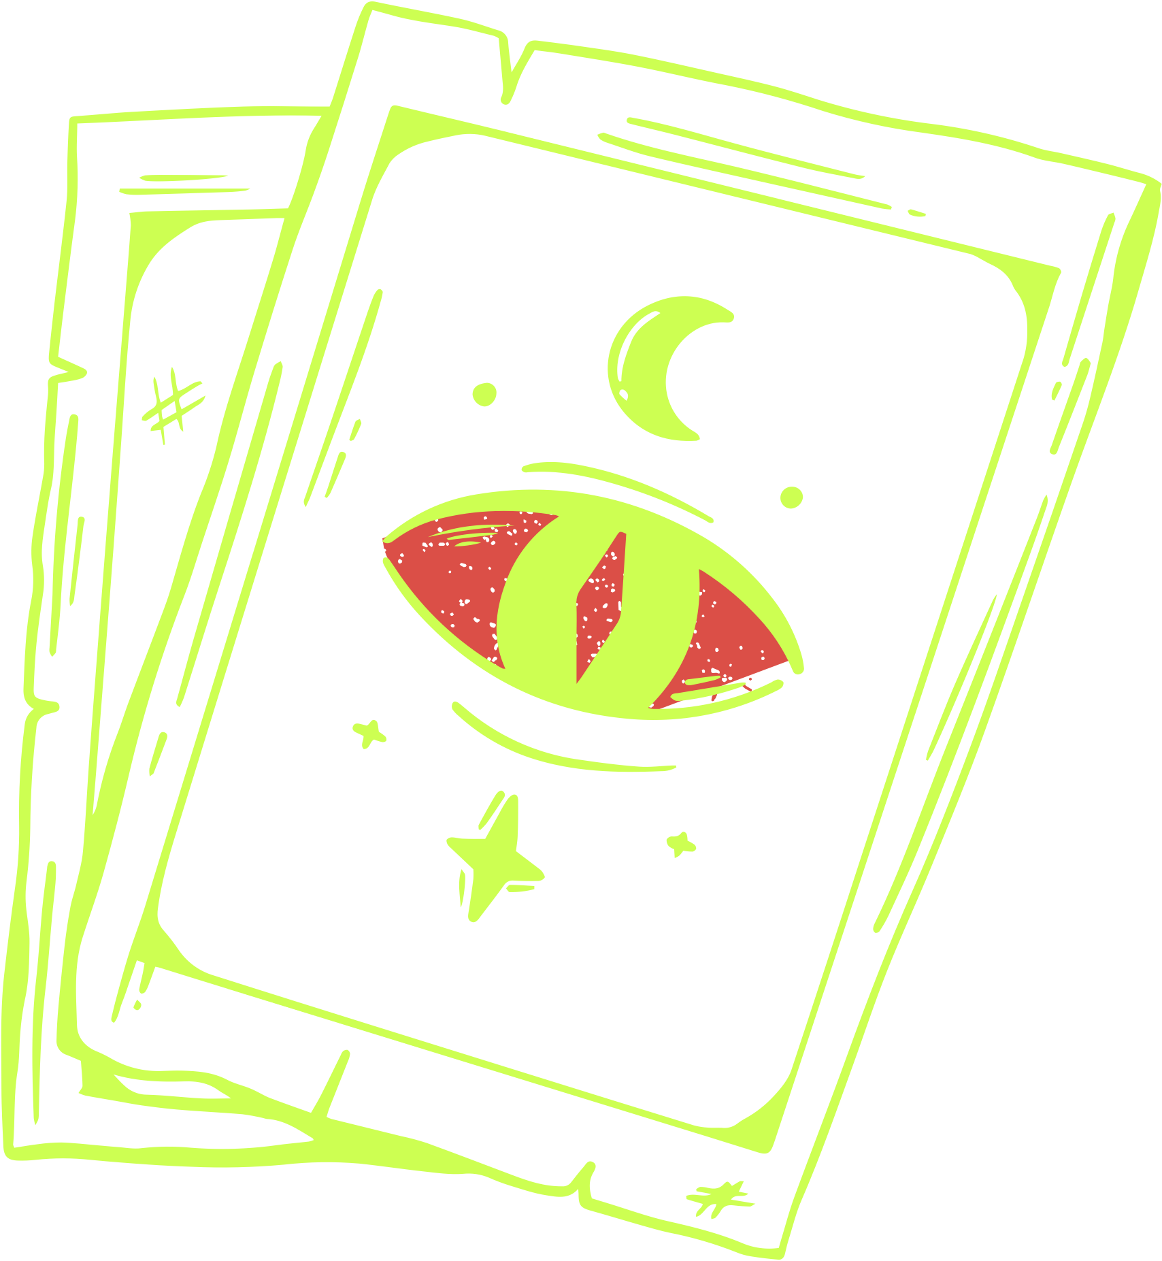


SPOOKY
HALLOWEEN
Party
Oct 31
7PM
Creepy Hollow Manor
123, Willow st. Batesville City

Slide 2












Join us for a
SPOOKY
HALLOWEEN
Party
DRINKS | LIVE MUSIC | COSTUME CONTEST
Creepy Hollow Manor
OCT 31 THURS
7PM to Midnight
RSVP +123-456-7890

Slide 3









SPOOKY
Halloween Party
Join us for a hauntingly good time!
Join us for a night of frightful fun and fabulous costumes. Whether you're a ghostly ghoul, a wicked witch, or a charming vampire, we want to see your best Halloween attire!

Slide 4












RESOURCE PAGE
  Use these design resources in your Canva Presentation.
Fonts
Colors
This presentation template
uses the following free fonts:
TITLES AND HEADER:
FRECKLE FACE
#E8E3F4
#0E0719
#DB4F47
Italianno
BODY COPY:
GIRASSOL
You can find these fonts online too.
#4209BB
#43208D
#CDFF52
  Design Elements

Slide 5



CREDITS
This design template is free for
  everyone to use thanks to the following:
  for the presentation template
Pexels, Pixabay
  for the photos
  Happy designing!

