Slide 1




India
Background Slides

Slide 2




Slide 3

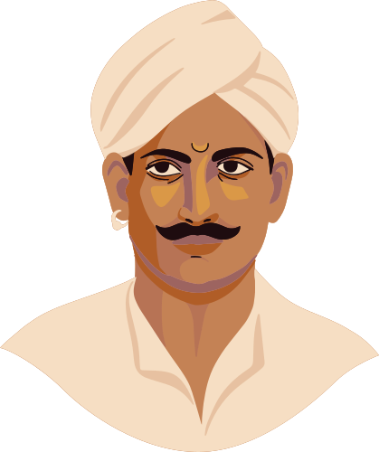

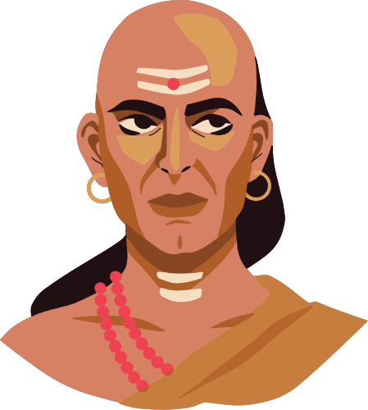
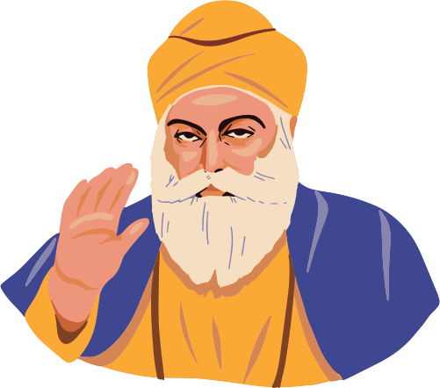
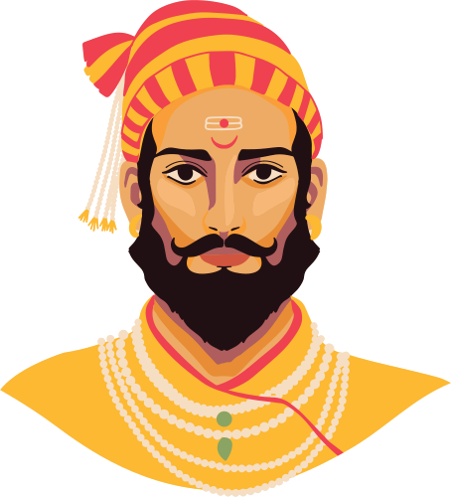
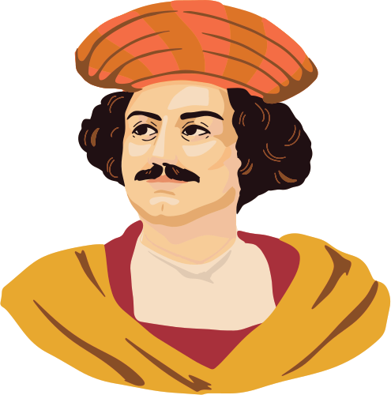
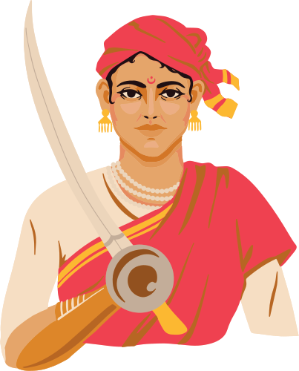
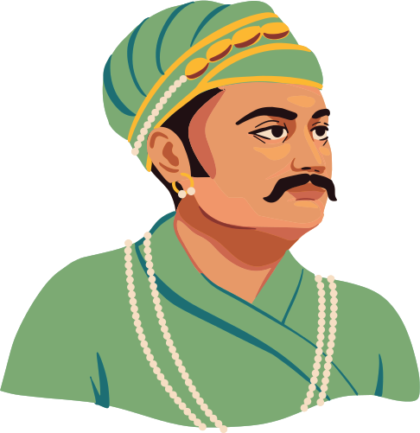
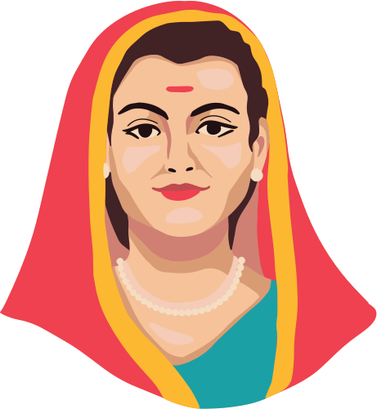
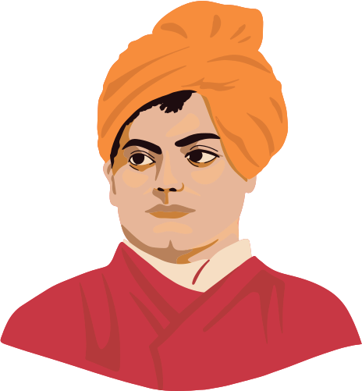
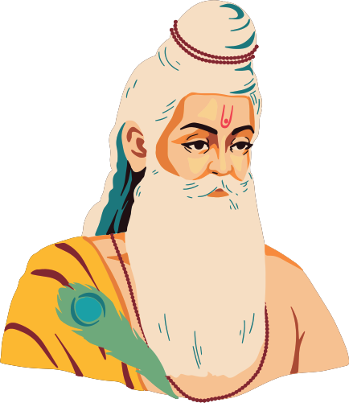
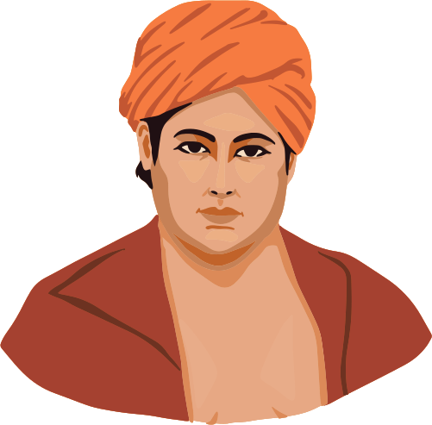
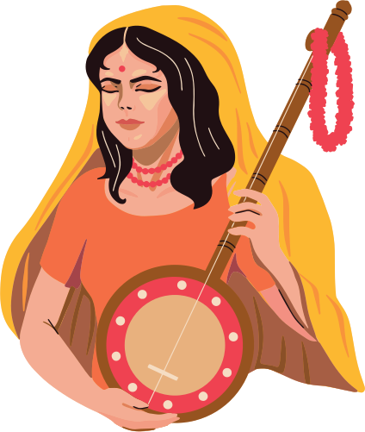
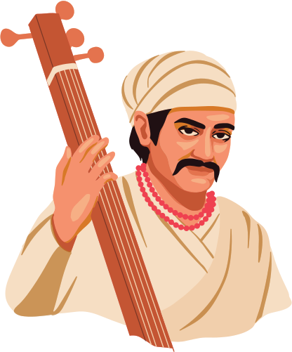
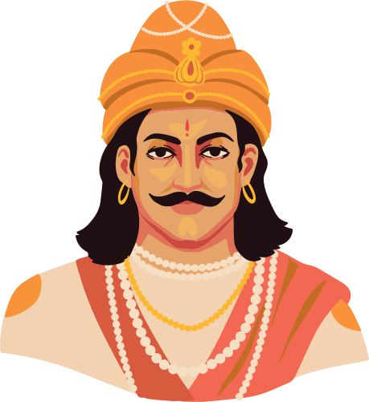
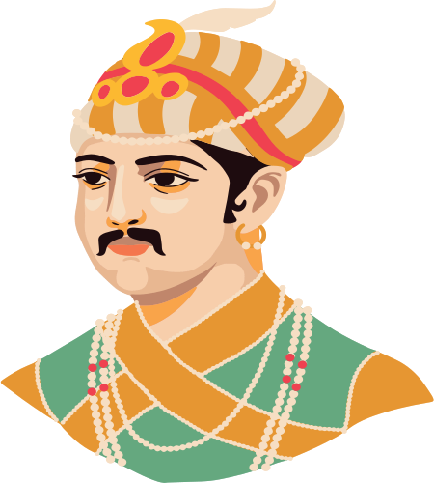
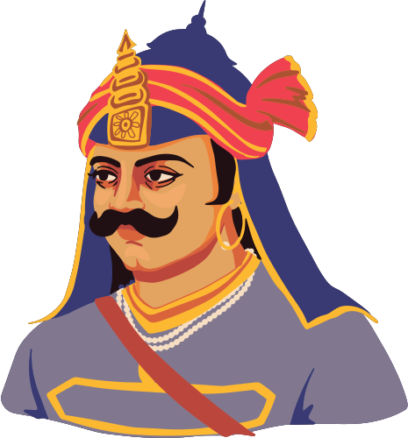

Slide 4


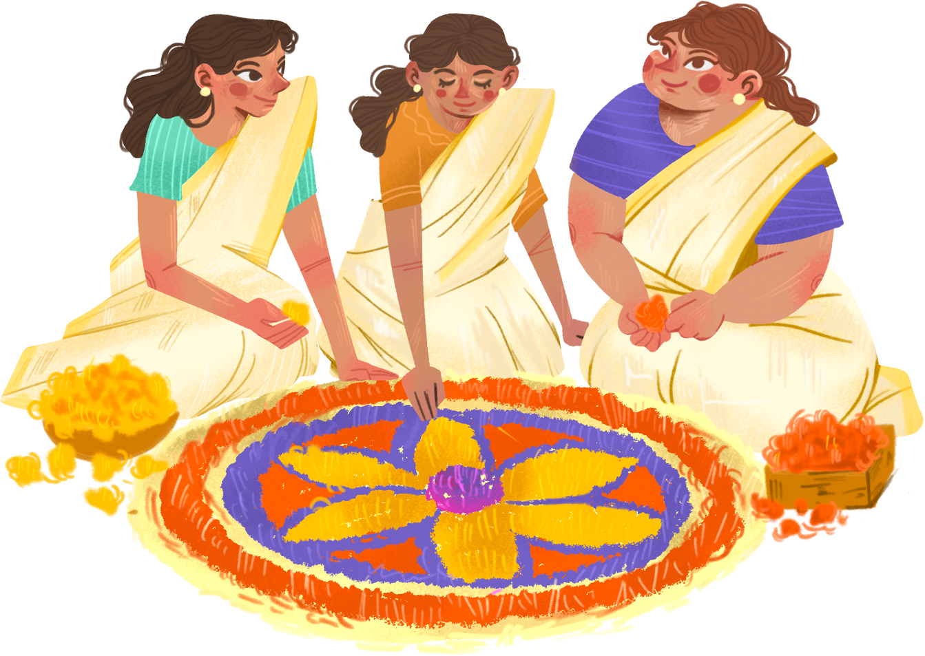
India is a country of belief,
a country of spirit,
and a country of a thousand shades of colors.

Slide 5
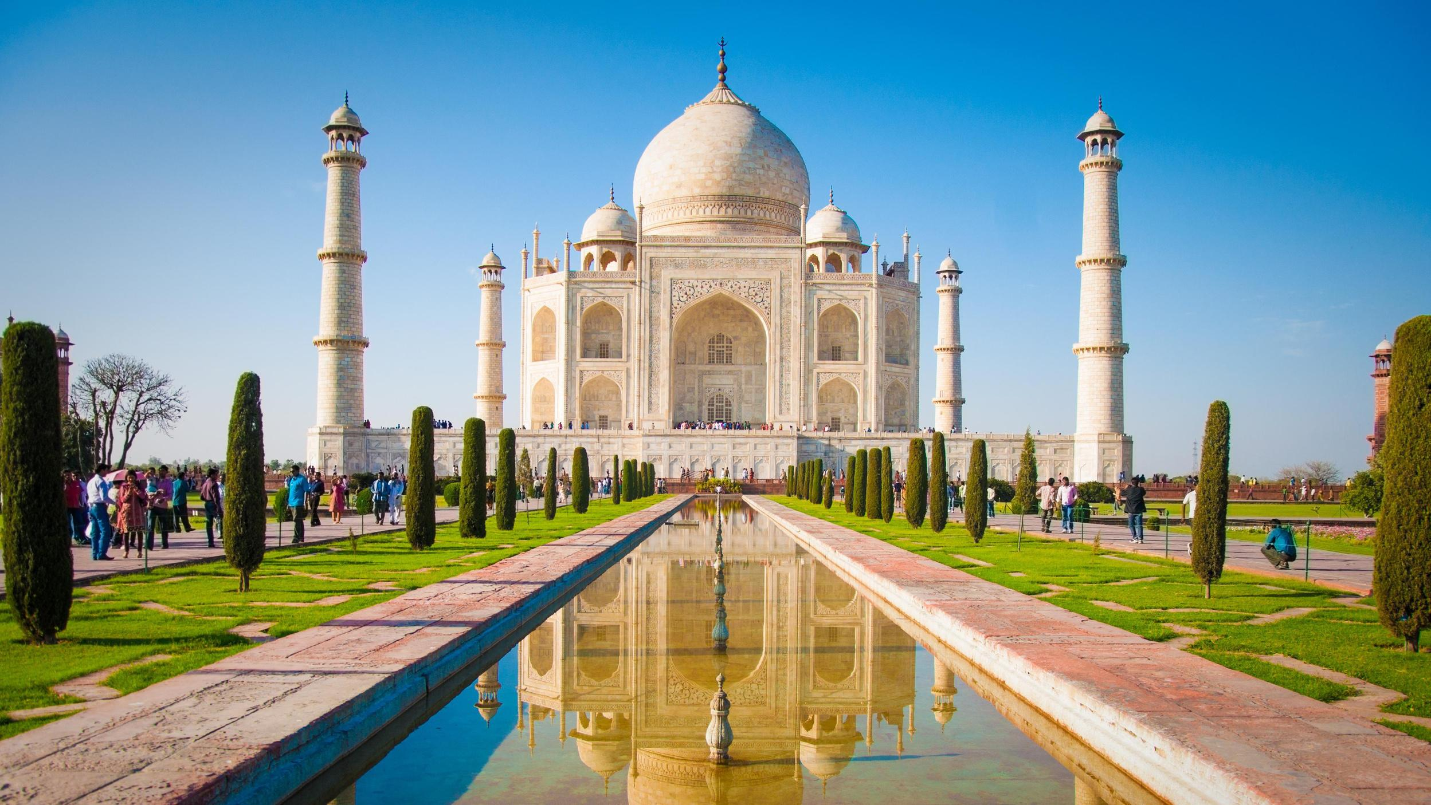


India's diversity
is a testament to its history and heritage.

Slide 6



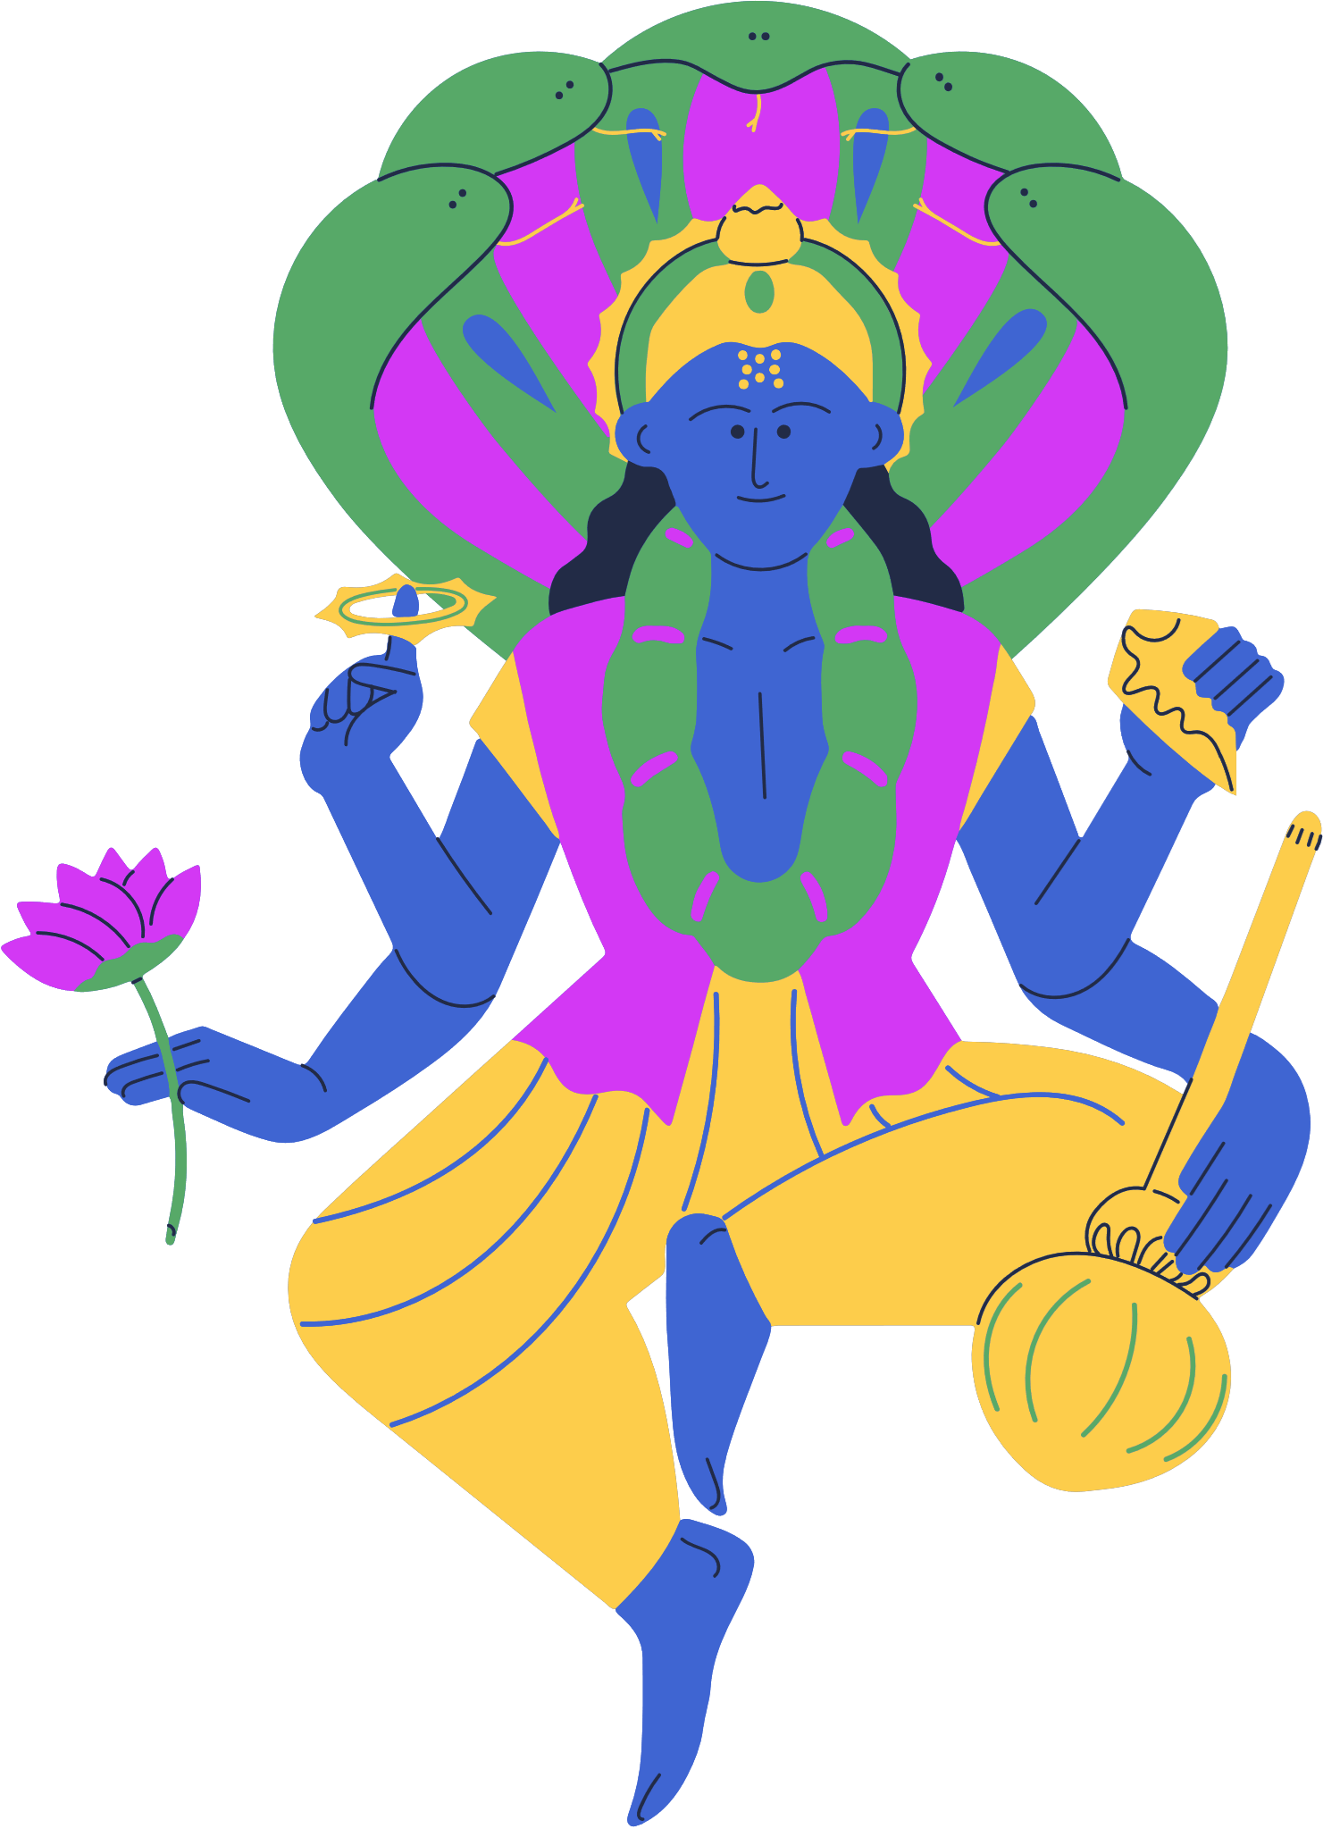




Slide 7


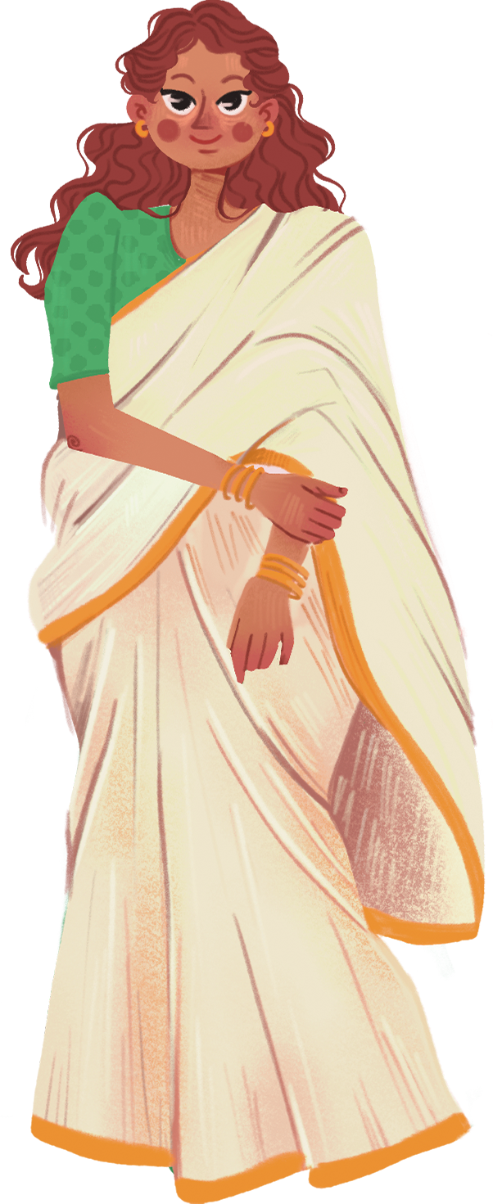
India is a mosaic
of different cultures, languages, and beliefs.

Slide 8
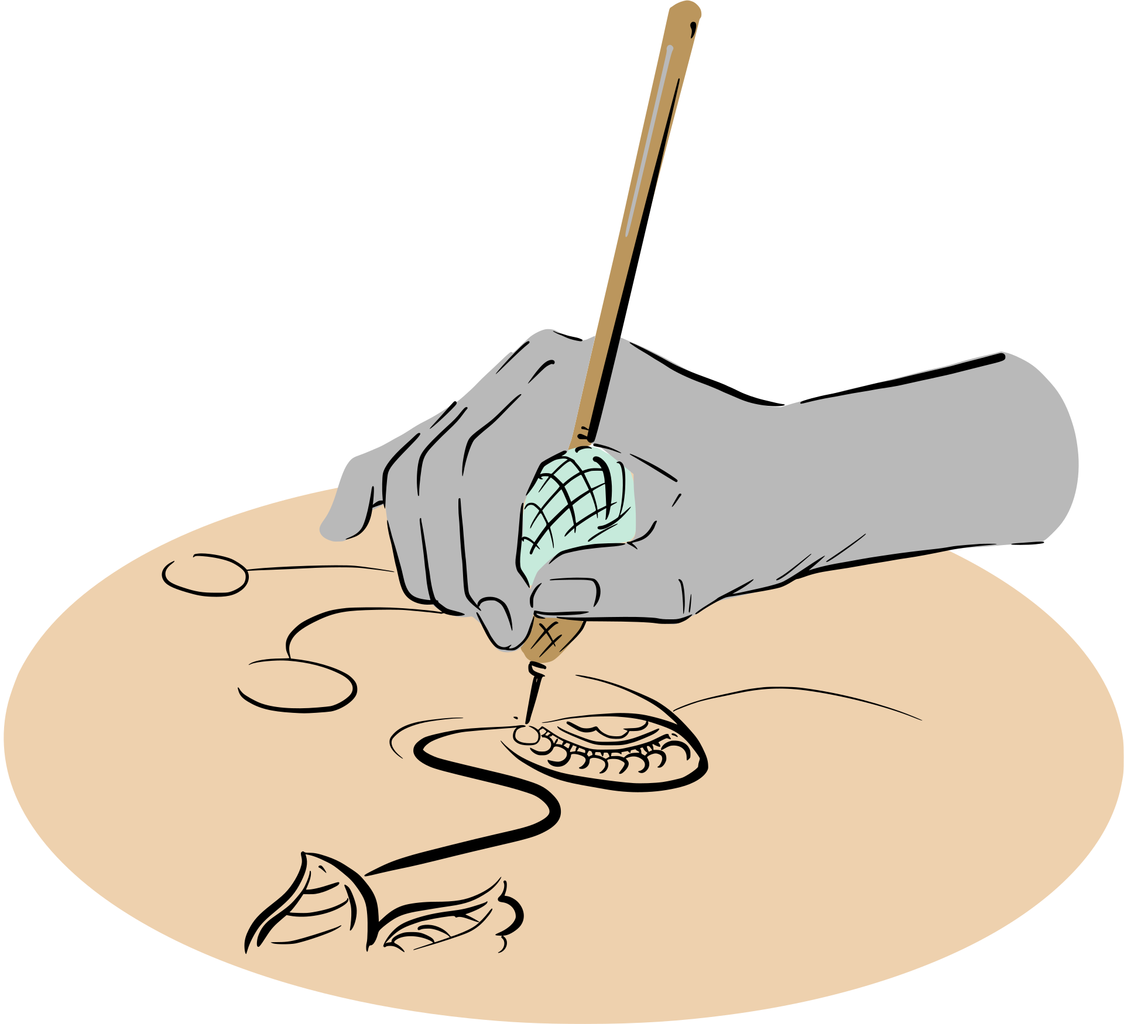
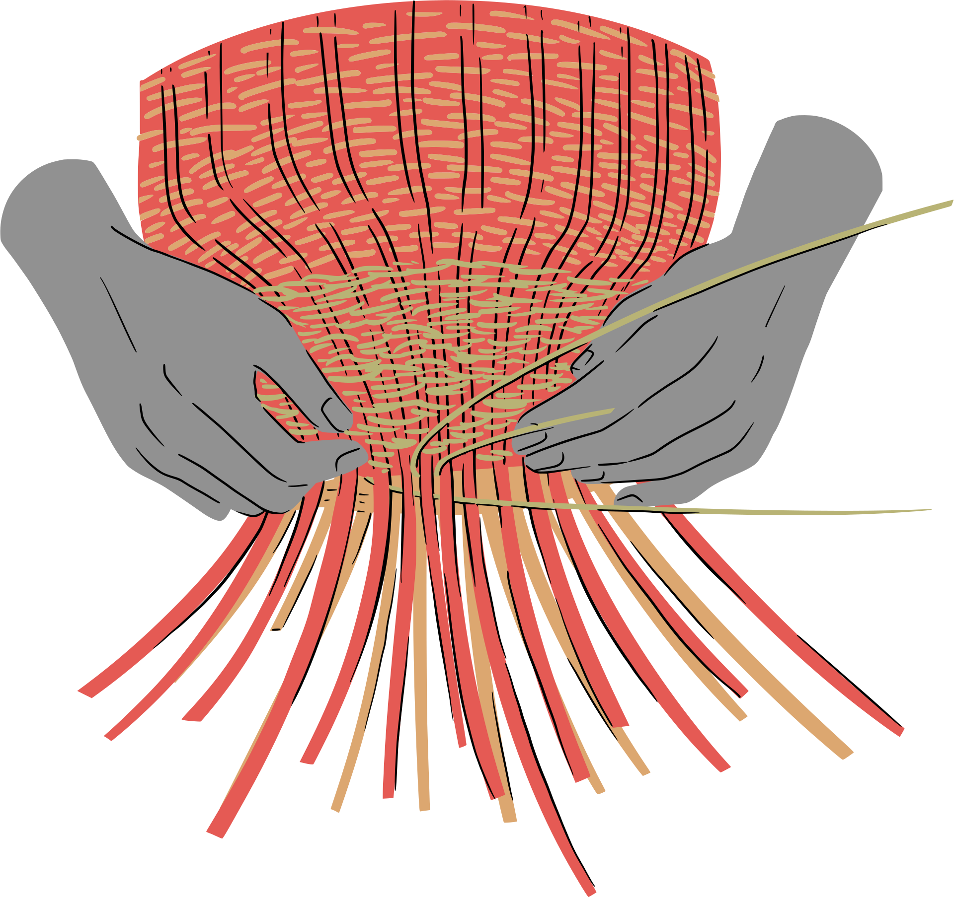
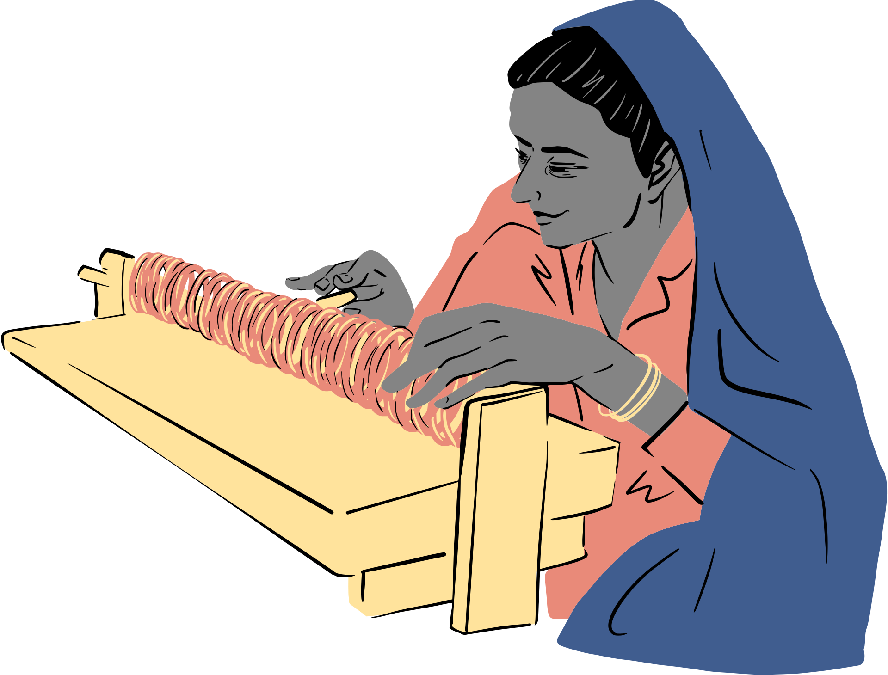
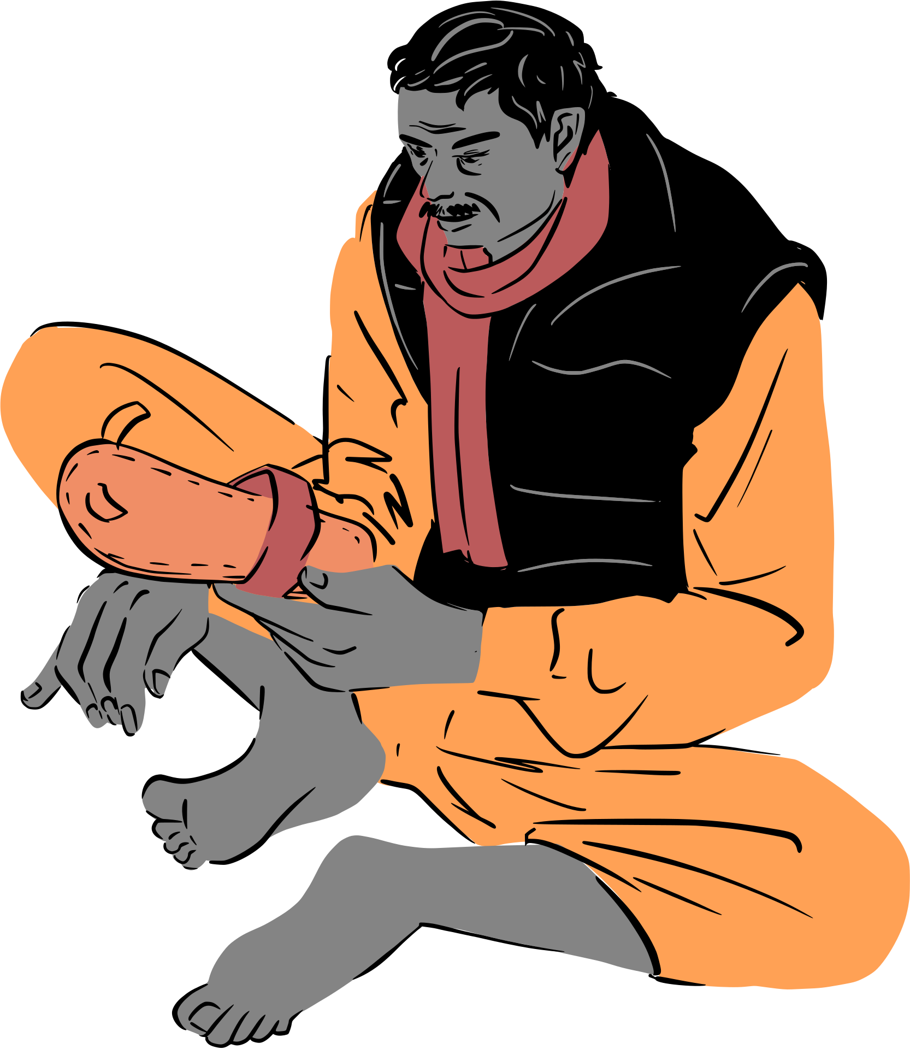
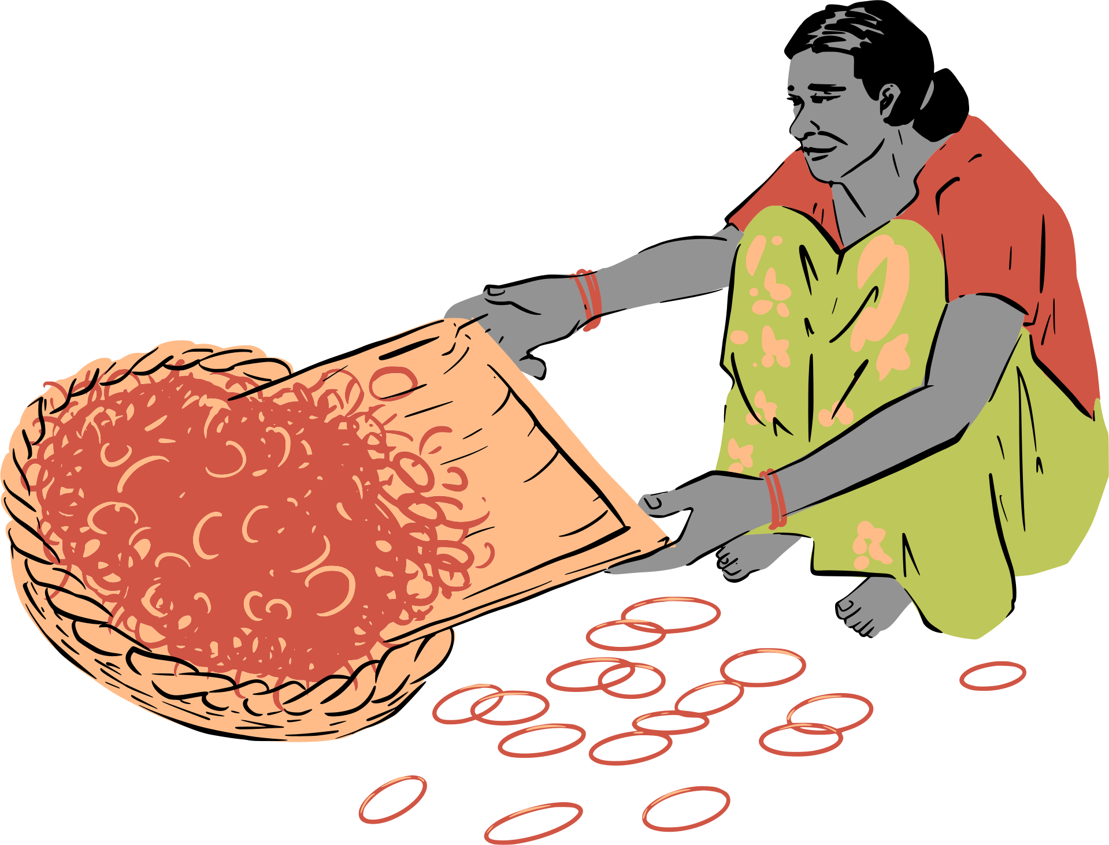
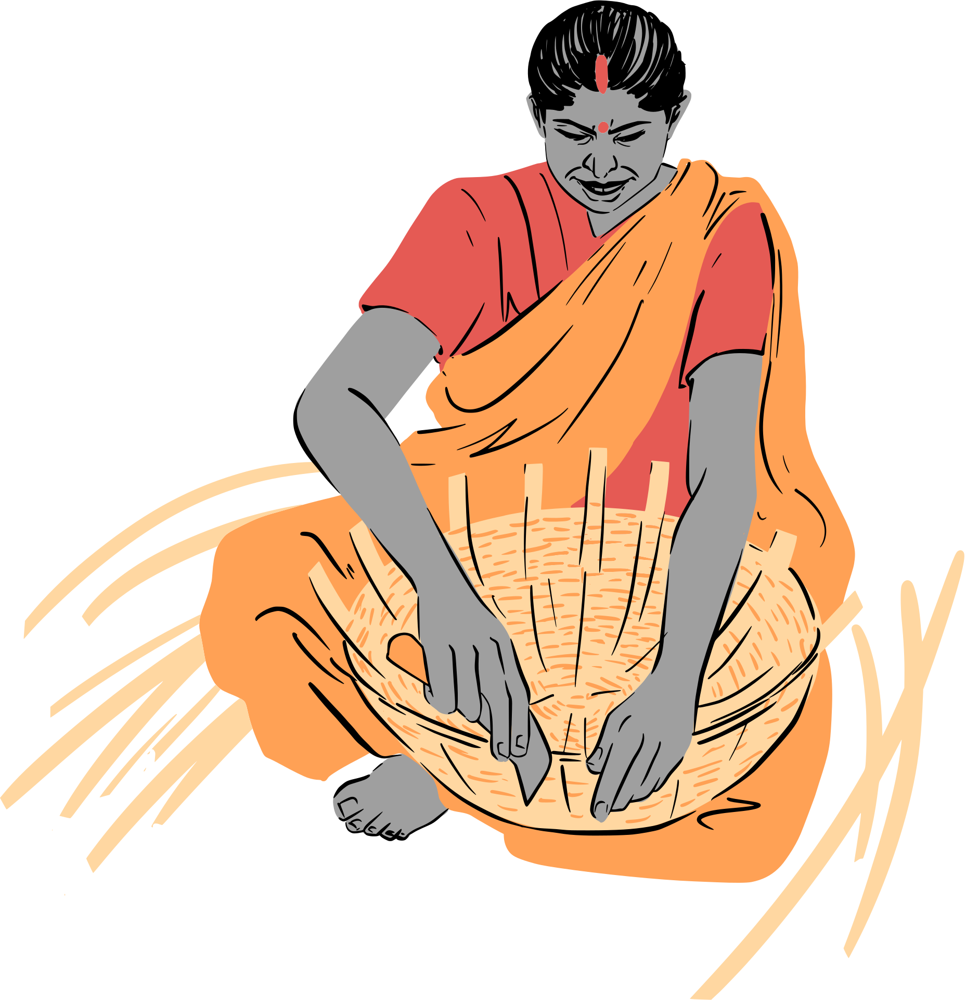
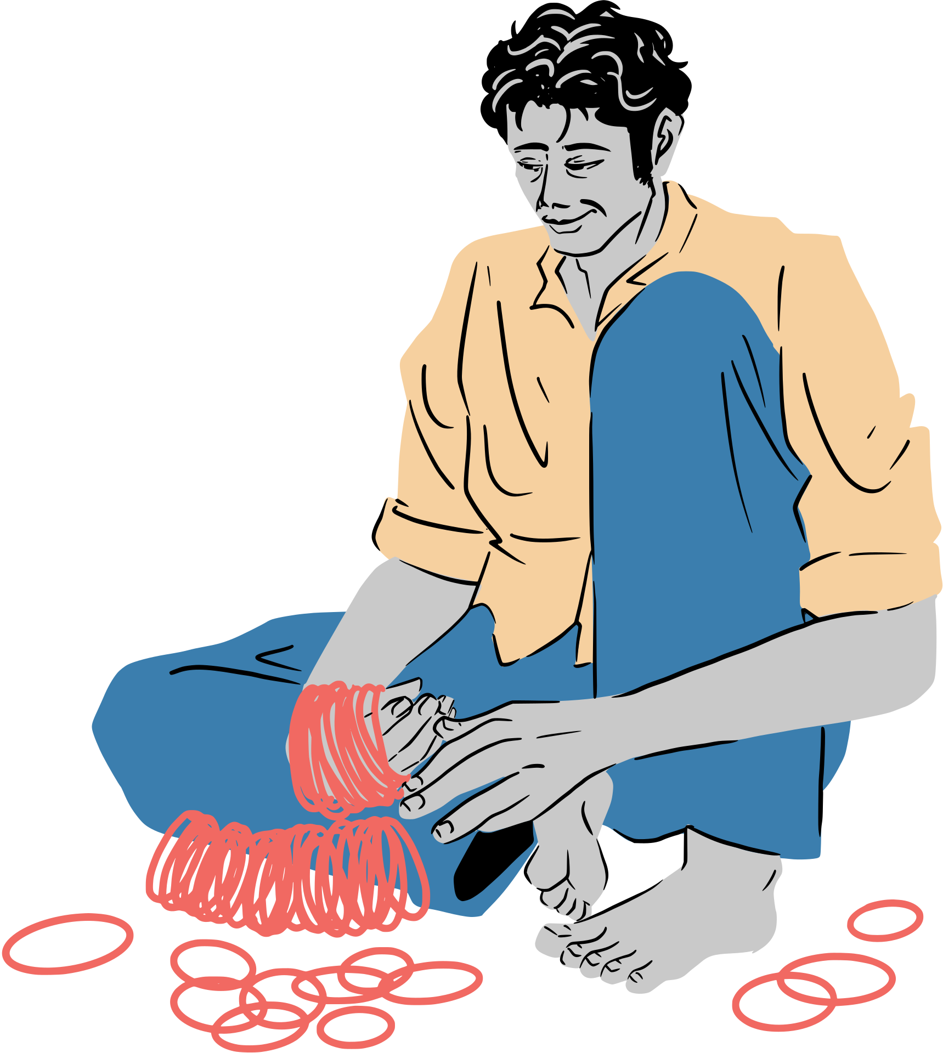
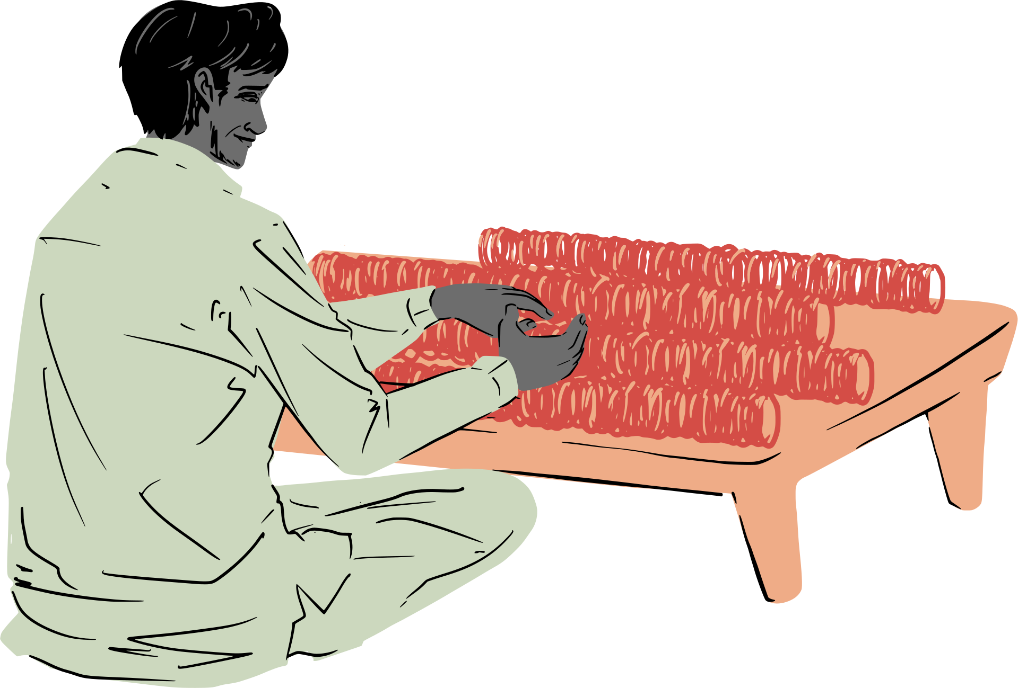

Slide 9
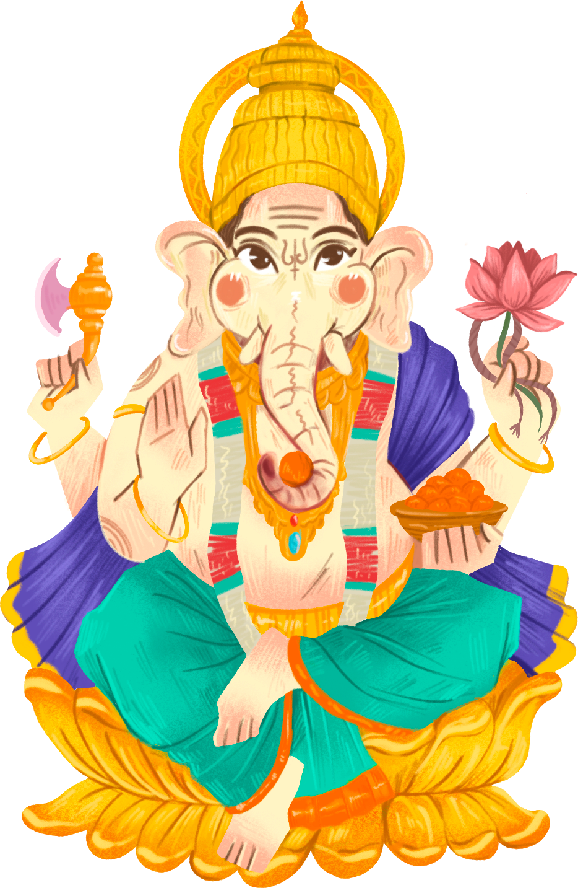

The great books of India have never been closed;
They have been growing continuously

Slide 10
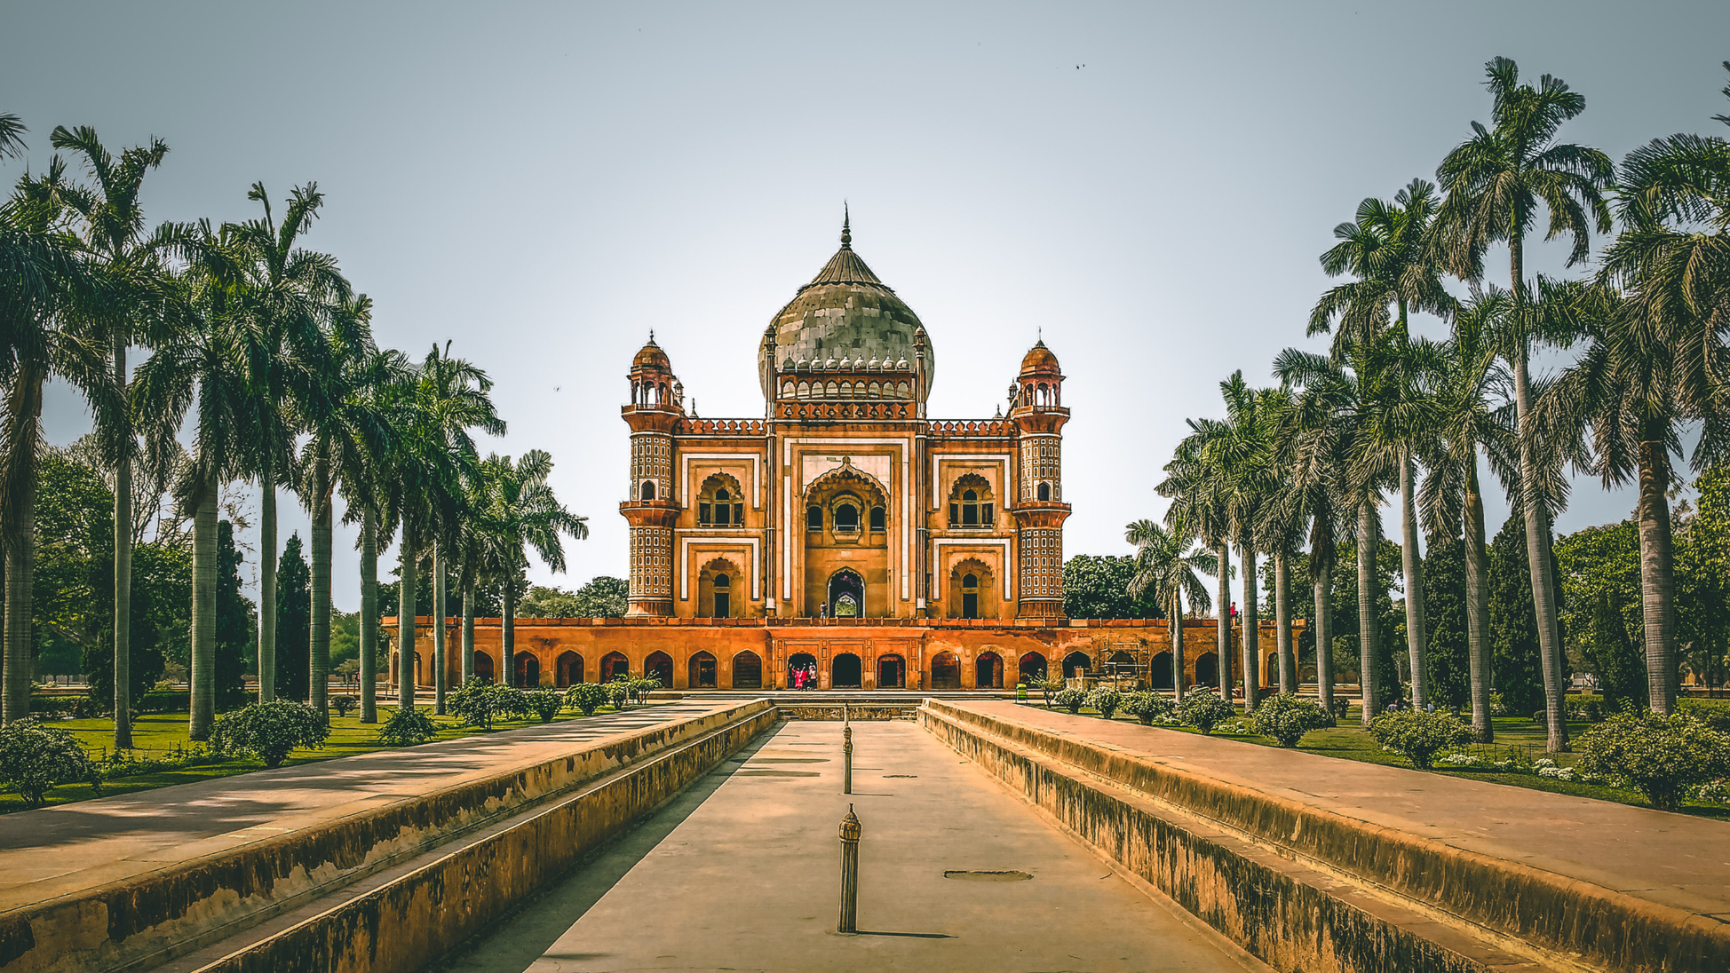

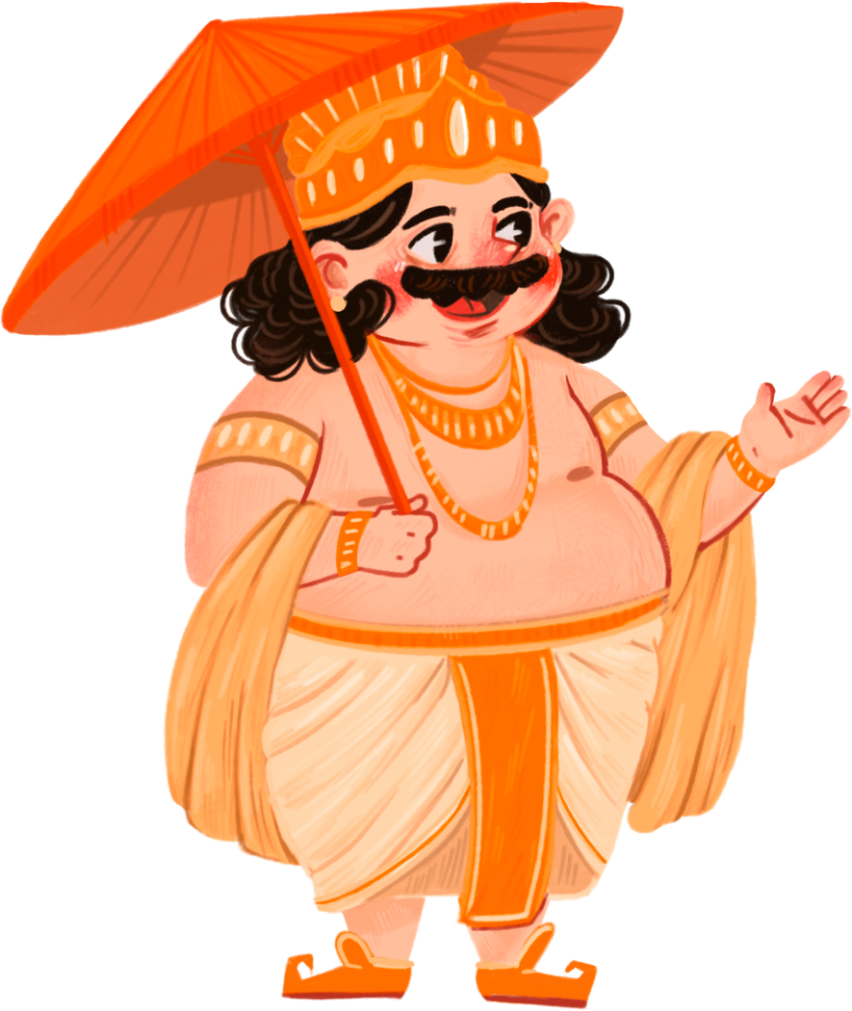
India is a place where the past is always present.

Slide 11



India is an unbroken chain of festivals, fairs, and celebrations. Every day, every season, every region has its own festivity.
Amartya Sen

Slide 12
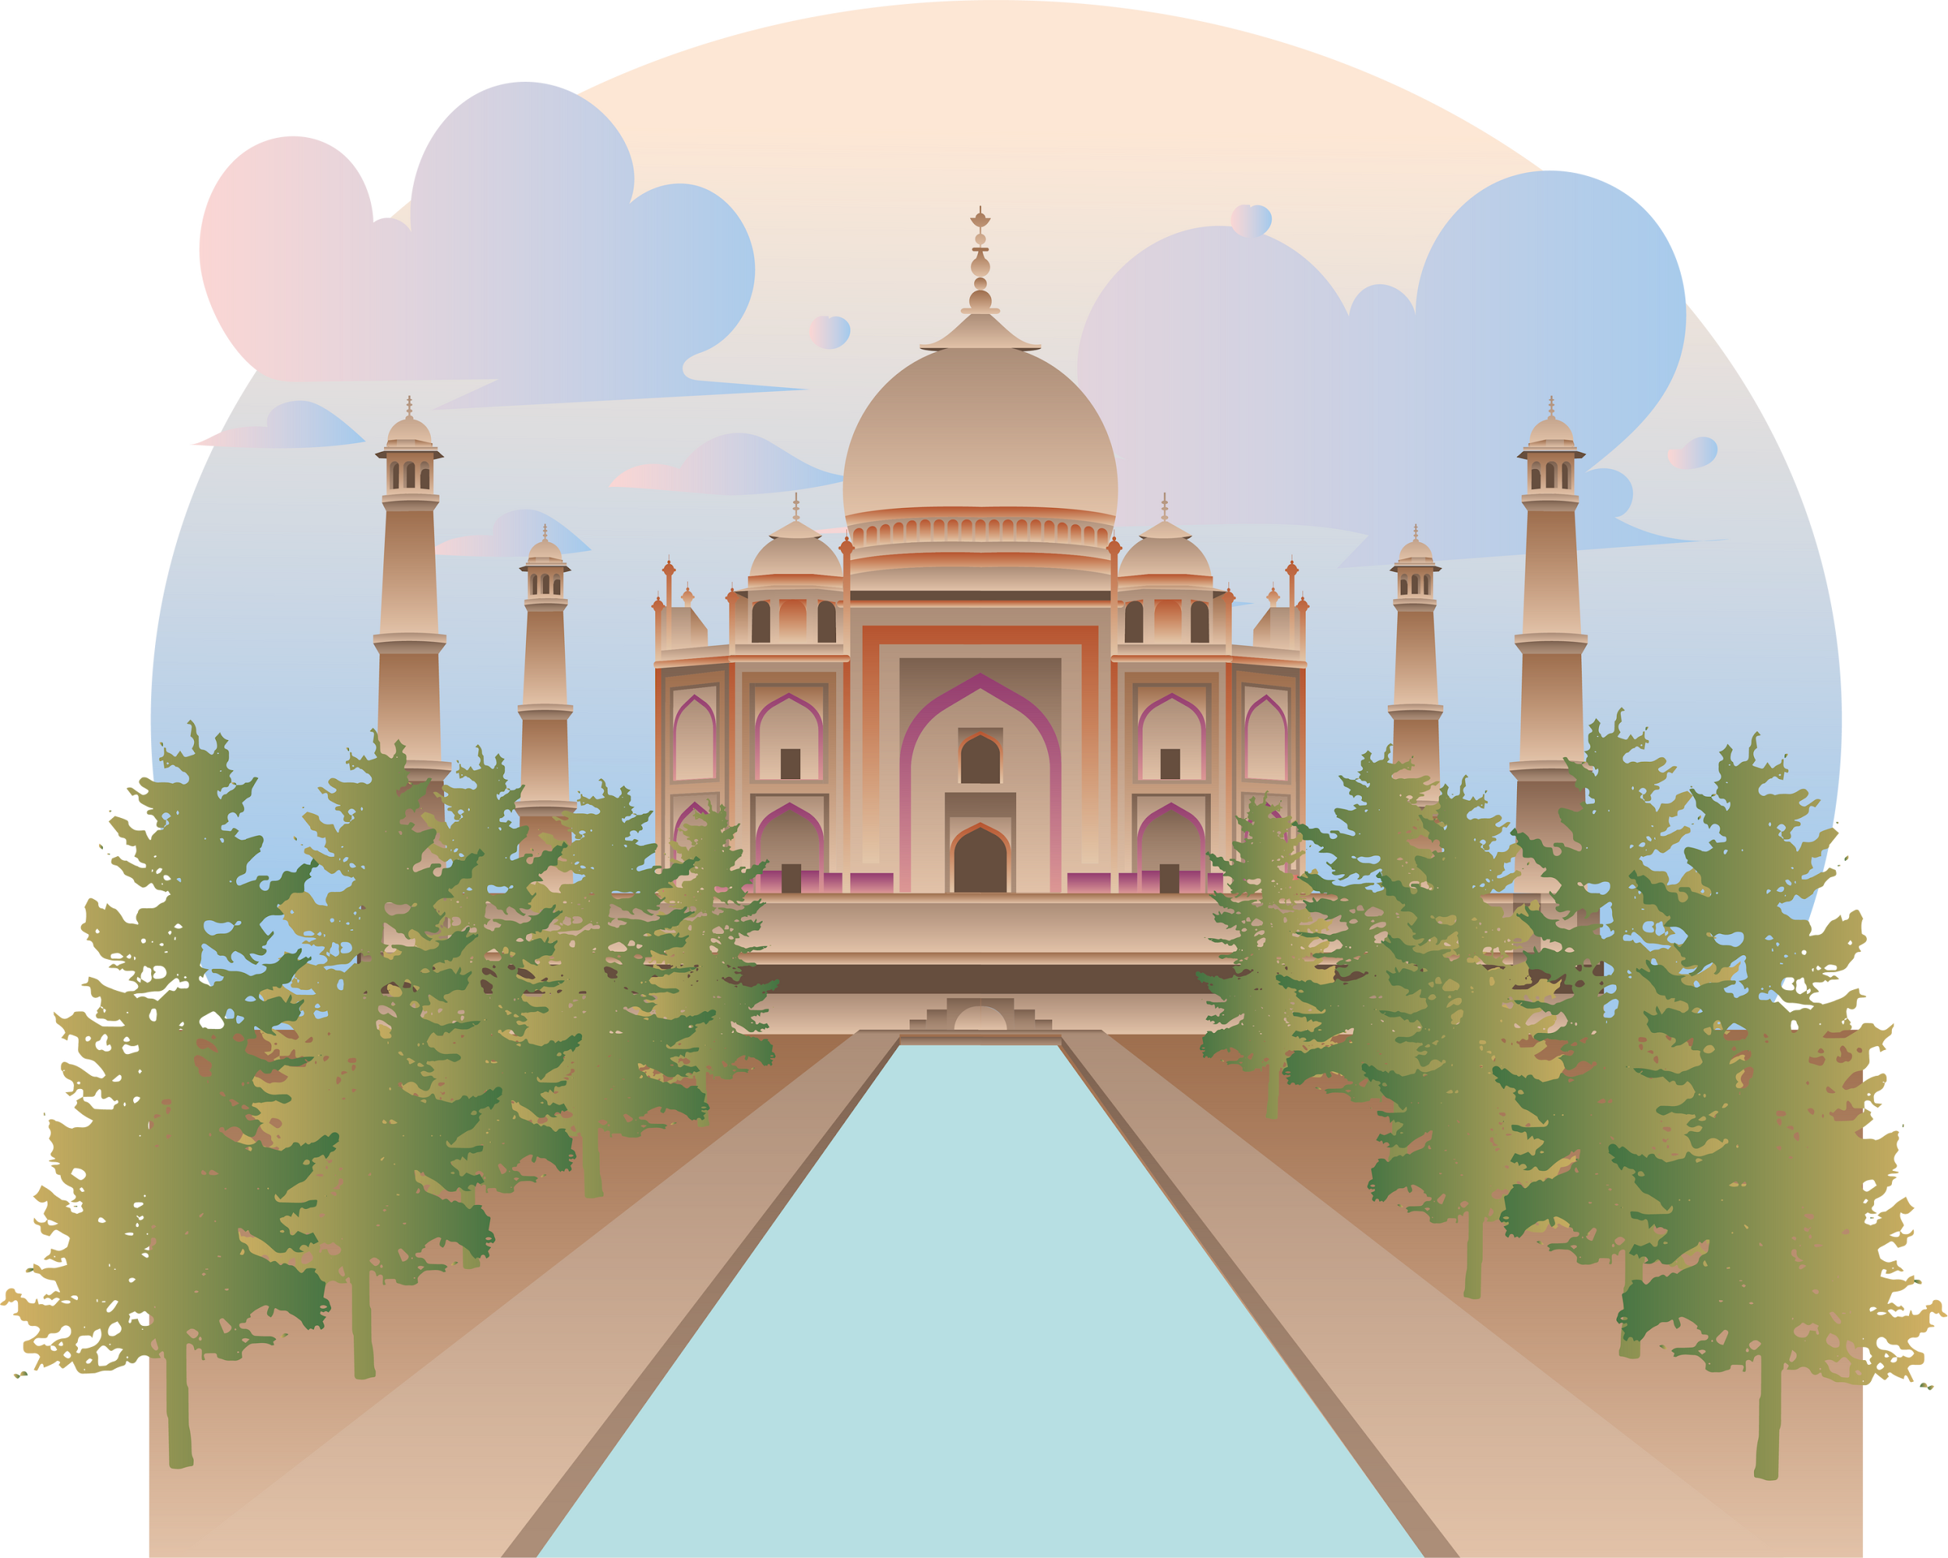
India is a place where every religion and every belief has found a home.

Slide 13
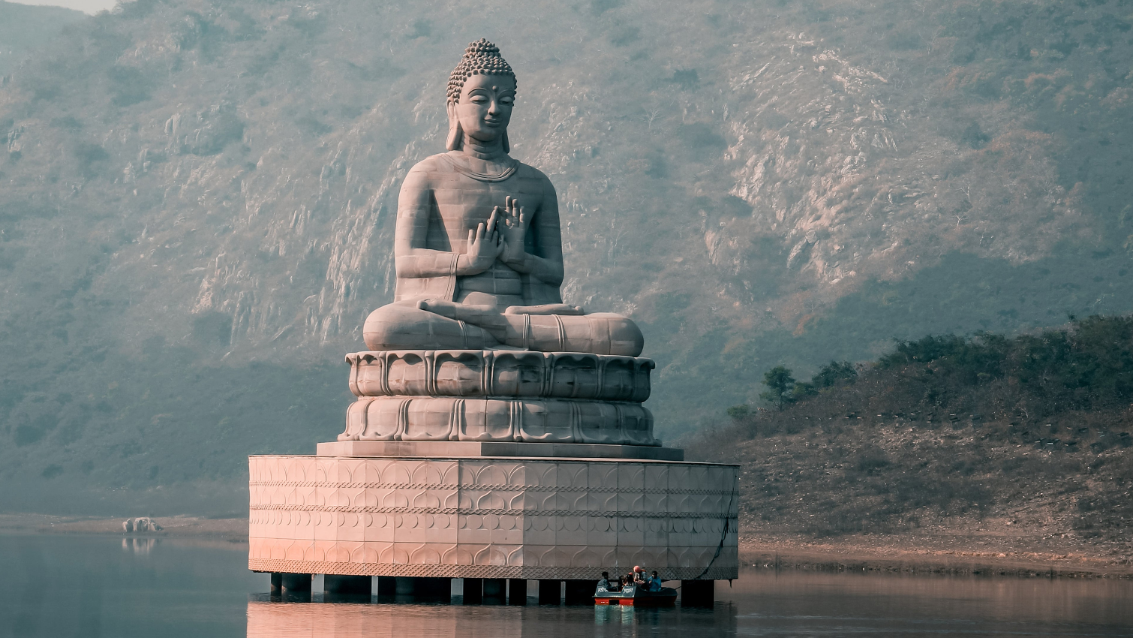

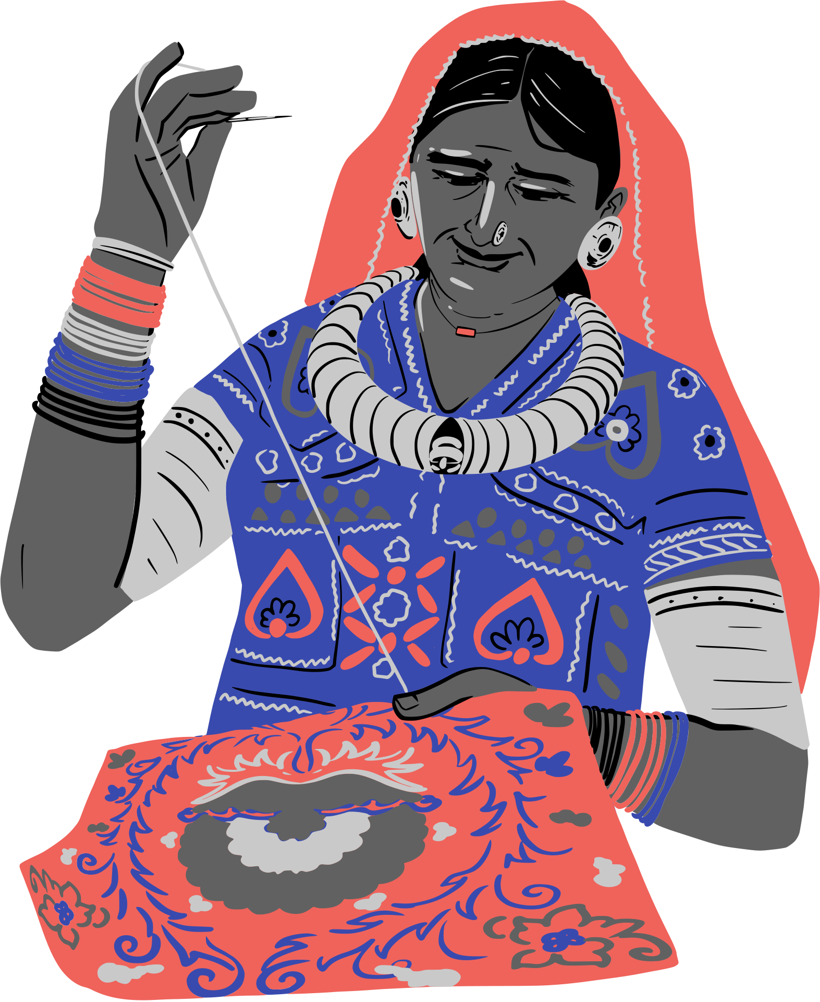
India is a global treasure house of traditions, heritage, and culture.

Slide 14







































Resource Page
Use these design resources in your Canva Presentation.
Fonts
Design Elements
This presentation template
uses the following free fonts:
TITLES:
PAYTONE ONE
HEADERS:
PAYTONE ONE
BODY COPY:
PAYTONE ONE
You can find these fonts online too.
Colors
#FFFFCC
#FCB931
#FF8E93
#D21B18
#222B45
  DON'T FORGET TO DELETE THIS PAGE BEFORE PRESENTING.

Slide 15

Credits
This presentation template is free for everyone to use thanks to the following:
  for the presentation template
Pexels, Pixabay
  for the photos
Happy designing!

