Slide 1


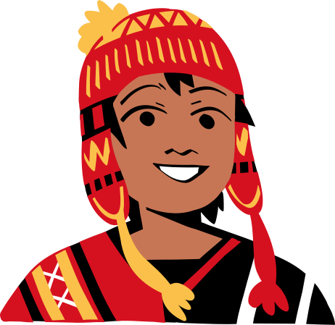



International
Day of the
World's
Indigenous Peoples

Slide 2


How to Use This Presentation
Google Slides
PowerPoint
Canva
Click on the "Google Slides" button below this presentation preview. Make sure to sign in to your Google account. Click on "Make a copy." Start editing your presentation.
Alternative: Click on the "Share" button on the top right corner in Canva and click on "More" at the bottom of the menu. Enter "Google Drive" in the search bar and click on the GDrive icon to add this design as a Google slide in your GDrive.
Click on the "PowerPoint" button below this presentation preview. Start editing your presentation.
Alternative: From Canva template file, Click on the "Share" button on the top right corner in Canva and click on "More" at the bottom of the menu. Enter "PowerPoint" in the search bar and click on the PowerPoint icon to download.
Click on the "Canva" button under this presentation preview. Start editing your presentation. You need to sign in to your Canva account.

Slide 3
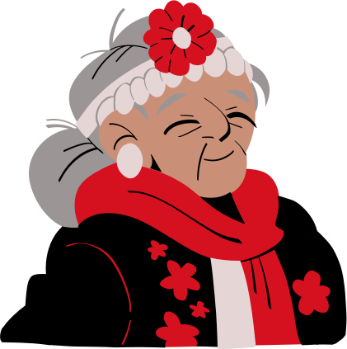
Table Of
Contents
Write an agenda here.
Write an agenda here.
Write an agenda here.
Write an agenda here.

Slide 4

Celebrating and Honoring Indigenous Cultures

Slide 5
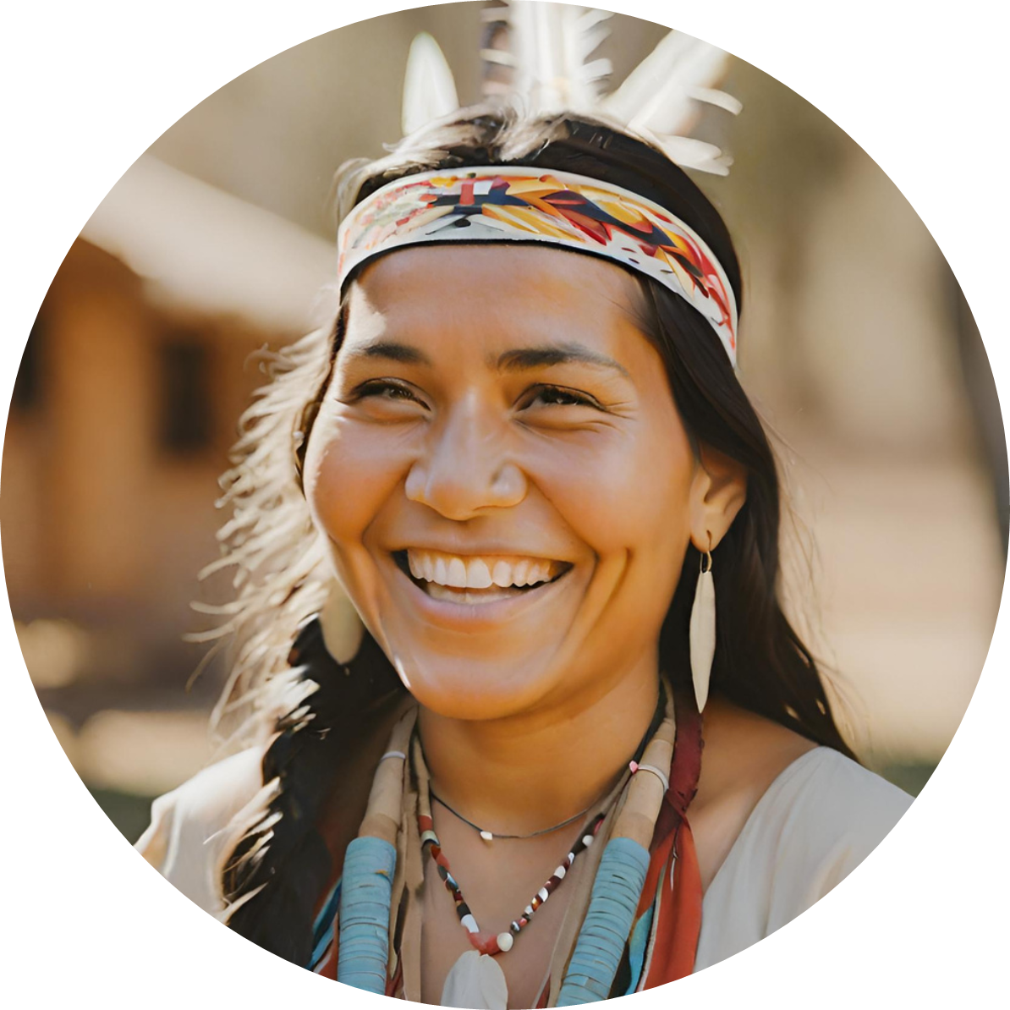
Hello there!
  I'm Rain, and I'll be sharing with you my beautiful ideas. Follow me at @reallygreatsite to learn more.

Slide 6
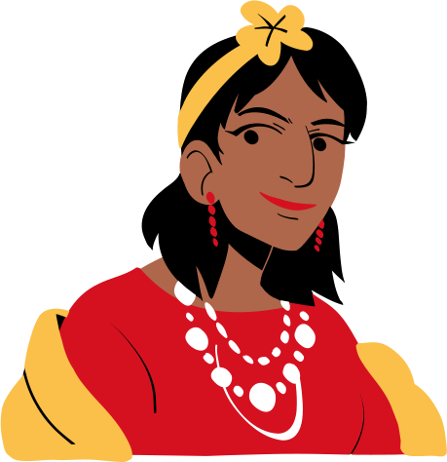
History of the
International
Day
History
  Established by the United Nations on August 9th, the International Day of the World's Indigenous Peoples has a rich history of acknowledging and celebrating the unique contributions of indigenous communities globally.

Slide 7
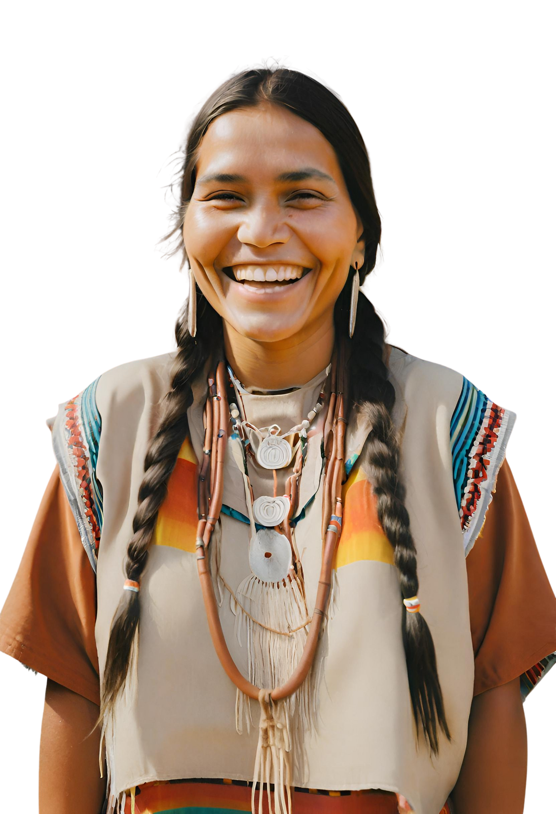
Traditional Knowledge and Practices
01.
Add a main point
Briefly elaborate on what you want to discuss.
02.
Add a main point
Briefly elaborate on what you want to discuss.
03.
Add a main point
Briefly elaborate on what you want to discuss.

Slide 8
Indigenous Languages
Indigenous languages are a vital part of cultural identity. Despite facing challenges, they represent a wealth of knowledge. Let's delve into the importance of preserving and revitalizing these languages.
01.
01.
Add a main point
Add a main point
Briefly elaborate on what you want to discuss.
Briefly elaborate on what you want to discuss.
01.
01.
Add a main point
Add a main point
Briefly elaborate on what you want to discuss.
Briefly elaborate on what you want to discuss.

Slide 9
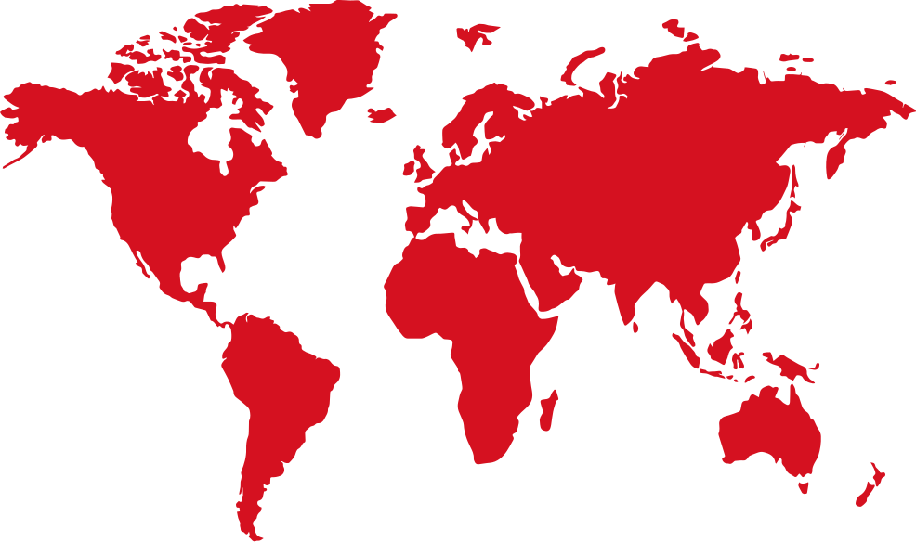
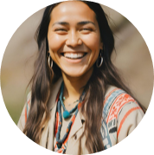
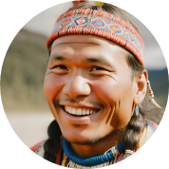
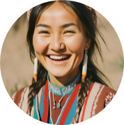
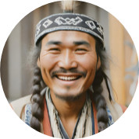
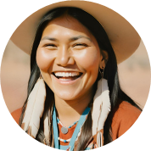
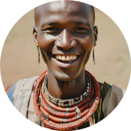
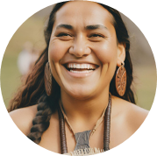
Indigenous Peoples Around the World
Main Point
Main Point
Briefly elaborate on what you want to discuss.
Briefly elaborate on what you want to discuss.
Main Point
Main Point
Briefly elaborate on what you want to discuss.
Briefly elaborate on what you want to discuss.

Slide 10
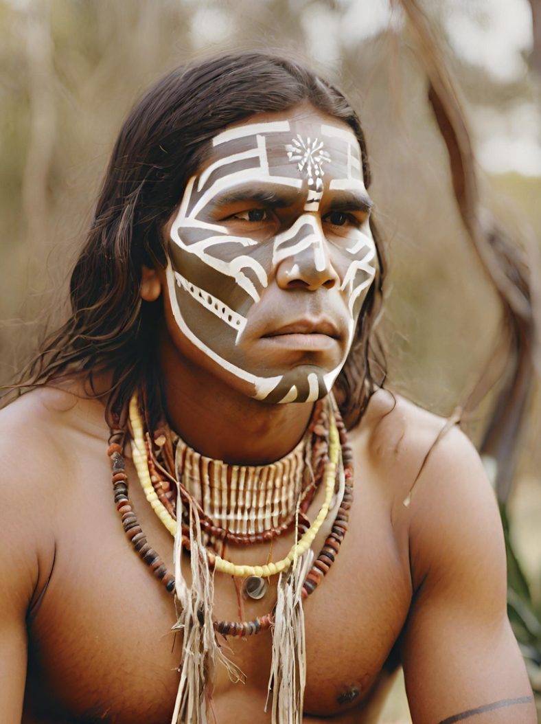
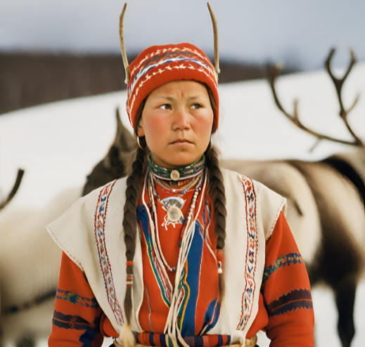
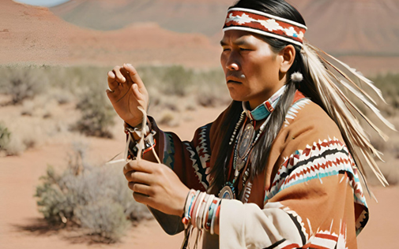
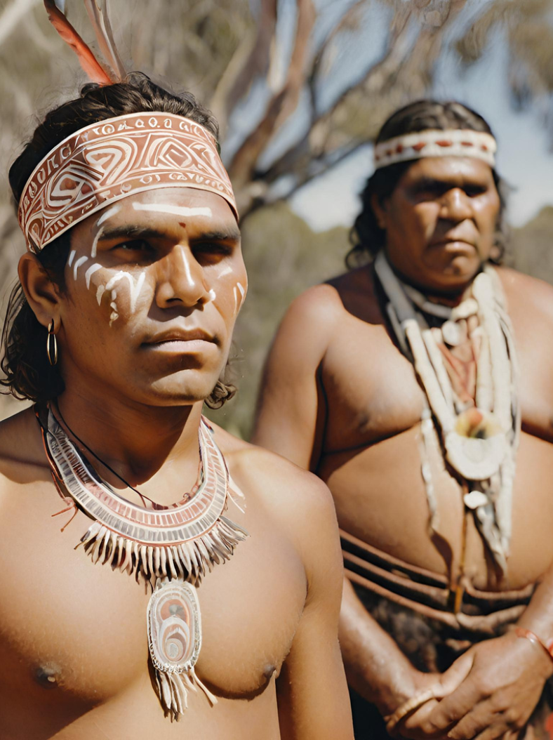
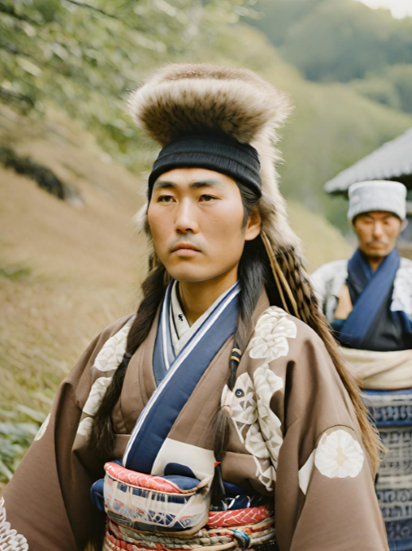
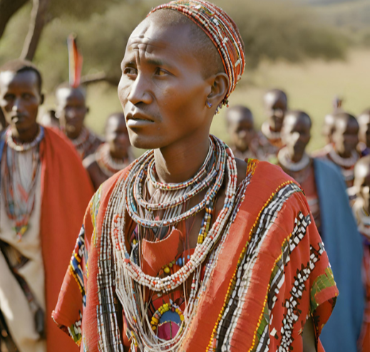
Image Gallery

Slide 11
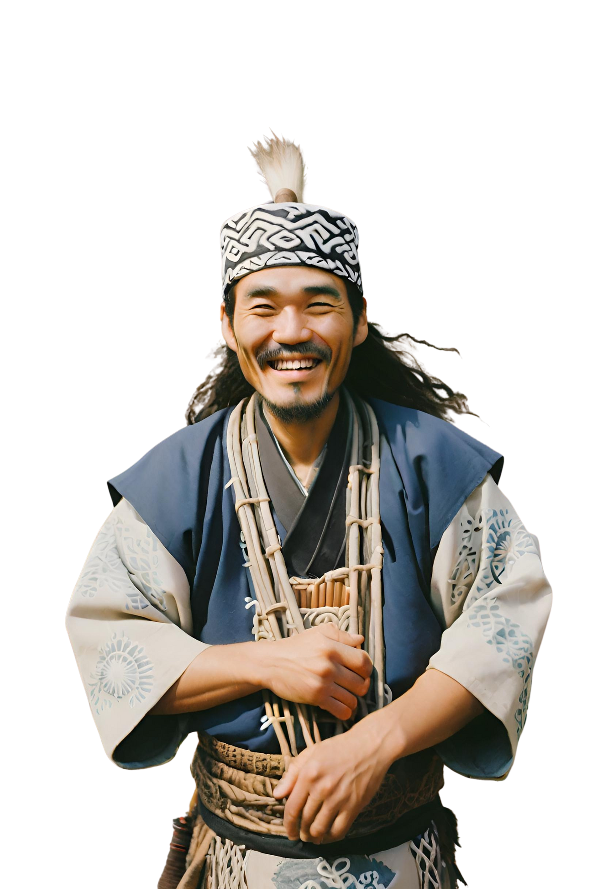
Cultural Heritage and Preservation
Main Point
01
Briefly elaborate on what you want to discuss.
Main Point
02
Briefly elaborate on what you want to discuss.

Slide 12
Indigenous
Sustainability
Traditional Ecological Knowledge
Community-Led Conservation Initiatives
  Indigenous communities possess a wealth of Traditional Ecological Knowledge (TEK), acquired through centuries of harmonious interaction with their environments. This knowledge, deeply rooted in sustainable practices, offers valuable insights for addressing modern environmental challenges and promoting sustainable development.
  Indigenous peoples are at the forefront of community-led conservation efforts. Through sustainable land management, preservation of biodiversity, and eco-friendly resource utilization, they contribute significantly to global efforts for sustainable development. These initiatives not only benefit the environment but also foster community resilience and well-being.

Slide 13
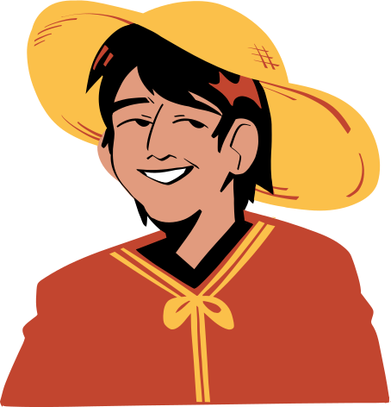
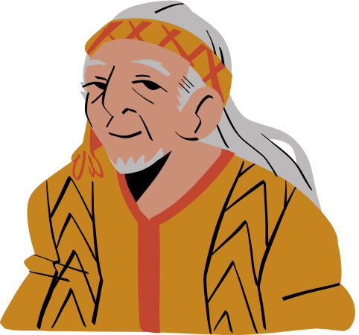
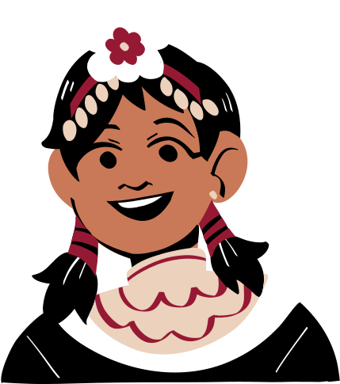
Indigenous Rights
Main Point
Main Point
Main Point
Briefly elaborate on what you want to discuss.
Briefly elaborate on what you want to discuss.
Briefly elaborate on what you want to discuss.

Slide 14
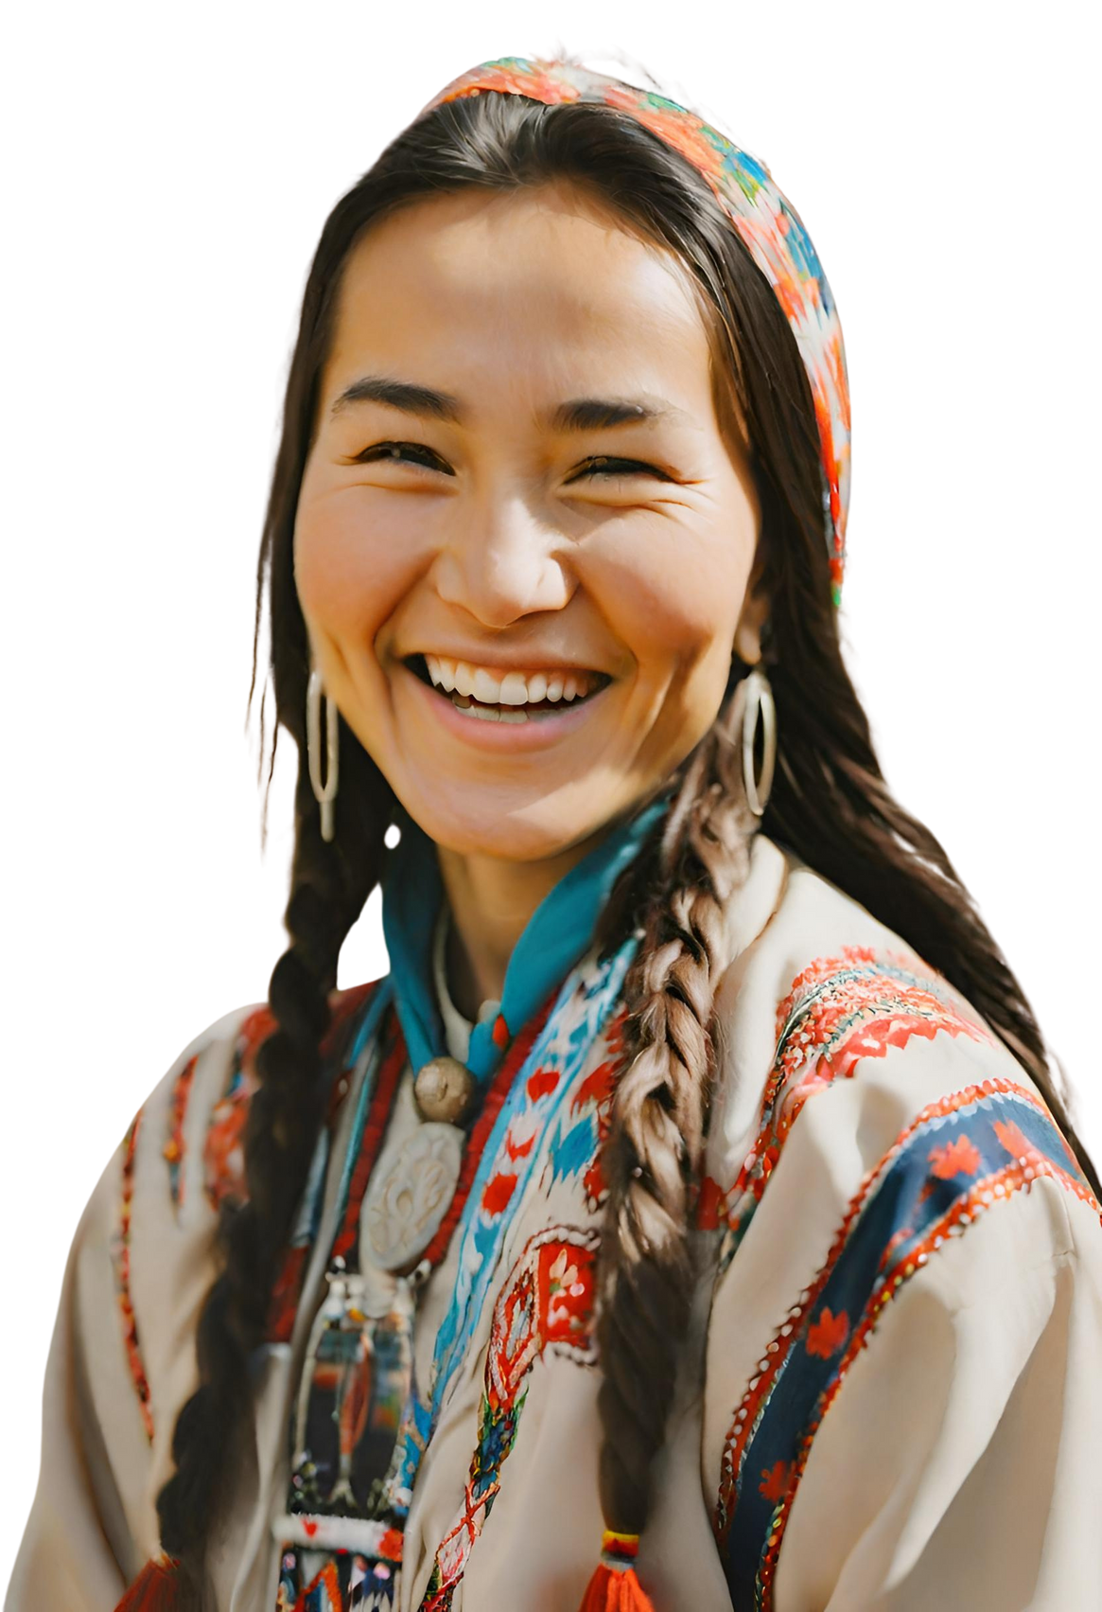
Traditional Knowledge and Practices
Main Point
Main Point
Briefly elaborate on what you want to discuss.
Briefly elaborate on what you want to discuss.
Discover the profound traditional knowledge and sustainable practices that have sustained indigenous communities for generations. These practices often offer valuable lessons for environmental stewardship.
Main Point
Main Point
Briefly elaborate on what you want to discuss.
Briefly elaborate on what you want to discuss.

Slide 15
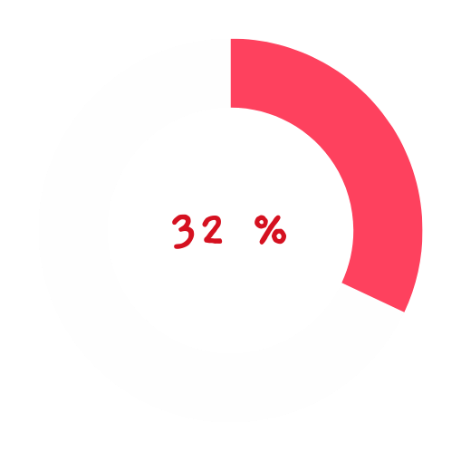
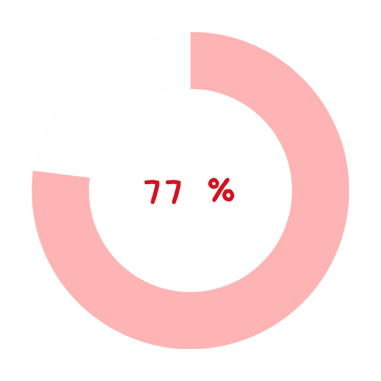
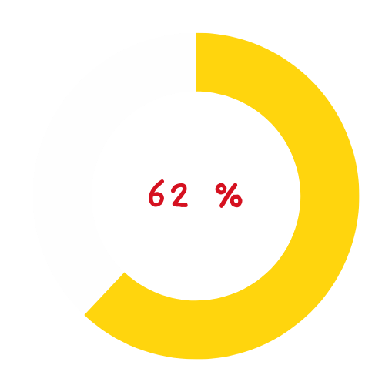
Indigenous Demographics
Explore the demographic and cultural landscape of indigenous communities
  through three insightful pie charts.
  Briefly elaborate on what you want to discuss.
  Briefly elaborate on what you want to discuss.
  Briefly elaborate on what you want to discuss.

Slide 16
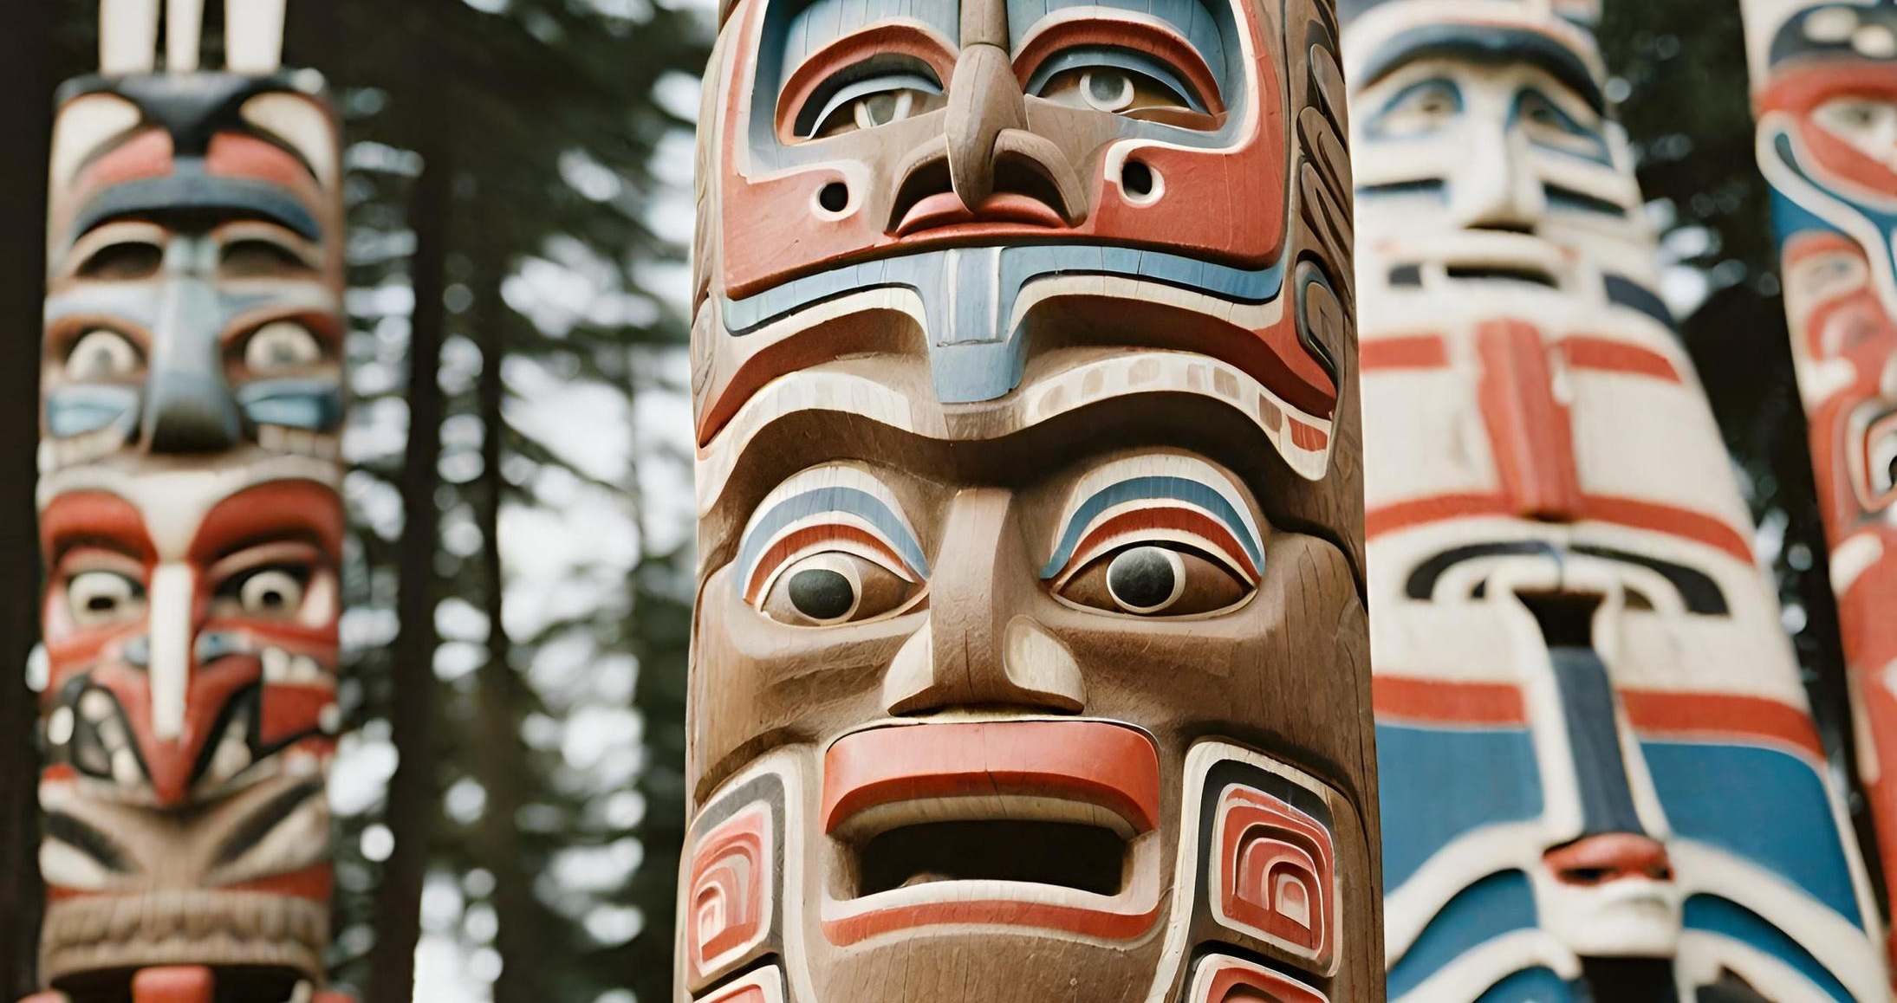
A picture is worth a thousand words

Slide 17
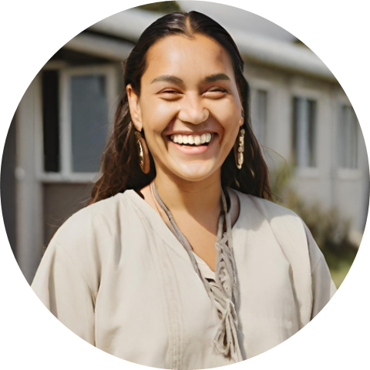
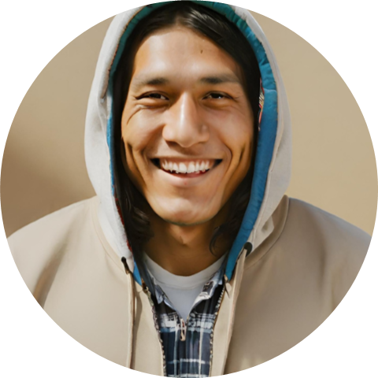
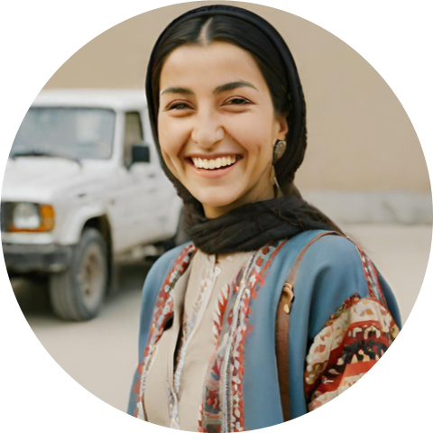
Meet the team
Name
Name
Name
  Elaborate on what you want to discuss.
  Elaborate on what you want to discuss.
  Elaborate on what you want to discuss.

Slide 18
Thank you!
Write a closing statement or call-to-action here.

Slide 19
Resource
Page
  Use these design resources
  in your Canva Presentation.
  This presentation template
  uses the following free fonts:
  Titles: Fascinate
  Headers: Gaegu
  Body Copy: Open Sans
  You can find these fonts
  online too. Happy designing!
  Don't forget to delete this
  page before presenting.

Slide 20

This presentation template is free for everyone to use thanks to the following:
  SlidesCarnival for the presentation template
  Pexels for the photos
Happy designing!

