Slide 1
COMPETITIVE PROFILE MATRIX
Infographic
 |  | OUR COMPANY |  | COMPETITOR A |  | COMPETITOR B
Success Factors | Weight | Rating | Score | Rating | Score | Rating | Score
Brand Reputation | 0.25 | 4 | 1 | 2 | 0.5 | 2 | 0.5
Advertising | 0.2 | 3 | 0.6 | 2 | 0.4 | 2 | 0.4
Customer Service | 0.2 | 4 | 0.8 | 1 | 0.2 | 2 | 0.4
Price | 0.2 | 3 | 0.6 | 2 | 0.4 | 3 | 0.6
Product Quality | 0.15 | 4 | 0.6 | 1 | 0.15 | 2 | 0.3
Total Score |  |  | 3.6 |  | 1.65 |  | 2.2

Slide 2
COMPETITIVE PROFILE MATRIX
 | Current Market Position | Economic Situation |  | Product Line |  | Market Position
Our Company | 9/10 | 7/10 |  | 8/10 |  | 21 | Contender
Company A | 8/10 | 4/10 |  | 6/10 |  | 125 | Cash Cow
Company B | 8/10 | 5/10 |  | 7/10 |  | 66 | Market Leader
Company C | 6/10 | 6/10 |  | 6/10 |  | 35 | Rising Star
Company D | 3/10 | 2/10 |  | 7/10 |  | 4 | Market Leader
Company E | 8/10 | 7/10 |  | 3/10 |  | 26 | Contender
COMPETITORS

Slide 3
COMPETITIVE PROFILE MATRIX
Infographic
 |  | OUR COMPANY |  | COMPETITOR A |  | COMPETITOR B
Success Factors | Weight | Rating | Score | Rating | Score | Rating | Score
Brand Reputation | 0.25 | 4 | 1 | 2 | 0.5 | 2 | 0.5
Advertising | 0.2 | 3 | 0.6 | 2 | 0.4 | 2 | 0.4
Customer Service | 0.2 | 4 | 0.8 | 1 | 0.2 | 2 | 0.4
Price | 0.2 | 3 | 0.6 | 2 | 0.4 | 3 | 0.6
Product Quality | 0.15 | 4 | 0.6 | 1 | 0.15 | 2 | 0.3
Total Score |  |  | 3.6 |  | 1.65 |  | 2.2

Slide 4
























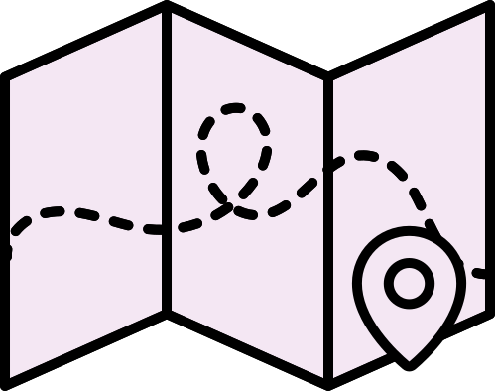














Resource Page
  Use these design resources in your Canva Presentation.
Fonts
  Design Elements
  This presentation template
  uses the following free fonts:
  Titles and Body Copy
LIBRE FRANKLIN
  You can find these fonts online too.
Colors
  Don't forget to delete this page before presenting.

Slide 5

Credits
  This design template is free for everyone to use thanks to the following:
  for the presentation template
  PEXELS, PIXABAY
  for the photos
  HAPPY DESIGNING!

