Slide 1


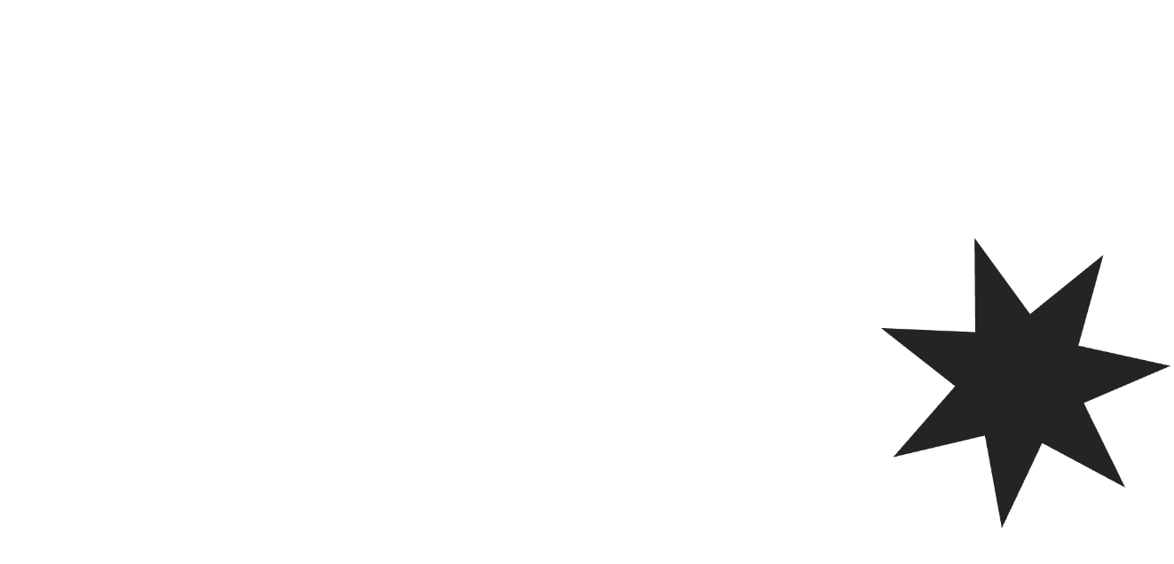


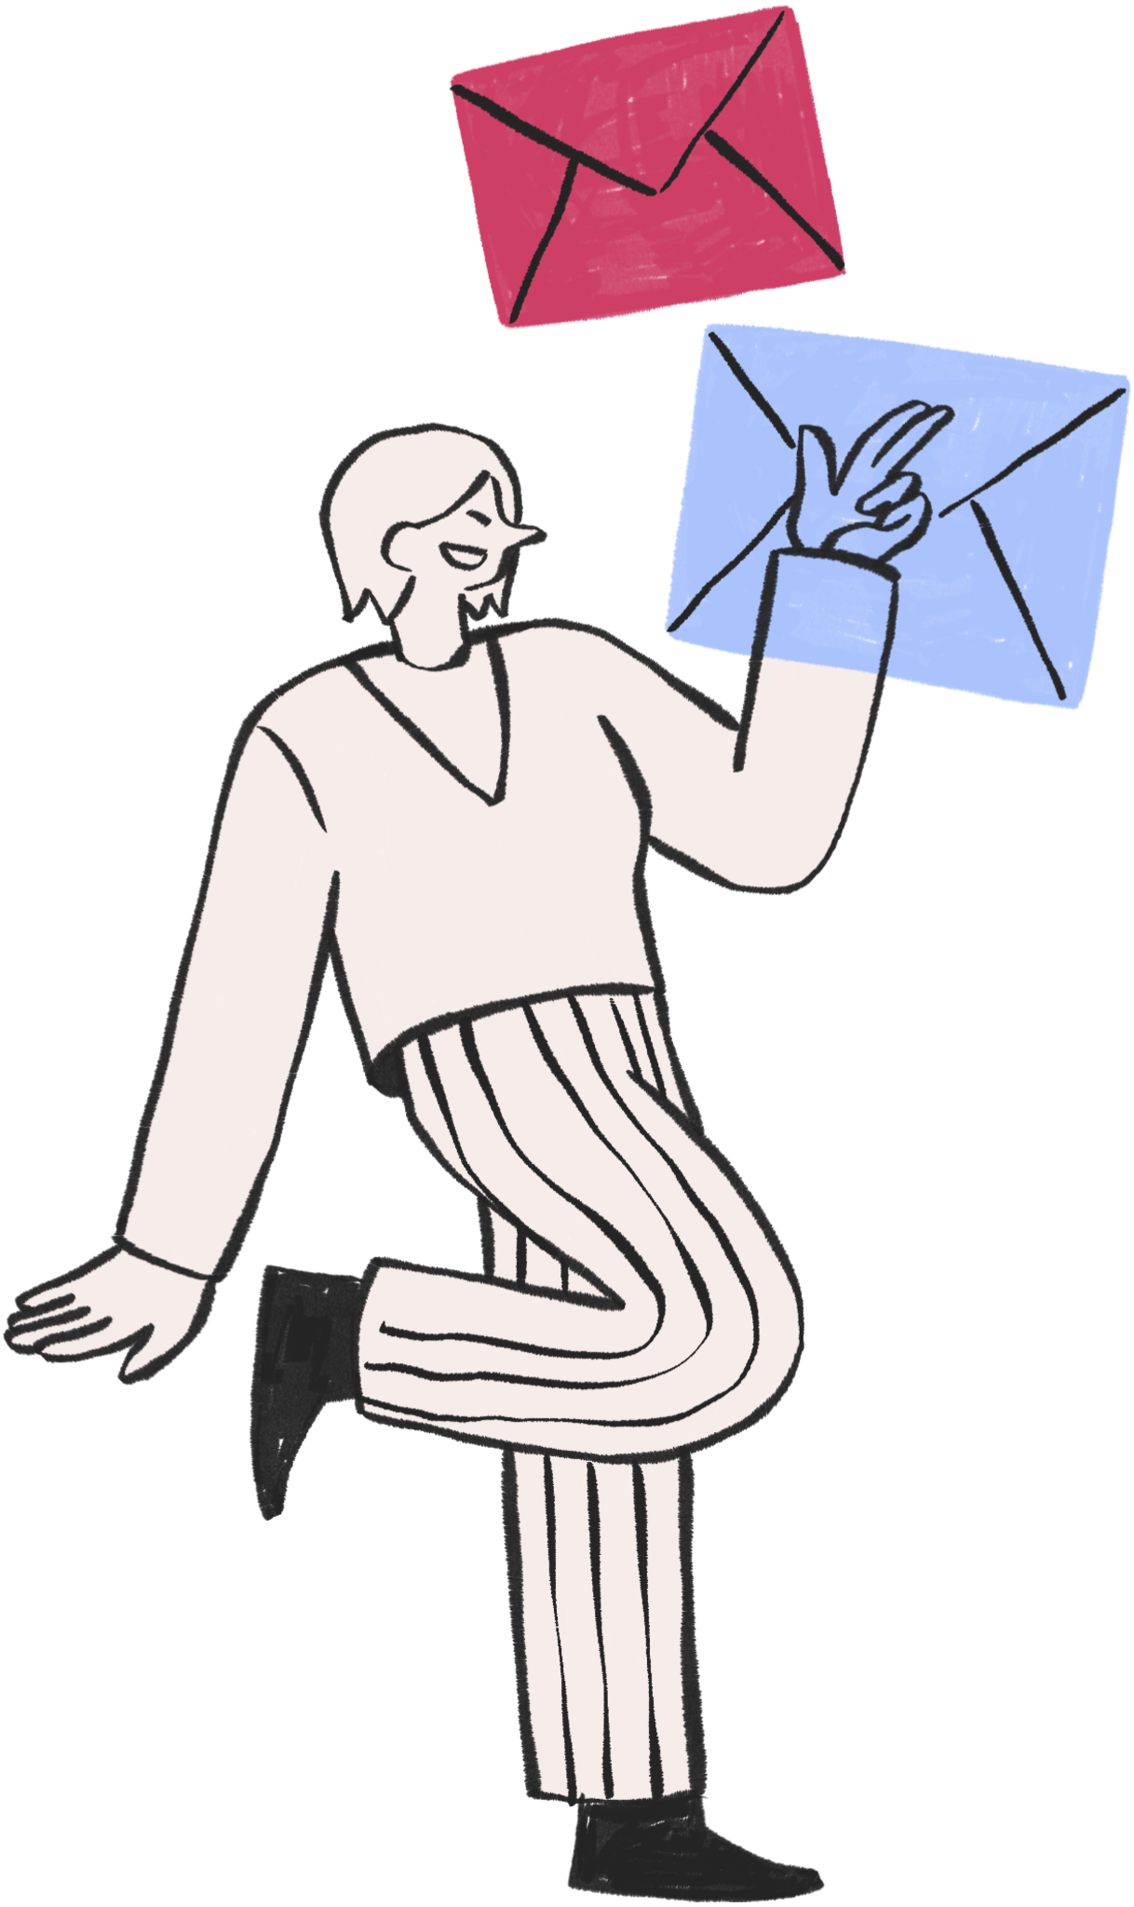




Email Marketing
START HERE:
Offer Sent to Customer via Email
Workflow Infographic
Send another email reminder
Send email reminder
after one week
Does customer open
the follow-up email?
Does the customer
open the email?
Customer directed to landing page
Customer directed to landing page
Customer downloads information
Send marketing email after 2 days
Customer added to
email marketing list
Does the customer download information?
Email newsletter 1 week after download
Customer subscribes
or downloads product
Customer acquired and
removed from list
Customer landed to
thank you page

Slide 2


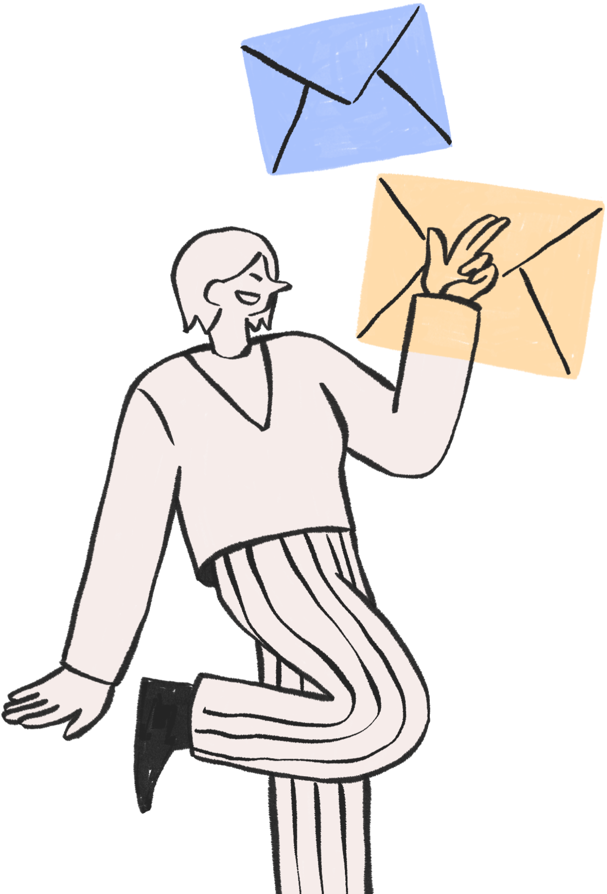
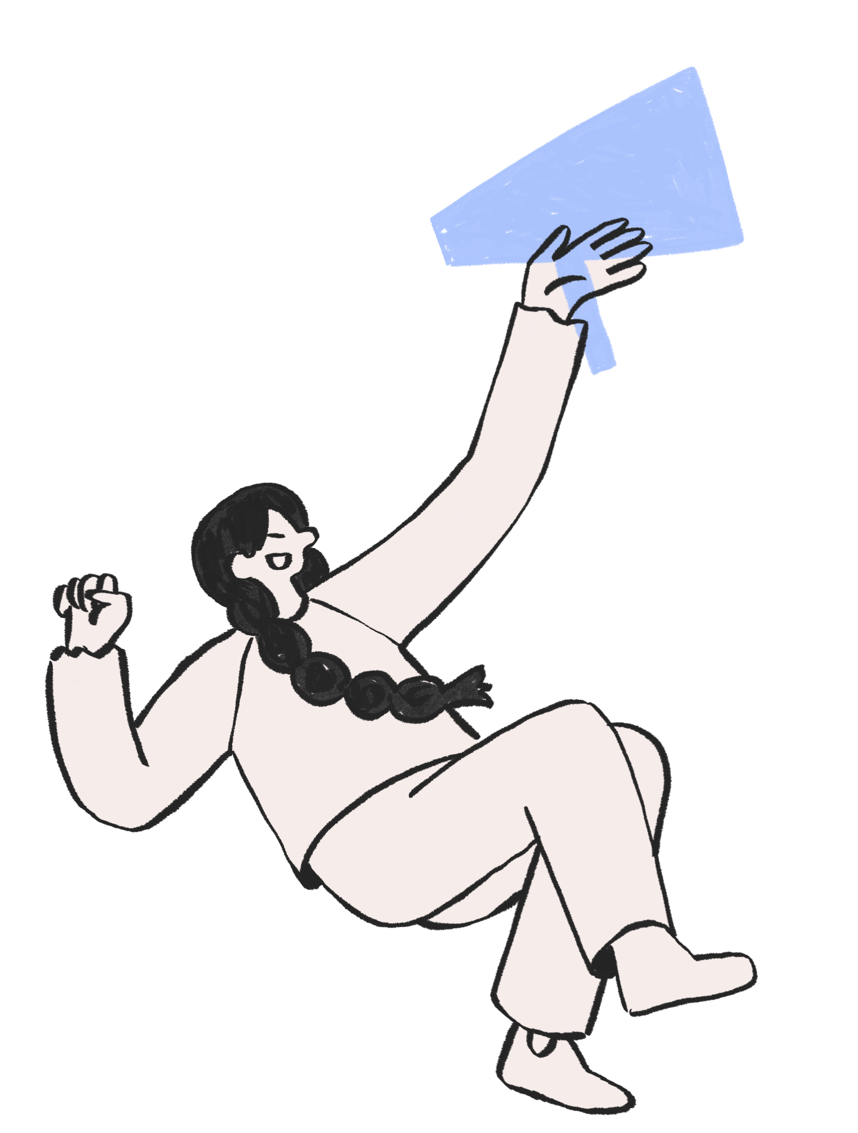
Offer Sent to Customer via Email
Does the customer
open the email?
Send email reminder
after one week
Email Marketing
NO
YES
Customer directed to landing page
Does customer open
the follow-up email?
Send another email reminder
YES
NO
Workflow Infographic
Does the customer download information?
Customer added to
email marketing list
Send marketing email after 2 days
Customer downloads information
NO
YES
Customer landed to thank you page
Customer acquired and
removed from list
Customer subscribes
or downloads product
Email newsletter 1 week after download

Slide 3


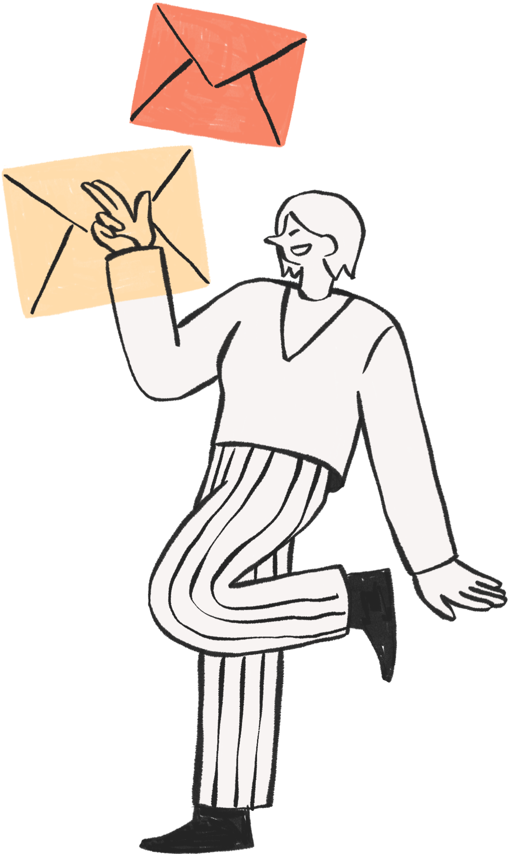


Email Marketing
START HERE:
Offer Sent to Customer via Email
Workflow Infographic
Send another email reminder
Does customer open
the follow-up email?
Send email reminder
after one week
Does the customer
open the email?
Customer directed to landing page
Customer directed to landing page
Customer downloads information
Send marketing email after 2 days
Customer added to
email marketing list
Does the customer download information?
Email newsletter 1 week after download
Customer subscribes
or downloads product
Customer acquired and
removed from list
Customer landed to
thank you page

Slide 4




RESOURCES
  Use these design resources in your Canva Presentation.
Fonts
Design Elements
This presentation template
uses the following free fonts:
TITLES:
Abeezee
HEADERS:
AMIKO
BODY COPY:
AMIKO
You can find these fonts online too.
Colors

Slide 5
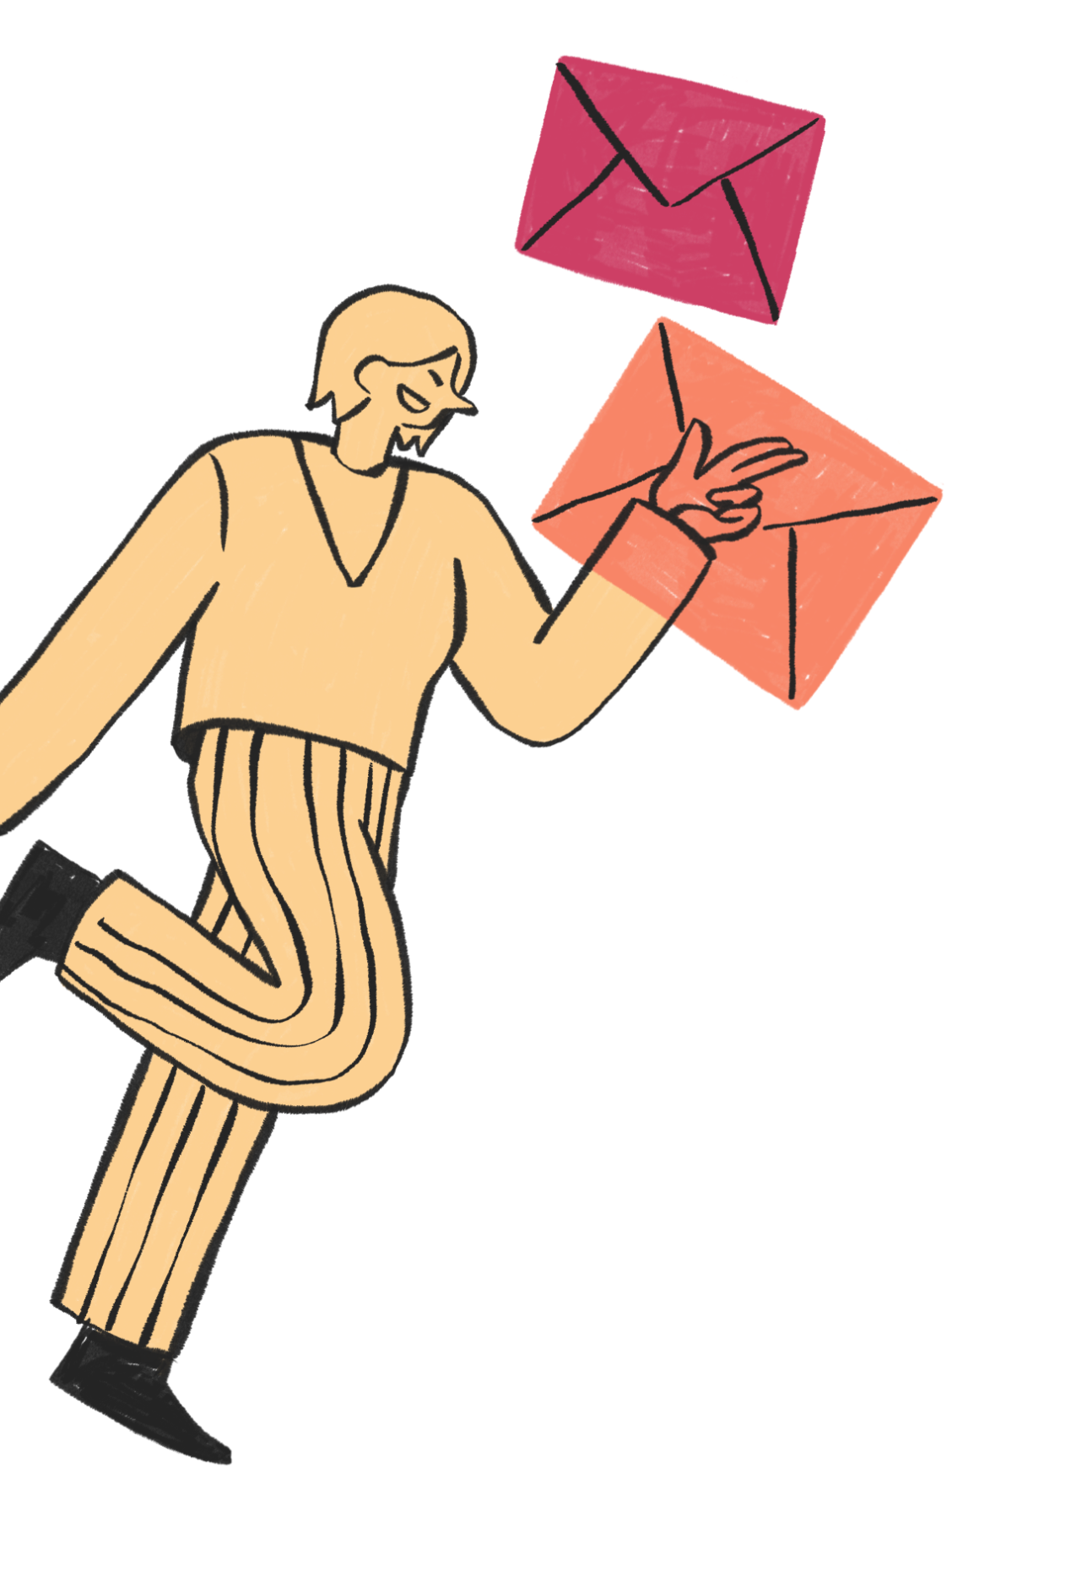
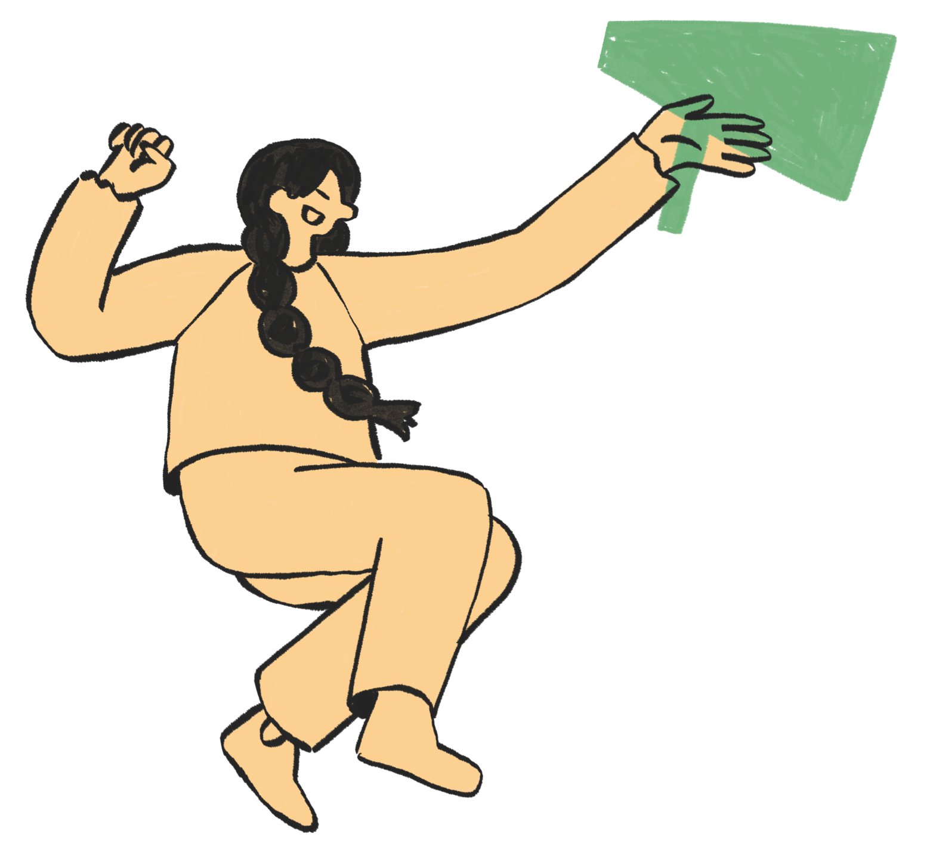


CREDITS
This design template is free for
everyone to use thanks to the following:
PEXELS AND PIXABAY
for the presentation template
For the photos

