Slide 1

Business Infographic Template
BUSINESS AND CORPORATE

Slide 2

Hello & welcome to presentation
WELCOME MESSAGE
Presentations are communication tools that can be used as demonstrations, lectures, speeches, reports, and more. It is mostly presented before an audience.
LETS GET STARTED

Slide 3



How to use this presentation
GOOGLE SLIDES
POWERPOINT
CANVA
Click on the "Google Slides" button below this presentation preview. Click on "Make a copy." Start editing your presentation. You need to sign in to your Google account.
Click on the "PowerPoint" button below this presentation preview.
Start editing your presentation.
Download and install the fonts used in this presentation as listed on page 21.
Click on the "Canva" button under this presentation preview. Start editing your presentation. You need to sign in to your Canva account.

Slide 4
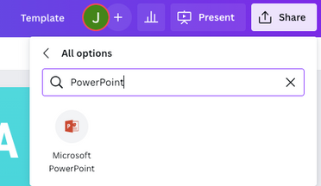
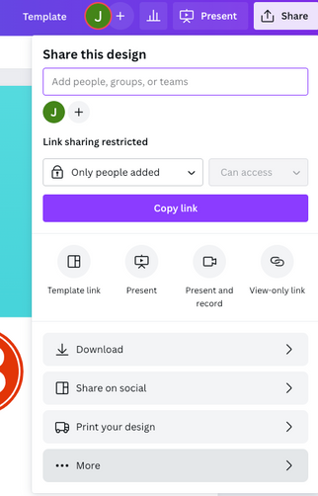
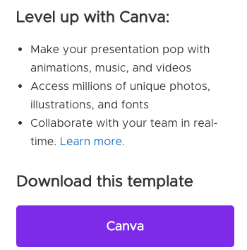
Download this presentation as a Powerpoint template in 3 steps
1.
2.
3.
Click on the "Canva" button next to this presentation. Start editing your presentation. You may need to sign in to your Canva account.
Click on the "Share" button on the top right corner in Canva and click on "More" at the bottom of the menu.
Enter "PowerPoint" in the search bar and click on the PowerPoint icon to download.

Slide 5
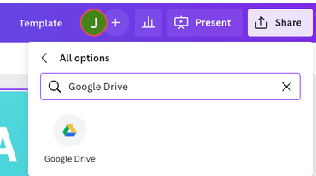
Download this presentation as a
Google Slide template in 3 steps
1.
2.
3.
Click on the "Canva" button next to this presentation. Start editing your presentation. You may need to sign in to your Canva account.
Click on the "Share" button on the top right corner in Canva and click on "More" at the bottom of the menu.
Enter "Google Drive" in the search bar and click on the Google Drive icon to add this design as a Google slide in your G Drive. It will ask you to link your Google account to Canva the first time.

Slide 6

Add an
Agenda Page
  WRITE AN AGENDA HERE.
  WRITE AN AGENDA HERE.
  WRITE AN AGENDA HERE.
  WRITE AN AGENDA HERE.
  WRITE AN AGENDA HERE.
  WRITE AN AGENDA HERE.

Slide 7

Infographic
Slide Report
125
100
Scenario 1
Presentations are communication tools that can be used as demonstrations. Presentations are communication tools that can be used as demonstrations
75
50
25
0
Item 1
Item 2
Item 3
Item 4
Item 5

Slide 8




Write your topic or idea
ADD A MAIN POINT
Briefly elaborate on what you want to discuss.
ADD A MAIN POINT
Briefly elaborate on what you want to discuss.
ADD A MAIN POINT
Briefly elaborate on what you want to discuss.

Slide 9
Add an Infographic Page
Elaborate on the data you want to discuss.
Item 1
13.7%
ITEM ONE
ITEM TWO
Presentations are
communication tools
Presentations are
communication tools
Item 4
39.2%
Item 2
19.6%
ITEM THREE
ITEM FOUR
Presentations are
communication tools
Presentations are
communication tools
Item 3
27.5%

Slide 10

Table 1 | Table 2 | Table 3
42 | 49 | 74
89 | 166 | 196
275 | 395 | 397
402 | 427 | 487
654 | 876 | 895
Infographic
Slide Report
Scenario 1
Presentations are communication tools that can be used as demonstrations.
Scenario 2
Presentations are communication tools that can be used as demonstrations.

Slide 11





Add an Infographic Page
Elaborate on the data you want to discuss
Step 1
Step 2
Step 3
Step 4
Step 5
Elaborate on the step here
Elaborate on the step here
Elaborate on the step here
Elaborate on the step here
Elaborate on the step here

Slide 12

Infographic
Slide Report
86%
46%
Scenario 1
Presentations are communication tools that can be used as demonstrations.
Scenario 2
Presentations are communication tools that can be used as demonstrations.
Scenario 3
Presentations are communication tools that can be used as demonstrations.
29%
82%
Scenario 4
Presentations are communication tools that can be used as demonstrations.

Slide 13
Infographic Slide Report
Presentations are communication tools that can be used as demonstrations.
Scenario 1
Scenario 2
Scenario 3
Presentations are communication tools that can be used as demonstrations.
Presentations are communication tools that can be used as demonstrations.
Presentations are communication tools that can be used as demonstrations.
61%
29%
70%

Slide 14

Infographic
Slide Report
50
40
Presentations are communication tools that can be used as demonstrations, lectures, speeches, reports, and more. It is mostly presented before an audience.
Presentations are communication tools that can be used as demonstrations, lectures, speeches, reports, and more. It is mostly presented before an audience.
30
20
10
0
Item 1
Item 2
Item 3
Item 4
Item 5

Slide 15
Add a Timeline Page
Elaborate on the data you want to discuss
ADD A MAIN POINT
ADD A MAIN POINT
ADD A MAIN POINT
ADD A MAIN POINT
Elaborate on what you want to discuss.
Elaborate on what you want to discuss.
Elaborate on what you want to discuss.
Elaborate on what you want to discuss.

Slide 16

2 out of 5
Elaborate on the featured statistic.
95%
Elaborate on the featured statistic.
12 million
Elaborate on the featured statistic.

Slide 17
Add an
Infographic Page
ELABORATE ON THE DATA YOU WANT TO DISCUSS.
Elaborate on the data you want to discuss
ELABORATE ON THE DATA YOU WANT TO DISCUSS.
Female
50%
Male
50%
80%
ELABORATE ON THE DATA YOU WANT TO DISCUSS.
ELABORATE ON THE DATA YOU WANT TO DISCUSS.
50%
40
30
Elaborate on the data you want to discuss
ELABORATE ON THE DATA YOU WANT TO DISCUSS.
20
10
10%
0
S
M
T
W
TH
F
SA

Slide 18
S | W | W | O | T
STRENGTHS | WEAKNESSES | WEAKNESSES | OPPORTUNITIES | THREATS
What are you doing well? What sets you apart? What are your good qualities? | Where do you need to improve? Are resources adequate? What do others do better than you? | Where do you need to improve? Are resources adequate? What do others do better than you? | What are your goals? Are demands shifting? How can it be improved? | What are the blockers you're facing? What are factors outside of your control?

Slide 19




Add a Team Members Page
Elaborate on what you want to discuss.
Name
Name
Name
Name
Title or Position
Title or Position
Title or Position
Title or Position

Slide 20







Add a Chart Page
Name
Job Title
Name
Job Title
Name
Job Title
Name
Job Title
Name
Job Title
Name
Job Title
Name
Job Title

Slide 21

Infographic
Slide Report
Series 1
Series 2
Series 3
Item 1
Scenario 1
Presentations are communication tools that can be used as demonstrations.
Item 2
Scenario 2
Presentations are communication tools that can be used as demonstrations.
Item 3
Scenario 3
Presentations are communication tools that can be used as demonstrations.
Item 4
Scenario 4
Presentations are communication tools that can be used as demonstrations.
0
10
20
30

Slide 22

BUSINESS AND CORPORATE
thanks for
watching
Presentations are communication tools that can be used as demonstrations, lectures, speeches, reports, and more. It is mostly presented before an audience.

Slide 23

Credits
THIS PRESENTATION TEMPLATE
IS FOR EVERYONE TO USE THANKS
TO THE FOLLOWING:
SlidesCarnival for the presentation template
Pexels for the photos
HAPPY DESIGNING!

Slide 24

Fonts In this Presentation
THIS PRESENTATION TEMPLATE USES THE FOLLOWING FONTS:
Titles: Open Sans Bold
Headers: Loto
Body Copy: Noto Sans
You can find these fonts online too.
Happy designing!

Slide 25







































Icons
Resource Page
Use these design resources in your Canva Presentation. Happy designing!
Don't forget to delete this page before presenting.

Slide 26

Free templates for all your presentation needs
For PowerPoint, Google Slides, and Canva
100% free for personal or commercial use
Ready to use, professional, and customizable
Blow your audience away with attractive visuals

