Slide 1
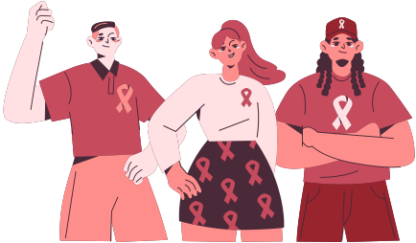











HIV & AIDS Awareness
Understanding prevention, transmission, and support
What Is HIV?
  HIV (Human Immunodeficiency Virus) attacks the immune system, specifically CD4 cells.
  Without treatment, HIV can progress to AIDS (Acquired Immunodeficiency Syndrome).
  HIV can be managed with lifelong medical treatment.
How HIV Spreads
Through unprotected sexual contact
Sharing contaminated needles or syringes
From mother to child passed during pregnancy
Through infected blood transfusions (rare)
HIV is not spread through casual contact, hugging, or sharing food.
Prevention & Treatment
Use condoms correctly
and consistently
Do not share or
re-use needles
Get tested regularly at testing centers
Antiretroviral therapy
(ART) to prolong life-span
Key Facts
39 million people worldwide were living with HIV in 2022
1.3 million new infections globally in 2022
Early testing and treatment greatly improves health outcomes
Get Informed. Get Tested.
Know your status and support stigma-free communities.

Slide 2
Resource Page
  Use these in your template, then delete or hide this page afterward.
Fonts
Colors
This presentation template
uses the following free fonts:
TITLES:
Montserrat
#ED7843
#ED7843
#ED7843
BODY TEXT:
Inter
You can find these fonts online too.
#ED7843
#ED7843
#ED7843
Design Elements / Icons

Slide 3

Credits
This template is free for everyone to use,
  thanks to the following:
  for this template
Pexels, Pixabay, Sketchify
  for the photos, graphics, and elements
  Happy designing!

