Slide 1
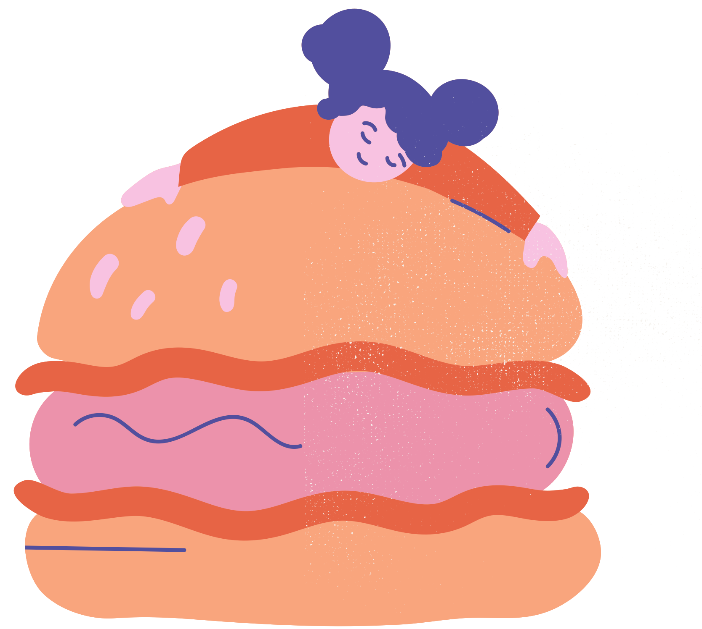


OBESITY AWARENESS
Understanding obesity, its risks, and ways to support healthier lifestyles
WHAT IS OBESITY?
Excess body fat that may increase health risks
  BMI 30 or higher
  Influenced by diet, activity, and genetics
  Affects children and adults worldwide
KEY NUMBERS
  1 in 8 people globally live with obesity
  650M+ adults affected worldwide
  39M children under 5 affected
HEALTH RISKS
Obesity is associated with several health conditions:
  Heart disease and stroke
  Type 2 diabetes
  High blood pressure and joint problems
PREVENTION
Healthy habits help reduce risk
  Balanced diet and regular exercise
  Limit sugary and ultra-processed foods
  Maintain sleep and active routines

Slide 2
Resource Page
  Use these in your template, then delete or hide this page afterward.
FONTS
DESIGN ELEMENTS / ICONS
This presentation template
uses the following free fonts:
TITLES:
pERMANENT MARKER
BODY TEXT:
Work Sans
Source Serif Pro
You can find these fonts online too.
COLORS
#524F9E
#E76445
#F49E77
#EC92AB
#F6F3EF

Slide 3
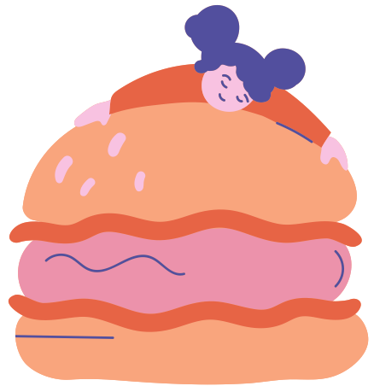

Credits
This presentation template is free for everyone to use, thanks to the following:
Pexels, Pixabay
  for the presentation template
  for the photos
Happy
  designing!

