Slide 1





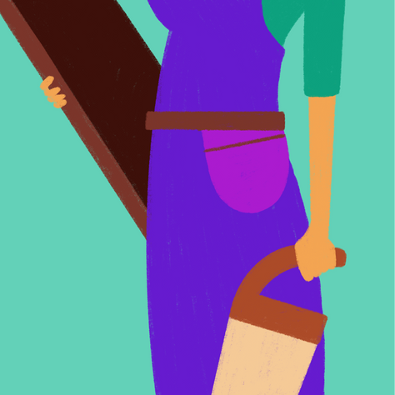
March 8, 2030
WOMEN'S DAY EVENT
Join us in celebrating the strength, resilience, and achievements of women everywhere! This Women's Day, we invite you to honor the incredible contributions of women in our lives and communities. Let’s celebrate the power of women!
Anywhere City, Anywhere Street
Grand Parade & Women-led businesses
Gate Opens at 12pm
RSVP @ WOMENSDAY.COM UNTIL MARCH 1, 2030, 11PM

Slide 2





WOMEN'S
DAY
EVENT
MARCH 8,2030
Join us in celebrating the strength, resilience, and achievements of women everywhere! This Women's Day, we invite you to honor the incredible contributions of women in our lives and communities. Let’s celebrate the power of women!
Anywhere City, Anywhere Street
Grand Parade & Women-led businesses
Gate Opens at 12pm
RSVP @ WOMENSDAY.COM UNTIL MARCH 1, 2030, 11PM

Slide 3
Resource Page
  Use these in your template, then delete or hide this page afterward.
Fonts
Colors
This presentation template
uses the following free fonts:
TITLES:
#651CCE
#CA72E3
#EA9A4E
Poppins
BODY TEXT:
#F7BD84
#FFEBDE
#57C896
Poppins
You can find these fonts online too.
#F8A9D8
#77CD7A
Design Elements / Icons

Slide 4

Credits
This template is free for everyone to use,
  thanks to the following:
  for this template
Pexels, Pixabay, Sketchify
  for the photos, graphics, and elements
  Happy designing!

