Slide 1



WHO KNOWS ME BETTER
JEOPARDY
WRITE A SUBTITLE HERE

Slide 2




RULES & OVERVIEW
WRITE A MAIN TOPIC HERE
WRITE A MAIN TOPIC HERE
WRITE A MAIN TOPIC HERE
Presentations are communication tools that can be used as lectures.
Presentations are communication tools that can be used as lectures.
Presentations are communication tools that can be used as lectures.

Slide 3

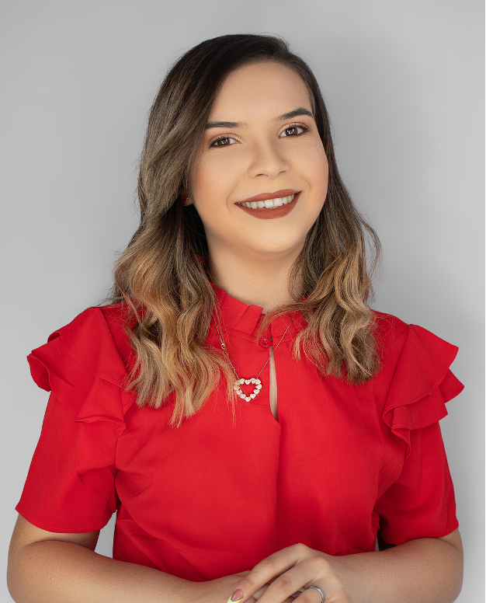
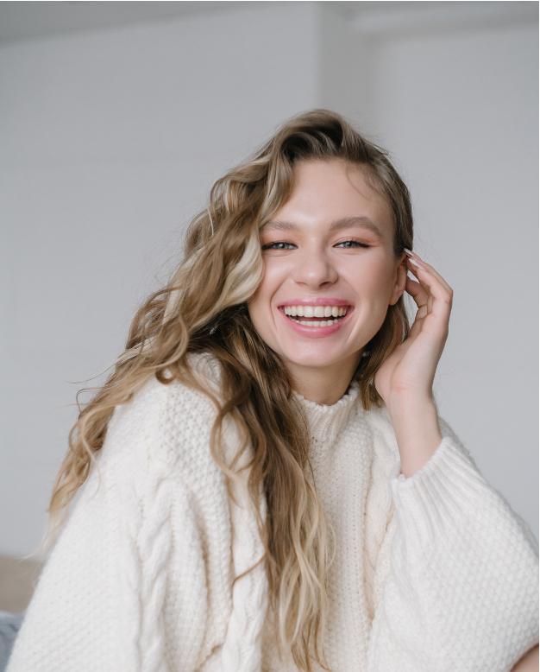

TEAM MEMBERS
JOHN DOE
Write a brief description here
JANE DOE
JANE DOE
Write a brief description here
Write a brief description here

Slide 4

CATEGORIES
QUIRKS & HABITS
FOOD&
DRINKS
HOLIDAY
RANDOM
SPORTS
NAMES

Slide 5



FOOD

Slide 6




QUESTION 1
WHAT’S MY
FAV DESSERT?
If your answer is correct,
you win 10 points!

Slide 7


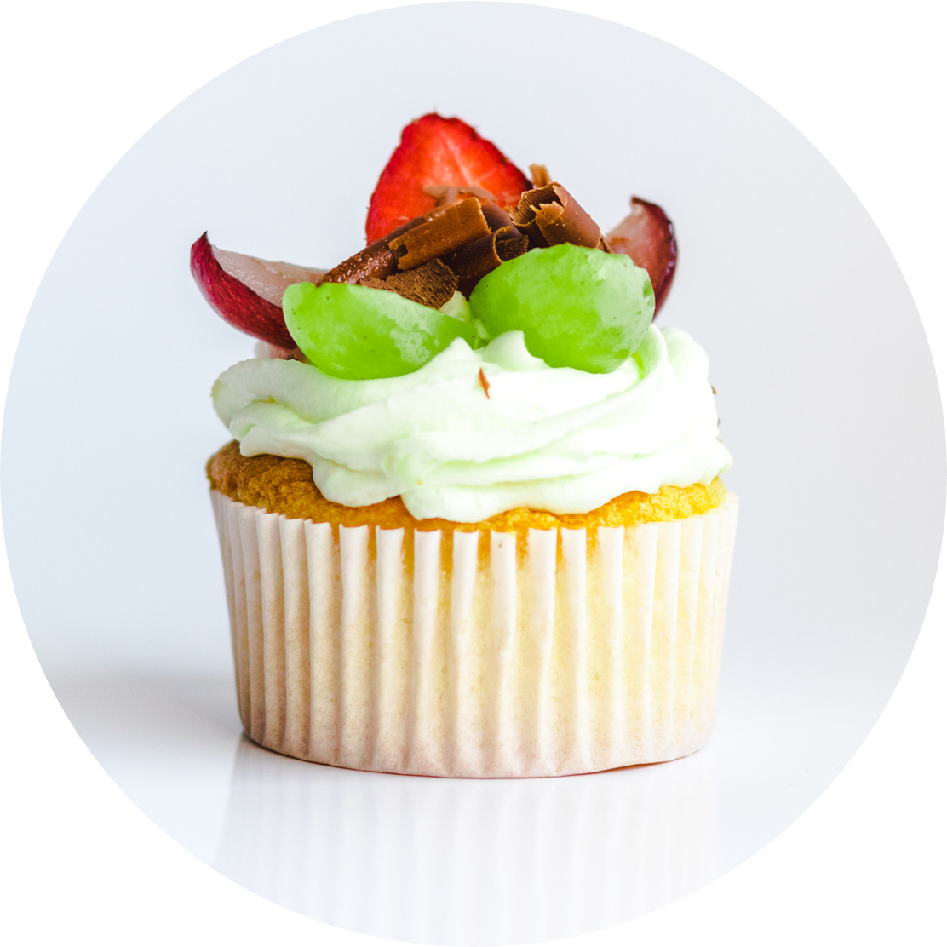
ANSWER
CUPCAKES
+10 POINTS

Slide 8


QUESTION 2
WHAT ARE MY TWO FAV CHIPS
HINT
One is a
Type of
Lays chips
If your answer is correct,
you win 30 points!

Slide 9

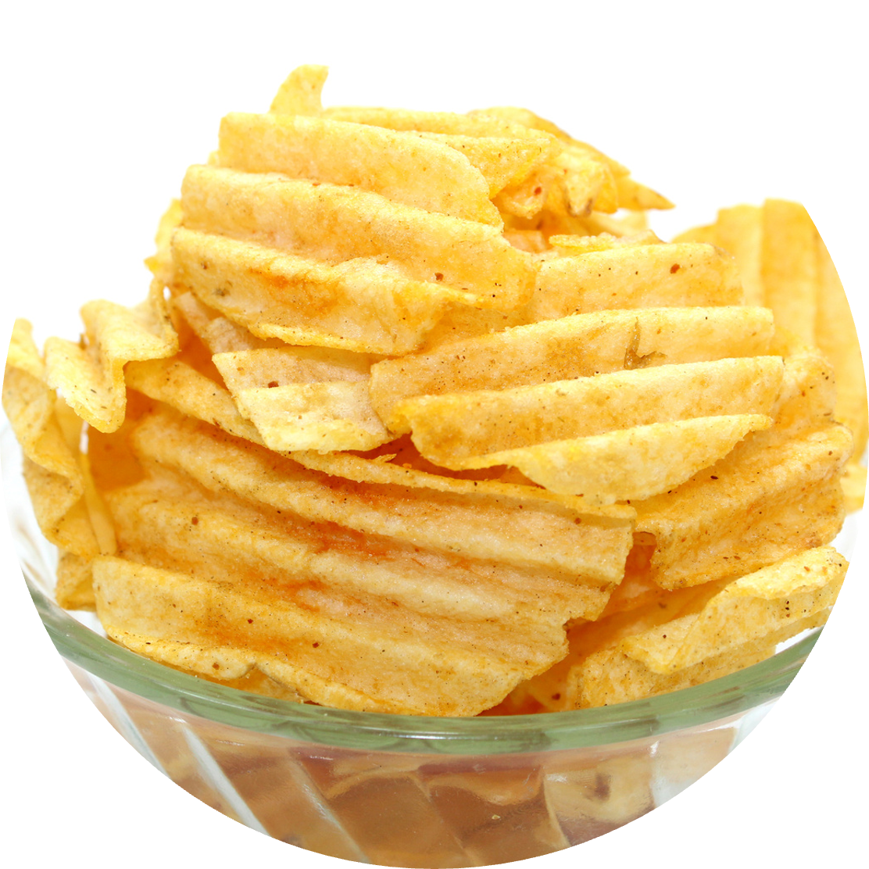
ANSWER
+30 POINTS
SALT &
VINEGAR
PEPPER

Slide 10




QUIRKS & HABITS

Slide 11



QUESTION 1
DO I PUT CILANTRO IN MY PHO?
If your answer is correct,
you win 15 points!

Slide 12

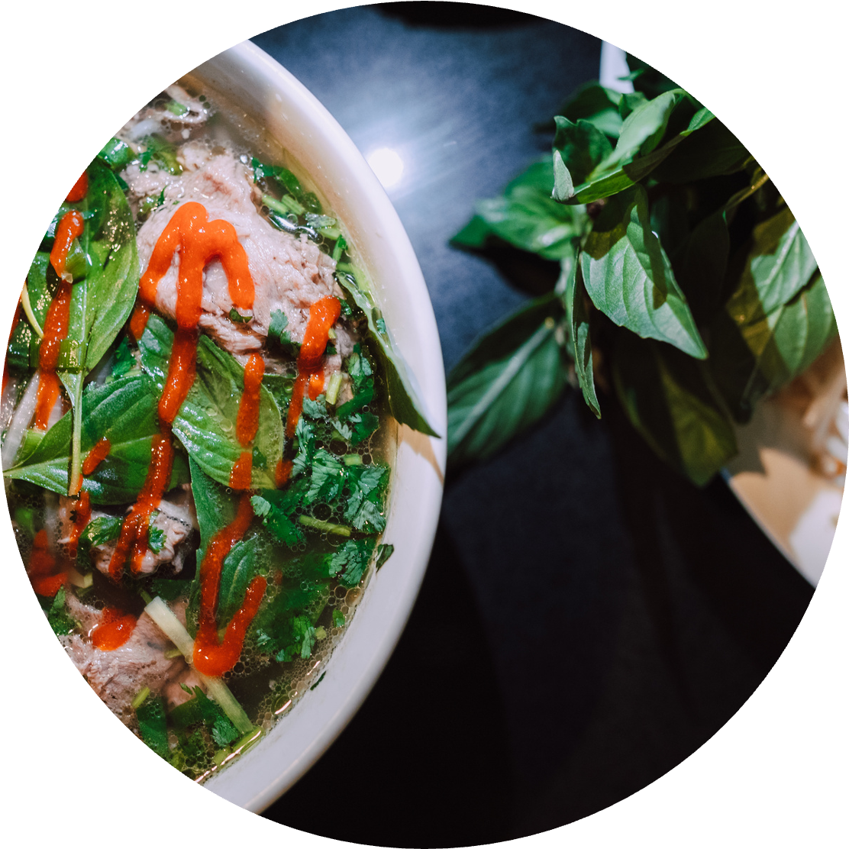

ANSWER
+15 POINTS
YES

Slide 13


If your answer is correct,
you win 50 points!
QUESTION 2
HOW DO I TAKE MY COFFEE OR TEA?
The details matter - is it black, with sugar, or do I have a unique preference?

Slide 14


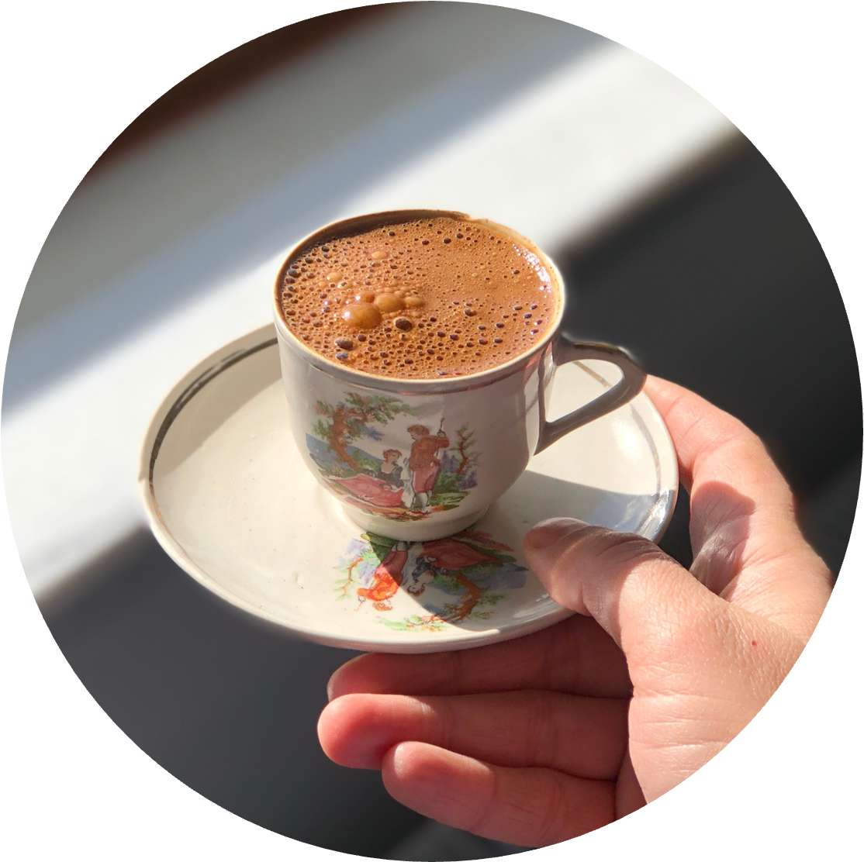
ANSWER
+50 POINTS
ESPRESSO WITH SUGAR CUBES

Slide 15

SCOREBOARD
 | Team A | Team B | Team C
1ST ROUND | 25 | 20 | 30
2ND ROUND | 15 | 25 | 20
3RD ROUND | 30 | 35 | 25
TOTAL | 70 | 80 | 75

Slide 16





THE WINNER IS
Team B

Slide 17

























Resource
Page
Use these design resources
in your Canva Presentation.
This presentation template
uses the following free fonts:
Titles: League Spartan
Headers: Blinker
Body Copy: Blinker
You can find these fonts
online too. Happy designing!
Don't forget to delete this
page before presenting.

Slide 18



CREDITS
This presentation template is free for everyone to use thanks to the following:
SlidesCarnival
for the presentation template
Pexels
for the photos

