Slide 1




LABOR LAW: WORKERS' RIGHTS
PRESENTATION

Slide 2



Table Of Contents
01.
Introduction
02.
What is Labor Law?
Elaborate on what you want to discuss.
Elaborate on what you want to discuss.
03.
Challenges
04.
Conclusion
Elaborate on what you want to discuss.
Elaborate on what you want to discuss.

Slide 3




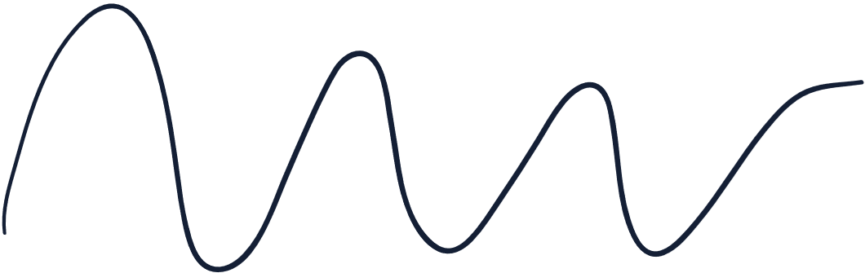
01.
Introduction
Welcome, everyone, to our presentation on labor law and the critical importance of protecting workers' rights in the modern workplace. In today's session, we will delve into the fundamental principles of labor law, explore key provisions aimed at safeguarding workers, and discuss the significance of upholding these rights in promoting fairness, equity, and social justice.
The world of work is constantly evolving, shaped by technological advancements, globalization, and changing economic landscapes. Amidst these transformations, it is imperative to ensure that workers' rights are upheld and protected, providing them with the dignity, respect, and support they deserve.

Slide 4
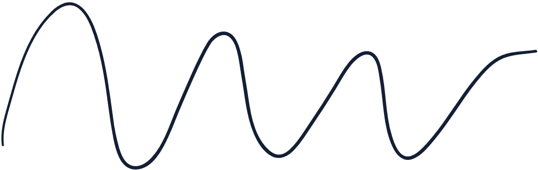

Welcome To
Presentation
Greetings and a warm welcome to everyone joining us today for this insightful presentation. We're thrilled to have you here as we delve into [topic of the presentation].
In this session, we'll be exploring [brief overview of what will be covered in the presentation]. We aim to provide valuable insights, spark thought-provoking discussions, and leave you with a deeper understanding of [topic].

Slide 5





Our Company
Who we are?
Briefly elaborate on what you want to discuss.
What we do?
Briefly elaborate on what you want to discuss.

Slide 6



01.
What is
Labor Law?
Welcome, everyone, to our presentation on labor law and the critical importance of protecting workers' rights in the modern workplace. In today's session, we will delve into the fundamental principles of labor law, explore key provisions aimed at safeguarding workers, and discuss the significance of upholding these rights in promoting fairness, equity, and social justice.

Slide 7



ESSENTIAL SERVICE
SERVICE
SERVICE
SERVICE
Elaborate on what you want to discuss.
Elaborate on what you want to discuss.
Elaborate on what you want to discuss.

Slide 8


Challenges and Solutions
Challenges
Solutions
Non-Compliance: Some employers may violate labor laws, leading to exploitation, wage theft, or unsafe working conditions for employees.
Globalization: Rapid globalization and outsourcing present challenges in enforcing labor standards and protecting workers' rights in a globalized economy.
Education and Awareness: Promote education and awareness campaigns to inform workers about their rights and resources available to them for seeking recourse in cases of labor law violations.
Enforcement: Strengthen enforcement mechanisms and regulatory oversight to ensure compliance with labor laws and hold employers accountable for violations.

Slide 9





GALLERY IMAGE
What can you say about your projects? Share it here!

Slide 10


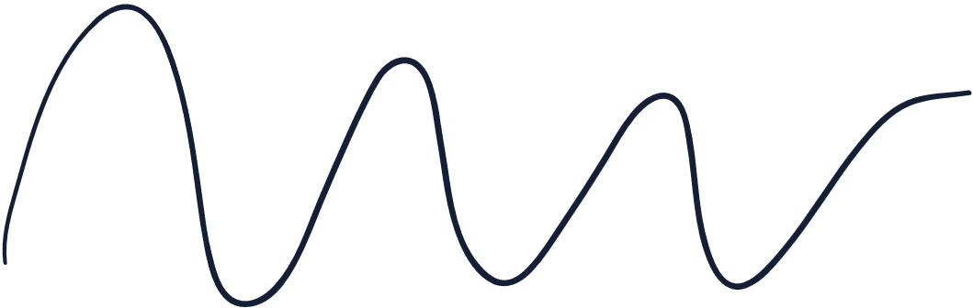
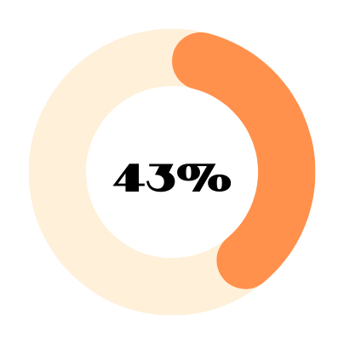


percetanges
Elaborate on the featured statistic.
Elaborate on the featured statistic.
Elaborate on the featured statistic.

Slide 11





04.
Conclusion
In conclusion, labor law serves as a cornerstone of our society, protecting the rights, dignity, and well-being of workers around the world. By upholding the principles of fairness, equality, and justice in the workplace, we can create a more equitable and prosperous society for all. Thank you for your attention.

Slide 12






OUR TEAM
YOUR NAME
YOUR NAME
YOUR NAME
Elaborate on what you want to discuss.
Elaborate on what you want to discuss.
Elaborate on what you want to discuss.

Slide 13





Key Concepts
Before we dive deeper, let's clarify some key concepts. Data analytics involves the process of analyzing raw data to uncover patterns, trends, and insights. It encompasses various techniques, including descriptive, diagnostic, predictive, and prescriptive analytics, each serving a distinct purpose in extracting value from data.

Slide 14



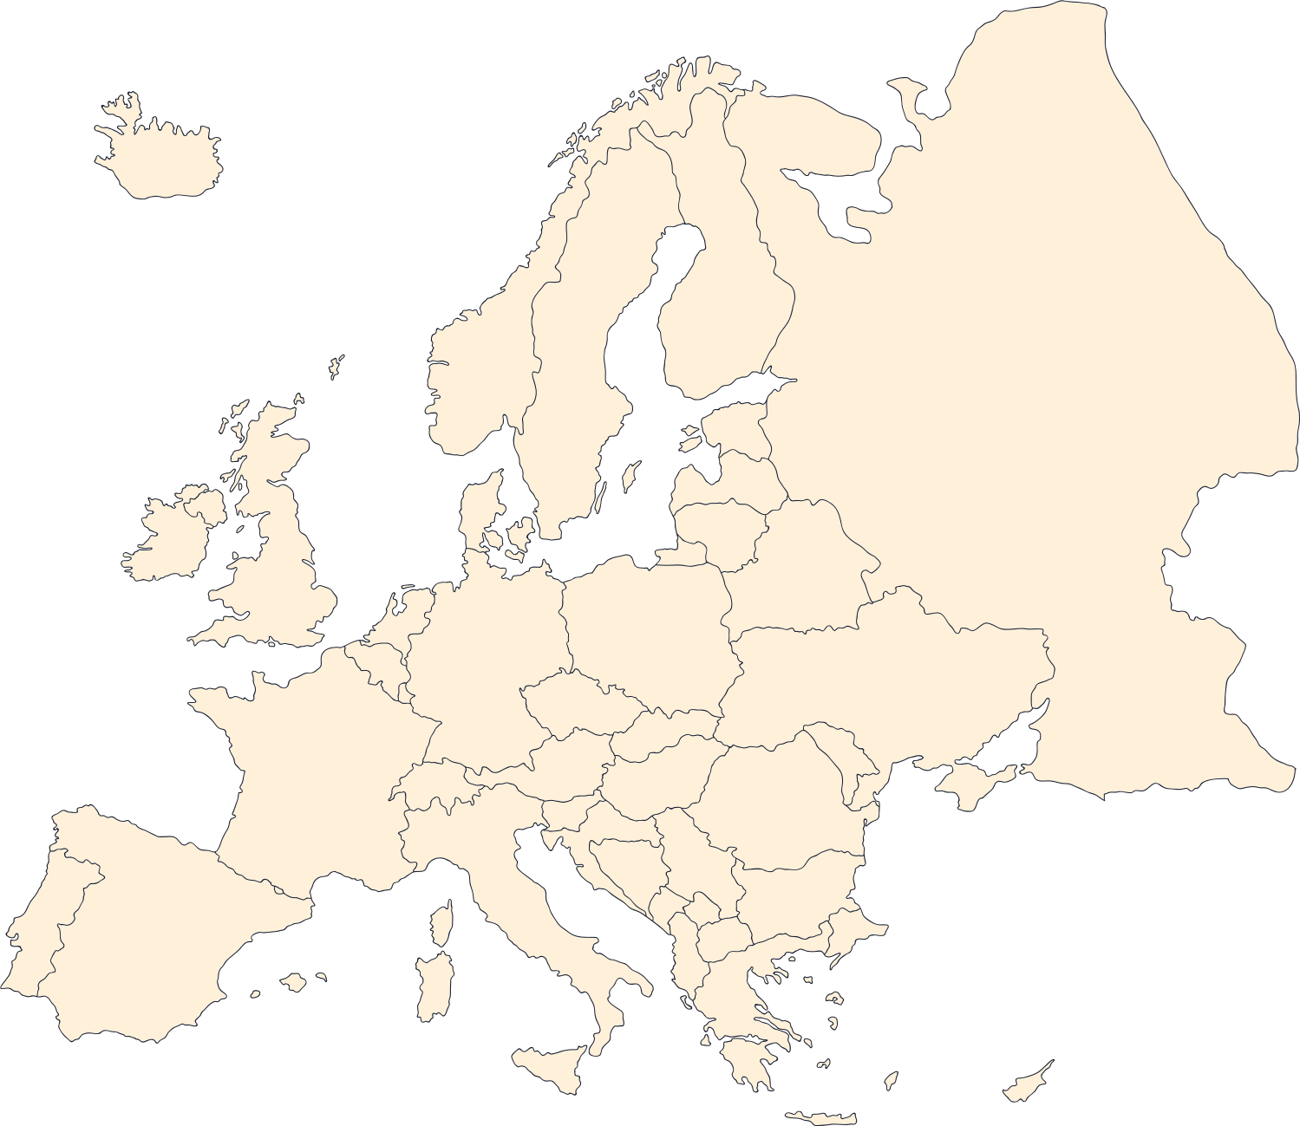

WORLD
MAP
Elaborate on what you want to discuss.
MAP
Elaborate on what you want to discuss.

Slide 15


4 098 434
Elaborate on what you want to discuss.

Slide 16




A picture is worth a thousand words

Slide 17

WRITE AN ORIGINAL STATEMENT OR INSPIRING QUOTE
— Include a credit, citation, or supporting message

Slide 18
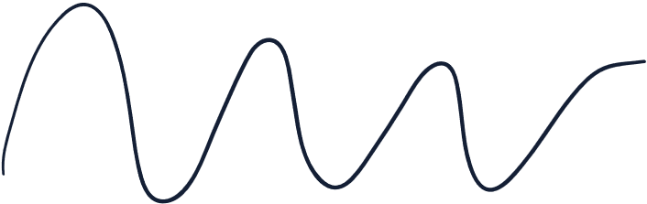



CONTACT US
Thank you for taking the time to learn more about [Company Name] and our commitment to engineering solutions for a sustainable future. We welcome the opportunity to connect with you and discuss how we can support your projects and initiatives.
[COMPANY NAME]
EMAIL: [YOUR EMAIL ADDRESS]
WEBSITE: [YOUR WEBSITE URL]

Slide 19

















Resource
Page
Use these design resources in your Canva Presentation.
You can find these fonts online too. Happy designing!
Don't forget to delete this page before presenting.
This presentation template uses the following free fonts:
  Titles: Notable
  Headers: Notable
  Body Copy: Anonymous Pro

Slide 20



Credits
This presentation template is free for everyone to use thanks to the following:
SlidesCarnival for the presentation template
Pexels for the photos
Happy designing!

