Slide 1












Start
ELEMENTS OF FLOWCHART INFOGRAPHIC
Actions
Start /
End
Input / Output
This marks the beginning and end of the process.
Actions
Actions
This include the actions to be done in a flow chart.
Decisions
Input / Output
This is either given data or resulting outcomes.
Input / Output
Decisions
This is a condition or question that lead to a different path in the flowchart.
End
Arrows
This shows the flow of the process.

Slide 2




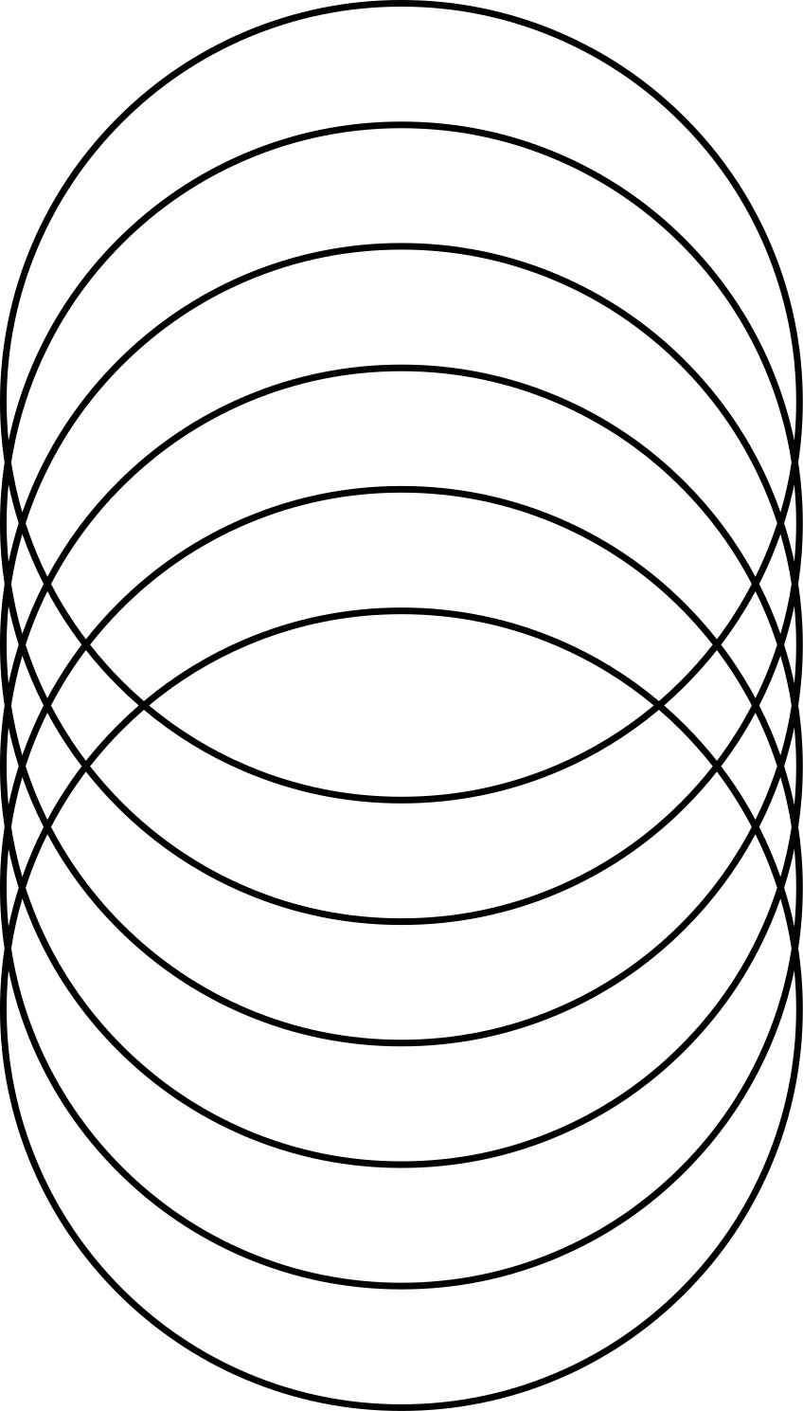


RESOURCE PAGE
  Use these design resources in your Canva Presentation.
Fonts
Colors
This presentation template
uses the following free fonts:
TITLES:
MONTSERRAT
HEADERS:
MONTSERRAT
BODY COPY:
MONTSERRAT
#FFBCD4
#FFD2BE
#FFFDE2
#FFABAB
You can find these fonts online too.
#FF89B3
#000000
Design Elements
  DON'T FORGET TO DELETE THIS PAGE BEFORE PRESENTING.

Slide 3

CREDITS
  This presentation template is free for everyone to use thanks to the following:
  for the presentation template
Pexels, Pixabay
  for the photos
  Happy designing!

