Slide 1



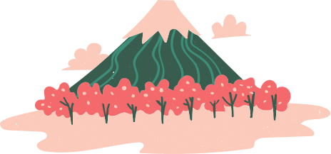


THE FOUR SEASONS
SPRING
SUMMER
It is the season wherein plants grow
and flowers bloom.
These are the warmest days because
sunlight hits the Earth at a steep angle.
AUTUMN
WINTER
Temperature starts to decrease and
leaves fall from trees.
It is the coldest season. Some parts of
the world experience cold rain and
snows during this season.

Slide 2


the 2 hemispheres
The two hemispheres experience opposite seasons. If it is winter in the Northern Hemisphere, it is summer in the Southern Hemisphere.
NORTHERN
HEMISPHERE
SOUTHERN
HEMISPHERE
Winter
Spring
Summer
Autumn
Summer
Autumn
Winter
Spring
FUN FACT
Not all countries experience four seasons. Countries near the equator
have milder seasons and almost remain constant year-round.
Reference: https://www.canva.com/templates/EAE6cCT1rF4-brown-and-beige-scrapbook-introduction-to-geography-education-infographic/

Slide 3
RESOURCE PAGE
  Use these design resources in your Canva Presentation.
Fonts
Colors
This presentation template
uses the following free fonts:
TITLES:
LUCKIEST GUY
BODY COPY:
ARIMO
#006C56
#3D8E78
#ED95A8
You can find these fonts online too.
#FFE2A4
#9DC6E1
#3B0E08
Design Elements

Slide 4

CREDITS
This presentation template is free for everyone to use
  thanks to the following:
  for the presentation template
Pexels, Pixabay
  for the photos
  HAPPY DESIGNING!

