Slide 1


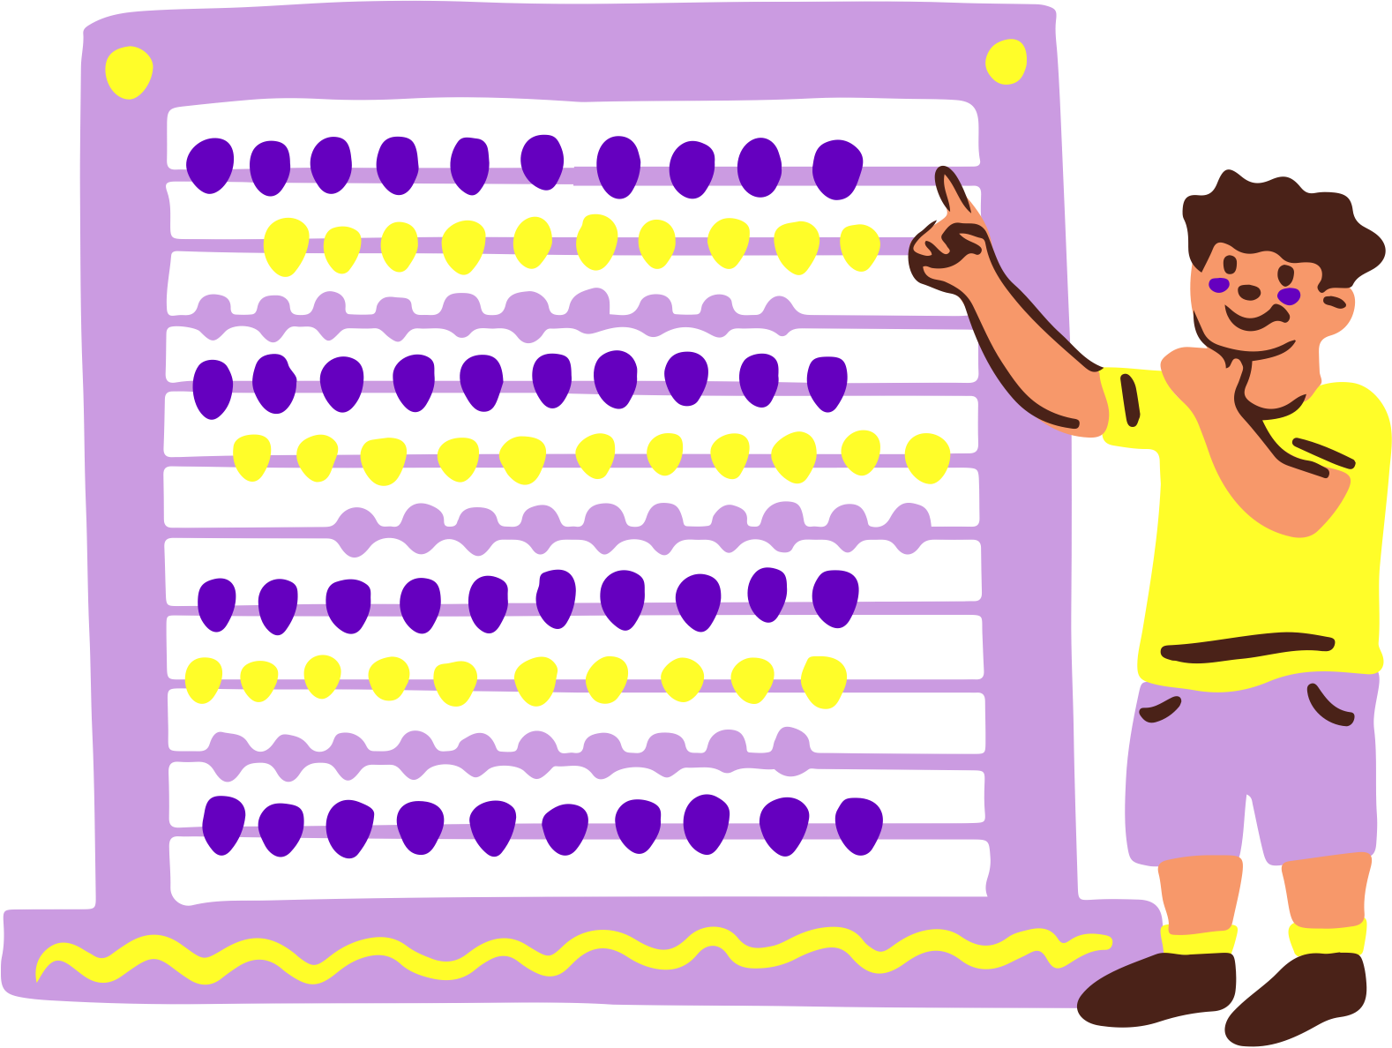

Comparing Decimals Lesson for Elementary
PRESENTATION

Slide 2





Comparing Decimals in Real-Life
When do comparing decimals come into play in your daily adventures?

Slide 3
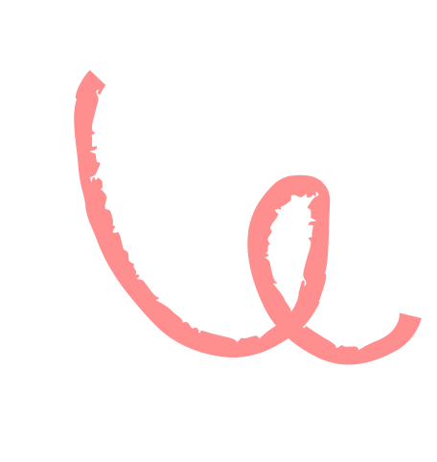

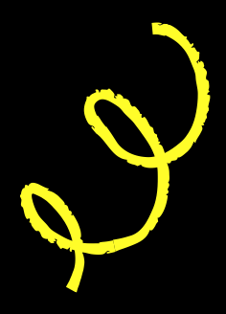


Symbols of the Day
Before we dive in, let's recall what these symbols mean.
Greater than
Less than
Equal
Used when the first number has a larger value than the second number.
Used when the first number has a smaller value than the second number.
Used when the first number has the same value as the second number.
5 > 3
3 < 5
5 = 5

Slide 4



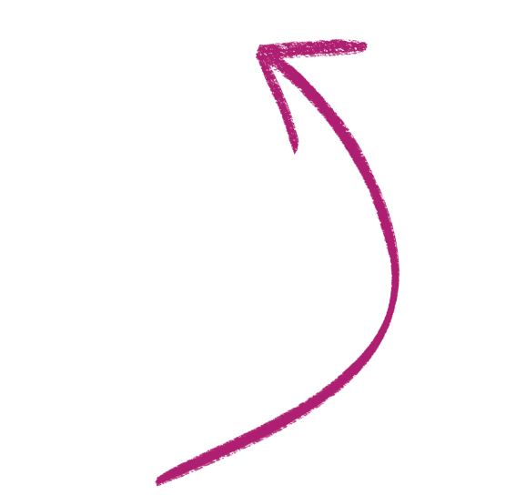
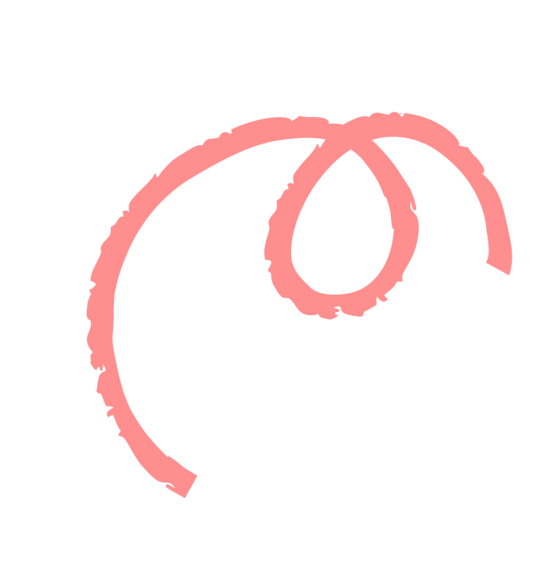

Our Learning Target
In today's lesson, our target is to learn how to compare decimals using place value charts and area models.

Slide 5





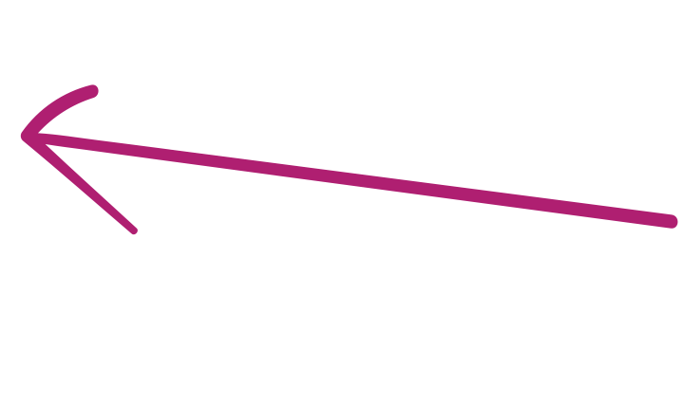
Comparing Using Place Value Charts
Step 2
Compare the digits from the largest place value.
B
If the digits are different, determine which digit is greater.
units | . | tenths | hundredths
5 | . | 8 | 7
units | . | tenths | hundredths
5 | . | 3 | 9

Slide 6
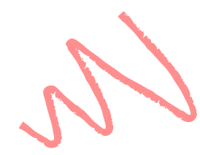


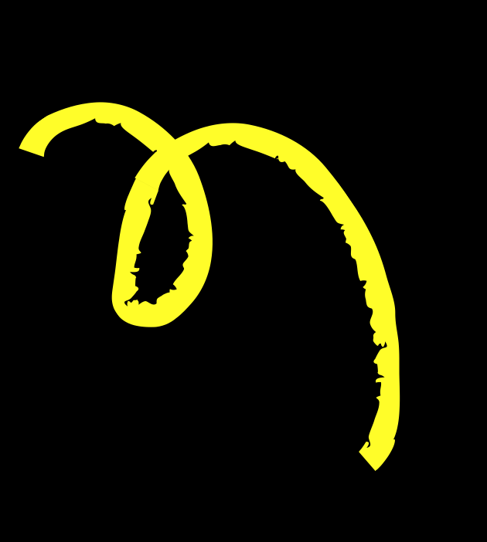
Comparing Using Place Value Charts
Step 1
Place the digits in their corresponding place value.
Another term to describe the ones place is units.
units | . | tenths | hundredths
5 | . | 8 | 7
units | . | tenths | hundredths
5 | . | 3 | 9

Slide 7



Comparing Using Area Models
Step 2
Compare the shaded regions of each model. The number with more shaded regions has greater value.
1.45
1.67
The number with more shaded regions has greater value.

Slide 8

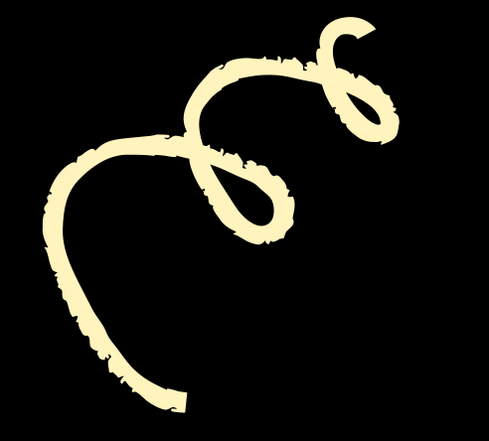

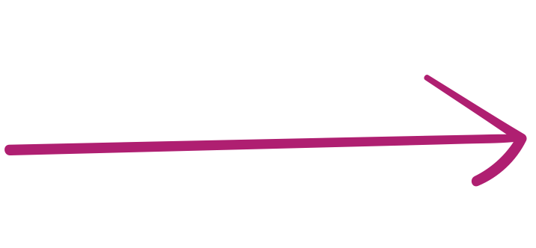
Comparing Using Place Value Charts
Step 2
Compare the digits from the largest place value.
A
If the digits are the same, move to the next place value to the right.
units | . | tenths | hundredths
5 | . | 8 | 7
units | . | tenths | hundredths
5 | . | 3 | 9

Slide 9


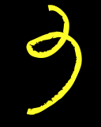


Comparing Using Place Value Charts
Step 3
Use the symbols, >, <, or = to describe the relationship of two numbers.
units | . | tenths | hundredths
5 | . | 8 | 7
5 | . | 3 | 9
In the tenths place, 8 is greater than 3. This means that 5.87 is greater than 5.39. In symbols, 5.87 > 5.39.

Slide 10


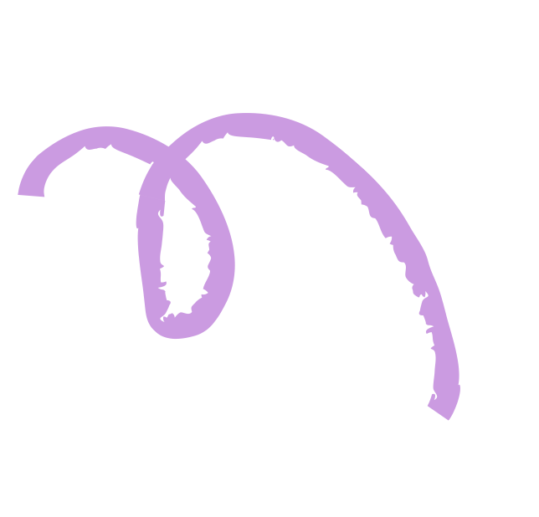
Comparing Using Area Models
Step 1
Draw a model for each decimal. Remember that 0.01 is 1 out of 100 parts and 1 is equivalent to 100 parts.
1.45
1.67

Slide 11


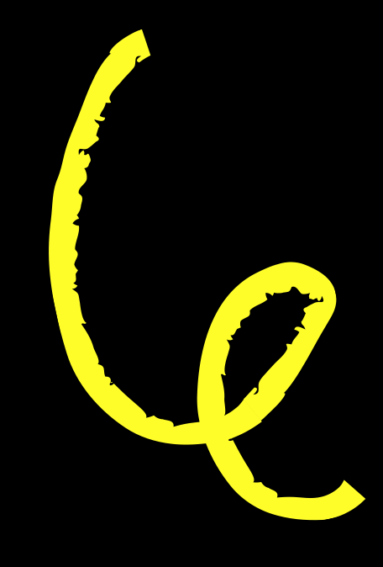
Comparing Using Area Models
Step 3
Use the symbols, >, <, or = to describe the relationship of two numbers.
1.45
1.67
In symbols, 1.45 < 1.67.

Slide 12






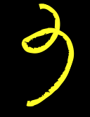
Which bag comes with a lower price tag?
Place <, >, = on the blank to make the statement true.
$3.26
$3.23

Slide 13





Which bag comes with a lower price tag?
Place <, >, = on the blank to make the statement true.
Answer Key
units | . | tenths | hundredths
3 | . | 2 | 6
3 | . | 2 | 3
$3.26
$3.23
The satchel comes with a lower price tag.

Slide 14




Recap
We can compare two decimal numbers using the following methods.
place value chart
area models
units | . | tenths | hundredths
3 | . | 2 | 6
3 | . | 2 | 3

Slide 15



A Question to Ponder!
Apart from using place value charts and area models, what are other ways we can compare decimals?

Slide 16




References
Mathspace. “6.04 Compare decimals
| Grade 4 Math | Common Core 4 - 2022 Edition.” Accessed 3 July 2023, https://mathspace.co/textbooks/syllabuses/Syllabus-1090/topics/Topic-21201/subtopics/Subtopic-274634/

Slide 17




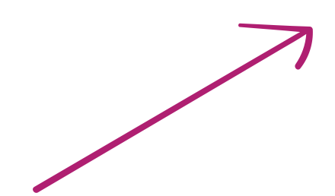
B
for blur
c
for confetti
Press these keys
while on Present mode!
D
for drumroll
m
for mic drop
0
for bubbles
Q
for quiet
Any number from 0-9 for a timer
u
for unveil
0-9

Slide 18



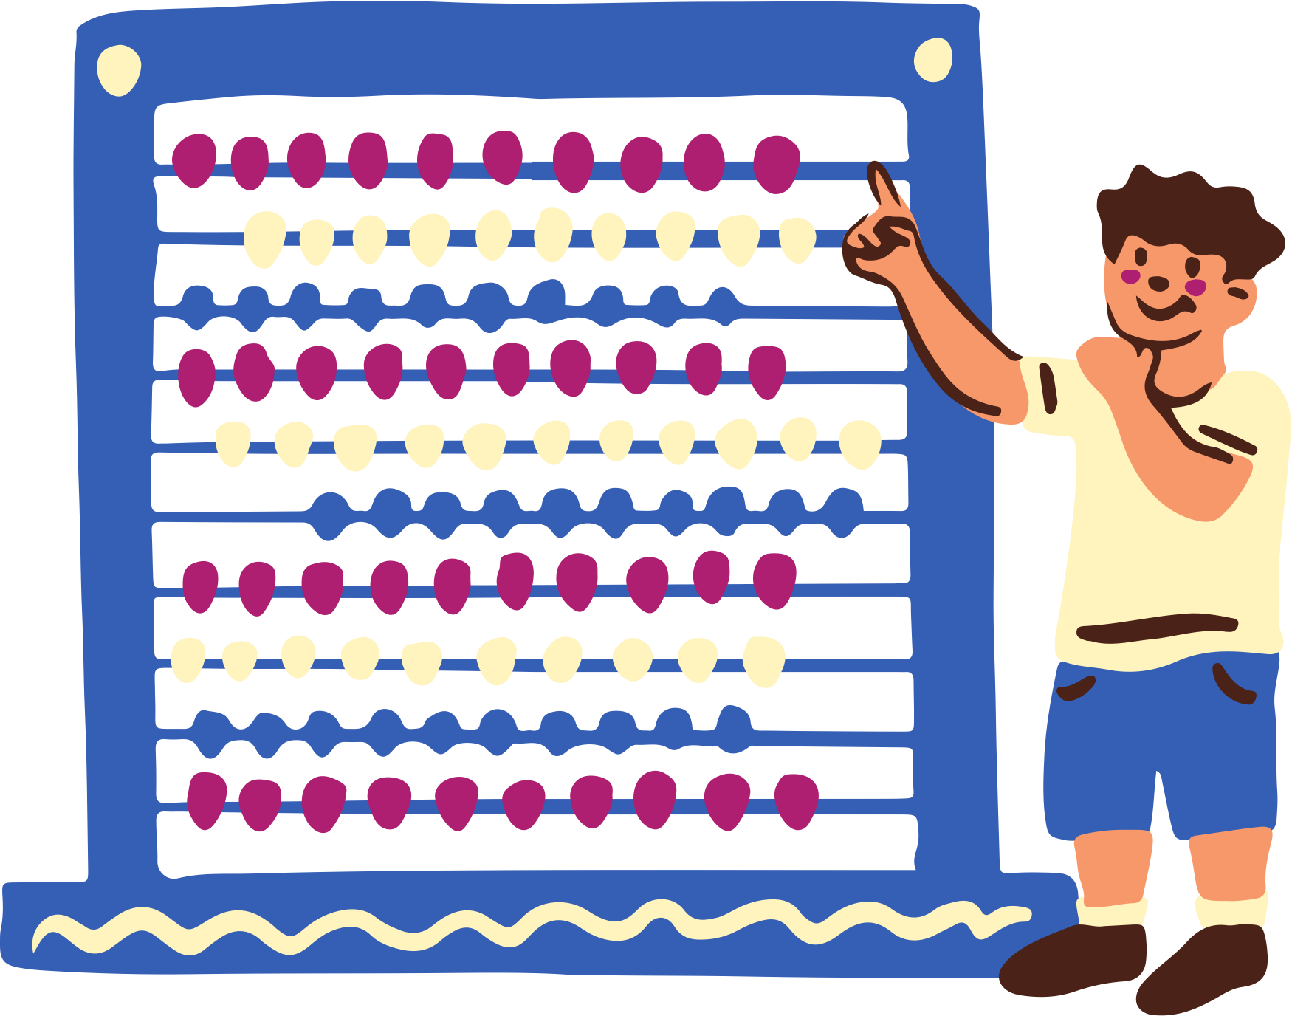




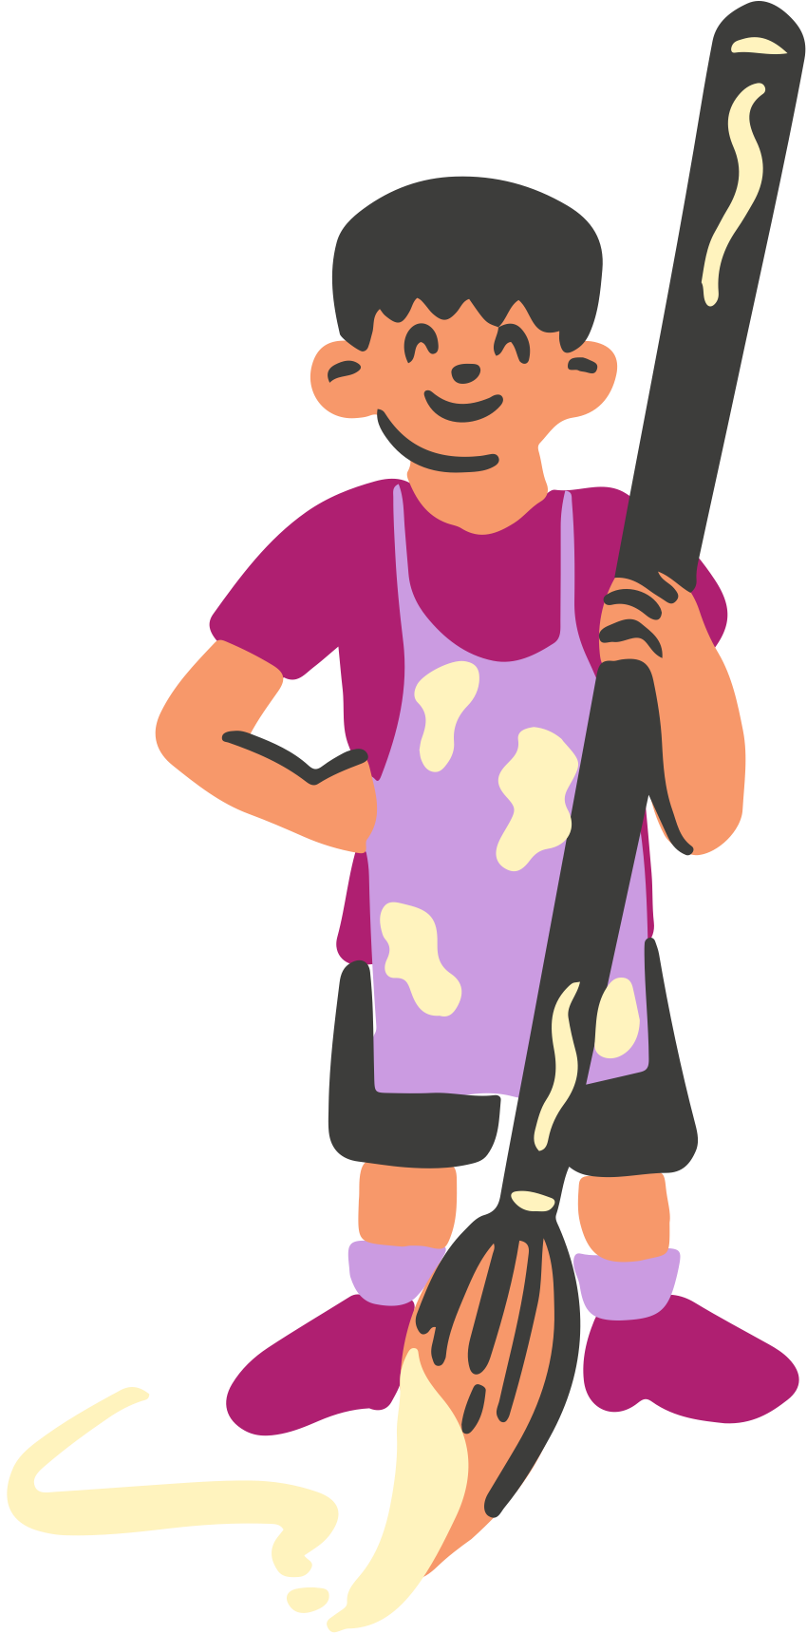
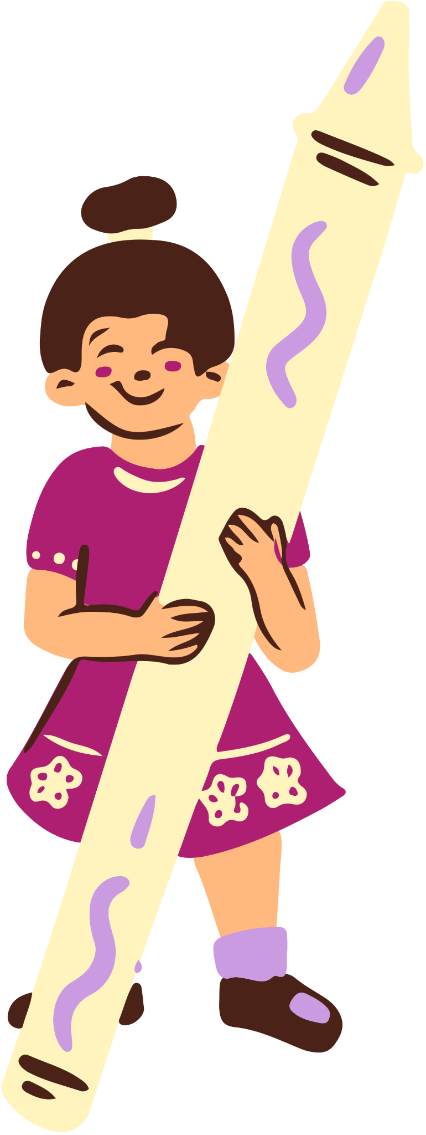



Resource Page
Use these design resources in your Canva Presentation.
You can find these fonts online too. Happy designing!
This presentation template uses the following free fonts:
  Titles: Luckiest Guy
  Headers: Luckiest Guy
  Body Copy: Nunito Sans

Slide 19







Credits
This presentation template is free for everyone to use thanks to the following:
SlidesCarnival for the presentation template
Pexels for the photos
Happy designing!

